Slide 1

Notes:
["What the World Needs Now is Love Sweet Love" video of HCPF employees starts playing 2 min prior to start time]
[15 seconds of Spanish interpreters speaking to guests]
KIM
Good morning. I’m Kim Bimestefer, Exec Dir of HCPF, and I have the honor of being with you all this morning.
Next slide please

Slide 2

Webinar Logistics
Registrants: Questions for Speakers: Use Q&A feature on the toolbar. We may not get to every question live.
Materials will also be posted to CO.gov/HCPF/events and CO.gov/hospital-reports-hub
Presentations, links and other materials will be posted in the Chat. Otherwise, the Chat is closed and is being used for presenter communications.
Please leverage the event pop-up polls to help us capture aggregate perspectives.
Accessibility: American Sign Language, audio only, Spanish interpretation, and closed captioning are available. They can be accessed via Zoom toolbar by clicking on Interpretation at the bottom of your screen and selecting to watch American Sign Language or listen in Spanish.
Notes:
KIM
CLEAR SLIDE
American Sign Language and Spanish interpretations are available and can be accessed through the Zoom toolbar by clicking on Interpretation at the bottom of your screen and selecting to watch American Sign Language or listen in Spanish.
Live captioning can be accessed through the Zoom toolbar. Select “Live Transcript”, then select “Show Subtitle” to display the captions.
For Audio only, you should have received a confirmation email after registering with an option to Join via Audio with a variety of phone numbers.
Keep in mind we do have a Q&A feature if you’d like to ask questions.
We’ll also be using polls to get your feedback on important topics. Please participate. You can close out the poll results if they are blocking your slide.
Materials will be published on our websites soon

Slide 3
Logísticas del Seminario Web
Participantes: Preguntas para los presentadores: Utilice la función de preguntas y respuestas de la barra de herramientas. Es posible que no podamos responder a todas las preguntas en vivo.
Los materiales también serán publicados en CO.gov/HCPF/events y CO.gov/hospital-reports-hub
Las presentaciones, enlaces y otros materiales se publicarán en el chat. De lo contrario, el chat se cierra y se utiliza para las comunicaciones del presentador.
Por favor, aproveche las encuestas emergentes del evento para ayudarnos a captar perspectivas agregadas.
Accesibilidad: se dispone de Lenguaje de Señas Americano, solo audio, interpretación al español y subtítulos. Se puede acceder a ellos a través de la barra de herramientas de Zoom haciendo clic en Interpretación en la parte inferior de la pantalla y seleccionando ver Lenguaje de Señas Americano o escuchar en español.
Notes:
KIM
CLEAR SLIDE
American Sign Language and Spanish interpretations are available and can be accessed through the Zoom toolbar by clicking on Interpretation at the bottom of your screen and selecting to watch American Sign Language or listen in Spanish.
Live captioning can be accessed through the Zoom toolbar. Select “Live Transcript”, then select “Show Subtitle” to display the captions.
For Audio only, you should have received a confirmation email after registering with an option to Join via Audio with a variety of phone numbers.
Keep in mind we do have a Q&A feature if you’d like to ask questions.
We’ll also be using polls to get your feedback on important topics. Please participate. You can close out the poll results if they are blocking your slide.
Materials will be published on our websites soon

Slide 4
Today’s Agenda
7:30 a.m. Welcome and Overview
7:40 a.m. Hospital Report Highlights
8:25 a.m. Question and Answer
8:40 a.m. Closing Remarks
Notes:
KIM
Thank you for joining us today.
We appreciate your collaborative partnership in navigating this unprecedented chapter and working together with us toward shared goals.
The purpose of today’s webinar is to drive fact-based health care policy, our objectives include:
Review important facts from the recent reports
Bring together research and reports for important takeaways
Collect stakeholder polled and discussion feedback on these topics

Slide 5
Agenda del día
7:30 a.m. Bienvenida y resumen
7:40 a.m. Destacados del reporte del hospital
8:25 a.m. Preguntas y respuestas
8:40 a.m. Observaciones finales
Notes:
KIM
Thank you for joining us today.
We appreciate your collaborative partnership in navigating this unprecedented chapter and working together with us toward shared goals.
The purpose of today’s webinar is to drive fact-based health care policy, our objectives include:
Review important facts from the recent reports
Bring together research and reports for important takeaways
Collect stakeholder polled and discussion feedback on these topics

Slide 6
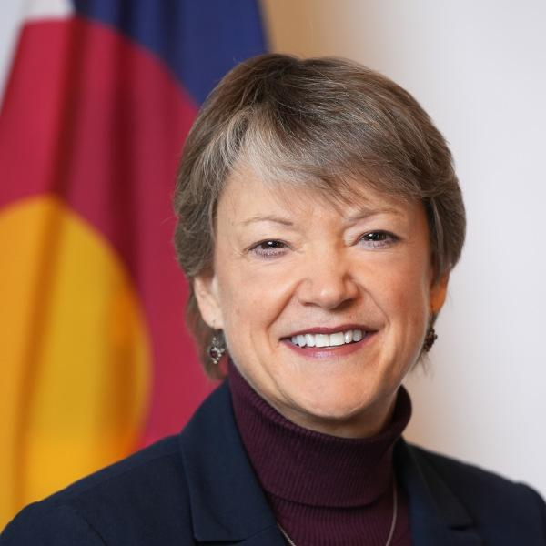



Today’s HCPF Speakers
Kim Bimestefer, HCPF Exec Director
CEO Health First CO
Bettina Schneider,
Finance Office Director, CFO
Nancy Dolson,
Special Financing Division Director
Dr. Lisa Rothgery,
Chief Medical Officer, CMO
Notes:
KIM
Today we are joined by
Bettina Schneider who is the Chief Financial Officer and oversees all financial operations.
Nancy Dolson, Special Financing Division Director, the instrumental driver of the Department’s hospital provider fee program.
and Dr. Lisa Rothgery, Chief Medical Officer who continues to care for patients at her independent family practice in Denver.

Slide 7
Oradores de HCPF del día
Kim Bimestefer, Directora Ejecutiva del HCPF
CEO Health First CO
Bettina Schneider, Directora Financiera de la Oficina, CFO
Nancy Dolson,
Directora Especial de la División de Financiamiento Especial
Dr. Lisa Rothgery,
Director Médico, CMO
Notes:
KIM
Today we are joined by
Bettina Schneider who is the Chief Financial Officer and oversees all financial operations.
Nancy Dolson, Special Financing Division Director, the instrumental driver of the Department’s hospital provider fee program.
and Dr. Lisa Rothgery, Chief Medical Officer who continues to care for patients at her independent family practice in Denver.

Slide 8











Colorado Department of Health Care Policy & Financing (HCPF)
Health First Colorado (Colorado’s Medicaid program)
Child Health Plan Plus
Buy-In Programs
State Dept that administers Health First Colorado (Colorado's Medicaid program), Child Health Plan Plus (CHP+) and other health care programs
Covering 1.31 million, including 22% Coloradans, over 40% state’s children, over 40% births
$16.0B Total Fund, $5.0B General Fund, roughly 1/3 state budget
96% budget pays providers, 4% admin including 0.5% staff
The Colorado Indigent Care Program
Long Term Services and Supports
Senior Dental Program
Family Planning
Cover All Coloradans
Federal Match, Corrections Continuous Coverage
Mission: Improving health care equity, access and outcomes for the people we serve while saving Coloradans money on health care and driving value for Colorado.
Health Related Social Needs
School Health Services
Resource available at CO.gov/hcpf/HereForYou
Notes:
Kim
REMEMBER the left side, changing capabilities, etc.
Largest Health Plan in the state
Roughly ⅓ of the state’s budget and the state is trying to reconcile being over budget; you’ve probably heard reports that between $250 and $1 billion must be cut to balance budget
Additionally, data shows that a large proportion of the surge in migrant populations recently within the state arrived in late 2023 to early 2024, which will not be fully reflected until next year’s report due to several hospital systems’ fiscal year end dates. In 2022 and 2023, there was very little shifting of patient type or uncompensated care costs despite the start of the COVID-19 Public Health Emergency (PHE) Unwind. The majority of the effects of the PHE Unwind will not be represented until 2024 data is published. This is due to data availability, as the PHE Unwind started in May of 2023 while a significant portion of hospitals’ fiscal years ended in June of 2023.
_______Updating talking points from August webinar___________
HCPF provides health coverage to about 1.3M people today, which is slightly more than 1 in 5 Coloradans. We cover more than 40% of Colorado’s children and more than 40% of births in the state. We provide these coverages and supports through Health First Colorado, which is the brand name for Colorado Medicaid, through Children’s Health Insurance Program or CHP+ and the other safety net programs you see listed on the side of this slide.
Medicaid and CHP+ are income based programs that also provide unique supports and services for people with disabilities, which make up about 4% of those we serve while the remaining 90%+ qualify based on income.
HCPF accounts for about ⅓ of the states budget
96% of that goes to paying our providers, with the remaining 4% covering admin costs and only 0.5% for staffing
Compared to commercial carriers who spend 13%+
We are the largest health plan in the state by far, and continue to be even after the end of the PHE’s disenrollments

Slide 9
Departmento de políticas y financiamiento de la asistencia de salud de Colorado (HCPF)
Health First Colorado (Programa de Medicaid de Colorado)
Child Health Plan Plus
Departamento de estado que administra Health First Colorado (programa Medicaid de Colorado), Child Health Plan Plus (CHP+) y otros programas de atención de salud.
Cubriendo 1.31 million, incluyendo 22% de Residentes de Colorado, más de 40% niños del estado, más de 40% nacimientos.
Fondo total de $16.0B, fondo general de $5.0B, aproximadamente 1/3 del presupuesto Estatal.
El 96% del presupuesto se destina a pagar los proveedores,el 4% para administración incuyendo 0.5% para el personal.
Programas de compras
Programa de Atención a Indigentes de Colorado
Servicios y Asistencias a Largo Plazo
Programa Dental para Adultos Mayores
Planificación Familiar
Cubre todos los Coloradenses
Cobertura de Combinación Federal, Correcciones Continúas
Misión: Mejorar la equidad, el acceso y los resultados de la atención de salud para las personas a las que servimos, mientras ahorramos dinero a los residentes de Colorado en atención de salud y generamos valor para Colorado.
Necesidades Sociales Relacionadas a la Salud
Servicio de Salud Escolar
Recursos disponibles en CO.gov/hcpf/HereForYou
Notes:
Kim
REMEMBER the left side, changing capabilities, etc.
Largest Health Plan in the state
Roughly ⅓ of the state’s budget and the state is trying to reconcile being over budget; you’ve probably heard reports that between $250 and $1 billion must be cut to balance budget
Additionally, data shows that a large proportion of the surge in migrant populations recently within the state arrived in late 2023 to early 2024, which will not be fully reflected until next year’s report due to several hospital systems’ fiscal year end dates. In 2022 and 2023, there was very little shifting of patient type or uncompensated care costs despite the start of the COVID-19 Public Health Emergency (PHE) Unwind. The majority of the effects of the PHE Unwind will not be represented until 2024 data is published. This is due to data availability, as the PHE Unwind started in May of 2023 while a significant portion of hospitals’ fiscal years ended in June of 2023.
_______Updating talking points from August webinar___________
HCPF provides health coverage to about 1.3M people today, which is slightly more than 1 in 5 Coloradans. We cover more than 40% of Colorado’s children and more than 40% of births in the state. We provide these coverages and supports through Health First Colorado, which is the brand name for Colorado Medicaid, through Children’s Health Insurance Program or CHP+ and the other safety net programs you see listed on the side of this slide.
Medicaid and CHP+ are income based programs that also provide unique supports and services for people with disabilities, which make up about 4% of those we serve while the remaining 90%+ qualify based on income.
HCPF accounts for about ⅓ of the states budget
96% of that goes to paying our providers, with the remaining 4% covering admin costs and only 0.5% for staffing
Compared to commercial carriers who spend 13%+
We are the largest health plan in the state by far, and continue to be even after the end of the PHE’s disenrollments

Slide 10
Medicaid Sustainability Framework
Address Drivers of Trend: Better address all the controllable factors that drive Medicaid cost trends
Maximize Federal Funding: Leverage and maximize HCPF’s ability to draw down additional federal dollars
Invest in Coloradans: Continue investing in initiatives to drive a Colorado economy and educational system to reduce the demand for Medicaid over the long term as Coloradans rise and thrive
Make Reasonable Medicaid Cuts or Adjustments: Identify where programs, benefits, and reimbursements are comparative outliers or designed in such a way that we are seeing - or will experience - higher than intended trends or unintended consequences
Reassess New Policies: Consider pausing or adjusting recently passed policies not yet implemented
Exercise Caution in Crafting Increases to the Medicaid program going forward
For more information, please visit CO.gov/hcpf/legislator
Notes:
Speaker: Kim
Very difficult budget challenge - more demand than funding, and TABOR limits the level of tax revenues we can retain to pay for demanded services, new policies and the like
HCPF trends are moving at 7%GF, 8%TF while TABOR moves at about 3-4%. Given that we consume about 32% of state GF, that’s not sustainable.
HCPF’s Medicaid Sustainability Framework seeks to organize emerging concepts and strategies to enable the thoughtful navigation of this multi-year, fiscal challenge while fostering partnership and collaboration to achieve shared goals. The six points of this framework are on the slide.
We’ll hit item 2 - drawdown today, and thank those stakeholders who are working with us to identify suggestions to help us real in this trend with a goal of avoiding draconian cuts over time to our benefits, reimbursements, eligibility rules and the like. Educational webinars like this also stimulate new ideas.

Slide 11
Marco de sostenibilidad de Medicaid
Abordar los Factores que Impulsan la Tendecia: Abordar mejor todos los factores controlables que impulsan las tendencias de costos de Medicaid
Maximizar el Financiamiento Federal : Aprovechar y maximizar la capacidad del HCPF para obtener fondos federales adicionales
Invertir en Coloradenses: Seguir invirtiendo en iniciativas para impulsar la economía y el sistema educativo de Colorado con el fin de reducir la demanda de Medicaid a largo plazo a medida que los habitantes de Colorado prosperan y se desarrollan
Realizar recortes o ajustes razonables en Medicaid: dentificar dónde los programas, beneficios y reembolsos son atípicos comparativos o están diseñados de tal manera que estamos viendo, o veremos, tendencias más altas de lo previsto o consecuencias no deseadas
Reevaluar Nuevas Políticas: considerar la posibilidad de pausar o ajustar las políticas aprobadas recientemente que aún no se han implementado
En lo adelante actuar con precaución en la elaboracion de los aumentos del programa de Medicaid
Para más información, por favor visite CO.gov/hcpf/legislator
Notes:
Speaker: Kim
Very difficult budget challenge - more demand than funding, and TABOR limits the level of tax revenues we can retain to pay for demanded services, new policies and the like
HCPF trends are moving at 7%GF, 8%TF while TABOR moves at about 3-4%. Given that we consume about 32% of state GF, that’s not sustainable.
HCPF’s Medicaid Sustainability Framework seeks to organize emerging concepts and strategies to enable the thoughtful navigation of this multi-year, fiscal challenge while fostering partnership and collaboration to achieve shared goals. The six points of this framework are on the slide.
We’ll hit item 2 - drawdown today, and thank those stakeholders who are working with us to identify suggestions to help us real in this trend with a goal of avoiding draconian cuts over time to our benefits, reimbursements, eligibility rules and the like. Educational webinars like this also stimulate new ideas.

Slide 12
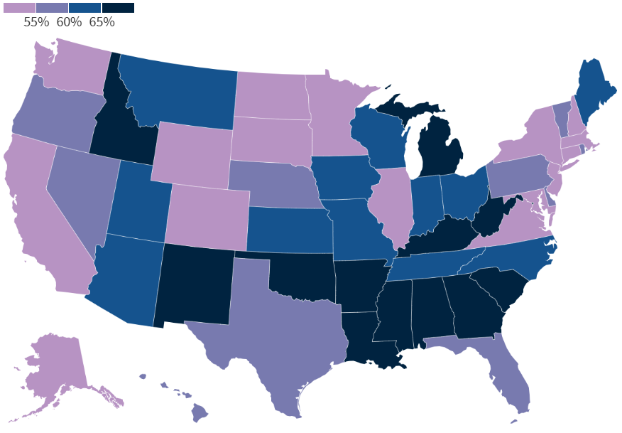
Emerging federal landscape & potential impacts to Medicaid
Federal Medicaid Assistance Percentage (FMAP) match; removal of 50% floor
Provider/CHASE Fees
Fed Medicaid per person capitation
Medicaid Expansion 400k at 90/10 (47k additional equals buy-in, parent caretakers, kids continuous coverage)
C4H Subsidies (77% or over 230k)
Medicaid match: Housing, Food
FQHC Safety Net Funding
Undocumented Coloradans
  Cover All Coloradans
  Public Charge
Work Requirements
FMAP for Traditional Medicaid Spending Effective for federal fiscal year 2026
Source: kff.org/medicaid/issue-brief/medicaid-financing-the-basics
Notes:
Kim
In addition to the state budget challenges and the misalignment between Medicaid trends and TABOR which impacts available revenues, we are also highly focused on monitoring and crafting approaches that navigate potential and emerging federal threats to Medicaid programs nationally.
While there are many potential threats identified on the right hand side of the slide, the four that are bubbling to the top most consistently based on feedback from a variety of sources - and certainly subject to change - include:
Decreases to FMAP, which reflects the match in funding coming from the fed, with the most prominent concern right now being the elimination of the current 50% FMAP floor, which directly impacts CO. This means our 50% match rate from the Ffed would be reduced, based on a calculation revolving around the state’s per capita income.
We are working on those calculations to quantify potential impacts. That relates to the left side of the slide. The magenta identifies those states who would be impacted if the Fed removed that 50% floor.
Second, Provider fees - what we call CHASE in CO
Third, PMPM or capitations - not so much block grants - but PMPM
Forth, Programs that cover undocumented individuals.
OTHER
The Department receives at least a 50 percent federal match on Medicaid services and administrative costs, and at least a 65 percent federal match on CHP+.
Non-Federal, “state” funding:
Must be “public” dollars
Fed funding - At least 40% of state share must be from state general revenue
Remainder can be from other government contributions including county dollars and health care related taxes
Federal Match Varies by State
By law, federal match cannot be less than 50% - examples:
MS 76.9%, WV 73.8%
NM 71.7%, ID 67.6%
AZ 64.9%, NV 60.2%
TX 60.0%, OR 59%
NE 57.5%, FL 57.2%
CA 50.0%, NY 50.0%
Source: Kaiser Family Foundation
Federal Budget: Medicaid, FQHC current funding levels extended through Mar 31, 2025; Medicaid DSH cuts eliminated for FFY24
Executive Actions: Immigration policies may impact Cover all Coloradans uptake
Policy Changes by Congress or Regulatory Actions: Current federal reg rollbacks, changes to public charge, work requirements, ACA changes (marketplace and Medicaid expansion)
Financing Cost Shifts to States: provider fees, block grants, federal match, expansion financing
Provider fees finance Colorado’s Medicaid expansion (90% federal/10% is provider fee)
Covers 350,378 expansion population adults without dependent children and 48,352 parents
Provider fees finance an additional: 18,927 continuous coverage for kids, 24,999 buy-in, 4,725 parents, 38,856 CHP+ kids/pregnant people 205-250% poverty level
Financial proposals to:
rescind e-FMAP for expansion coverage group on a graduated or other basis
reduce the FMAP percentage floor from 50 to either a uniform lower level OR remove the percentage floor so that the state’s share increases, and the federal contribution is smaller
permit or mandate block grant arrangements or per capita caps
revisit 1115 budget neutrality policy changes
review use of state directed payments (SDPs)
review use of provider tax arrangements
Eligibility proposals to:
cap expansion eligibility at 100% of FPL; or
eliminate the adult expansion coverage group
Rulemaking proposals to rescind some or all of the 2024 package of federal Medicaid rules
1115 waiver proposals to:
take a permissive or mandatory approach to states’ implementing community engagement/work requirements
shift course from current areas of focus (e.g. HRSN, reentry)
Any Congressional proposals around Medicaid are likely to be enacted through the federal budget reconciliation process. Here is a brief overview of that process on NAMD’s member-only website. Please ensure you are logged in to access this resource and related materials.

Slide 13
Panorama Federal emergente e impactos potenciales a Medicaid
Igualación del porcentaje de asistencia federal de Medicaid (FMAP); eliminación del 50 % de base.
Tarifa Proveedores/CHASE.
Capitación federal de Medicaid por persona.
Expansión de Medicaid 400k a 90/10 (47k adicionales equivalente a compras, cuidadores, cobertura continua para niños)
Subvenciones de C4H (77% o más de 230k)
Igualación de Medicaid: Vivienda, Alimentación.
Red de Seguridad de Financianciamiento de FQHC.
Coloradenses Indocumentados.
  Cubre todos los Coloradenses
  Cargo Público
Requisitos Laborales.
FMAP para gastos de Medicaid tradicional vigente para el año fiscal federal 2026.
Fuente: kff.org/medicaid/issue-brief/medicaid-financing-the-basics
Notes:
Kim
In addition to the state budget challenges and the misalignment between Medicaid trends and TABOR which impacts available revenues, we are also highly focused on monitoring and crafting approaches that navigate potential and emerging federal threats to Medicaid programs nationally.
While there are many potential threats identified on the right hand side of the slide, the four that are bubbling to the top most consistently based on feedback from a variety of sources - and certainly subject to change - include:
Decreases to FMAP, which reflects the match in funding coming from the fed, with the most prominent concern right now being the elimination of the current 50% FMAP floor, which directly impacts CO. This means our 50% match rate from the Ffed would be reduced, based on a calculation revolving around the state’s per capita income.
We are working on those calculations to quantify potential impacts. That relates to the left side of the slide. The magenta identifies those states who would be impacted if the Fed removed that 50% floor.
Second, Provider fees - what we call CHASE in CO
Third, PMPM or capitations - not so much block grants - but PMPM
Forth, Programs that cover undocumented individuals.
OTHER
The Department receives at least a 50 percent federal match on Medicaid services and administrative costs, and at least a 65 percent federal match on CHP+.
Non-Federal, “state” funding:
Must be “public” dollars
Fed funding - At least 40% of state share must be from state general revenue
Remainder can be from other government contributions including county dollars and health care related taxes
Federal Match Varies by State
By law, federal match cannot be less than 50% - examples:
MS 76.9%, WV 73.8%
NM 71.7%, ID 67.6%
AZ 64.9%, NV 60.2%
TX 60.0%, OR 59%
NE 57.5%, FL 57.2%
CA 50.0%, NY 50.0%
Source: Kaiser Family Foundation
Federal Budget: Medicaid, FQHC current funding levels extended through Mar 31, 2025; Medicaid DSH cuts eliminated for FFY24
Executive Actions: Immigration policies may impact Cover all Coloradans uptake
Policy Changes by Congress or Regulatory Actions: Current federal reg rollbacks, changes to public charge, work requirements, ACA changes (marketplace and Medicaid expansion)
Financing Cost Shifts to States: provider fees, block grants, federal match, expansion financing
Provider fees finance Colorado’s Medicaid expansion (90% federal/10% is provider fee)
Covers 350,378 expansion population adults without dependent children and 48,352 parents
Provider fees finance an additional: 18,927 continuous coverage for kids, 24,999 buy-in, 4,725 parents, 38,856 CHP+ kids/pregnant people 205-250% poverty level
Financial proposals to:
rescind e-FMAP for expansion coverage group on a graduated or other basis
reduce the FMAP percentage floor from 50 to either a uniform lower level OR remove the percentage floor so that the state’s share increases, and the federal contribution is smaller
permit or mandate block grant arrangements or per capita caps
revisit 1115 budget neutrality policy changes
review use of state directed payments (SDPs)
review use of provider tax arrangements
Eligibility proposals to:
cap expansion eligibility at 100% of FPL; or
eliminate the adult expansion coverage group
Rulemaking proposals to rescind some or all of the 2024 package of federal Medicaid rules
1115 waiver proposals to:
take a permissive or mandatory approach to states’ implementing community engagement/work requirements
shift course from current areas of focus (e.g. HRSN, reentry)
Any Congressional proposals around Medicaid are likely to be enacted through the federal budget reconciliation process. Here is a brief overview of that process on NAMD’s member-only website. Please ensure you are logged in to access this resource and related materials.

Slide 14
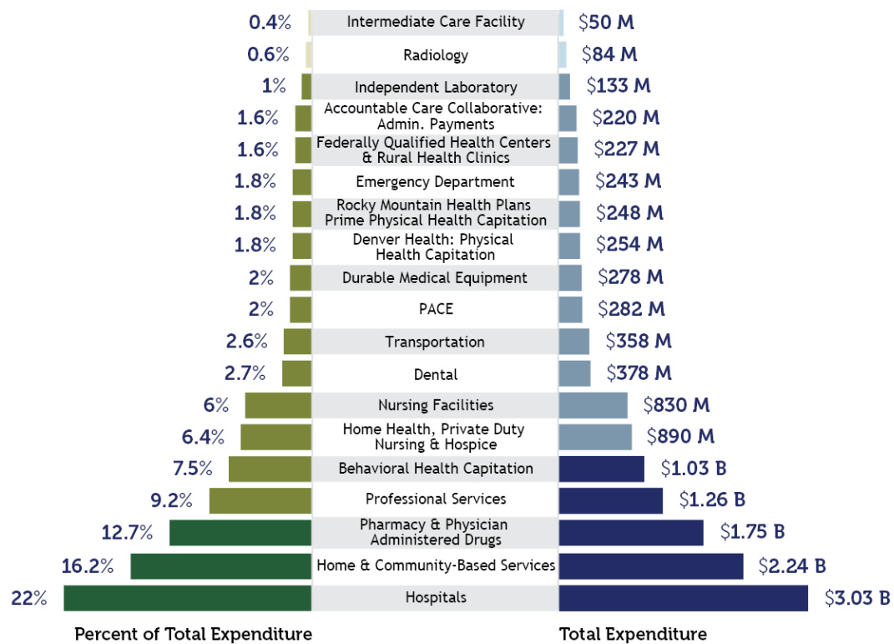
Hospital Transparency reports are required by state laws
  Have evolved to reflect stakeholders’ growing interests
  CHASE and the cost shift
  Hospital financials, costs, payments, profits, uncompensated care, mergers and acquisitions
  Community benefit
Hospitals reflect the largest part of the health care dollar
  Chart is Medicaid spend by major category
Does not include $1.7 B of CHASE supplemental payments
Payment breakdown to Health First Colorado (Colorado’s Medicaid program) partners - Total Expenditure
FY 2023-24 (7/1/2023-6/30/2024 with payment run out until 9/30/2024) from 2023-2024 HCPF Annual Report at CO.gov/HCPF/publications
Notes:
Kim
CLEAR THE SLIDE
Transparency Reports and webinars like this call to part of our mission to “save people money on health care” and to improve access, quality outcomes, and equity for the people we serve and bringing value to Colorado (in other words - control our budget)
Add that while the right reflects Medicaid, hospitals reflect a much higher percent of overall spend because the commercial industry doesn’t cover the preponderance of people with disabilities - 5% of our members, 40% of our expenditures.
This chart refers to medical services cost only, not total HCPF spending. It is based on claims data by date of service and will differ from data calculated on a cash accounting basis. Due to rounding, percentages may not total 100%.
We’ve found that hospitals are one of the largest spending categories of the state behind education. Medicaid spends $3 billion on hospitals, which exceeds all but two state departments: higher education and K-12.
Hospital care is the largest slice of the health care dollar. Driver of premiums as the largest private or public insurance expenditure
10.4% growth in spending in 2023
Large part of the economy
Health care spending as a share of 17.6% of GDP, hospital care = 5.5% of GDP
Hospitals are large employers in their counties
For comparison: Housing services (residential fixed investment plus housing and utility services) is 16.1% of GDP

Slide 15
Los Informes de transparencia hospitalaria son exigidos por las leyes estatales.
  Han evolucionado para reflejar los crecientes intereses de las partes interesadas.
  CHASE y el cambio de costos.
  Finanzas, costos, pagos, beneficios, atención no remunerada, fusiones y adquisiciones hospitalaria.
  Beneficios comunitarios.
Los hospitales representan la mayor parte del gasto en atención a la salud.
  El gráfico muestra el gasto de Medicaid por categoría principal.
No incluye $1.7B de pagos suplementarios de CHASE
Desglose de pagos a socios de Health First Colorado (programa Medicaid de Colorado) - Gasto total.
Ejercicio fiscal 2023-24 (7/1/2023-6/30/2024 con vencimiento de pago hasta el 9/30/2024) del Informe anual del HCPF 2023-2024 enCO.gov/HCPF/publications
Notes:
Kim
CLEAR THE SLIDE
Transparency Reports and webinars like this call to part of our mission to “save people money on health care” and to improve access, quality outcomes, and equity for the people we serve and bringing value to Colorado (in other words - control our budget)
Add that while the right reflects Medicaid, hospitals reflect a much higher percent of overall spend because the commercial industry doesn’t cover the preponderance of people with disabilities - 5% of our members, 40% of our expenditures.
This chart refers to medical services cost only, not total HCPF spending. It is based on claims data by date of service and will differ from data calculated on a cash accounting basis. Due to rounding, percentages may not total 100%.
We’ve found that hospitals are one of the largest spending categories of the state behind education. Medicaid spends $3 billion on hospitals, which exceeds all but two state departments: higher education and K-12.
Hospital care is the largest slice of the health care dollar. Driver of premiums as the largest private or public insurance expenditure
10.4% growth in spending in 2023
Large part of the economy
Health care spending as a share of 17.6% of GDP, hospital care = 5.5% of GDP
Hospitals are large employers in their counties
For comparison: Housing services (residential fixed investment plus housing and utility services) is 16.1% of GDP

Slide 16
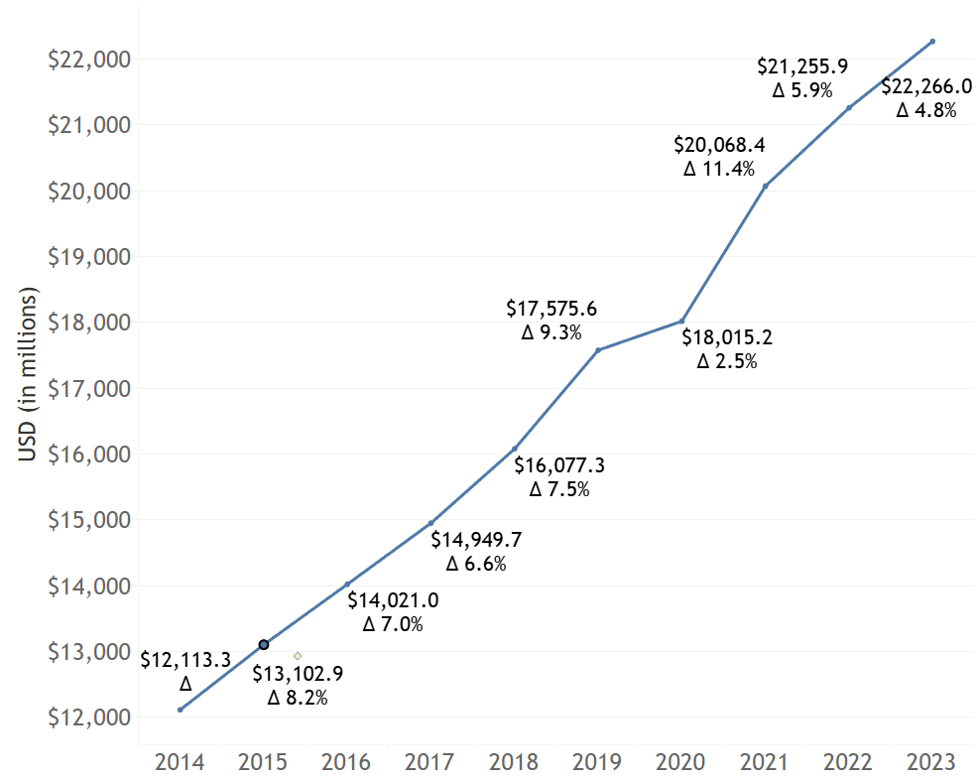
Growth in Revenues to Hospitals
Colorado Hospital Net Patient Revenue
Such as claim payments and out of pocket costs
Growing $1 billion per year, then by $2 billion annually, more recently
Rising 7% or more a year on average, up 84% from 2014 to 2023 ($10 billion)
CO population grew 9.2%, or about 1% each year
Notes:
Kim
Hospital payments biggest part of health care dollar/premium
Hospital patient service payments, which includes carrier claims and patient out of pocket paid to hospitals, are consistently growing at $1 billion a year for most of the 10 years captured here and more like $2 billion in the last few
7% or more a year
We recognize the PHE increase by 550k and then decrease by a bit less during 2020 - 2023 and then 2023, we start to shrink again
These increasing are outpacing inflation and population growth
The costs go straight into premiums, which employers pay 50% of the time. Individual Coloradans absorb an increasing share of this cost through out of pocket increases in premiums and copays.
This is the base challenge before us….how do we change this reality, this trajectory. It’s not sustainable.

Slide 17
Crecimiento de los ingresos de los Hospitales
Ingresos netos de pacientes del Hospital de Colorado
Tales como pagos de reclamaciones y gastos de bolsillo.
Creciendo 1 billón, luego 2 billones anuales,reciente.
Aumento del 7 % o más al año de un promedio, un 84 % más que entre 2014 y 2023 (10 billones).
La población de Colorado creció un 9.2 %, o alrededor de un 1 % cada año.
Notes:
Kim
Hospital payments biggest part of health care dollar/premium
Hospital patient service payments, which includes carrier claims and patient out of pocket paid to hospitals, are consistently growing at $1 billion a year for most of the 10 years captured here and more like $2 billion in the last few
7% or more a year
We recognize the PHE increase by 550k and then decrease by a bit less during 2020 - 2023 and then 2023, we start to shrink again
These increasing are outpacing inflation and population growth
The costs go straight into premiums, which employers pay 50% of the time. Individual Coloradans absorb an increasing share of this cost through out of pocket increases in premiums and copays.
This is the base challenge before us….how do we change this reality, this trajectory. It’s not sustainable.

Slide 18
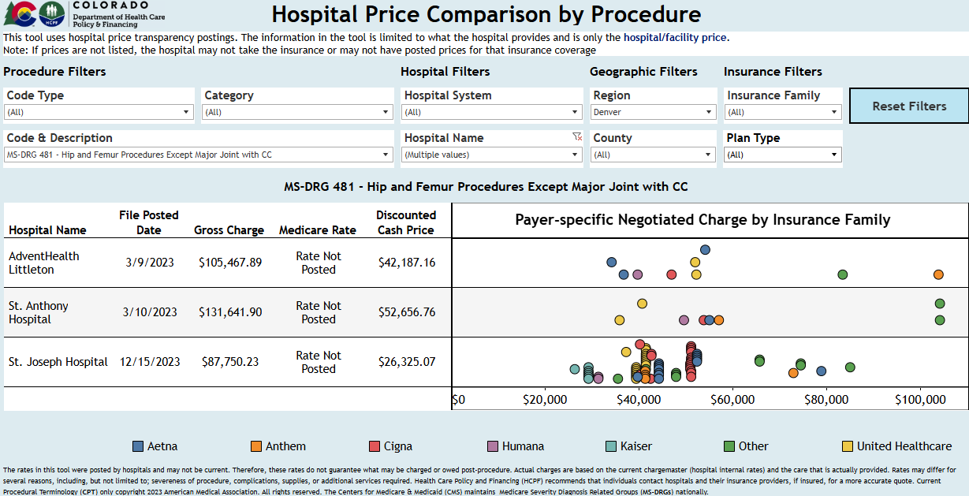
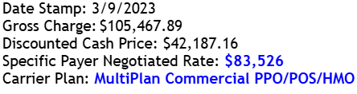
All hospital reports and tools available on the Hospital Reports Hub
Access the Price Transparency Webpage and Tool. Reach out to hcpf_hospitalpricing@state.co.us for a demo
Notes:
Nancy - 7:50
Thank you Kim
One of the most important drivers of hospital revenues and profits is the price charged by the hospital.
It is also the most important variable to Coloradans, employers and tax payers, because hospital prices are what factor straight into insurance premium prices.
Last year HCPF released a free price comparison tool.
this tool allows users - like employers and their associations, legislators, policy makers, insurance carriers, advocates, communities and others to compare commercial prices by hospital, by insurance network plan - across more than 5,000 different procedures.
It also helps inform productive conversations between communities or employers with hospitals about their prices.
In this example, we removed the hospital name for this public webinar, but hospital name shows up when you use the tool live.
This screen shot looks at hip replacements. You can see the wide price variation amongst plans.
You can leverage this tool to see if your local hospitals are charging higher or more competitive prices than other Colorado hospitals for the same services. You can look up births, cardiac or oncology procedures, colonoscopies, MRIs and so much more.
The pricing data is updated twice a year.
If you want a demo or help comparing the prices for hospitals in your employer region or your community, you can reach out to my team for support at hcpf_hospitalpricing@state.co.us
Now I’ll turn it to Kim to review changes in hospitals’ operating costs.
Next slide please

Slide 19
Todos los informes hospitalarios y herramientas disponibles en el Hospital Reports Hub
Acceda a la página web y a la herramienta de transparencia de precios. Póngase en contacto con hcpf_hospitalpricing@state.co.us para solicitar una demostración
Notes:
Nancy - 7:50
Thank you Kim
One of the most important drivers of hospital revenues and profits is the price charged by the hospital.
It is also the most important variable to Coloradans, employers and tax payers, because hospital prices are what factor straight into insurance premium prices.
Last year HCPF released a free price comparison tool.
this tool allows users - like employers and their associations, legislators, policy makers, insurance carriers, advocates, communities and others to compare commercial prices by hospital, by insurance network plan - across more than 5,000 different procedures.
It also helps inform productive conversations between communities or employers with hospitals about their prices.
In this example, we removed the hospital name for this public webinar, but hospital name shows up when you use the tool live.
This screen shot looks at hip replacements. You can see the wide price variation amongst plans.
You can leverage this tool to see if your local hospitals are charging higher or more competitive prices than other Colorado hospitals for the same services. You can look up births, cardiac or oncology procedures, colonoscopies, MRIs and so much more.
The pricing data is updated twice a year.
If you want a demo or help comparing the prices for hospitals in your employer region or your community, you can reach out to my team for support at hcpf_hospitalpricing@state.co.us
Now I’ll turn it to Kim to review changes in hospitals’ operating costs.
Next slide please

Slide 20
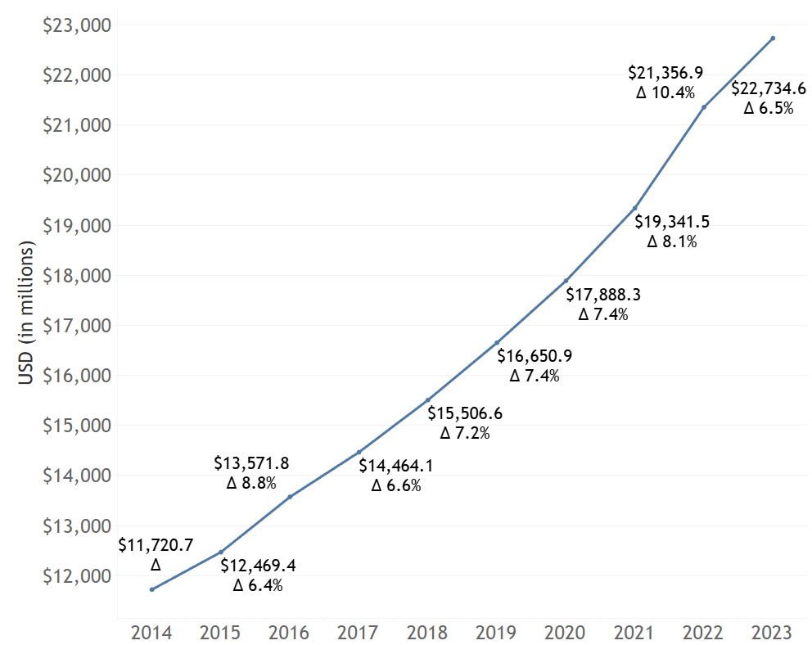
Hospital Operating Expenses Growth
Colorado Hospital
Total Operating Expenses
Similar to revenue growth, hospital operating expenses are growing by $1 billion per year and $2 billion per year, more recently
Up 7% or more a year from 2014 to 2023
Drivers: inflation and rising labor expenses
45% of operating expenses are for labor expenses (salaries, wages, and benefits).
Notes:
Kim
Hospital operating expenses are growing at a rapid rate as well, an annual increase of 7%.
45% of operating expenses are for labor expenses (salaries, wages, and benefits).
While costs have continued to rise steeply, they were exacerbated during the PHE, given COVID induced supply chain inflation and rising labor costs
Let’s dive into the latter on the next slide please

Slide 21
Crecimiento de gastos operativos de Hospitales
Gastos operativos totales del Hospital de Colorado
De manera similar al crecimiento de los ingresos, los gastos operativos de los hospitales están aumentando en $1 billón al año y, más recientemente, en $2 billones al año.
Un aumento del 7 % o más al año entre 2014 y 2023.
Impulsores: inflación y aumento de los gastos laborales.
El 45 % de los gastos operativos son gastos de mano de obra (salarios, sueldos y prestaciones).
Notes:
Kim
Hospital operating expenses are growing at a rapid rate as well, an annual increase of 7%.
45% of operating expenses are for labor expenses (salaries, wages, and benefits).
While costs have continued to rise steeply, they were exacerbated during the PHE, given COVID induced supply chain inflation and rising labor costs
Let’s dive into the latter on the next slide please

Slide 22
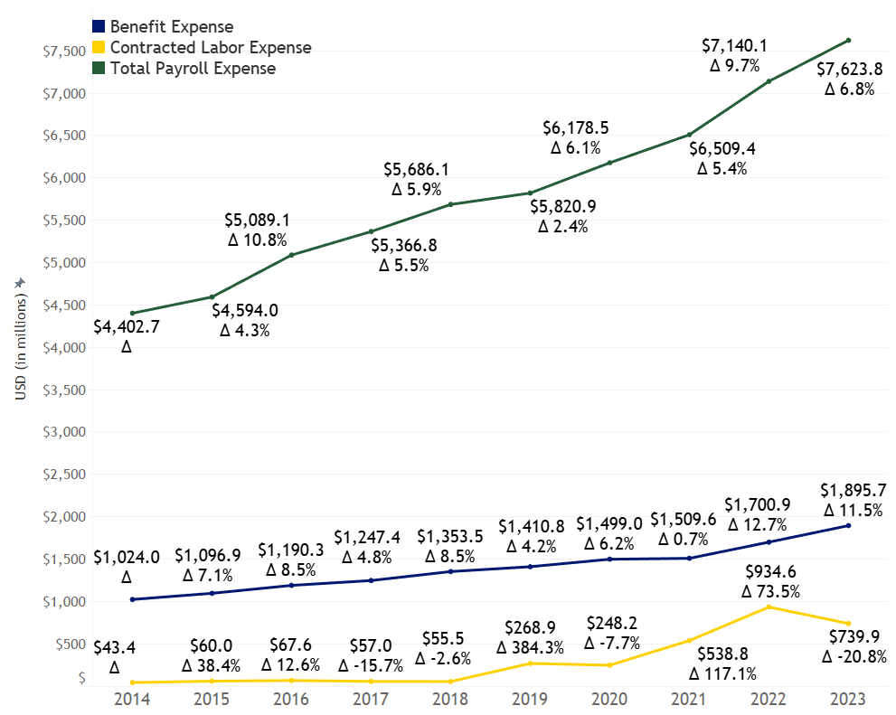

Significant increase in labor costs
Significant staffing agency cost increases in 2018 & 2019
Unprecedented staffing agency increases in 2021 & 2022: rising 350% from 2019
While payroll increased about 31% between 2020 and 2023
Increases in employed workforce expense driven by:
  Increase in workforce (36%) and hours (12%)
  Non-physician base compensation increases
Notes:
Kim
The right side of the slide reflects employees wage trends in green, benefits in blue and contracted labor (workers employed through staffing agencies) in yellow.
As you can see, the contracted labor went from about $55M in 2018, to $269M in 2019 to $935M in 2022
While payroll increased about 31% between 2020 and 2023 driven by wage increases, workforce increases and hours
These increases in the largest part of hospital operating expenses will have a direct impact on profits
These reports dive into the different categories of hospital operating expenses to identify specific cost drivers
But it was the largest slice of operating expenses, labor expenses that was the largest driver in operating expenses for hospitals. Between 2020 and 2023 labor expense grew 29.4% or $2.3 billion.

Slide 23
Aumento significativo de costos laborales
Aumento significativo de los costos de las agencias de empleo en 2018 y 2019.
Aumentos sin precedentes de las agencias de empleo en 2021 y 2022: un 350 % más que en 2019.
Mientras que la nómina aumentó alrededor de un 31 % entre 2020 y 2023.
Aumento de los gastos de empleo impulsado por :
  Aumento de personal (36%) y Horas (12%)
  Aumentos de la compensación básica de los no medicos.
Notes:
Kim
The right side of the slide reflects employees wage trends in green, benefits in blue and contracted labor (workers employed through staffing agencies) in yellow.
As you can see, the contracted labor went from about $55M in 2018, to $269M in 2019 to $935M in 2022
While payroll increased about 31% between 2020 and 2023 driven by wage increases, workforce increases and hours
These increases in the largest part of hospital operating expenses will have a direct impact on profits
These reports dive into the different categories of hospital operating expenses to identify specific cost drivers
But it was the largest slice of operating expenses, labor expenses that was the largest driver in operating expenses for hospitals. Between 2020 and 2023 labor expense grew 29.4% or $2.3 billion.

Slide 24
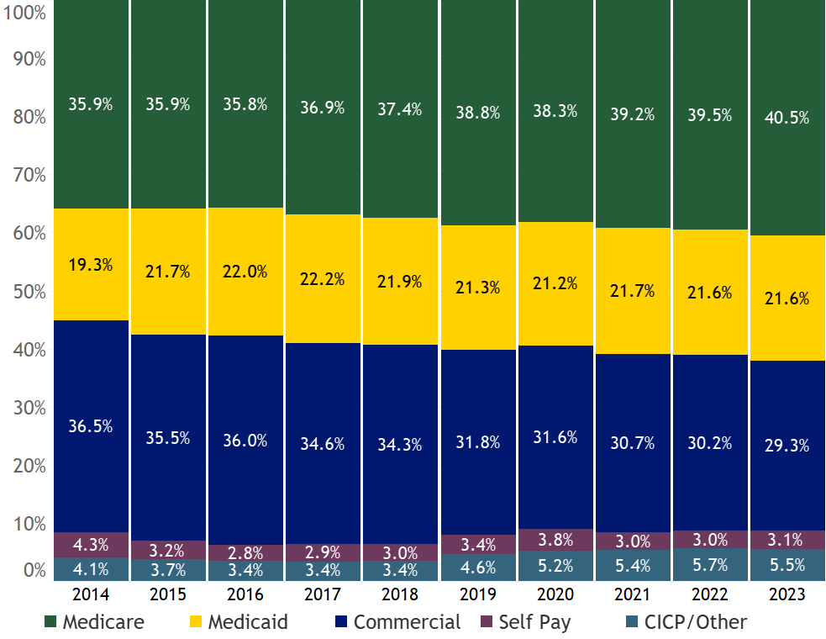
Hospital Payer Mix (hospital charges)
Public payers growing, Commercial decreasing
2014-2023: Commercial dropped 36.5% to 29.3%, Medicare and Medicaid grew from 55.1% to 62.1%
Aging CO population driving Medicare growth
Medicaid PHE growth not showing impact to hospital payer mix
Effects of PHE Unwind/Migrant influx won’t be fully realized until next year’s data & reporting
Notes:
Nancy - start 7:53 - 7:54
Thanks again Kim.
The chart to the right shows changing hospital patient/revenue mix using gross charges between 2014 and 2023.
This is the proportion of services provided by the hospital by insurance coverage type.
The green represents Medicare, which has grown from about 36% to 40.5% over the 10 year period 2014 to 2023.
This reflects an aging population; People are living longer and can spend decades on Medicare.
Conversely, the yellow represents Medicaid payer mix, which has stayed pretty darn flat at about 21.5% between 2015 and 2023, despite a increase in enrollment through the Public Health Emergency of more than 500,000 Coloradans.
This reflects the reality that the PHE did not shift payer mix for hospitals due to the lower risk or lower utilizing members moving from Commercial coverage to Medicaid through the PHE.
The blue reflects commercial, and a significant downward shift from 36.5% to 29.3% - a reduction of about 20%, which is significant.
Again, Commercial pays higher than public programs like Medicare and Medicaid.
At the bottom of the chart, the maroon and teal represent self pay and CICP.
You can see the impact of the ACA between 2014 and 2017 moving those lower pay categories from 8.4% down to about 6.4% in 2018 and then the jump in 2019 to 8%, and an increase to 8.6% in 2023.
We should also note that this chart does not yet fully reflect the impact of the PHE unwind or the immigration surge which will be more fully reflected in next years reporting.
Next slide please

Slide 25
Combinación de Contribuyentes de Hospitales
(gastos hospitalarios)
Los Contribuyentes públicos creciendo, comerciales disminuyendo
2014-2023: la parte comercial cayó del 36,5 % al 29,3 %, mientras que Medicare y Medicaid crecieron del 55,1 % al 62,1%.
El envejecimiento de la población de Colorado impulsa el crecimiento de Medicare.
El crecimiento del PHE de Medicaid no muestra impacto en la combinación de contribuyentes de los hospitales.
Los efectos del PHE La afluencia de inmigrantes no se conocerá por completo hasta ver los datos y el informe del próximo año.
Notes:
Nancy - start 7:53 - 7:54
Thanks again Kim.
The chart to the right shows changing hospital patient/revenue mix using gross charges between 2014 and 2023.
This is the proportion of services provided by the hospital by insurance coverage type.
The green represents Medicare, which has grown from about 36% to 40.5% over the 10 year period 2014 to 2023.
This reflects an aging population; People are living longer and can spend decades on Medicare.
Conversely, the yellow represents Medicaid payer mix, which has stayed pretty darn flat at about 21.5% between 2015 and 2023, despite a increase in enrollment through the Public Health Emergency of more than 500,000 Coloradans.
This reflects the reality that the PHE did not shift payer mix for hospitals due to the lower risk or lower utilizing members moving from Commercial coverage to Medicaid through the PHE.
The blue reflects commercial, and a significant downward shift from 36.5% to 29.3% - a reduction of about 20%, which is significant.
Again, Commercial pays higher than public programs like Medicare and Medicaid.
At the bottom of the chart, the maroon and teal represent self pay and CICP.
You can see the impact of the ACA between 2014 and 2017 moving those lower pay categories from 8.4% down to about 6.4% in 2018 and then the jump in 2019 to 8%, and an increase to 8.6% in 2023.
We should also note that this chart does not yet fully reflect the impact of the PHE unwind or the immigration surge which will be more fully reflected in next years reporting.
Next slide please

Slide 26
How is all this impacting the cost shift?
Positive hospital impact from Affordable Care Act, Expansion, Provider Fee/CHASE
  2009 Medicaid $0.54 cents on dollar of cost vs $0.79 during the last few years
2023 payment to cost ratio is 100%, meaning higher commercial reimbursement is just offsetting lower public programs reimbursements with growing payer mix
Exacerbated by higher hospital expenses from inflation, worker wages/compensation
Year | Medicare | Medicaid | Commercial Insurance | Self Pay | CICP/Other | Overall
2009* | 0.78 | 0.54 | 1.55 | 0.52* | 0.52* | 1.05
2019 | 0.75 | 0.63 | 1.84 | 0.30 | 0.89 | 1.08
2020 | 0.71 | 0.80 | 1.67 | 0.42 | 0.88 | 1.03
2020 w/ stimulus | 0.76 | 0.87 | 1.76 | 0.49 | 0.95 | 1.10
2021 | 0.76 | 0.77 | 1.75 | 0.35 | 0.94 | 1.06
2022 | 0.73 | 0.79 | 1.64 | 0.33 | 0.90 | 1.02
2023 | 0.73 | 0.79 | 1.63 | 0.25 | 0.84 | 1.00
*When comparing results from 2009 to 2018 with those after 2019 one should remember the change in methodology when viewing trends that connect the two periods. 2009’s values combined Self Pay and the CICP/Other category
Notes:
Nancy 7:57
Part of our reporting is a review of the cost shift. Keep in mind that our hospital provider fee program was put in place with the intent to reduce shifting the cost shift of under reimbursement from Medicaid to commercial insurance.
Many of you have heard of the cost shift, which reflects the shift of underpayments from public programs - who reimburse less than hospital costs - to Commercial payers - who end up reimbursing hospitals more to make up for the public payer underpayments.
As Medicaid payments grew, and the uninsured rate decreased from the ACA, there was an opportunity to reduce the cost shift.
The reporting demonstrates that there have been net income gains to hospitals from CHASE, Medicaid expansion and then further enhanced by the ACA.
Medicaid payment to cost ratios, demonstrated here in the third column, grew from $0.54 cents on dollar of cost vs $0.79 last few years
Not only does CHASE provide greater reimbursement, but the Medicaid expansion population funded by CHASE reduced the uninsured rate.
The uninsured or self pay category includes low-income individuals unlikely or unable to pay.
Medicaid expansion provided coverage for those individuals, reducing the need to cost shift from the self pay pay category, which has the lowest payment to cost ratio on this chart: $0.25 cents on dollar.
That is what the hospital provider fee and Medicaid expansions were meant to do. And, in theory, it should have reduced the cost shift to Commercial payers. Instead the commercial insurance payment to cost ratio rose and hovered around 1.7 until recently.
However, things have changed over the last few years with rising hospital operating expenses. (Keep in mind costs are half of the equation for the payment to cost ratio). You can see that in the lower right corner, in 2022 and 2023, the overall payment to cost ratio has decreased tremendously, and is at 1.0 or 100% in 2023, meaning that - overall - the hospitals are just breaking even in the aggregate for patient services - across all payers with $8.5 million in patient service net income in 2023
But patient services are just one part of how hospitals, like any other organization, makes earnings.
Bettina, I’ll turn to you to discuss hospital earnings.
Next slide please.
7:57

Slide 27
¿Cómo influye esto en el cambio de gastos?
Impacto hospitalario positivo de la Ley de Cuidado de Salud a bajo precio, expansión, tarifa a proveedores/CHASE
  En 2009 Medicaid 0,54 centavos por dólar de costo frente a los 0,79 de los últimos años.
  En 2023, la relación entre pagos al costo es del 100%, lo que significa que el aumento de los reembolsos comerciales compensa la disminución de los reembolsos de los programas públicos, con una combinación de contribuyentes cada vez mayor.
Agravado por el aumento de los gastos hospitalarios debido a la inflación y a los salarios e indemnizaciones de los trabajadores.
Año | Medicare | Medicaid | Seguro Comercial | Pago por cuenta propia | CICP/Otros | En General
2009* | 0.78 | 0.54 | 1.55 | 0.52* | 0.52* | 1.05
2019 | 0.75 | 0.63 | 1.84 | 0.30 | 0.89 | 1.08
2020 | 0.71 | 0.80 | 1.67 | 0.42 | 0.88 | 1.03
2020 con estímulo | 0.76 | 0.87 | 1.76 | 0.49 | 0.95 | 1.10
2021 | 0.76 | 0.77 | 1.75 | 0.35 | 0.94 | 1.06
2022 | 0.73 | 0.79 | 1.64 | 0.33 | 0.90 | 1.02
2023 | 0.73 | 0.79 | 1.63 | 0.25 | 0.84 | 1.00
Al comparar los resultados de 2009 a 2018 con los posteriores a 2019, hay que tener en cuenta el cambio de metodología al ver las tendencias que conectan los dos periodos. Los valores de 2009 combinaban el pago por cuenta propia y la categoría CICP/Otros
Notes:
Nancy 7:57
Part of our reporting is a review of the cost shift. Keep in mind that our hospital provider fee program was put in place with the intent to reduce shifting the cost shift of under reimbursement from Medicaid to commercial insurance.
Many of you have heard of the cost shift, which reflects the shift of underpayments from public programs - who reimburse less than hospital costs - to Commercial payers - who end up reimbursing hospitals more to make up for the public payer underpayments.
As Medicaid payments grew, and the uninsured rate decreased from the ACA, there was an opportunity to reduce the cost shift.
The reporting demonstrates that there have been net income gains to hospitals from CHASE, Medicaid expansion and then further enhanced by the ACA.
Medicaid payment to cost ratios, demonstrated here in the third column, grew from $0.54 cents on dollar of cost vs $0.79 last few years
Not only does CHASE provide greater reimbursement, but the Medicaid expansion population funded by CHASE reduced the uninsured rate.
The uninsured or self pay category includes low-income individuals unlikely or unable to pay.
Medicaid expansion provided coverage for those individuals, reducing the need to cost shift from the self pay pay category, which has the lowest payment to cost ratio on this chart: $0.25 cents on dollar.
That is what the hospital provider fee and Medicaid expansions were meant to do. And, in theory, it should have reduced the cost shift to Commercial payers. Instead the commercial insurance payment to cost ratio rose and hovered around 1.7 until recently.
However, things have changed over the last few years with rising hospital operating expenses. (Keep in mind costs are half of the equation for the payment to cost ratio). You can see that in the lower right corner, in 2022 and 2023, the overall payment to cost ratio has decreased tremendously, and is at 1.0 or 100% in 2023, meaning that - overall - the hospitals are just breaking even in the aggregate for patient services - across all payers with $8.5 million in patient service net income in 2023
But patient services are just one part of how hospitals, like any other organization, makes earnings.
Bettina, I’ll turn to you to discuss hospital earnings.
Next slide please.
7:57

Slide 28
CO Hospital Profits (Net Income) Metrics (in millions)
Profit Metric | 2019 | 2020 | 2021 | 2022 | 2023
Patient Service Profit (patient care) | $1,311.1 | $555.4 | $1,209.8 | $334.3 | $8.5
Operating Profit (Patient care +med ed tuition, research grants, gift shop, etc.) | $1,913.2 | $1,296.5 | $1,962.3 | $981.3 | $750.4
Total Profit (Operating + Inv earnings, tax revenues, fed stim, other grants) | $2,285.4 | $1,843.3 | $3,424.8 | $336.1 | $1,497.4
Patient service and operating margin decreases in 2023
Significant profits over last five years
Impacts: Cost increases due to rising wages and inflation, plus shifts in investment returns, notably 2022 stock and bond market crash
Notes:
Bettina
Thank you Nancy,
That 1.0 payment to cost ratio from Nancy’s last slide, or $8.5 million dollars is the top right cell of this table, which shows all three different categorizations of hospital profits as reported in the Hospital Financial Transparency Report.
Patient service profits - the first measure on the chart - reflects profits generated from patient care.
Operating profits, the second row on the chart, includes patient services profits plus other operating activities like the hospital’s medical education tuition and research grants or a gift shop, cafeteria, or parking.
Total profits, the bottom line on the chart, adds investment gains as well as non-operating activities like grants, federal stimulus, and tax subsidies
There have been lots of swings and shifts throughout these recent years: driven by growth in operating expenses, inflation, stimulus funding, and, of course, pricing decisions
Patient service and operating margin have decreased in 2023, after significant profits over the previous five years.
But what we hope you take away from this different perspective of hospital profits is that we can’t just look at patient services. Investment earning are a large percentage of Colorado hospital earnings, roughly 50%. However, large losses from the market like those of 2022 are possible as well.
It is important to note that NOT EVERY HOSPITAL SITTING ON SIGNIFICANT RESERVES.
Next slide, please
OTHER NOTES:
Note: Denver Health, National Jewish, Children’s, and Boulder Community are largest Other operating revenue drivers for the difference between PSNI and Operating.
OTHER Speaker notes
Patient Services: Patient service net income is the difference between net patient revenue and all costs associated with direct patient care.
Operating: Net operating income is the difference between all operating revenue and expenses. There are some operating revenues and expenses that aren’t directly associated with patient care.
Total: Total Profit or “net Income” or “Change in net assets” refers to the final profits of an organization, including all operating and non-operating profits. Non-operating revenues and expenses can include investment income, tax income or expenses.

Slide 29
Ganancias de Hospitales de CO (Ingresos Netos) métricas (en millones)
Métricas de Ganancias | 2019 | 2020 | 2021 | 2022 | 2023
Ganancias por servicios al paciente (Cuidado del paciente) | $1,311.1 | $555.4 | $1,209.8 | $334.3 | $8.5
Ganancias de operación (cuidado del paciente + matrícula de educación médica, becas de investigación, tienda de regalos, etc.) | $1,913.2 | $1,296.5 | $1,962.3 | $981.3 | $750.4
Ganancias totales (Ganancias de operación + inversión, impuestos, estímulo federal, otras subvenciones)) | $2,285.4 | $1,843.3 | $3,424.8 | $336.1 | $1,497.4
El servicio al paciente y el margen operativo disminuyen en 2023.
Ganancias significativas en los últimos cinco años.
Impactos: Aumento de los gastos debido al aumento de los salarios y la inflación, además de cambios en el rendimiento de las inversiones, en particular la caída del mercado de valores y de bonos en 2022.
Notes:
Bettina
Thank you Nancy,
That 1.0 payment to cost ratio from Nancy’s last slide, or $8.5 million dollars is the top right cell of this table, which shows all three different categorizations of hospital profits as reported in the Hospital Financial Transparency Report.
Patient service profits - the first measure on the chart - reflects profits generated from patient care.
Operating profits, the second row on the chart, includes patient services profits plus other operating activities like the hospital’s medical education tuition and research grants or a gift shop, cafeteria, or parking.
Total profits, the bottom line on the chart, adds investment gains as well as non-operating activities like grants, federal stimulus, and tax subsidies
There have been lots of swings and shifts throughout these recent years: driven by growth in operating expenses, inflation, stimulus funding, and, of course, pricing decisions
Patient service and operating margin have decreased in 2023, after significant profits over the previous five years.
But what we hope you take away from this different perspective of hospital profits is that we can’t just look at patient services. Investment earning are a large percentage of Colorado hospital earnings, roughly 50%. However, large losses from the market like those of 2022 are possible as well.
It is important to note that NOT EVERY HOSPITAL SITTING ON SIGNIFICANT RESERVES.
Next slide, please
OTHER NOTES:
Note: Denver Health, National Jewish, Children’s, and Boulder Community are largest Other operating revenue drivers for the difference between PSNI and Operating.
OTHER Speaker notes
Patient Services: Patient service net income is the difference between net patient revenue and all costs associated with direct patient care.
Operating: Net operating income is the difference between all operating revenue and expenses. There are some operating revenues and expenses that aren’t directly associated with patient care.
Total: Total Profit or “net Income” or “Change in net assets” refers to the final profits of an organization, including all operating and non-operating profits. Non-operating revenues and expenses can include investment income, tax income or expenses.

Slide 30
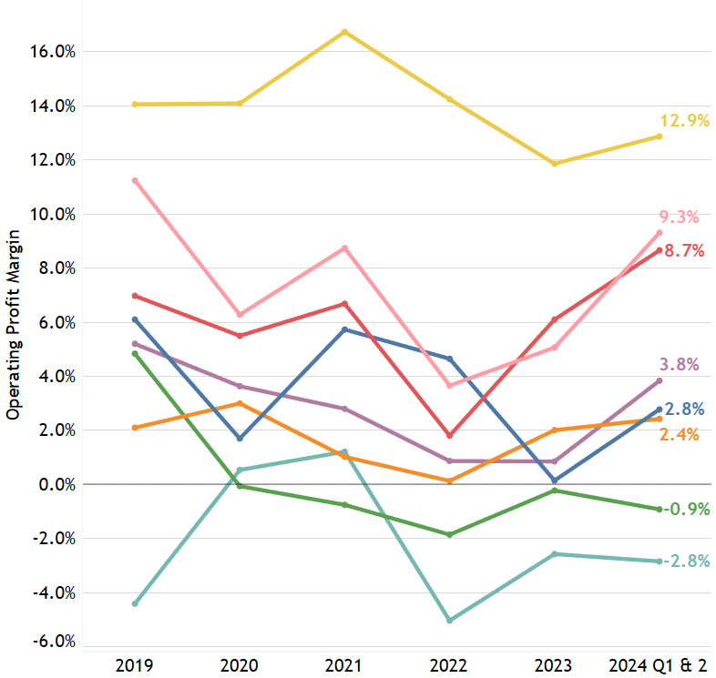
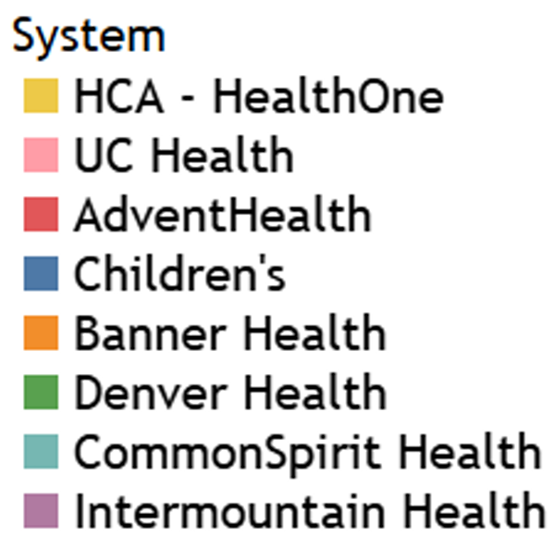
2024 operating profits thru Q2, rebounding
Year over Year Review
Systems recovering to pre-COVID operating profits
Most within 2% of 2019, except Children’s and Denver Health
2023/2024 stabilization after 2022 drop.
Drivers of 2022 drop:
  Stim funds ended
  Labor costs/wages
  Inflation
Notes: Intermountain Health had merger and acquisition activity in 2022, which led to accounting impacts reflected in the high profit margins. HCA HealthONE’s operating margin is higher than other systems in part due to necessary tax expenses being a non-operating expense; Total Profit Margin includes these expenses
Notes:
Bettina
The chart illustrates health system Operating Profit margin from 2019 through Q2 2024
It indicates a rebounding with most systems catching up with their pre-covid financial performance
Denver Health (the bright green line) and Children’s Hospital (the blue line) are notable exceptions.
The dip and recovery across 2022 and 2023 reflects the end of the stimulus funding, rising inflation, and the increases in labor costs
Since this graphic reflects Operating Profits, it does not include profits from investment earnings on reserves.
The graphic also shows the range of operating margins across the larger hospitals and hospital systems
From negative for Common Spirit and Denver Health to highs of HCA, UCHealth and Advent Health
We want to give a shout out to HCA-HealthOne, which gave back their Federal Stimulus dollars during the public health emergency, not just here in CO but nationally as well, to the tune of $6 billion, which is pretty incredible.
Next slide, please
Other notes:
AdventHealth, CommonSpirit hospital split - Decline in 2022 might reflect. This was two years ago - Feb 2023, completed in Aug 2023. they call it a "disaffiliation"

Slide 31
Ganancias de operación en 2024 (segundo trimestre) repuntando
Revisión Interanual
Recuperación de los sistemas a las ganancias de operación anteriores al COVID.
La mayoría dentro del 2 % de 2019, excepto Children's y Denver Health.
Estabilización en 2023/2024 tras la caída de 2022.
Impulsores de la caída de 2022:
  Fin de los fondos de estímulo.
  Costos de mano de obra/salarios.
  Inflación.
Notas: Intermountain Health tuvo actividad de fusión y adquisición en 2022, lo que llevó a impactos reflejados en los altos márgenes de beneficio. El margen operativo de HCA HealthONE es más alto que el de otros sistemas en parte debido a que los gastos fiscales necesarios son un gasto no operativo; el margen de beneficio total incluye estos gastos.
Notes:
Bettina
The chart illustrates health system Operating Profit margin from 2019 through Q2 2024
It indicates a rebounding with most systems catching up with their pre-covid financial performance
Denver Health (the bright green line) and Children’s Hospital (the blue line) are notable exceptions.
The dip and recovery across 2022 and 2023 reflects the end of the stimulus funding, rising inflation, and the increases in labor costs
Since this graphic reflects Operating Profits, it does not include profits from investment earnings on reserves.
The graphic also shows the range of operating margins across the larger hospitals and hospital systems
From negative for Common Spirit and Denver Health to highs of HCA, UCHealth and Advent Health
We want to give a shout out to HCA-HealthOne, which gave back their Federal Stimulus dollars during the public health emergency, not just here in CO but nationally as well, to the tune of $6 billion, which is pretty incredible.
Next slide, please
Other notes:
AdventHealth, CommonSpirit hospital split - Decline in 2022 might reflect. This was two years ago - Feb 2023, completed in Aug 2023. they call it a "disaffiliation"

Slide 32
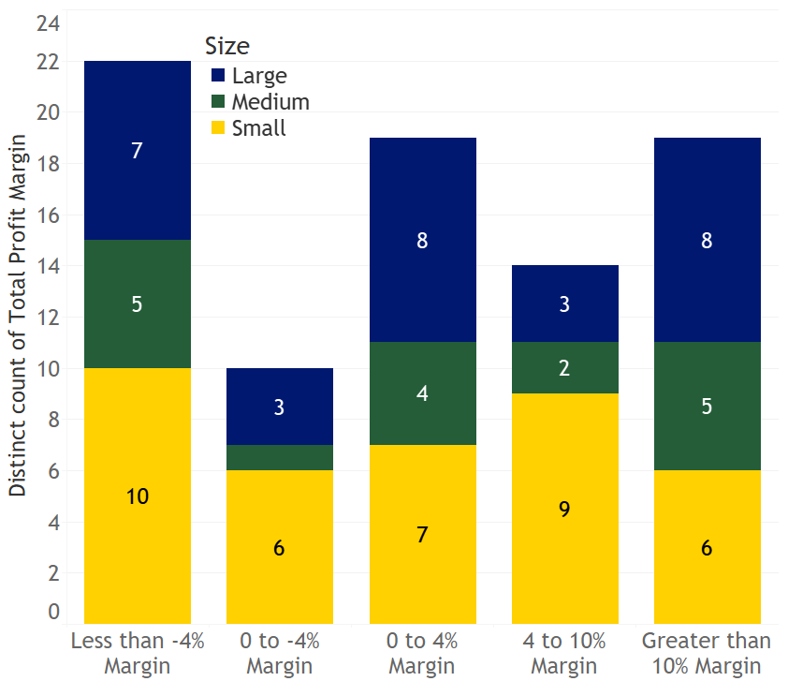
Total Profit Insight
Total Profit Margins by Peer Group
2023 Hospital Count
Total Profits broad range: from negative 23.7% to plus 32.9%
32 hospitals (38%): negative total profits
Commonalities:
Recently built
Recently acquired
Rural
Half are independent
Many system hospitals with negative Total Profits record investment gains at the system level
0 to 4% Margin
Notes:
Bettina
While it’s helpful to look at the system level, we also need to dive into the individual hospital level. Each hospital in Colorado has a unique market, a unique community, and there is a wide range of financial results that could result in sustainability or risk to access.
Total profits range from negative -23.7% to positive +32.9%.
The chart on the right shows the number of large, medium and small hospitals represented by blue, green, and yellow respectively, and places them in various profit performance categories on the x axis.
This chart illustrates that all hospital sizes are reflected in all distinct hospital total profits categories, from -4% through greater than 10%
But when you look at the specific hospitals that have negative profits, some commonalities appear:
Newly constructed UCHealth hospitals and Children’s new hospital in CO Springs
Many newly acquired hospitals like the Intermountain (formerly SCL) hospitals, St Elizabeth, Parkview
There are many hospitals, roughly half, that aren’t part of a system
Many are rural hospitals
But while we review these individual hospital metrics and you hear about the unsustainable hospitals in the news, it is important to look at it from a system perspective as we did on the previous slide
Half of these hospitals are part of a system that has had positive profits and positive gains. These hospitals are health care access in the community but also entry points to the hospital health system’s greater network.
The other half of these hospitals do not have a system to lean on or share costs. These are the hospitals at risk for acquisition and service line closures
Kim, back to you to discuss hospital reserves
Other potential talking points
One reason for this Total Profit view is that many rural hospitals survive on tax funding raised from the community which is not reflected in Operating margin, only Total margin.
UCHealth for example: broomfield, grandview, greeley, and longs peaks with <-4%, and Highlands Ranch with <0% >-4%, flip side Poudre with 26% and University with 16%. Smaller/new urban hospitals worse margins, larger system urban hospitals have high margins with higher $ amounts.
34.5% of all large hospitals had a negative total profit margin in 2023 or 11.9% of the total 84 General acute care hospitals, whereas 35.3% of medium hospitals had a negative profit margin (or 7.1% of total 84 hospitals) and 42.1% of small hospitals had a negative total profit margin (or 19.0% of all 84 hospitals).

Slide 33
Información de ganancias totales
Margen de ganancias totales por grupo Similares 2023 Recuento de Hospitales
Ganancias totales: amplio rango, desde -23,7 % hasta más de 32,9 %
32 hospitales (38%): ganancia negativa total
Elementos comunes:
Construcción reciente
Adquirido recientemente
Rural
La mitad son independientes
Muchos hospitales del sistema con ganancias totales negativas registran ganancias de inversión a nivel del Sistema.
0 to 4% Margin
Notes:
Bettina
While it’s helpful to look at the system level, we also need to dive into the individual hospital level. Each hospital in Colorado has a unique market, a unique community, and there is a wide range of financial results that could result in sustainability or risk to access.
Total profits range from negative -23.7% to positive +32.9%.
The chart on the right shows the number of large, medium and small hospitals represented by blue, green, and yellow respectively, and places them in various profit performance categories on the x axis.
This chart illustrates that all hospital sizes are reflected in all distinct hospital total profits categories, from -4% through greater than 10%
But when you look at the specific hospitals that have negative profits, some commonalities appear:
Newly constructed UCHealth hospitals and Children’s new hospital in CO Springs
Many newly acquired hospitals like the Intermountain (formerly SCL) hospitals, St Elizabeth, Parkview
There are many hospitals, roughly half, that aren’t part of a system
Many are rural hospitals
But while we review these individual hospital metrics and you hear about the unsustainable hospitals in the news, it is important to look at it from a system perspective as we did on the previous slide
Half of these hospitals are part of a system that has had positive profits and positive gains. These hospitals are health care access in the community but also entry points to the hospital health system’s greater network.
The other half of these hospitals do not have a system to lean on or share costs. These are the hospitals at risk for acquisition and service line closures
Kim, back to you to discuss hospital reserves
Other potential talking points
One reason for this Total Profit view is that many rural hospitals survive on tax funding raised from the community which is not reflected in Operating margin, only Total margin.
UCHealth for example: broomfield, grandview, greeley, and longs peaks with <-4%, and Highlands Ranch with <0% >-4%, flip side Poudre with 26% and University with 16%. Smaller/new urban hospitals worse margins, larger system urban hospitals have high margins with higher $ amounts.
34.5% of all large hospitals had a negative total profit margin in 2023 or 11.9% of the total 84 General acute care hospitals, whereas 35.3% of medium hospitals had a negative profit margin (or 7.1% of total 84 hospitals) and 42.1% of small hospitals had a negative total profit margin (or 19.0% of all 84 hospitals).

Slide 34
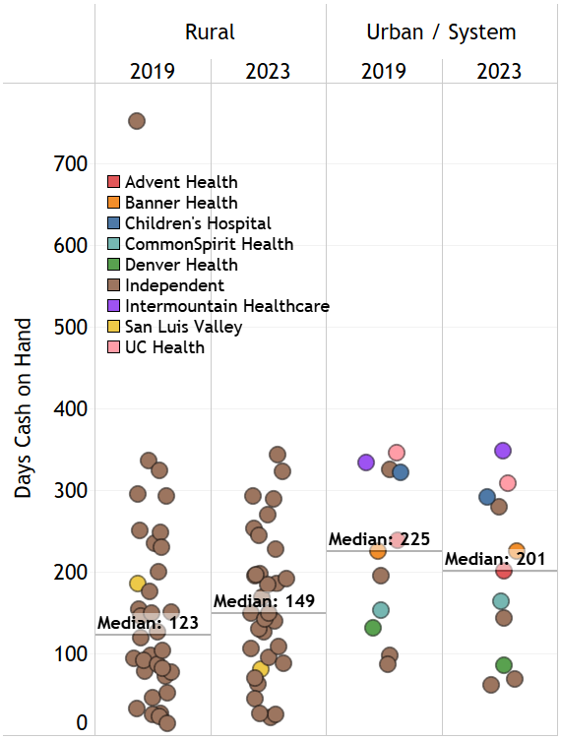
Days Cash on Hand Reserves
Days cash on hand, or reserves, measure financial stability and an opportunity for investment income
Wide variation - 11 days to 348 days cash on hand
S&P indicates 150 days cash on hand is strong
Median 2023 days cash on hand at 164 days is higher than 2019 pre-pandemic @ 149 days
  In greater Denver, Denver Health has lowest days cash on hand @ 85 (2023)
  Rural median 52 days less than urban independents/ national systems
Days Cash on Hand Median for All Hospitals or Health Systems
2019 | 2020 | 2021 | 2022 | 2023
149 | 218 | 215 | 183 | 164
Days cash on hand: if a hospital stopped operations and no longer was receiving revenues, its days cash on hand would suggest that the hospital could remain open for that many more days before closing its doors
Credit Rating Criteria for U.S. And Canadian Not-For-Profit Acute Care Health Care Organizations.(April 2024). S&P Global
 | 2019 | 2023
Rural | 123 | 149
Range | 7-330 (verify) | 10-350 (verify
Urban | 225 | 201
Range | 97-350 (verify) | 60-350 (verify)
Notes:
Kim
Days cash on hand, or reserves, is an important measure of hospital stability
The S&P Global ratings indicate that 150 days cash on hand for a Not-For-Profit Acute Care Health Care Organization and above is a strong rating to borrow money competitively and to be able to handle financial fluctuations year to year
Days cash on hand reserves also present an opportunity to make investment returns, which as we said, reflect about hospitals 50% of Total Profit performance.
Overall, hospitals look similar to pre-pandemic amounts
Cash reserves have declined from 2021 and 2020 levels. However, cash reserves in 2021 and 2020 were assisted by federal COVID-19 stimulus packages.
In 2023, the median days cash on hand is 164, a decline of 19 days from the median in 2022;
however, 2023 is more in line with DCOH medians from 2019 before the PHE.
But there is wide variation between hospitals, across rural/urban divides.

Slide 35
Reservas de Efectivo disponible
Los días de efectivo disponible, o reservas, miden la estabilidad financiera y la oportunidad de obtener ingresos por inversiones.
Amplia variación: de 11 a 348 días de efectivo disponible.
S&P indica que 150 días de efectivo disponible es fuerte.
El mediano de efectivo disponible en 2023, de 164 días, es superior a la de 2019, antes de la pandemia, de 149 días
  Denver Health tiene el efectivo disponible más bajo, 85 días (202 en el área metropolitana de Denver, 3).
  La media rural es 52 días menos que la de los independientes urbanos/sistemas nacionales.
Mediano de días de efectivo disponible para todos los hospitales o sistemas de salud
2019 | 2020 | 2021 | 2022 | 2023
149 | 218 | 215 | 183 | 164
Días de efectivo disponible: si un hospital dejara de funcionar y dejara de recibir ingresos, sus días de efectivo disponible sugerirían que el hospital podría permanecer abierto durante esos días antes de cerrar sus puertas.
Criterios de calificación crediticia para organizaciones de atención de salud de cuidados agudos sin fines de lucro de EE. UU. y Canadá (abril de 2024). S&P Global
 | 2019 | 2023
Rural | 123 | 149
Rango | 7-330 (verificar) | 10-350 (verificar)
Urbano | 225 | 201
Rango | 97-350 (verificar) | 60-350 (verificar)
Notes:
Kim
Days cash on hand, or reserves, is an important measure of hospital stability
The S&P Global ratings indicate that 150 days cash on hand for a Not-For-Profit Acute Care Health Care Organization and above is a strong rating to borrow money competitively and to be able to handle financial fluctuations year to year
Days cash on hand reserves also present an opportunity to make investment returns, which as we said, reflect about hospitals 50% of Total Profit performance.
Overall, hospitals look similar to pre-pandemic amounts
Cash reserves have declined from 2021 and 2020 levels. However, cash reserves in 2021 and 2020 were assisted by federal COVID-19 stimulus packages.
In 2023, the median days cash on hand is 164, a decline of 19 days from the median in 2022;
however, 2023 is more in line with DCOH medians from 2019 before the PHE.
But there is wide variation between hospitals, across rural/urban divides.

Slide 36
Colorado’s hospital collaboration and efforts are moving all hospital financial metrics in the right direction. Healthy hospital finances help maintain Medicaid coverage and access for Coloradans statewide
CO National Rankings for Price, Cost, & Profit (Highest to Lowest)
 | 2018 | 2019 | 2020 | 2021 | 2022 | 2023
Price/Patient | 5th | 4th | 4th * | 6th | 10th | 10th
Cost/Patient | 8th | 8th | 10th | 13th | 13th | 11th
Profit/Patient | 3rd | 3rd | 5th * | 3rd * | 11th | 13th
Total Profit | 1st | 4th | 5th | 4th | 25th | 19th
*Data from Medicare Cost Reports, cost of living adjustment applied. Some rankings shifted slightly from 2023 Insights report due to additional hospital data submissions. 2018 and 2019 Rankings remain as reported in the 2023 Insights report.
Notes:
KIM
We want our hospitals to be healthy - to expand access, to invest in tomorrow.
We just don’t want them charging such high prices, or making such high profits, that its unnecessarily and inappropriately impacting all of those who pay for that - employers, consumers, taxpayers….
Because hospitals represent the biggest part of the health care dollar, a reasonable comparison to understand where we have opportunity to improve affordability to employers, consumers and taxpayers is how CO hospitals compare nationally across various affordability metrics
Shout out to hospitals - all metrics are moving in the right direction - costs, price, and profit measures for 3 years straight, to ranking 10th or lower in all measures for 2022 and 2023
Hospitals are taking action. This is Aggregate for the state. Total margin plummeted because of investment markets deteriorating. (See preview profits visual). University went from nearly $1 billion in total net income in 2021 to (-$100 million) in 2022. Affected CO more than other states due to the large stockpiles hospitals have here, also More to do what is happening in other states. 25 rank to 19 = Mix of hospitals not doing quite as well, but other states doing better. AGgregation of above might have impact
Is it costs too high? What is impact of federal stimulus?
Price/Cost/Profit rankings compared to other states has improved over last 5 years
From being among the highest in all categories, to 10th or lower.
Price ranking can continue to fall, along with costs, to further improve affordability for Coloradans.
Profit/patient: Patient services Net Income per Adjusted Discharge.
Total Profit: Total Aggregate Profit Margin for states (including investments).
Price: Net Patient Revenue per Adjusted Discharge.

Slide 37
La colaboración y los esfuerzos de Hospitales de Colorado están moviendo todas las métricas financieras hospitalarias en la dirección correcta. Las finanzas hospitalarias saludables ayudan a mantener la cobertura y el acceso a Medicaid para los Coloradenses en todo el estado.
Clasificaciones nacionales de Colorado por precio, costo y beneficio
(mayor a menor)
 | 2018 | 2019 | 2020 | 2021 | 2022 | 2023
Precio/Paciente | 5to | 4to | 4to * | 6to | 10mo | 10mo
Costo/Paciente | 8vo | 8vo | 10mo | 13ro | 13ro | 11vo
Ganancia/ Paciente | 3ro | 3ro | 5to * | 3ro * | 11vo | 13ro
Ganancia Total | 1ro | 4to | 5to | 4to | 25to | 19no
Datos de los informes de costos de Medicare, con ajuste por costo de vida aplicado. Algunas clasificaciones cambiaron ligeramente con respecto al informe de perspectivas de 2023 debido a la presentación de datos hospitalarios adicionales. Las clasificaciones de 2018 y 2019 se mantienen como se informó en el informe de perspectivas de 2023
Notes:
KIM
We want our hospitals to be healthy - to expand access, to invest in tomorrow.
We just don’t want them charging such high prices, or making such high profits, that its unnecessarily and inappropriately impacting all of those who pay for that - employers, consumers, taxpayers….
Because hospitals represent the biggest part of the health care dollar, a reasonable comparison to understand where we have opportunity to improve affordability to employers, consumers and taxpayers is how CO hospitals compare nationally across various affordability metrics
Shout out to hospitals - all metrics are moving in the right direction - costs, price, and profit measures for 3 years straight, to ranking 10th or lower in all measures for 2022 and 2023
Hospitals are taking action. This is Aggregate for the state. Total margin plummeted because of investment markets deteriorating. (See preview profits visual). University went from nearly $1 billion in total net income in 2021 to (-$100 million) in 2022. Affected CO more than other states due to the large stockpiles hospitals have here, also More to do what is happening in other states. 25 rank to 19 = Mix of hospitals not doing quite as well, but other states doing better. AGgregation of above might have impact
Is it costs too high? What is impact of federal stimulus?
Price/Cost/Profit rankings compared to other states has improved over last 5 years
From being among the highest in all categories, to 10th or lower.
Price ranking can continue to fall, along with costs, to further improve affordability for Coloradans.
Profit/patient: Patient services Net Income per Adjusted Discharge.
Total Profit: Total Aggregate Profit Margin for states (including investments).
Price: Net Patient Revenue per Adjusted Discharge.

Slide 38
Rural hospitals less financially stable.
Require more intervention and support
Generally, Rural hospitals have:
Higher percent of the community is covered by public programs
Higher uncompensated care
Far fewer inpatient beds/stays. Depend on outpatient services
No large system to rely on to share admin costs, investments in advances
Higher % of Admin costs
Lower margins/profits
Lower days cash on hand reserves, driving lower investment income
We recognize that many depend on tax funding raised from community
Public payers reimburse close to rural hospital costs:
  Medicaid = 96%
  Medicare = 99% (Sequestration lowered by 2%, 101% minus 2%)
Notes:
Kim
CAHs are particularly vulnerable to reimbursement policy changes given that the majority of their payer mix is from Medicare and Medicaid who reimburse below the cost of care and are generally located in areas which face great economic, infrastructure, and access to care challenges than urban areas of the state.
Unlike traditional hospitals (which are paid under prospective payment systems), Medicare pays critical access hospitals based on costs. CMS pays at 101% of reasonable costs. However, due to he Budget Control Act of 2011’s Medicare Sequestration Payment Reductions, the reimbursement is subject to a 2% reduction through 2032, meaning critical access hospitals are currently paid below cost of care provided to Medicare patients.
The proportion of general and administrative expenses for small hospitals has been increasing over the last few years and is an area which HCPF will continue to focus on. If these hospitals are spending more and more on maintaining operations versus serving patients this could affect access to care for rural Coloradans. However, if these expenses are being used to increase access and financial stability, then this increase could signal better results for rural Coloradans.

Slide 39
Los Hospitales rurales financieramente menos estables, requieren más intervención y apoyo
Por lo general, los hospitales rurales tienen:
Un mayor porcentaje de la comunidad cubierto por programas públicos.
Mayores tasas de cuidados no compensados.
Mucho menos camas/estancias de pacientes hospitalizados. Dependen de los servicios ambulatorios.
No depende de un sistema grande para compartir gastos administrativos, inversiones en anticipos.
% más elevado de gastos administrativos.
Menores márgenes/ganancias
Menores reservas de días de efectivo disponible, lo que reduce los ingresos por inversiones.
Reconocemos que muchos dependen de los fondos fiscales recaudados de la comunidad
Los contribuyentes públicos reembolsan gastos cercanos a los de un hospital rural:
  Medicaid = 96%
  Medicare = 99% (Reducción de la retención por 2%, 101% menos 2%)
Notes:
Kim
CAHs are particularly vulnerable to reimbursement policy changes given that the majority of their payer mix is from Medicare and Medicaid who reimburse below the cost of care and are generally located in areas which face great economic, infrastructure, and access to care challenges than urban areas of the state.
Unlike traditional hospitals (which are paid under prospective payment systems), Medicare pays critical access hospitals based on costs. CMS pays at 101% of reasonable costs. However, due to he Budget Control Act of 2011’s Medicare Sequestration Payment Reductions, the reimbursement is subject to a 2% reduction through 2032, meaning critical access hospitals are currently paid below cost of care provided to Medicare patients.
The proportion of general and administrative expenses for small hospitals has been increasing over the last few years and is an area which HCPF will continue to focus on. If these hospitals are spending more and more on maintaining operations versus serving patients this could affect access to care for rural Coloradans. However, if these expenses are being used to increase access and financial stability, then this increase could signal better results for rural Coloradans.

Slide 40

Investing in rural hospital access, outcomes, affordability
Healthy hospital finances help maintain care access for Coloradans statewide
ACC Phase III - ACO-like support for rural RHCs and Independent PCPs
Hospital Transformation Program Rural Support Fund - $60M over 5 years to help 23 critical access and rural hospitals modernize ($48M paid out)
Colorado “Internet for All” - $826M state grant program to achieve 99% connectivity goal; initial proposal approved
Rural Connectivity and Access to Virtual Care - $17.4M in federal matching funds over 4 years; 100% of rural safety net providers now connected to state HIE with incentive payments annually to help them stay connected
Improving Rural Access and Affordability - $10.6M rural access & affordability
SB23-298 enables rural hospitals to collaborate/cooperate without violating anti-competitive federal or state laws
Opportunity for further transformative partnerships
More information available at Colorado Broadband Office. Visit the Rural Provider Access and Affordability Stimulus Grant Program for a list of hospital projects and award amounts
Notes:
Kim
To minimize the digital divide between rural and front-range providers, the state has connected 100% of rural safety net providers to the statewide health information exchange (HIE) and custom data analytics. This is important progress toward enabling all critical access hospitals and rural health clinics to connect to health information exchange services. In partnership with the Office of eHealth Innovation (OeHI) and as supported by the General Assembly, a total of $17.4 million in federal matching funds has or will be invested over four years. This connectivity supports rural member access to virtual care, helps keep care local by supplying rural health care providers with access to critical data and technology, improves care coordination and enhances the efficiency of care delivery to rural patients
We recognize the struggles of rural hospitals and lower margins they have and have worked hard to support them to keep pace with emerging demands through several investments:
CLEAR SLIDE
CRHC and EPHC trying to consistently providing help
TEE UP NANCY, THE STRONG PARTNERSHIP, GOOD WORK HTP, CHASE, ETC….NEED FOR MORE ADVANCES, WHILE MONITORING THE FEDS PERSPECTIVES AND POTENTIAL DECREASES IN SOME AREAS

Slide 41
Invirtiendo al acceso, resultados y asequibilidad de hospitales rurales
Las finanzas saludables hospitalarias ayudan a mantener el acceso a cuidados para los Coloradenses en todo el estado
Fase III del ACC: un apoyo similar al de ACO para los RHC rurales y los PCPs independientes
Programa de transformación hospitalaria Fondo de apoyo rural: $60M en 5 años para ayudar a modernizar 23 hospitales rurales y de acceso crítico ($48M desembolsados)
Colorado “Internet para todos” - Programa de subvenciones estatales de $826M para alcanzar el objetivo de conectividad del 99 %; propuesta inicial aprobada.
Conectividad rural y acceso a la Cuidado virtual: $17.4M en fondos federales de contrapartida durante 4 años; el 100 % de los proveedores de redes de seguridad rurales están ahora conectados al HIE estatal con pagos de incentivos anuales para ayudarles a mantenerse conectados
Mejora del acceso rural y la asequibilidad - $10.6M para el acceso rural y la asequibilidad
La ley SB23-298 permite a los hospitales rurales colaborar/cooperar sin violar las leyes federales o estatales anticompetitivas
Oportunidad de nuevas asociaciones transformadoras.
Más información disponible en Colorado Broadband Office. Visite el Programa de subvenciones de estímulo al acceso y asequibilidad de los proveedores rurales para obtener una lista de los proyectos hospitalarios y los montos de las concesiones
Notes:
Kim
To minimize the digital divide between rural and front-range providers, the state has connected 100% of rural safety net providers to the statewide health information exchange (HIE) and custom data analytics. This is important progress toward enabling all critical access hospitals and rural health clinics to connect to health information exchange services. In partnership with the Office of eHealth Innovation (OeHI) and as supported by the General Assembly, a total of $17.4 million in federal matching funds has or will be invested over four years. This connectivity supports rural member access to virtual care, helps keep care local by supplying rural health care providers with access to critical data and technology, improves care coordination and enhances the efficiency of care delivery to rural patients
We recognize the struggles of rural hospitals and lower margins they have and have worked hard to support them to keep pace with emerging demands through several investments:
CLEAR SLIDE
CRHC and EPHC trying to consistently providing help
TEE UP NANCY, THE STRONG PARTNERSHIP, GOOD WORK HTP, CHASE, ETC….NEED FOR MORE ADVANCES, WHILE MONITORING THE FEDS PERSPECTIVES AND POTENTIAL DECREASES IN SOME AREAS

Slide 42
Effective Partnership with Hospitals to Increase Federal
Funding and Support to Achieve Shared Goals
Affordable Care Act (ACA) lowered CO’s uninsured rate, 15.8% to 6.5%, including Medicaid Expansion covering 427k from Oct. 2023 through Sep. 2024
Provider Fee/CHASE:
  Finances state 10% share of Medicaid Expansion pop (427k) coverage, financing $968M in hospital claim payments for this population in FY2023/24
  Increases Medicaid reimbursements, $0.54 cents on the dollar of hospital cost to $0.79, decreasing Medicaid shortfall.
  Most recent 2024 Fed Fiscal Year: hospitals put in $1.26 billion, got back $1.755 billion, net gain to hospitals of $495 million
Hospital Transformation Program (Program Year 4):
  Additional Federal funding to drive value based payments, focus, better outcomes. Hospitals are now in pay-for-performance years of program.
    Enhanced federal match averaging $151.4 million a year ($757 million in fee savings)
  Hospitals performing across 27 state and local measures to drive better results
  Rural Support Fund: $60 million over 5 years
Notes:
Nancy - start 8:06 - 8:08
Thank you, Kim.
HCPF works with hospitals across a number of fronts, to the benefit of hospitals, Medicaid, our economy, the state and all Coloradans.
Our partnership is improving access, quality outcomes, and affordability. This slide touches on several of those shared efforts.
First, through the ACA Medicaid Expansion, Colorado’s uninsured rate dropped dramatically from 15.8% to about 6.5%.
For the last federal fiscal year ended Sept 2024, about 427k Coloradans were covered through Medicaid Expansion - and that’s good news for all providers, Coloradans, and our economy.
Second, through the CHASE hospital provider fee, we are driving a number of positive outcomes.
As you may recall, through CHASE the hospitals finance the 10% state share of the 90/10 Federal/ state financing partnership to cover these individuals.
By covering these 427k Coloradans, who may have otherwise represented uncompensated care patients, hospitals received $968M in hospital claim payments for the Medicaid Expansion population in SFY 2023-24
CHASE also increases the net reimbursements hospitals receive for Medicaid patients as we discussed earlier, now paying .79 cents on the dollar of hospital costs, up from .54 cents in 2009, before CHASE started
Every year, hospitals have a net gain through CHASE in the aggregate. In this recent Federal Fiscal Year ending Sept 2024, that net gain was $495M.
In other words, hospitals put in $1.26B and through HCPF’s ability to draw down federal dollars, they got back $1.755B.
That’s a win, win, win - the CHASE partnership covers more Coloradans, lowers the uninsured rate, lowers hospital uncompensated care, and increases Medicaid payments.
Finally,
The Hospital Transformation Program or HTP is in program year 4 of 5, with very productive results.
HTP represents the largest value based payment in the state, by far, setting a new standard for paying for value not just volume.
This has been an important focus of the federal government, with increased federal dollars provided to move to this payment structure.
The program is now in the “pay for performance” stage, advancing from the prior “pay for implementation stage” of the program,
though hospitals continue to be responsible for reporting on their milestone achievements and driving performance improvements on their selected measures.
To support the HTP, we have enhanced federal match, reducing the amount of money or fees that hospitals had to put in by $757M in fee savings, averaging $151.4M a year.
As well, we added the $60M in supplemental funding through the Rural Support Fund that Kim discussed on the previous slide.

Slide 43
Asociación efectiva con Hospitales para aumentar la financiación Federal y el apoyo para lograr objetivos compartidos
La Ley de Cuidado de Salud a Bajo Precio (ACA) redujo la tasa de no asegurados de CO, del 15,8% al 6,5%, incluyendo la expansión de Medicaid que cubre 427k desde Oct. de 2023 hasta Sept. de 2024.
Tarifa Proveedor/CHASE:
  Financia la parte estatal del 10% de la cobertura de la población de la Ampliación de Medicaid (427k), financiando $968M en pagos de reclamaciones hospitalarias para esta población en el año fiscal 2023/24.
  Aumenta los reembolsos de Medicaid, de $0.54 centavos por dólar de costo hospitalario a $0.79, disminuyendo el déficit de Medicaid.
  El Año fiscal federal 2024 más reciente: los hospitales aportaron $1.26 billones recuperaron $1.755 billones, ganancia neta para los hospitales de $495 millones.
Programa de Transformación Hospitalaria (año 4 del programa):
  Financiamiento federal adicional para impulsar los pagos basados en el valor, el enfoque, mejores resultados. Los hospitales se encuentran ahora en los años del programa de pago por resultados.
    Aumento de la contrapartida federal, con una media de $151.4 millones al año ($757 millones de ahorro en cargo) .
  Los hospitales rinden en 27 medidas estatales y locales para impulsar mejores resultados
  Fondo de Apoyo Rural: $60 millones en 5 años.
Notes:
Nancy - start 8:06 - 8:08
Thank you, Kim.
HCPF works with hospitals across a number of fronts, to the benefit of hospitals, Medicaid, our economy, the state and all Coloradans.
Our partnership is improving access, quality outcomes, and affordability. This slide touches on several of those shared efforts.
First, through the ACA Medicaid Expansion, Colorado’s uninsured rate dropped dramatically from 15.8% to about 6.5%.
For the last federal fiscal year ended Sept 2024, about 427k Coloradans were covered through Medicaid Expansion - and that’s good news for all providers, Coloradans, and our economy.
Second, through the CHASE hospital provider fee, we are driving a number of positive outcomes.
As you may recall, through CHASE the hospitals finance the 10% state share of the 90/10 Federal/ state financing partnership to cover these individuals.
By covering these 427k Coloradans, who may have otherwise represented uncompensated care patients, hospitals received $968M in hospital claim payments for the Medicaid Expansion population in SFY 2023-24
CHASE also increases the net reimbursements hospitals receive for Medicaid patients as we discussed earlier, now paying .79 cents on the dollar of hospital costs, up from .54 cents in 2009, before CHASE started
Every year, hospitals have a net gain through CHASE in the aggregate. In this recent Federal Fiscal Year ending Sept 2024, that net gain was $495M.
In other words, hospitals put in $1.26B and through HCPF’s ability to draw down federal dollars, they got back $1.755B.
That’s a win, win, win - the CHASE partnership covers more Coloradans, lowers the uninsured rate, lowers hospital uncompensated care, and increases Medicaid payments.
Finally,
The Hospital Transformation Program or HTP is in program year 4 of 5, with very productive results.
HTP represents the largest value based payment in the state, by far, setting a new standard for paying for value not just volume.
This has been an important focus of the federal government, with increased federal dollars provided to move to this payment structure.
The program is now in the “pay for performance” stage, advancing from the prior “pay for implementation stage” of the program,
though hospitals continue to be responsible for reporting on their milestone achievements and driving performance improvements on their selected measures.
To support the HTP, we have enhanced federal match, reducing the amount of money or fees that hospitals had to put in by $757M in fee savings, averaging $151.4M a year.
As well, we added the $60M in supplemental funding through the Rural Support Fund that Kim discussed on the previous slide.

Slide 44
Hospital Transformation Program (HTP) is transforming hospital care with value based payments for all Coloradans
Impressive actions by hospitals to drive better quality care, affordability
HTP Activities Summary To Date, Driving Value/Results for All Coloradans
13,048 activities to reach milestones across hospital interventions
98% hospitals met reporting milestone
95% on track for future milestones
Hospitals’ Community Health Neighborhood Engagement (CHNE)
3,754 consultations with key stakeholders
808 community advisory meetings and 260 public engagement meetings
Representing 4,800 unique CHNE activities
For more information, visit hcpf.colorado.gov/colorado-hospital-transformation-program
Notes:
Nancy - 8:09
Progress continues to be made as HTP continues in year four of its five-year program
there are exciting results that highlight Colorado hospitals’ continued commitment to improving the quality and affordability of hospital care and engaging with the communities they serve.
Throughout the HTP, hospitals have 13,048 different interim activities across all hospital interventions, and as you can see, are on track to meet future milestones as the program continues in years four and five.
Hospitals have also made significant Community & Health Neighborhood Engagement (CHNE) progress under the HTP.
Hospitals reported more than 3,700 consultations with key stakeholders, more than 800 community advisory meetings, and 260 public engagement meetings.
Overall, this makes up over 4,800 unique CHNE activities and illustrates that hospitals are making strides in connecting with their community and partner organizations on pertinent HTP topics.
Overall, this illustrates that hospitals are making strides in connecting with their community and partner organizations on pertinent HTP topics. HCPF is pleased share with you all the robust progress and engagement from hospitals in the HTP.
Bettina, would you review some of our current CHASE work?
Next slide please.

Slide 45
El Programa de transformación Hospitalaria (HTP) está transformando los cuidados hospitalarios con el valor basado en los pagos para todos los Coloradenses
Impresionantes medidas de los hospitales para mejorar la calidad de los cuidados y su asequibilidad
Resumen de las actividades de HTP hasta la fecha, generando valor/resultados para todos los Coloradenses.
13,048 actividades para alcanzar hitos en todas las intervenciones hospitalarias.
98% hospitales cumplieron el hito de presentar reports.
95% en vías de alcanzar futuros hitos.
Compromiso de los hospitales con la salud de la comunidad (CHNE)
3,754 consultas con las principales partes interesadas.
808 reuniones de asesoramiento comunitario y 260 reuniones de participación pública.
Representan 4,800 actividades únicas de la CHNE.
Para mas información, visite hcpf.colorado.gov/colorado-hospital-transformation-program
Notes:
Nancy - 8:09
Progress continues to be made as HTP continues in year four of its five-year program
there are exciting results that highlight Colorado hospitals’ continued commitment to improving the quality and affordability of hospital care and engaging with the communities they serve.
Throughout the HTP, hospitals have 13,048 different interim activities across all hospital interventions, and as you can see, are on track to meet future milestones as the program continues in years four and five.
Hospitals have also made significant Community & Health Neighborhood Engagement (CHNE) progress under the HTP.
Hospitals reported more than 3,700 consultations with key stakeholders, more than 800 community advisory meetings, and 260 public engagement meetings.
Overall, this makes up over 4,800 unique CHNE activities and illustrates that hospitals are making strides in connecting with their community and partner organizations on pertinent HTP topics.
Overall, this illustrates that hospitals are making strides in connecting with their community and partner organizations on pertinent HTP topics. HCPF is pleased share with you all the robust progress and engagement from hospitals in the HTP.
Bettina, would you review some of our current CHASE work?
Next slide please.

Slide 46
Fiscal Year 2024-25 New CHASE Work
UPL Add’l Funds Distribution
CO Hospital System | Add'l Net $$ (millions) | % of Total
Banner Health | $2.3 | 4%
AdventHealth | $3.2 | 6%
CommonSpirit Health | $7.4 | 14%
Children's Hospital CO | $2.9 | 5%
Denver Health | $0.6 | 1%
HCA HealthONE | $12.4 | 23%
San Luis Valley | $0.7 | 2%
Intermountain Health | $5.6 | 10%
UCHealth | $8.5 | 16%
All Others | $10.3 | 19%
Totals | $54.0 | 100%
CHA asked to increase CHASE Upper Payment Limit (UPL) above 97.2%
Increased model to 99.25%, driving $19 million annual net hospital increase going forward
Retrospectively, this change added $54 million in new drawdown payments sent out Dec. 2024
$34M - 4 quarters from 10/1/21 to 9/30/22
$19M - 4 quarters from 10/1/22 to 9/30/23
New CHASE workgroup effort to drawdown additional hospital funds through “Directed Payments,” leveraging Rocky Mt Prime and DH MCOs and BH hospitals
Concerned about Directed Payments potential, given Fed threats to Provider fees/CHASE
For more information, visit Colorado Healthcare Affordability and Sustainability Enterprise (CHASE) Board
Notes:
Bettina
Thank you Nancy. The Department and the CHASE Board, which makes recommendations to the Medical Services Board regarding CHASE, has been very busy:
This includes increasing hospital net reimbursements through advances to the CHASE funding model - specifically to the CHASE upper payment limit (the UPL) and researching the opportunity for new funding to drawdown additional hospital funds through Directed Payments.
Just in FY24-25, CHASE has eaten into the small gap between payments and the UPL, increasing payments from the model to 99.25% of the UPL. This change resulted in retrospective gains to hospitals of $54 million and ongoing increases in CHASE reimbursements to hospitals estimated at $19 million annually going forward.
The table on this slide illustrates the distribution of the additional $54 million in new funds available in this fiscal year with the top recipients being HCAHealthOne receiving 23% or $12.4M, UCHealth receiving 16% or $8.5M, and CommonSpirit receiving 14% or $7.4M.
The CHASE methodology is based on IP Payment = MD FFS Days * ADJUSTMENT FACTORS/Per-Diem Rate and OP Payment = MD OP FFS Costs * % Rate
In addition to this increase in the CHASE Model UPL, a new workgroup has also been formed to leverage additional CHASE drawdown from hospital payments paid under managed care services in the state, covered through our Denver Health managed care arrangement and our Rocky Mountain Prime MCO arrangement, as well as under the RAEs, which pay behavioral health hospital claims.
The objective is to develop recommendations for revisions to CHASE including the addition of new State Directed Payments.
We also want to recognize that there are concerns about the potential of additional Directed Payments given the federal threats to these financial arrangements.
I also want to thank Nancy and her small team for working so hard to pursue these additional monies within existing resources.
Now I will turn it over to Nancy to talk about uncompensated care.

Slide 47
Año fiscal 2024-25 nuevo trabajo de CHASE
UPL distribución adicional de fondos
Sistema Hospitalario CO | Add Neto $$ (millones) | % de Total
Banner Health | $2.3 | 4%
AdventHealth | $3.2 | 6%
CommonSpirit Health | $7.4 | 14%
Children's Hospital CO | $2.9 | 5%
Denver Health | $0.6 | 1%
HCA HealthONE | $12.4 | 23%
San Luis Valley | $0.7 | 2%
Intermountain Health | $5.6 | 10%
UCHealth | $8.5 | 16%
All Others | $10.3 | 19%
Totals | $54.0 | 100%
CHA solicitó aumentar el límite superior de pago (UPL) de CHASE por encima de 97,2 %
Aumento del modelo al 99.25 %, lo que supone un aumento neto anual de $19 millones en los hospitales en adelante
En retrospectiva, este cambio añadió $54 millones en nuevos pagos de retiro enviados en Dic. 2024
$34M - 4 trimestres desde 10/1/21 a 9/30/22
$19M - 4 trimestres desde 10/1/22 a 9/30/23
Nuevo esfuerzo del grupo de trabajo CHASE para obtener fondos hospitalarios adicionales a través de “Pagos dirigidos”, aprovechando Rocky Mt Prime y DH MCO y hospitales BH. Preocupados por los pagos dirigidos potenciales, dadas las amenazas de la reserva federal a las tarifas de los proveedores/CHASE.
Para mas información, visite Colorado Healthcare Affordability and Sustainability Enterprise (CHASE) Board
Notes:
Bettina
Thank you Nancy. The Department and the CHASE Board, which makes recommendations to the Medical Services Board regarding CHASE, has been very busy:
This includes increasing hospital net reimbursements through advances to the CHASE funding model - specifically to the CHASE upper payment limit (the UPL) and researching the opportunity for new funding to drawdown additional hospital funds through Directed Payments.
Just in FY24-25, CHASE has eaten into the small gap between payments and the UPL, increasing payments from the model to 99.25% of the UPL. This change resulted in retrospective gains to hospitals of $54 million and ongoing increases in CHASE reimbursements to hospitals estimated at $19 million annually going forward.
The table on this slide illustrates the distribution of the additional $54 million in new funds available in this fiscal year with the top recipients being HCAHealthOne receiving 23% or $12.4M, UCHealth receiving 16% or $8.5M, and CommonSpirit receiving 14% or $7.4M.
The CHASE methodology is based on IP Payment = MD FFS Days * ADJUSTMENT FACTORS/Per-Diem Rate and OP Payment = MD OP FFS Costs * % Rate
In addition to this increase in the CHASE Model UPL, a new workgroup has also been formed to leverage additional CHASE drawdown from hospital payments paid under managed care services in the state, covered through our Denver Health managed care arrangement and our Rocky Mountain Prime MCO arrangement, as well as under the RAEs, which pay behavioral health hospital claims.
The objective is to develop recommendations for revisions to CHASE including the addition of new State Directed Payments.
We also want to recognize that there are concerns about the potential of additional Directed Payments given the federal threats to these financial arrangements.
I also want to thank Nancy and her small team for working so hard to pursue these additional monies within existing resources.
Now I will turn it over to Nancy to talk about uncompensated care.

Slide 48
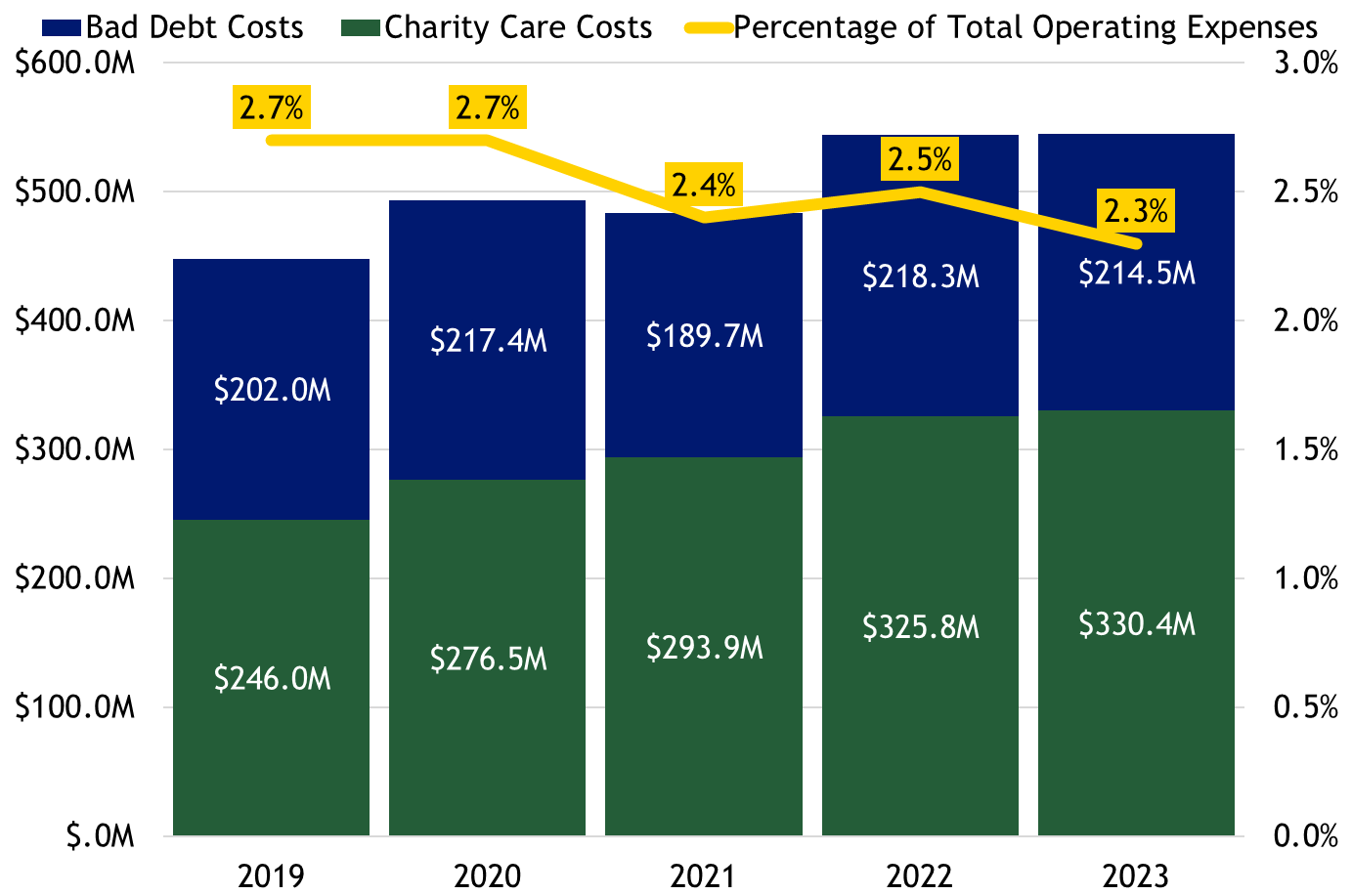
Uncompensated Care
2023 Uncompensated Care Costs
Charity Care: inability to pay is expected
Bad Debt: payment is expected but not received
Together: Uncompensated Care:
  $554.9 million in 2023
Adjusted for inflation similar from 2019 to 2023
Increased in costs, but percentage of expenses is declining
PHE is during this time
Expect increases in 2024, reflecting impact of PHE Unwind and additional migrant impact
Figure is not adjusted for inflation
Notes:
Nancy - 8:12
Thank you Bettina.
Hospitals receive little or no payment for services to some patients resulting in uncompensated care.
All three of these reports discuss uncompensated care.
As we discussed earlier, a goal of CHASE is to cover more individuals through Medicaid Expansion, which reduces uncompensated care and the shifting of those costs to commercial payers
Charity care is also covered in the Community Benefit report.
But let’s start by explaining these terms quickly,
Charity care is when the hospital agrees to provide free or low cost services to patients who are uninsured or underinsured with limited resources. Here, the hospitals did not expect payment.
Bad debt is when a payment is expected but never received by the hospital, like when an insured patient does not pay their copayment/deductible due
Uncompensated care costs measure the costs of the Charity care provided and Bad debt incurred by providers
In 2023, there was $554.9 million in uncompensated care costs covered by hospitals.
On the graphic to the right, you can see this is very similar to the previous year, in 2022.
The bar chart indicates an increase in uncompensated care costs over time, but population growth and inflation account for most of this growth.
Overall, when adjusted for inflation uncompensated care costs increased 2.1% or $11.4 million between 2019 and 2023, less than 1% a year
In fact, uncompensated care costs as a portion of operating expenses, demonstrated by the yellow line on this graph, has fallen for four years straight.
The percent of total operating expenses is now 2.3% in 2023
The chart largely covers the Public Health Emergency period, when our uninsured rate dropped significantly as Medicaid didn’t disenroll individuals even if they no longer qualified.
However, the 2023 period largely isn’t capturing the PHE Unwind. Some of the migrant influx is covered, as it started around Dec 2022.
That means our reports next year, which will reflect 2024 hospital reporting is expected to show different results.
Dr. Rothgery, could you please give us some insights into help us understand what we might see in 2024?
Next slide please.

Slide 49
Cuidados no compensados
Costos de cuidados no compensados 2023
Cuidados caritativos: se espera la incapacidad de pago
Deuda fallida: se espera el pago pero no se ha recibido.
Juntos: Cuidados no compensados:
  $554.9 millones en 2023
Ajustado a la inflación similar de 2019 a 2023.
Aumento de los costos, pero el porcentaje de gastos está disminuyendo.
El PHE es durante este tiempo.
Se esperan aumentos en 2024, que reflejarán el impacto de la desvinculación de PHE y el impacto adicional de los migrantes.
La cifra no se ajusta a la inflación
Notes:
Nancy - 8:12
Thank you Bettina.
Hospitals receive little or no payment for services to some patients resulting in uncompensated care.
All three of these reports discuss uncompensated care.
As we discussed earlier, a goal of CHASE is to cover more individuals through Medicaid Expansion, which reduces uncompensated care and the shifting of those costs to commercial payers
Charity care is also covered in the Community Benefit report.
But let’s start by explaining these terms quickly,
Charity care is when the hospital agrees to provide free or low cost services to patients who are uninsured or underinsured with limited resources. Here, the hospitals did not expect payment.
Bad debt is when a payment is expected but never received by the hospital, like when an insured patient does not pay their copayment/deductible due
Uncompensated care costs measure the costs of the Charity care provided and Bad debt incurred by providers
In 2023, there was $554.9 million in uncompensated care costs covered by hospitals.
On the graphic to the right, you can see this is very similar to the previous year, in 2022.
The bar chart indicates an increase in uncompensated care costs over time, but population growth and inflation account for most of this growth.
Overall, when adjusted for inflation uncompensated care costs increased 2.1% or $11.4 million between 2019 and 2023, less than 1% a year
In fact, uncompensated care costs as a portion of operating expenses, demonstrated by the yellow line on this graph, has fallen for four years straight.
The percent of total operating expenses is now 2.3% in 2023
The chart largely covers the Public Health Emergency period, when our uninsured rate dropped significantly as Medicaid didn’t disenroll individuals even if they no longer qualified.
However, the 2023 period largely isn’t capturing the PHE Unwind. Some of the migrant influx is covered, as it started around Dec 2022.
That means our reports next year, which will reflect 2024 hospital reporting is expected to show different results.
Dr. Rothgery, could you please give us some insights into help us understand what we might see in 2024?
Next slide please.

Slide 50
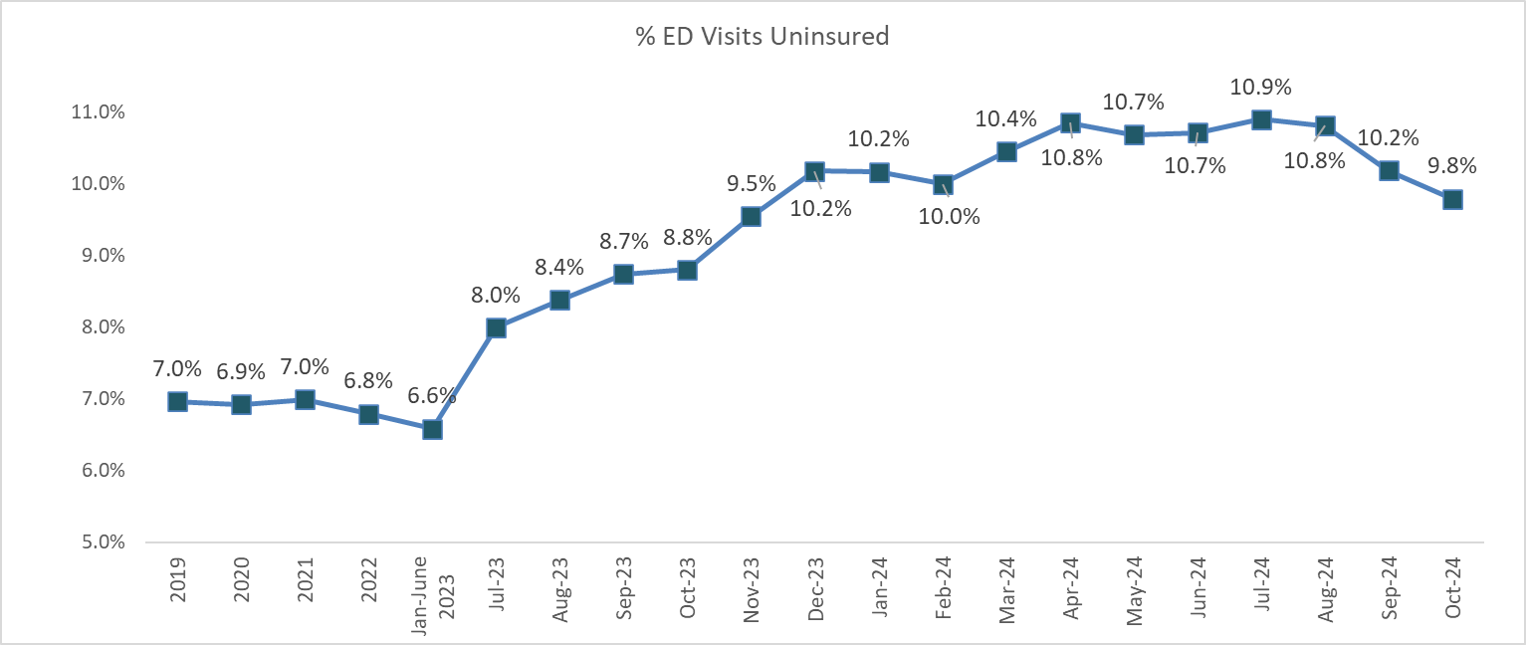
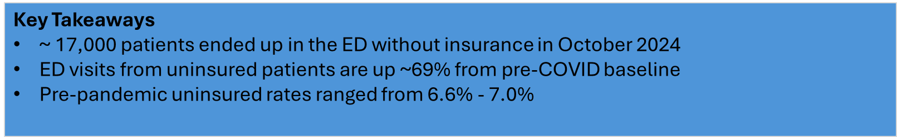
ER Visits- Rising % Uninsured
December 2022 was the beginning of the immigration surge in Denver.
Notes:
Lisa
Thank you Nancy.
Hello everyone. I’m Dr. Lisa Rothgery, the Chief Medical Officer for HCPF. I might be a new face for many of you as I recently joined HCPF in July, so I will quickly provide you with a bit of my background. I am a family physician who has been practicing in Denver since I moved here for my residency 20 years ago. Prior to taking this role, I was the CMO for HCAs value based entity- HealthONE CCP as well as the CMO for a large Colorado IPA- Practice Health. I am an acting board member for the CAFP as well as an independent practice owner and provider.
As I direct your attention to this slide, I do want to thank the CO Hospital Association for providing this slide as well as for their partnership through the PHE and the Medicare PHE Unwind.
This graph shows the percentage of ED visits that are provided for the uninsured.
This slide highlights the impact of both the migrant surge, which began around Dec 2022, as well as the Medicare PHE Unwind, on uninsured hospital ER visit rates.
Recall that the Medicaid PHE Unwind went from May 2023 - April 2024. Then, and still now, we continue to work on getting disenrolled Coloradans connected to coverage, especially as we approved enrollments in January of 2025.
You can see the uninsured ER visit rate growth that starts around 6.9% pre-PHE Unwind and increases to about 10%.
This would have a direct and negative impact on hospital earnings.
The good news is the rate is dropping most recently.
Thank you to all of you who have partnered with HCPF towards two big January 2025 goals intended to continue to lower the uninsured rate and the related hospital ER uninsured visits.
First of those, January’s open enrollment is a big month for the Marketplace Exchange, Medicare, and Employers. We have worked hard with Connect for Health and commercial carriers to connect disenrolling Coloradans to coverage and are hopeful to see strong results from these efforts.
Second, we also implemented Cover All Coloradans effective Jan 1. This provides Medicaid and CHP+ “look alike safety net coverage programs” for undocumented Coloradans who would have been eligible for those coverages had it not been for their undocumented status.
More than 12,000 individuals have enrolled.
While all hospitals are feeling some of this reality, the uninsured and uncompensated care impact is not felt equally across all hospitals.
Next slide please
OPTIONAL LANGUAGE
We’d like to take an opportunity to recognize that while we are reviewing and learning from HCPF’s hospital transparency 2023 reports, 2024 may look different.
Medicaid’s PHE Unwind period went from May 2023 through April 2024.
The hospital reports cover only a small portion of this period as some hospital’s fiscal year spans half of 2023 and the rising uninsured rate continued through 2024.

Slide 51
Visitas a Emergencias % en aumento no asegurados
Diciembre de 2022 fue el comienzo del aumento de la inmigración en Denver.
Notes:
Lisa
Thank you Nancy.
Hello everyone. I’m Dr. Lisa Rothgery, the Chief Medical Officer for HCPF. I might be a new face for many of you as I recently joined HCPF in July, so I will quickly provide you with a bit of my background. I am a family physician who has been practicing in Denver since I moved here for my residency 20 years ago. Prior to taking this role, I was the CMO for HCAs value based entity- HealthONE CCP as well as the CMO for a large Colorado IPA- Practice Health. I am an acting board member for the CAFP as well as an independent practice owner and provider.
As I direct your attention to this slide, I do want to thank the CO Hospital Association for providing this slide as well as for their partnership through the PHE and the Medicare PHE Unwind.
This graph shows the percentage of ED visits that are provided for the uninsured.
This slide highlights the impact of both the migrant surge, which began around Dec 2022, as well as the Medicare PHE Unwind, on uninsured hospital ER visit rates.
Recall that the Medicaid PHE Unwind went from May 2023 - April 2024. Then, and still now, we continue to work on getting disenrolled Coloradans connected to coverage, especially as we approved enrollments in January of 2025.
You can see the uninsured ER visit rate growth that starts around 6.9% pre-PHE Unwind and increases to about 10%.
This would have a direct and negative impact on hospital earnings.
The good news is the rate is dropping most recently.
Thank you to all of you who have partnered with HCPF towards two big January 2025 goals intended to continue to lower the uninsured rate and the related hospital ER uninsured visits.
First of those, January’s open enrollment is a big month for the Marketplace Exchange, Medicare, and Employers. We have worked hard with Connect for Health and commercial carriers to connect disenrolling Coloradans to coverage and are hopeful to see strong results from these efforts.
Second, we also implemented Cover All Coloradans effective Jan 1. This provides Medicaid and CHP+ “look alike safety net coverage programs” for undocumented Coloradans who would have been eligible for those coverages had it not been for their undocumented status.
More than 12,000 individuals have enrolled.
While all hospitals are feeling some of this reality, the uninsured and uncompensated care impact is not felt equally across all hospitals.
Next slide please
OPTIONAL LANGUAGE
We’d like to take an opportunity to recognize that while we are reviewing and learning from HCPF’s hospital transparency 2023 reports, 2024 may look different.
Medicaid’s PHE Unwind period went from May 2023 through April 2024.
The hospital reports cover only a small portion of this period as some hospital’s fiscal year spans half of 2023 and the rising uninsured rate continued through 2024.

Slide 52
Denver Health carrying high level of Uncompensated Care
2023 Uncompensated Care Costs by System
System | Bad Debt Costs (millions) | Charity Care Costs (millions) | Total Uncompensated Care Costs (millions)
Banner Health | $5.6 | $13.3 | $18.9
Commonspirit | $2.1 | $46.4 | $48.5
AdventHealth | -$3.1 | $19.1 | $16.0
Childrens | $2.7 | $8.4 | $11.1
HealthONE | $14.3 | $26.4 | $40.7
Intermountain | $17.2 | $37.5 | $54.7
San Luis Valley | $3.9 | $0.0 | $3.9
UCHealth | $68.2 | $61.3 | $129.5
Total Independent | $103.6 | $118.0 | $221.6
Denver Health | $47.4 | $93.8 | $141.5
All Other Independent | $55.9 | $24.3 | $80.1
Grand Total | $214.5 | $330.4 | $544.9
Denver Health Portion of Uncompensated Care Costs
26% of statewide
45% of Denver DOI region
80% of Denver county
Before PHE Unwind and Migrant surge impact is fully presenting
Why are uninsured or underinsured patients traveling to DH, vs using their local hospital?
How might other hospitals step up to help DH, given their lower Uncompensated Care costs?
  Community Benefit? CHASE?
Effects of PHE Unwind/Migrant influx won’t be fully realized until next year’s data & reporting
Notes:
Lisa
Denver Health is one of the hospitals picking up a greater burden of uncompensated care costs.
In fact, Denver Health provides more uncompensated care than any other hospital in Colorado, even when compared to some systems of 6 or more hospitals.
Denver Health is bearing 26% of the uncompensated care costs in the state, 45% in the Denver DOI region, and 80% in Denver county
The effects of the PHE Unwind and migrant influx you saw on the last slide aren’t fully represented on this slide and won’t be fully realized in the data until next year’s data and reporting.
Regardless, there is major risk to DH, the state’s main safety net, as carrying this level of outlier uncompensated care is unsustainable.
Some questions we might want to ask ourselves, given these statistics:
Why are uninsured or underinsured patients traveling to DH, versus using their local hospital?
What can we all do - and what might all hospitals be able to do - to support these patients within their local community instead?
What can we as a state do to support our main safety net hospital with our current levers? Particularly if people are leaving their communities to visit DH for some reason.
To that end, we did a poll earlier to get your input on using CHASE dollars to help the safety net.
Also, charity care partnerships within a hospital’s community benefit are another lever.
Nancy, could you walk us through community benefit?

Slide 53
Denver Health lleva un alto nivel de cuidados no compensados
Costos de Cuidados No-compensados 2023 por el sistema
Sistema | Costos deuda fallida (millones) | Costos de Cuidados de Caridad (millones) | Costos totales de cuidados no compensados (millones)
Banner Health | $5.6 | $13.3 | $18.9
Commonspirit | $2.1 | $46.4 | $48.5
AdventHealth | -$3.1 | $19.1 | $16.0
Childrens | $2.7 | $8.4 | $11.1
HealthONE | $14.3 | $26.4 | $40.7
Intermountain | $17.2 | $37.5 | $54.7
San Luis Valley | $3.9 | $0.0 | $3.9
UCHealth | $68.2 | $61.3 | $129.5
Total Independent | $103.6 | $118.0 | $221.6
Denver Health | $47.4 | $93.8 | $141.5
All Other Independent | $55.9 | $24.3 | $80.1
Grand Total | $214.5 | $330.4 | $544.9
Porción de los costos de los cuidados no compensados de Denver Health:
26% en todo el estado
45% de la región DOI de Denver
80% del Condado de Denver
Antes de PHE El despliegue el impacto del aumento de migrantes se presente por complete
¿Por qué los pacientes sin seguro o con seguro insuficiente acuden al DH en lugar de utilizar su hospital local?
Cómo podrían otros hospitales dar un paso adelante para ayudar a DH, dados sus menores costos de cuidados no compensados?
  Beneficio para la comunidad? CHASE?
Efectos del PHE La afluencia de inmigrantes no se conocerá en su totalidad hasta los datos y el informe del próximo año.
Notes:
Lisa
Denver Health is one of the hospitals picking up a greater burden of uncompensated care costs.
In fact, Denver Health provides more uncompensated care than any other hospital in Colorado, even when compared to some systems of 6 or more hospitals.
Denver Health is bearing 26% of the uncompensated care costs in the state, 45% in the Denver DOI region, and 80% in Denver county
The effects of the PHE Unwind and migrant influx you saw on the last slide aren’t fully represented on this slide and won’t be fully realized in the data until next year’s data and reporting.
Regardless, there is major risk to DH, the state’s main safety net, as carrying this level of outlier uncompensated care is unsustainable.
Some questions we might want to ask ourselves, given these statistics:
Why are uninsured or underinsured patients traveling to DH, versus using their local hospital?
What can we all do - and what might all hospitals be able to do - to support these patients within their local community instead?
What can we as a state do to support our main safety net hospital with our current levers? Particularly if people are leaving their communities to visit DH for some reason.
To that end, we did a poll earlier to get your input on using CHASE dollars to help the safety net.
Also, charity care partnerships within a hospital’s community benefit are another lever.
Nancy, could you walk us through community benefit?

Slide 54
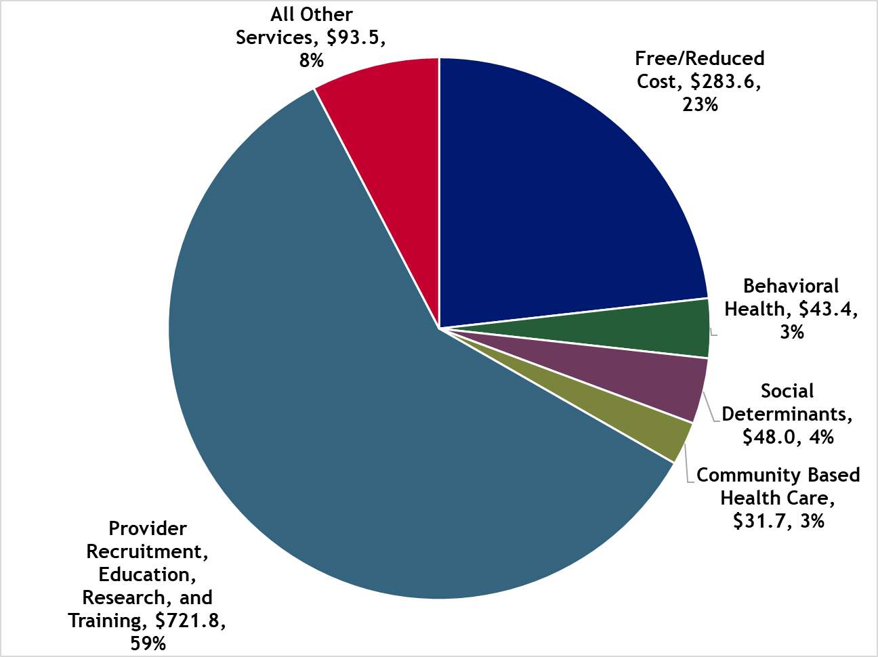
Community Benefit
2022 Community Benefit Major Investment Areas
Community Benefit: $1.22 billion
7.2% of patient revenues
15% w/Medicaid shortfall
59% is provider training, recruitment, education, research
All systems spending more than est. tax liability, incl. Community Benefit and Medicaid shortfall value
Most spending more with just Community Benefit
Behavioral health still a highly prioritized need. 15 did not invest despite prioritization
Community benefit are actions hospitals take to qualify for tax-exempt status and also refer to the dollar amount/ expense spent on these actions. Tax exemption estimates for 2022 are low compared to other years due to investment market losses in 2022.
Notes:
Nancy
Thank you, Dr. Rothgery
Hospitals spend a lot for community benefit activities: $1.2 billion dollars in 2022
Community benefit are actions hospitals take to qualify for tax-exempt status. They also refer to the dollar amount/ expense spent on these actions
Hospitals report community benefit investments within different categories (seen within this pie chart) and we provide them within the reports
The $1.2 billion in community benefit is 7% of patient revenues and 15% of patient revenues when Medicaid shortfall is included
Currently, there is a large focus on Provider Recruitment, Research, Education and Training. The majority: 59%.
Some hospitals and health systems are spending a lot of money on recruitment, which is a difficult investment to understand its impact, particularly to the local community.
HCPF will work with hospitals to increase transparency on effects of this huge ($722 billion) spending, and how it is increasing providers in CO.
Keep in mind that hospitals invest in their communities in lieu of paying taxes, basically serving as the community’s health care’s budget committee
so The reports also compare community benefit activities to an estimated tax liability.
Due to low profits in 2023, Community benefit spending vastly outpaced potential tax amounts
These reports also review if the spending aligns with community health needs assessments or CHNAs.
One powerful finding from the reports this year is that 15 hospitals did not invest in a prioritized community need (behavioral health).
This mismatch portrays misalignment between the hospitals’ stated prioritized needs and their investment activities, reflecting an opportunity going forward
next slide please

Slide 55
Beneficio comunitario
Beneficios a la comunidad en areas principales de inversión 2022
Beneficio comunitario: $1.22 billones
7.2% de ingresos de pacientes
15% con déficit de Medicaid
59% es formación, contratación, educación e investigación de proveedores
Todos los sistemas que gastan más de la obligación tributaria estimada, incluido el valor del déficit de Medicaid y de beneficios comunitarios.
La mayoría del gasto más con solo beneficio comunitario.
La salud del comportamiento sigue siendo una necesidad altamente prioritaria. 15 no invirtieron a pesar de la priorización.
Los beneficios comunitarios son acciones que los hospitales llevan a cabo para poder optar a la exención de impuestos y también se refieren a la cantidad de dólares/gastos invertidos en estas acciones. Las estimaciones de exención de impuestos para 2022 son bajas en comparación con otros años debido a las pérdidas del mercado de inversión en 2022.
Notes:
Nancy
Thank you, Dr. Rothgery
Hospitals spend a lot for community benefit activities: $1.2 billion dollars in 2022
Community benefit are actions hospitals take to qualify for tax-exempt status. They also refer to the dollar amount/ expense spent on these actions
Hospitals report community benefit investments within different categories (seen within this pie chart) and we provide them within the reports
The $1.2 billion in community benefit is 7% of patient revenues and 15% of patient revenues when Medicaid shortfall is included
Currently, there is a large focus on Provider Recruitment, Research, Education and Training. The majority: 59%.
Some hospitals and health systems are spending a lot of money on recruitment, which is a difficult investment to understand its impact, particularly to the local community.
HCPF will work with hospitals to increase transparency on effects of this huge ($722 billion) spending, and how it is increasing providers in CO.
Keep in mind that hospitals invest in their communities in lieu of paying taxes, basically serving as the community’s health care’s budget committee
so The reports also compare community benefit activities to an estimated tax liability.
Due to low profits in 2023, Community benefit spending vastly outpaced potential tax amounts
These reports also review if the spending aligns with community health needs assessments or CHNAs.
One powerful finding from the reports this year is that 15 hospitals did not invest in a prioritized community need (behavioral health).
This mismatch portrays misalignment between the hospitals’ stated prioritized needs and their investment activities, reflecting an opportunity going forward
next slide please

Slide 56
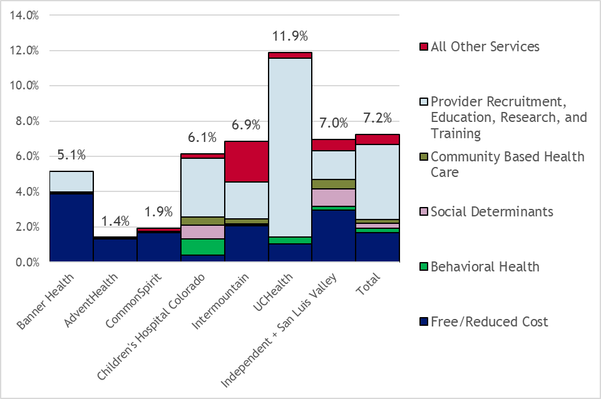
2022 Community Benefit Investment
% of Net Patient Revenue
Hospital Community Benefit new legislation improved optics into where money is going, by system
Hospital Prioritized Needs in their Community Health Needs Assessments: Behavioral Health (84.8%), access to care (58.7%), chronic conditions (39.1%)
HB23-1243 updated public meeting requirements
Rules eff. July 2024. Impact not reflected in latest report
Notes:
Nancy - 8:20
Based on recent legislation (HB23-1243) HCPF now has more information related to hospitals community benefit spending as well as where the money is being directed in terms of Community Benefit.
However, based on the timing of some these requirements which went into effect on July 30,2024, we do not yet have all of the information (like public meetings) included in this years Community Benefit Report but will have more information in our reports moving forward.
(Based on the timing of these rules, hospitals held their meetings or would right before we need their Community Benefit information and since there were changes to the timeline for community feedback we elected to not hold hospitals out of compliance as long as they followed the 1320 rules for public meetings.) More info if wanted
This chart shows hospitals investment percentages of net patient revenue by system into different community benefit categories for 2022.
As you can see, the largest category for most is that provider recruitment, education research and training category.
Given the large investment scale it should match what hospitals have outlined as the top priorities based on their community meetings and identified in their required Community Health Needs Assessments (CHNA).
Specifically, the 3 most top community benefit identified needs were Behavioral Health, access to care and chronic conditions - with access to care partially addressed through provider recruitment and training.
That said, Behavioral health was prioritized by 85% of the community,
but only 3% of community benefit investments were in this category, and that reflects a major opportunity going forward to better align hospital community investment spending with the voice of the community.
Another opportunity for us to pursue in partnership with the hospitals is a better understanding as to how the provider recruitment education, research, and training category aligns with the specific types of care access needs of the community.
Is recruitment and training resulting for primary care, nursing, behavioral health care providers or other areas of known shortages?
Finding those answers and driving alignment between provider recruitment and training with provider shortages and access needs represents an opportunity going forward.
With that, I will turn it over to Dr. Lisa Rothgery to address mergers and acquisitions.
Next slide please

Slide 57
Inversión en beneficio de la comunidad
% de ingresos netos de pacientes en 2022
Los beneficios comunitarios hospitalarios: la nueva legislación mejora la transparencia en el destino del dinero, por el sistema.
Necesidades prioritarias del hospital en sus evaluaciones de las necesidades de salud de la comunidad: salud del comportamiento (84.8 %), acceso a los cuidados (58.7 %), enfermedades crónicas (39.1 %).
HB23-1243: requisitos actualizados para reuniones públicas.
Normas en vigor desde Julio de 2024. Impacto no reflejado en el último informe.
Notes:
Nancy - 8:20
Based on recent legislation (HB23-1243) HCPF now has more information related to hospitals community benefit spending as well as where the money is being directed in terms of Community Benefit.
However, based on the timing of some these requirements which went into effect on July 30,2024, we do not yet have all of the information (like public meetings) included in this years Community Benefit Report but will have more information in our reports moving forward.
(Based on the timing of these rules, hospitals held their meetings or would right before we need their Community Benefit information and since there were changes to the timeline for community feedback we elected to not hold hospitals out of compliance as long as they followed the 1320 rules for public meetings.) More info if wanted
This chart shows hospitals investment percentages of net patient revenue by system into different community benefit categories for 2022.
As you can see, the largest category for most is that provider recruitment, education research and training category.
Given the large investment scale it should match what hospitals have outlined as the top priorities based on their community meetings and identified in their required Community Health Needs Assessments (CHNA).
Specifically, the 3 most top community benefit identified needs were Behavioral Health, access to care and chronic conditions - with access to care partially addressed through provider recruitment and training.
That said, Behavioral health was prioritized by 85% of the community,
but only 3% of community benefit investments were in this category, and that reflects a major opportunity going forward to better align hospital community investment spending with the voice of the community.
Another opportunity for us to pursue in partnership with the hospitals is a better understanding as to how the provider recruitment education, research, and training category aligns with the specific types of care access needs of the community.
Is recruitment and training resulting for primary care, nursing, behavioral health care providers or other areas of known shortages?
Finding those answers and driving alignment between provider recruitment and training with provider shortages and access needs represents an opportunity going forward.
With that, I will turn it over to Dr. Lisa Rothgery to address mergers and acquisitions.
Next slide please

Slide 58

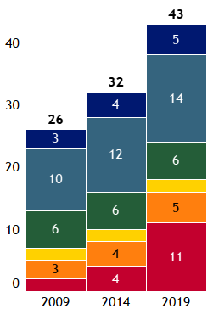

Increasing acquisition and merger activities across Colorado
Colorado Hospital Growth and Consolidation Over Time
Growing systems (From 2009 to 2024):
UCH went from 2 to 12 hospitals
Banner and SCL Health / Intermountain Heath went from 3 to 5 hospitals
Centura went from 10 to 16, then split
HealthOne and San Luis Valley stayed consistent
Opp for economies of scale, cost efficiency, innovations, access. Concurrent threat to price increases due to hospital market power
Opportunity for analysis of merger impact
37 independent hospitals: 32 rural hospitals, Denver Health, Boulder Community, and National Jewish along the Front Range. Community Hospital and Family Health West in Grand Junction
Notes:
Lisa
Thank you Nancy,
Similar to Community Benefit, evolving hospital transparency legislation required disclosures to provide insights into acquisitions and mergers.
Consolidations should result in economies of scale and cost efficiencies. They can also preserve community access by preventing hospital closures.
That said, mergers can also drive hospital market dominance and negotiating power, resulting in less competition, higher prices, and less consumer choice.
The graph on the right shows the growth in the number of SYSTEM affiliated hospitals from 2009 through 2024, illustrating that 48 of 85 CO hospitals are now part of a SYSTEM, including 36 of 39 on the front range.
This includes mergers, acquisitions, as well as new construction.
The largest consolidation was seen with UCHealth, growing from 2 to 12 hospitals
Banner and SCL grew from 3 to 5 hospitals, with SCL now being part of InterMountain Health
On the other hand, Centura separated formally into Common Spirit and Adventist Health
As we continue hospital financial transparency analysis, there is more opportunity to evaluate the impact of this hospital merger and acquisition activity
Next slide

Slide 59
Aumento de las actividades de adquisición y fusión en todo Colorado
Crecimiento y consolidación del Hospital Colorado a lo largo del tiempo
Sistemas en Crecimiento (De 2009 a 2024):
UCH pasaron de 2 a 12 hospitales
Banner and SCL Health / Intermountain Heath pasaron de 3 a 5 hospitales.
Centura pasó de 10 a 16, luego dividió.
HealthOne y San Luis Valley permanecieron consistentes
Oportunidad para economías de escala, eficiencia de costos, innovaciones, acceso. Amenaza simultánea de aumentos de precios debido al poder de mercado de los hospitales.
Oportunidad para el análisis del impacto de la fusión.
37 hospitales independientes: 32 hospitales rurales, Denver Health, Boulder Community y National Jewish a lo largo de la cordillera Front Range. Community Hospital y Family Health West en Grand Junction
Notes:
Lisa
Thank you Nancy,
Similar to Community Benefit, evolving hospital transparency legislation required disclosures to provide insights into acquisitions and mergers.
Consolidations should result in economies of scale and cost efficiencies. They can also preserve community access by preventing hospital closures.
That said, mergers can also drive hospital market dominance and negotiating power, resulting in less competition, higher prices, and less consumer choice.
The graph on the right shows the growth in the number of SYSTEM affiliated hospitals from 2009 through 2024, illustrating that 48 of 85 CO hospitals are now part of a SYSTEM, including 36 of 39 on the front range.
This includes mergers, acquisitions, as well as new construction.
The largest consolidation was seen with UCHealth, growing from 2 to 12 hospitals
Banner and SCL grew from 3 to 5 hospitals, with SCL now being part of InterMountain Health
On the other hand, Centura separated formally into Common Spirit and Adventist Health
As we continue hospital financial transparency analysis, there is more opportunity to evaluate the impact of this hospital merger and acquisition activity
Next slide

Slide 60
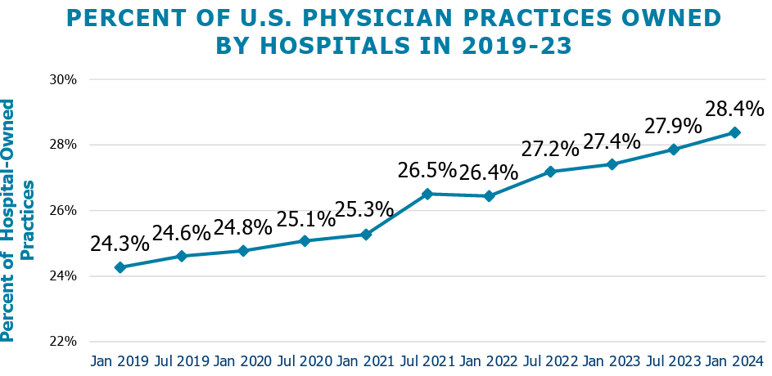
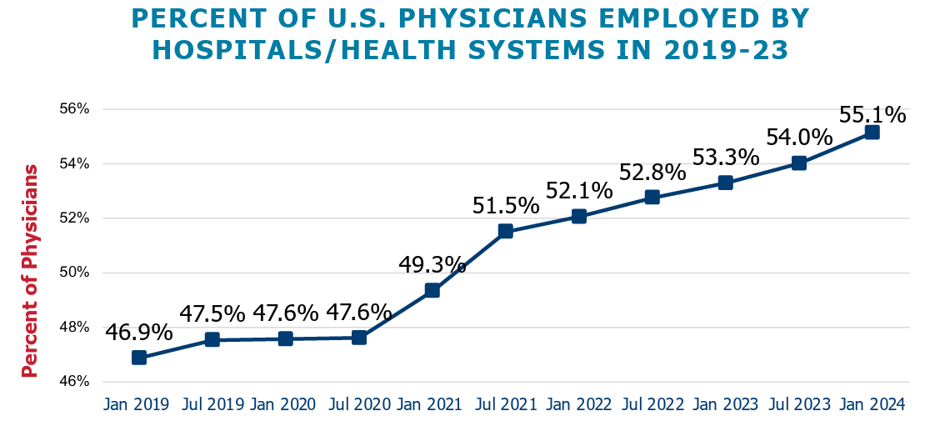
Latest legislation on hospital transparency required sharing of physician acquisitions by hospitals. Colorado insights:
75 physician practices acquired between 2014-2023
35.6% by UCHealth
31.5% by independent hospitals
17.8% by CommonSpirit Health
Physician integration is a national trend with 55.1% physicians employed by hospitals or health systems, as illustrated in the graphic
Opportunity for physician integration impact analysis
Various perspectives on cost-benefit of hospital-owned physician practices, included in Hospital Facility Fee Report
Avalere Health. (April 2024). Physicians Advocacy Institute. Updated Report: Hospital and Corporate Acquisition of Physician Practices and Physician Employment 2019-2023. Avalere analysis of IQVIA OneKey database that contains physician and practice location information on hospital/health system ownership
Hospital Facility Fee Steering Committee. (October 2024). Hospital Facility Fee Report
Notes:
Lisa
The acquisitions within healthcare are not just hospital to hospital, but also include hospital acquisitions of physician groups.
This is sometimes called Vertical Integration.
Between 2014 and 2023, 75 physician practices were acquired by hospitals:
35.6% by UCHealth
31.5% by independent hospitals and
17.8% by CommonSpirit Health
Nationally, vertical integration is a continual trend, as shown in this graph, with more than 50% of physicians employed by hospitals or health systems by the end of 2023.
It is important for us to be able to quantify and qualify the impact of these acquisitions on affordability, access, and quality.
That is a clear opportunity for us going forward.
In the interim, some impacts of vertical integration are highlighted in the facility fee report produced by the Facility Fee Steering Committee last year.
We have provided a link to that report on this slide.
Bettina, I’ll pass to you to discuss administrative compensation.

Slide 61
La legislación más reciente sobre transparencia hospitalaria exigía que los hospitales compartieran las adquisiciones de médicos. Perspectivas de Colorado :
75 consultorios médicos adquiridos entre 2014 y 2023
35.6% por UCHealth
31.5% por hospitales independientes
17.8% por CommonSpirit Health
La integración de los médicos es una tendencia nacional, con un 55.1 % de los médicos empleados por hospitales o sistemas de salud, como se ilustra en el gráfico.
Oportunidad para el análisis de impacto de la integración médica.
Varias perspectivas sobre la relación costo-beneficio de los consultorios médicos propiedad de hospitales, incluidas en el Hospital Facility Fee Report
●Avalere Health. (abril de 2024). Instituto de Defensa de los Médicos. Informe actualizado: Adquisición de consultas médicas y contratación de médicos por parte de hospitales y empresas 2019-2023. Análisis de Avalere de la base de datos IQVIA OneKey que contiene información sobre médicos y ubicación de consultas sobre la propiedad de hospitales/sistemas de salud.
●Comité Directivo de Tarifas de Centros Hospitalarios. (octubre de 2024). Informe de tarifas de centros hospitalarios
Notes:
Lisa
The acquisitions within healthcare are not just hospital to hospital, but also include hospital acquisitions of physician groups.
This is sometimes called Vertical Integration.
Between 2014 and 2023, 75 physician practices were acquired by hospitals:
35.6% by UCHealth
31.5% by independent hospitals and
17.8% by CommonSpirit Health
Nationally, vertical integration is a continual trend, as shown in this graph, with more than 50% of physicians employed by hospitals or health systems by the end of 2023.
It is important for us to be able to quantify and qualify the impact of these acquisitions on affordability, access, and quality.
That is a clear opportunity for us going forward.
In the interim, some impacts of vertical integration are highlighted in the facility fee report produced by the Facility Fee Steering Committee last year.
We have provided a link to that report on this slide.
Bettina, I’ll pass to you to discuss administrative compensation.

Slide 62
Top Administrative Compensation
Latest legislation required sharing of salary and total compensation for top five highest paid admin positions of each nonprofit hospital
In 2023, $106.8 million paid to top five positions, 1.4% of payroll
Average compensation to top 5 positions
  Large hospitals: $602,000
  Medium hospitals: $559,000
  Small hospitals: $310,000
2023 learnings from what CEOs were incentivized to drive:
  89.3% - quality of care outcomes
  81.3% - profits/margin
  88% - patient satisfaction
  69% - address workforce needs
  41% - affordability
Reported compensation information is under-represented because it does not include data for hospital systems or regional leadership. The compensation information for the top 5 positions is for the hospitals themselves, not their system leadership
Notes:
Bettina
Thanks, Lisa.
Recent Hospital Transparency Legislation also required disclosure of Hospital leadership compensation. This is the first year of this reporting so there is no directional information yet. The data is also limited because it is does not include data for hospital systems or regional leadership.
Hospitals reported that the top 5 administrative positions were paid $106.8 million or 1.4% of payroll for the top 5 administrative positions.
The average compensation for these positions depended on the size of the hospital, ranging from an average of $310,000 for small hospitals to $609,000 for the large hospitals
More importantly, data was collected on what CEOs were incentivized to drive.
For example, 89% are incentivized to drive their hospital’s quality of care outcomes,
81.3% - profits/margin
88% - patient satisfaction
69% - address workforce needs
41% - affordability
These performance metrics are determined by hospital board members who should be influenced by their communities in crafting CEO performance incentives.
Clearly, some of our rural hospital CEOs need to be focused on financial stability metrics while other larger hospital boards may wish to more thoroughly compare the needs of the community with the CEO’s incentive plan and pursue plan adjustments that address gaps.
I will now turn it back over to Kim to start the Q&A portion of our Webinar.
ADDITIONAL NOTES:
Quality of care outcomes- 89.3%
Profit or margin- 81.3%
Consumer and employer affordability- 41.3%
Patient satisfaction- 88.0%
Community benefit- 45.3%
Market share- 26.7%
Revenue growth- 48.0%
Changes in DCOH or cash reserves- 28.0%
Work force- 69.3%
HB23-1226 Hospital Transparency Reporting, which set up hospitals reporting performance metrics to HCPF calls out quality of care outcomes, patient satisfaction, community benefit, consumer and employer affordability, market share, profit or margin, revenue growth, changes in dash cash on hand, and work force. Hospitals have the option to add additional performance metrics not included in this list.
12 hospitals or 16.0%, all UCHealth hospitals, added “improving access for our communities” as an additional performance metric.

Slide 63
Compensación superior administrativa
La legislación más reciente exigía compartir el salario y la compensación total de los cinco puestos administrativos mejor pagados de cada hospital sin fines de lucro.
En 2023, Se pagaron $106.8 milliona las 5 posiciones más altas, 1.4% de nómina.
Compensación media para los 5 puestos más altos.
  Hospitales grandes: $602,000
  Hospitales medianos: $559,000
  Hospitales pequeños: $310,000
Aprendizajes de lo que se incentivó a los directores generales a impulsar en 2023:
  89.3% - Calidad de los resultados de los cuidados
  81.3% - Ganancias/margen
  88% - Satisfacción del paciente
  69% - Atender las necesidades del personal
  41% - Asequibilidad
La información sobre compensación reportada está subrepresentada porque no incluye datos de sistemas hospitalarios o liderazgo regional. La información sobre compensación para los 5 puestos más altos es para los hospitales mismos, no para el liderazgo de su sistema
Notes:
Bettina
Thanks, Lisa.
Recent Hospital Transparency Legislation also required disclosure of Hospital leadership compensation. This is the first year of this reporting so there is no directional information yet. The data is also limited because it is does not include data for hospital systems or regional leadership.
Hospitals reported that the top 5 administrative positions were paid $106.8 million or 1.4% of payroll for the top 5 administrative positions.
The average compensation for these positions depended on the size of the hospital, ranging from an average of $310,000 for small hospitals to $609,000 for the large hospitals
More importantly, data was collected on what CEOs were incentivized to drive.
For example, 89% are incentivized to drive their hospital’s quality of care outcomes,
81.3% - profits/margin
88% - patient satisfaction
69% - address workforce needs
41% - affordability
These performance metrics are determined by hospital board members who should be influenced by their communities in crafting CEO performance incentives.
Clearly, some of our rural hospital CEOs need to be focused on financial stability metrics while other larger hospital boards may wish to more thoroughly compare the needs of the community with the CEO’s incentive plan and pursue plan adjustments that address gaps.
I will now turn it back over to Kim to start the Q&A portion of our Webinar.
ADDITIONAL NOTES:
Quality of care outcomes- 89.3%
Profit or margin- 81.3%
Consumer and employer affordability- 41.3%
Patient satisfaction- 88.0%
Community benefit- 45.3%
Market share- 26.7%
Revenue growth- 48.0%
Changes in DCOH or cash reserves- 28.0%
Work force- 69.3%
HB23-1226 Hospital Transparency Reporting, which set up hospitals reporting performance metrics to HCPF calls out quality of care outcomes, patient satisfaction, community benefit, consumer and employer affordability, market share, profit or margin, revenue growth, changes in dash cash on hand, and work force. Hospitals have the option to add additional performance metrics not included in this list.
12 hospitals or 16.0%, all UCHealth hospitals, added “improving access for our communities” as an additional performance metric.

Slide 64
Discussion, Questions
Notes:
15 min

Slide 65
Conversaciones,Preguntas
Notes:
15 min

Slide 66
Pop up poll #6 - HCPF Priorities
Select up to 5 HCPF priorities that are the most important to you.
Mitigate significant cuts to Medicaid thru state budget challenges
Protect Medicaid from federal threats
Transform Colorado’s Behavioral Health System
Drive Value Based Care
Save Coloradans Money on Health Care
Improve our State’s Eligibility System Infrastructure and Supports
Advance Medicaid through Accountable Care Collaborative Phase III
Stabilize Long Term Services and Supports EcoSystem
Advance Social Determinants of Health Supports
Reduce the Uninsured Rate
Maintain/Increase Access to Care

Slide 67
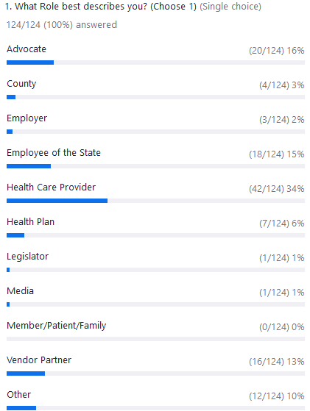
Poll #1 - Attendees: What Role best describes you?

Slide 68
Encuesta #1 - Participantes: ¿Qué Rol te describe mejor?

Slide 69
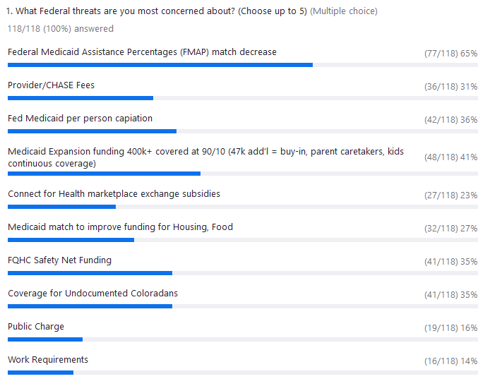
Poll #2:
What federal issues are you most concerned about?

Slide 70
Encuesta #2:
¿Qué asuntos federales le preocupan más?

Slide 71
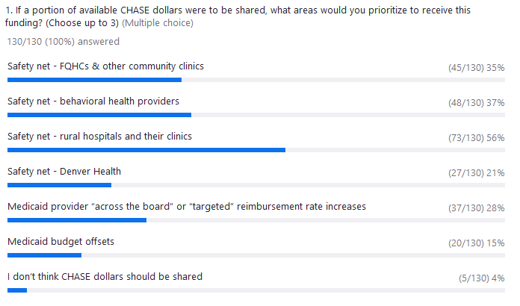
Poll 3:
If a portion of available CHASE dollars were to be shared, what areas would you prioritize to receive this funding?

Slide 72
Encuesta 3:
Si se compartiera una parte de los dólares disponibles de CHASE, ¿A cuales áreas daría prioridad para recibir esta financiación ?

Slide 73
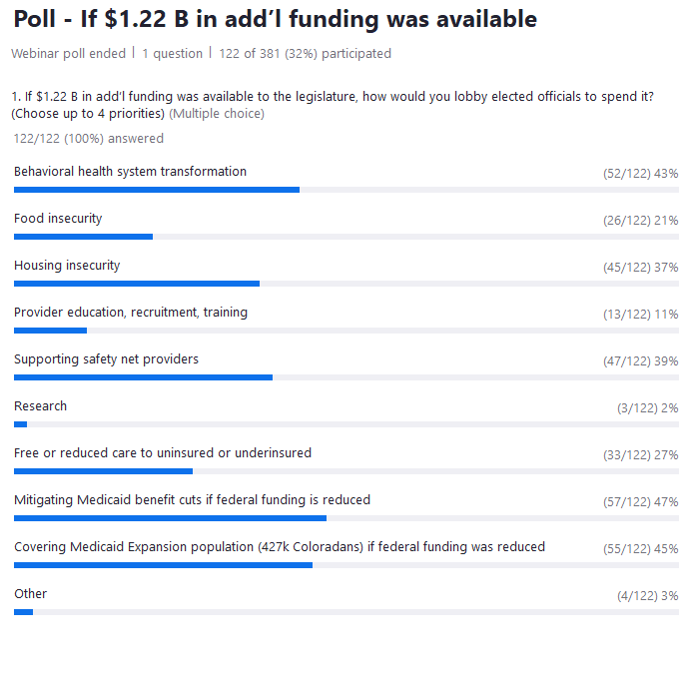
Poll 4: If $1.22 B additional funding was available to the legislature, how would you want elected officials to spend it?

Slide 74
Encuesta 4: Si la legislatura dispusiera de $1.22 B adicionales, ¿Cómo querría que los funcionarios electos los gastaran?
?

Slide 75
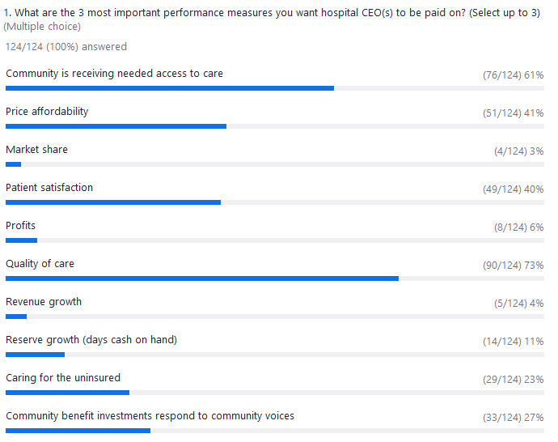
Poll 5:
What are the 3 most important performance measures you want your local hospital CEO(s) to be paid on?

Slide 76
Encuesta 5:
Cuáles son las tres medidas de rendimiento más importantes en las que quiere que se pague los directores generales de su hospital local?

Slide 77
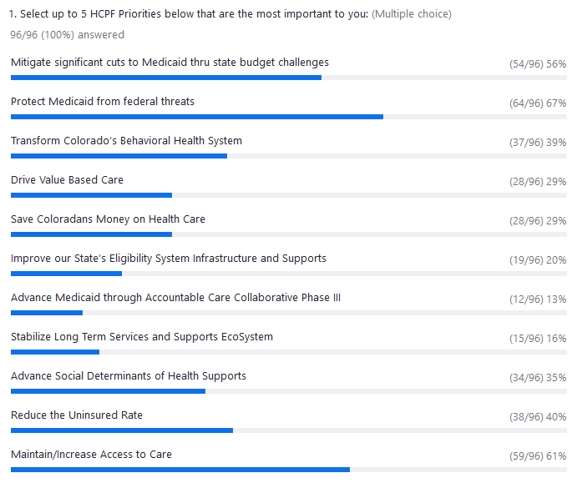
Poll 6:
HCPF priorities most important to you

Slide 78
Encuesta 6:
Las prioridades de HCPF más importantes para usted

Slide 79
Thank you!

Slide 80
Gracias!

Slide 81
Appendix

Slide 82
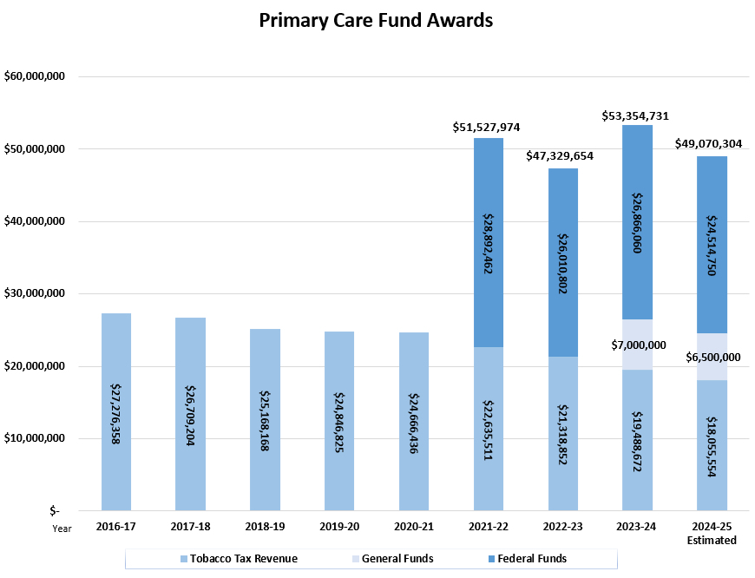
Colorado’s Safety Net Programs
FY 2023-24: 170,000 patients served
$306M paid to hospitals and clinics
Low Cost Care for Uninsured Coloradans
Hospitals | 64,173
Community Health Centers & Safety Net Clinics | 106,736
Total | 170,909
Safety Net Programs Payments
Hospitals: Disproportionate Share Hospital (DSH) | $253,049,824
Clinics: Primary Care Fund | $53,354,731
Total | $306,404,555
Notes:
At its peak (2010-11), approximately 225k Coloradans received discounted health care at participating clinics and hospitals

Slide 83
Primary Care Fund Provider | Patients Served | Tobacco Tax Revenue | General Fund | Federal Funds | Total Payment
Clinica Campesina Family Health Services | 12,696 | $2,318,132 | $832,634 | $3,200,560 | $6,351,326
Basin Clinic | 27 | $4,930 | $1,771 | $6,817 | $13,518
Carin’ Clinic | 45 | $8,216 | $2,951 | $11,342 | $22,510
Clinica Colorado | 1,721 | $314,233 | $112,867 | $433,783 | $860,884
Colorado Coalition for the Homeless* | 3,596 | $656,585 | $235,834 | $906,382 | $1,798,801
Community Dental Clinic, Inc. | 760 | $138,767 | $49,843 | $191,560 | $380,169
Denver Health and Hospital Authority | 20,803 | $3,798,370 | $1,364,310 | $5,247,416 | $10,410,097
Denver Indian Health and Family | 279 | $50,942 | $18,297 | $70,323 | $139,562
Doctors Care | 164 | $29,944 | $10,756 | $41,337 | $82,037
Family Medicine Clinic for Health Equity (CAHEP) | 762 | $139,132 | $49,974 | $192,383 | $381,488
High Plains Community Health Center* | 782 | $142,784 | $51,285 | $197,105 | $391,174
Hopelight Medical Clinic | 1,247 | $227,687 | $81,781 | $314,310 | $623,778
Inner City Health Center | 1,624 | $296,522 | $106,506 | $410,553 | $813,581
Kids First Health Center | 424 | $77,417 | $27,807 | $106,870 | $212,095
La Clinica Tepeyac, Inc. | 1,899 | $346,734 | $124,541 | $478,648 | $949,923
Marillac Clinic, Inc.* | 880 | $160,677 | $57,712 | $221,807 | $440,196
Metro Community Provider Network | 8,217 | $1,500,322 | $538,890 | $2,071,118 | $4,110,331
Mountain Family Health Centers | 2,707 | $494,265 | $177,531 | $682,307 | $1,354,103
Northwest Colorado Visiting Nurse Association | 968 | $176,745 | $63,484 | $243,987 | $484,216
Olathe Community Clinic, Inc. | 2,140 | $390,738 | $140,346 | $539,393 | $1,070,477
Open Bible Baptist Church | 171 | $31,222 | $11,215 | $0 | $42,437
Peak Vista Community Health Center | 9,435 | $1,722,714 | $618,770 | $2,378,119 | $4,719,603
Plan de Salud del Valle, Inc. | 12,867 | $2,349,355 | $843,848 | $3,243,164 | $6,436,367
Poudre Valley Health Systems, Inc. | 201 | $36,700 | $13,182 | $50,663 | $100,545
Pueblo Community Health Center | 2,035 | $371,566 | $133,460 | $512,928 | $1,017,954
Rocky Mountain Youth Medical and Nursing Consultants, Inc. | 1,154 | $210,706 | $75,682 | $290,869 | $577,257
SET of Colorado Springs | 71 | $12,964 | $4,656 | $17,900 | $35,520
Southwest Colorado Mental Health Center | 1,230 | $224,583 | $80,666 | $310,025 | $615,274
Summit Community Care Clinic, Inc. | 1,705 | $311,312 | $111,818 | $429,750 | $852,880
Sunrise Community Health | 9,489 | $1,732,574 | $622,311 | $2,391,730 | $4,746,615
Uncompahgre Combined Clinic | 204 | $37,248 | $13,379 | $51,419 | $102,045
University of Colorado College of Nursing | 1,498 | $273,516 | $98,242 | $377,610 | $749,369
Uptown | 1,966 | $358,967 | $128,935 | $495,536 | $983,438
Valley-Wide Health Systems, Inc. | 2,969 | $542,103 | $194,714 | $748,345 | $1,485,162
Totals | 106,736 | $19,488,672 | $7,000,000 | $26,866,060 | $53,354,731
FY 2023-24 Primary Care Fund Payments

Slide 84
Notes:
Introduce yourself, I have been with the Dept for xx years, background in both state and fed policy and communications...

