Slide 1

Notes:
Hello, and welcome to our provider training on the Health First Colorado doula benefit. The goal of this training is to support doulas in enrolling in Health First Colorado, the state’s Medicaid program, and to bill for services.
This training is sponsored by the Colorado Department of Health Care Policy and Financing or HCPF, sometimes referred to as "the Department“ in this presentation.

Slide 2
Beneficio de Doula de Health First Colorado: Capacitación para Proveedores
Notes:
Hello, and welcome to our provider training on the Health First Colorado doula benefit. The goal of this training is to support doulas in enrolling in Health First Colorado, the state’s Medicaid program, and to bill for services.
This training is sponsored by the Colorado Department of Health Care Policy and Financing or HCPF, sometimes referred to as "the Department“ in this presentation.

Slide 3

Notes:
Hello, and welcome to our provider training on the Health First Colorado doula benefit. The goal of this training is to support doulas in enrolling in Health First Colorado, the state’s Medicaid program, and to bill for services.
This training is sponsored by the Colorado Department of Health Care Policy and Financing or HCPF, sometimes referred to as "the Department“ in this presentation.

Slide 4
Beneficio de Doula de Health First Colorado: Capacitación para Proveedores
Notes:
Hello, and welcome to our provider training on the Health First Colorado doula benefit. The goal of this training is to support doulas in enrolling in Health First Colorado, the state’s Medicaid program, and to bill for services.
This training is sponsored by the Colorado Department of Health Care Policy and Financing or HCPF, sometimes referred to as "the Department“ in this presentation.

Slide 5
Benefits of Doula Care
“a trained professional who provides continuous physical, emotional and informational support to their client before, during and shortly after childbirth to help them achieve the healthiest, most satisfying experience possible.”
– DONA International
Provide education
Improve focus on patient-centered care
Help manage pain
Offer culturally appropriate birth practices
Improve health outcomes and advance health equity
Notes:
A doula is a “trained professional who provides continuous physical, emotional, and informational support to people before, during, and shortly after childbirth to help them achieve the healthiest, most satisfying experience possible.”¹
Examples of this support includes (1) providing information about what to expect at different stages of pregnancy and postpartum, (2) suggesting relaxation or breathing techniques to manage pain during labor, (3) improving the focus on patient-centered care, and (4) offering culturally appropriate birth practices. (5) This support is shown to improve health outcomes and advance health equity.
Let’s start with an overview of the benefit.

Slide 6
Beneficios del Cuidado de una Doula
“Un profesional capacitado que brinda apoyo continuo en lo físico, emocional e informativo a su cliente antes, durante y poco después del parto, para ayudarles a lograr la experiencia más saludable y satisfactoria posible”
– DONA International
Proporcionar educación
Mejorar el enfoque en la atención centrada en el paciente
Ayudar a manejar el dolor
Ofrecer prácticas de parto culturalmente apropiadas
Mejorar los resultados de salud y promover la equidad en salud
Notes:
A doula is a “trained professional who provides continuous physical, emotional, and informational support to people before, during, and shortly after childbirth to help them achieve the healthiest, most satisfying experience possible.”¹
Examples of this support includes (1) providing information about what to expect at different stages of pregnancy and postpartum, (2) suggesting relaxation or breathing techniques to manage pain during labor, (3) improving the focus on patient-centered care, and (4) offering culturally appropriate birth practices. (5) This support is shown to improve health outcomes and advance health equity.
Let’s start with an overview of the benefit.

Slide 7



Covered Doula Benefit in Health First Colorado
Labor & Delivery
Prenatal
Postpartum
Notes:
Health First Colorado’s doula benefit covers three important services: (1) prenatal care, (2) labor and delivery, and (3) postpartum care.

Slide 8
Beneficio Doula Cubierto en Health First Colorado
Trabajo de parto y parto
Cuidado Prenatal
Postparto
Notes:
Health First Colorado’s doula benefit covers three important services: (1) prenatal care, (2) labor and delivery, and (3) postpartum care.

Slide 9
Prenatal Care
Reimbursement for up to 180 minutes of prenatal care per member
$25 per 15 minutes of service
Cap of 12 units
or
$300 per member served in 12-month period
Notes:
A doula can be reimbursed for up to 180 minutes of prenatal care per member at (2) $25 per 15 minutes of service. (3) There is a cap of 12 units or $300 per member during a 12-month period.
The period starts at the time of the first doula claim.

Slide 10
Cuidado Prenatal
Reembolso por hasta 180 minutos de cuidado prenatal por miembro
$25 por 15 minutos de servicio
Límite de 12 unidades
o
$300 por miembro atendido en un período de 12 meses
Notes:
A doula can be reimbursed for up to 180 minutes of prenatal care per member at (2) $25 per 15 minutes of service. (3) There is a cap of 12 units or $300 per member during a 12-month period.
The period starts at the time of the first doula claim.

Slide 11
Labor and Delivery
Reimbursement for up to $900
per delivery
Notes:
A doula can also be reimbursed for supporting the member during labor and delivery.

Slide 12
Trabajo de parto y parto
Reembolso de hasta $900
por parto
Notes:
A doula can also be reimbursed for supporting the member during labor and delivery.

Slide 13
Postpartum Care
Reimbursement for up to 180 minutes of postpartum care per member
$25 per 15 minutes of service
Cap of 12 units
or
$300 per member served
Notes:
(1, 2, 3) The reimbursement structure for postpartum care is the same as that of prenatal care.

Slide 14
Cuidado Postparto
Reembolso por hasta 180 minutos de cuidado postparto por miembro
$25 por 15 minutos de servicio
Límite de 12 unidades
o
$300 por miembro atendido
Notes:
(1, 2, 3) The reimbursement structure for postpartum care is the same as that of prenatal care.

Slide 15
The Doula Benefit Offers Flexibility
Even distribution across prenatal and postpartum care
Three 60-minute visits
Labor and delivery
Three 60-minute visits
Higher frequency of postpartum visits
Two 90-minute visits
Labor and delivery
Six 30-minute visits
Late enrollment
Six 30-minute visits
Notes:
The doula benefit is meant to offer doulas and their clients flexibility, so services can best meet member needs.
(1,2) For example, one member may prefer to use benefits equally in the prenatal and postpartum period.
(3,4) Another may want more frequent, shorter visits during the postpartum period.
(5,6) Finally, a member may start accessing services after delivery and just receive postpartum doula care.

Slide 16
El beneficio Doula ofrece flexibilidad
Distribución equitativa entre el cuidado prenatal y postparto
Tres visitas de 60 minutos
Trabajo de parto y parto
Tres visitas de 60 minutos
Mayor frecuencia de visitas postparto
Dos visitas de 90 minutos
Trabajo de parto y parto
Seis visitas de 30 minutos
Inscripción tardía
Seis visitas de 30 minutos
Notes:
The doula benefit is meant to offer doulas and their clients flexibility, so services can best meet member needs.
(1,2) For example, one member may prefer to use benefits equally in the prenatal and postpartum period.
(3,4) Another may want more frequent, shorter visits during the postpartum period.
(5,6) Finally, a member may start accessing services after delivery and just receive postpartum doula care.

Slide 17



Important Considerations
A member cannot forfeit prenatal care for more postpartum care beyond the $300 postpartum cap.
All benefits relate to the member, not the doula.
Reimbursement per delivery is $900, regardless of how long labor and delivery lasts.
Delivery
Caps on service
Member focused
Notes:
Some important considerations.
Both prenatal care and postpartum care have individual caps. So, a member cannot forfeit prenatal care for more postpartum care beyond the $300 postpartum cap.
All benefits relate to the member. If more than one doula supports the member, then the combined time across those doulas cannot exceed the caps.
The reimbursement per delivery is $900 regardless of how long labor and delivery lasts. The doula and member should discuss expectations and processes should the labor and delivery exceed the time that the doula is able to assist.

Slide 18
Consideraciones importantes
Un miembro no puede renunciar a la atención prenatal a cambio de más atención postparto que supere el límite postparto de $300.
Todos los beneficios se relacionan con el miembro, no con la doula.
El reembolso por parto es de $900, independientemente de la duración del trabajo de parto y el parto.
Entrega
Límites en el servicio
Enfoque en el miembro
Notes:
Some important considerations.
Both prenatal care and postpartum care have individual caps. So, a member cannot forfeit prenatal care for more postpartum care beyond the $300 postpartum cap.
All benefits relate to the member. If more than one doula supports the member, then the combined time across those doulas cannot exceed the caps.
The reimbursement per delivery is $900 regardless of how long labor and delivery lasts. The doula and member should discuss expectations and processes should the labor and delivery exceed the time that the doula is able to assist.

Slide 19
Prenatal and postpartum care can be provided via telehealth
Labor and delivery support can only be provided in-person
Notes:
(1) Doulas can provide prenatal and postpartum care in the member’s home, in any other community-based setting (such as an office), or via telehealth. (2)
Labor and delivery services cannot be provided via telehealth. While doulas must provide in-person labor and delivery support, location can vary.

Slide 20
Cuidado prenatal y postparto puede ser proporcionado a través de telemedicina
El apoyo durante el trabajo de parto y parto solo puede ser brindado en persona.
Notes:
(1) Doulas can provide prenatal and postpartum care in the member’s home, in any other community-based setting (such as an office), or via telehealth. (2)
Labor and delivery services cannot be provided via telehealth. While doulas must provide in-person labor and delivery support, location can vary.

Slide 21
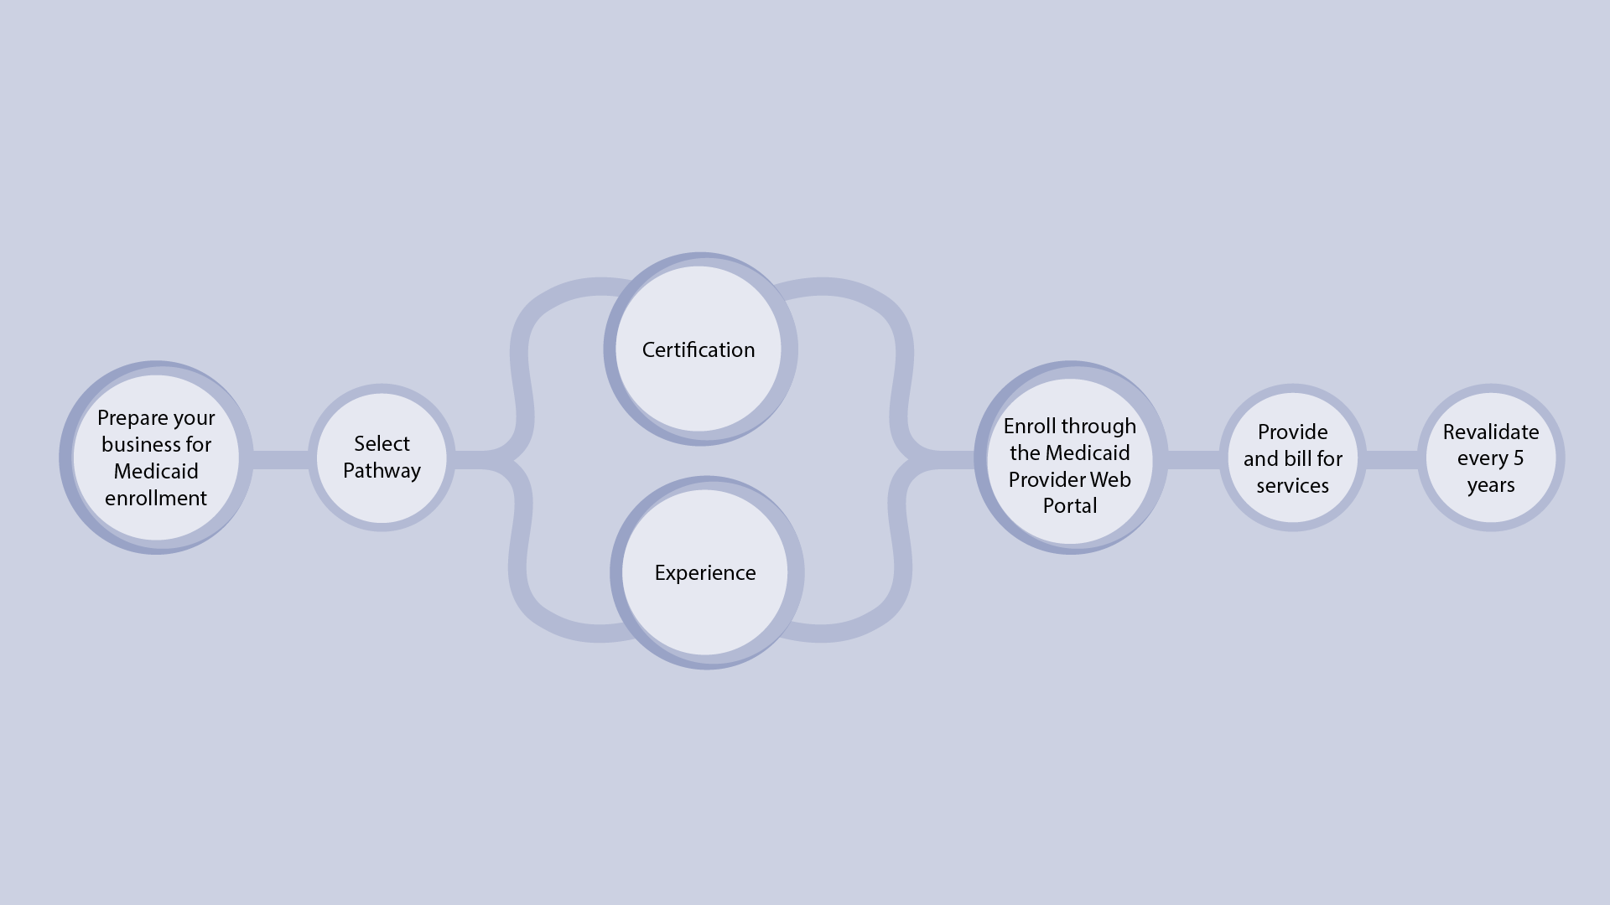
Enrollment Process
Notes:
Individuals and organizations interested in providing doula services to Health First Colorado members must first prepare their business for enrollment.
Then, doulas must determine how they will meet qualifying requirements. The Department does not require a specific doula certification. Instead, doulas select a pathway (certification or experience) and gather documentation and attestations demonstrating they meet requirements associated with the selected pathway.
Doulas then enroll through the Medicaid Provider Web Portal.
Once enrollment is complete, doulas provide and bill for services.
Doulas must revalidate through the Medicaid Provider Web Portal every five years to demonstrate ongoing compliance with the pathway and other requirements.

Slide 22
Proceso de inscripción
Certificación
Prepara tu negocio para inscripción en Medicaid
Registro a través del Portal Web de Medicaid
Prestar y facturar los servicios
Revalidar cada 5 años
Selecciona la ruta
Experiencia
Notes:
Individuals and organizations interested in providing doula services to Health First Colorado members must first prepare their business for enrollment.
Then, doulas must determine how they will meet qualifying requirements. The Department does not require a specific doula certification. Instead, doulas select a pathway (certification or experience) and gather documentation and attestations demonstrating they meet requirements associated with the selected pathway.
Doulas then enroll through the Medicaid Provider Web Portal.
Once enrollment is complete, doulas provide and bill for services.
Doulas must revalidate through the Medicaid Provider Web Portal every five years to demonstrate ongoing compliance with the pathway and other requirements.

Slide 23
Overview of Required Documentation
 | Certification Pathway | Experience Pathway
Front of driver’s license/state ID | • | •
Back of driver's license/state ID | • | •
Copy of insurance policy | • | •
Voided check/bank letter | • | •
W9 with Social Security Number | • | •
CPR card | • | •
Doula Attestation Form | • | •
Doula Code of Conduct | • | •
Lawful Presence Affidavit | • | •
Doula certification | •
Doula training certificate |  | •
Two letters of recommendation from previous clients |  | •
Letter of recommendation from colleague /doula |  | •
Letter of recommendation from a clinical provider |  | •
ADMINISTRATIVE
SHARED CRITERIA
PATHWAY
Notes:
Before we go into each of these steps in more detail, we want to present the list of required documents you’ll need –to upload to the Medicaid Provider Web portal or to keep in your records. As you can see by the table, the documents depend on the enrollment pathway you select.
(1) All doulas will need administrative documents, including copies of a driver’s license or state ID, an insurance policy, a voided check, and a W-9 with Social Security Number.
(2) Doulas also need common forms that demonstrate they meet qualifying criteria.
(3) The final set of documents depend on the pathway. Those who pursue the Certification Pathway need a doula certification. Those who pursue the experience pathway, need a training certificate and letters of recommendation.
It is critically important to use your legal name across all these documents. This name should appear on your driver’s license, W-9, training certifications, liability insurance, and fingerprinting card. If your name is not consistent across all your required documents, your application could be rejected.
We’ll describe these documents later in the training.

Slide 24
Descripción general de la documentación requerida
 | Ruta de certificación | Ruta de la experiencia
Frente de la licencia de conducir/ID estatal | • | •
Reverso de la licencia de conducir/ID estatal | • | •
Copia de la póliza de seguro | • | •
Cheque anulado/carta del banco | • | •
W9 con número de Seguro Social | • | •
Tarjeta de RCP | • | •
Formulario de certificación de Doula | • | •
Código de Conducta de Doula | • | •
Declaración jurada de presencia legal | • | •
Certificación de Doula | •
Certificado de capacitación en Doula |  | •
Dos cartas de recomendación de clientes anteriores |  | •
Carta de recomendación de un colega/doula |  | •
Carta de recomendación de un proveedor clínico |  | •
VÍA
CRITERIOS COMPARTIDOS
ADMINISTRATIVA
Notes:
Before we go into each of these steps in more detail, we want to present the list of required documents you’ll need –to upload to the Medicaid Provider Web portal or to keep in your records. As you can see by the table, the documents depend on the enrollment pathway you select.
(1) All doulas will need administrative documents, including copies of a driver’s license or state ID, an insurance policy, a voided check, and a W-9 with Social Security Number.
(2) Doulas also need common forms that demonstrate they meet qualifying criteria.
(3) The final set of documents depend on the pathway. Those who pursue the Certification Pathway need a doula certification. Those who pursue the experience pathway, need a training certificate and letters of recommendation.
It is critically important to use your legal name across all these documents. This name should appear on your driver’s license, W-9, training certifications, liability insurance, and fingerprinting card. If your name is not consistent across all your required documents, your application could be rejected.
We’ll describe these documents later in the training.

Slide 25
Training Content
Notes:
This training will discuss each step in more detail.

Slide 26
Contenido de la capacitación
Notes:
This training will discuss each step in more detail.

Slide 27

Training Content
Preparing your Business
Establishing Good Processes
Meeting Requirements
Enrolling through the Web Portal
Billing for Services
Provider Maintenance and Revalidation
Notes:
First, it can help you prepare for Health First Colorado Enrollment. You may choose to register as a business with the Colorado Secretary of State and will need to obtain identifiers required for enrollment.
We’ll also discuss sound business practices, so you can provide person-centered care, maintain client confidentiality, and meet federal and state requirements.
Then, we’ll review general requirements and those specific to each pathway.
The next section walks you through how to register for the Medicaid Provider Web Portal and submit an application. In order to process your application as efficiently as possible, you’ll want to gather your documentation prior to starting your application on the Medicaid Provider Web Portal.
We’ll discuss the billing processes.
And, finally, provider maintenance and revalidation.

Slide 28
Contenido de la capacitación
Prepara tu negocio
Establecimiento de buenos procesos
Cumplir con los requisitos
Inscripción a través del Portal Web
Facturación de servicios
Mantenimiento y revalidación de proveedores
Notes:
First, it can help you prepare for Health First Colorado Enrollment. You may choose to register as a business with the Colorado Secretary of State and will need to obtain identifiers required for enrollment.
We’ll also discuss sound business practices, so you can provide person-centered care, maintain client confidentiality, and meet federal and state requirements.
Then, we’ll review general requirements and those specific to each pathway.
The next section walks you through how to register for the Medicaid Provider Web Portal and submit an application. In order to process your application as efficiently as possible, you’ll want to gather your documentation prior to starting your application on the Medicaid Provider Web Portal.
We’ll discuss the billing processes.
And, finally, provider maintenance and revalidation.

Slide 29
Preparing your Business for Health First Colorado Enrollment
Notes:
Now we will talk about preparing your business for Health First Colorado Enrollment.
Doulas must enroll in the Health First Colorado program to bill for services provided to members. To do so, some doulas may want to start a business; some doulas are operating within a group already enrolled in Health First Colorado.

Slide 30
Preparando tu Negocio para la Inscripción en Health First Colorado
Notes:
Now we will talk about preparing your business for Health First Colorado Enrollment.
Doulas must enroll in the Health First Colorado program to bill for services provided to members. To do so, some doulas may want to start a business; some doulas are operating within a group already enrolled in Health First Colorado.

Slide 31

Preparing Your Business for Health First Colorado Enrollment
1. Establish Business Name
2. Register with the Colorado Secretary of State
3. Apply for a National Provider Identifier (NPI)
Notes:
When preparing your business for enrollment into Health First Colorado, there are several steps to consider: you may want to establish a business name that is consistent across all your legal forms and enrollment documentation, registering with the Colorado Secretary of state, and applying for a national provider identifier or NPI. (1) There may also be minimal administrative costs associated with starting a business in Colorado, such as paying the Colorado Secretary of State’s filing fee. We dive deeper into each of these steps in the forthcoming slides.

Slide 32
Preparando tu Negocio para la Inscripción en Health First Colorado
1. Establecer el nombre del negocio
2. Regístrese en la Secretaría de Estado de Colorado
3. Solicitar un Identificador Nacional de Proveedor (NPI)
Notes:
When preparing your business for enrollment into Health First Colorado, there are several steps to consider: you may want to establish a business name that is consistent across all your legal forms and enrollment documentation, registering with the Colorado Secretary of state, and applying for a national provider identifier or NPI. (1) There may also be minimal administrative costs associated with starting a business in Colorado, such as paying the Colorado Secretary of State’s filing fee. We dive deeper into each of these steps in the forthcoming slides.

Slide 33



Types of Doulas
Doulas may want to register as a business and will need an NPI.
Doulas need their own NPIs, but can be added to an existing group.
Doulas need their own NPIs, but can be added to an existing group.
Sole proprietors
Doulas within a group
Doulas within a health care group
Notes:
The steps you need to take depend on how you operate.
Sole proprietor doulas may want to register as a business and will need an NPI to enroll.
Each doula within an existing doula group or health care group will need an NPI and submit an individual application. Note that these groups need to already be enrolled in Health First Colorado.

Slide 34
Tipos de Doulas
Las doulas pueden optar por registrarse como un negocio y necesitarán un NPI.
Cada doula debe tener su propio NPI, aunque puede ser añadida a un grupo existente.
Cada doula debe tener su propio NPI, aunque puede ser añadida a un grupo existente.
Propietarios únicos
Doulas dentro de un grupo
Doulas en un grupo de atención médica
Notes:
The steps you need to take depend on how you operate.
Sole proprietor doulas may want to register as a business and will need an NPI to enroll.
Each doula within an existing doula group or health care group will need an NPI and submit an individual application. Note that these groups need to already be enrolled in Health First Colorado.

Slide 35

1. Establish Business Name
Business name must be consistent across all platforms, including DBAs, if applicable:
Application Submitted through the Medicaid Provider Web Portal
Attestation Forms
Internal Revenue Service (IRS) Forms
Registration for an NPI
*Any slight discrepancy will prevent your application from being approved
Notes:
Establishing a business name and using it consistently throughout the enrollment process is crucial. (1) Your business name must be the same on your application submitted through the (2) Medicaid Provider Web Portal, (3) your attestation forms, (4) your Internal Revenue Service forms, (5) and your registration for an NPI. (6) Any slight mismatch can mean your application is not approved.
If you choose to use a “doing business as” or DBA, which is separate from your business name, it must also be consistent across the enrollment process.

Slide 36
1. Establecer el nombre del negocio
El nombre del negocio debe ser consistente en todas las plataformas, incluyendo nombres comerciales (DBAs), si corresponde:
Solicitud presentada a través del Portal Web de Proveedores de Medicaid
Formularios de certificación
Formularios del Servicio de Impuestos Internos (IRS)
Registro para un NPI
¨* Cualquier pequeña discrepancia puede impedir la aprobación de tu solicitud.
Notes:
Establishing a business name and using it consistently throughout the enrollment process is crucial. (1) Your business name must be the same on your application submitted through the (2) Medicaid Provider Web Portal, (3) your attestation forms, (4) your Internal Revenue Service forms, (5) and your registration for an NPI. (6) Any slight mismatch can mean your application is not approved.
If you choose to use a “doing business as” or DBA, which is separate from your business name, it must also be consistent across the enrollment process.

Slide 37
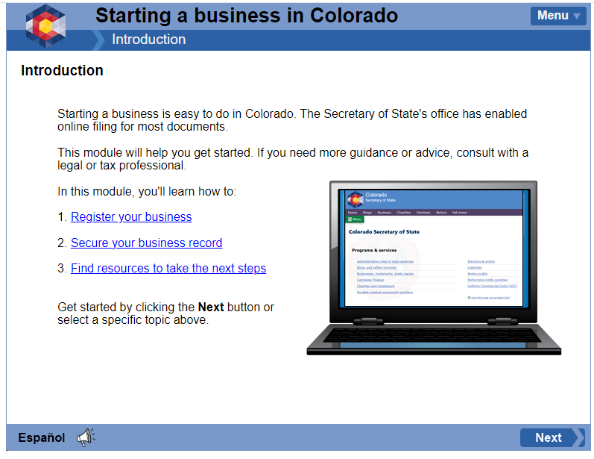
2. Register with the Colorado Secretary of State
On the Colorado Secretary of State Business Website:
“Starting a Business in Colorado” eLearning Module
Legal Structure
Creating Business Name
Filling Out Correct Forms
Be sure to save your login credentials
Save the business registration document and certificate of good standing
Notes:
If you decide to register as a business you will apply through the Colorado Secretary of State Business Organizations website. (1) The agency offers a Starting a Business in Colorado eLearning module that walks you through your (2) legal structure, (3) creating a business name, and (4) filing out the correct forms. Be sure to save your login credentials so you can access your account later. (7) It is also important to save the business registration document and Certificate of Good Standing. However, you can access these documents on the Colorado Secretary of State website anytime

Slide 38
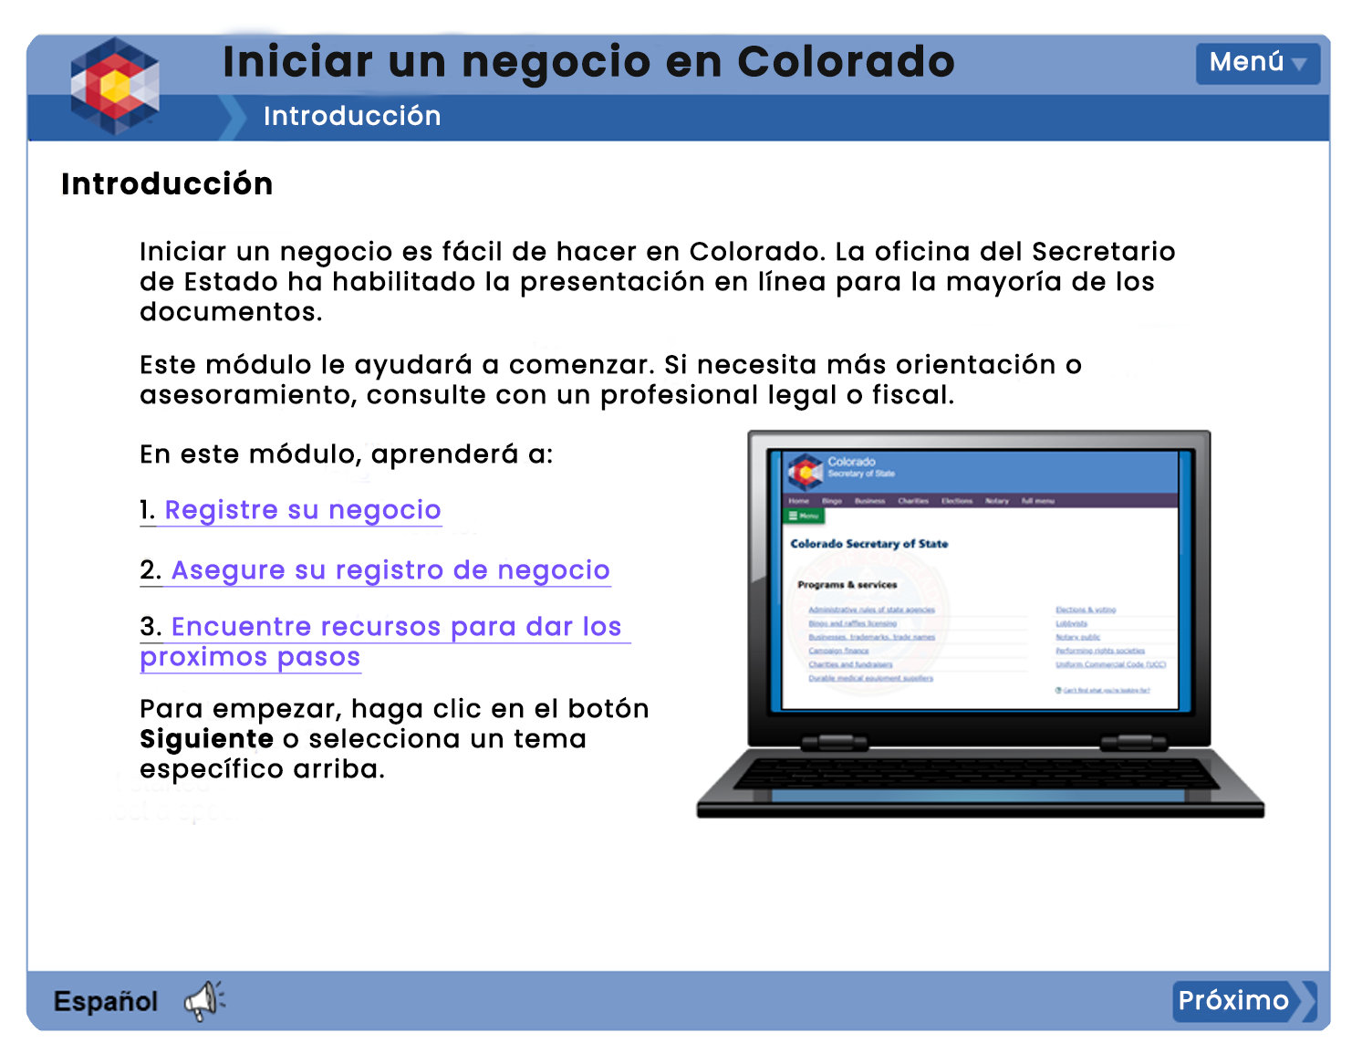
2. Regístrese en la Secretaría de Estado de Colorado
En el sitio web de negocios de la Secretaría de Estado de Colorado:
Módulo de eLearning “Iniciar un Negocio en Colorado”
Estructura Legal
Creación de un nombre comercial
Llenar los formularios correctos
Asegúrate de guardar tus credenciales de acceso
Guarda el documento de registro del negocio y el certificado de buena reputación
Notes:
If you decide to register as a business you will apply through the Colorado Secretary of State Business Organizations website. (1) The agency offers a Starting a Business in Colorado eLearning module that walks you through your (2) legal structure, (3) creating a business name, and (4) filing out the correct forms. Be sure to save your login credentials so you can access your account later. (7) It is also important to save the business registration document and Certificate of Good Standing. However, you can access these documents on the Colorado Secretary of State website anytime

Slide 39
2. Register with the Colorado Secretary of State
On the Colorado Secretary of State Business Website:
Know your business structure or organization type so you can enter it into the Medicaid Provider Web Portal
During business registration, be sure to add an abbreviation of the name depending on the type of business you choose, such as LLC., Ltd., etc.
Questions? Contact the Colorado Secretary of State at
(303)-894-2200 or business@coloradosos.gov
Notes:
You need your business structure or organization type to enter into the Medicaid Provider Web Portal. (1) When registering your business, be sure to follow the instructions clearly, including adding an abbreviation of the name depending on the type of business you choose, such as LLC.
(2) If you have questions, you can contact the Colorado Secretary of State using the contact information displayed on the screen.

Slide 40
2. Regístrese en la Secretaría de Estado de Colorado
En el sitio web de negocios de la Secretaría de Estado de Colorado:
Conoce la estructura de tu negocio o tipo de organización para poder ingresarlo en el Portal Web de Proveedores de Medicaid
Durante el registro del negocio, asegúrate de añadir una abreviatura del nombre según el tipo de negocio que elijas, como LLC, Ltd., etc.
¿Tienes preguntas? Contacta a la Secretaría de Estado de Colorado al
(303)-894-2200 o business@coloradosos.gov
Notes:
You need your business structure or organization type to enter into the Medicaid Provider Web Portal. (1) When registering your business, be sure to follow the instructions clearly, including adding an abbreviation of the name depending on the type of business you choose, such as LLC.
(2) If you have questions, you can contact the Colorado Secretary of State using the contact information displayed on the screen.

Slide 41

3. Apply for a National Provider Identifier (NPI)
NPIs are needed for: billing, eligibility and enrollment, and referrals and authorizations
Individual practitioners, organizations, and individuals that are part of a group can all have an NPI
A doula organization =
Type 2 NPI
Individual practitioners and individuals who are part of a group = Type 1 NPI
Notes:
Doulas need an NPI, a unique 10-digit identification number for covered health care providers, obtained from the National Plan & Provider Enumeration System or NPPES (pronounced: N-PEZ). The NPPES assigns NPIs. You can apply online.
(1) NPIs are needed for billing, eligibility and enrollment, and referrals and authorizations. Individual practitioners, organizations, and individuals a part of a group can all have an NPI. (2) Individual practitioners and individuals a part of a group need their own NPI if they perform standard transactions on their own (separately from their parent organization).
(3) A doula group may have a Type 2 NPI.
(4) Sole proprietors and individuals within a doula group need their own NPI, a Type 1 NPI, for Health First Colorado enrollment and billing purposes.

Slide 42
3. Solicitar un Identificador Nacional de Proveedor (NPI)
Los NPI son necesarios para: facturación, elegibilidad e inscripción, y referencias y autorizaciones
Los profesionales individuales, organizaciones y personas que forman parte de un grupo pueden tener un NPI
Una organización de doulas =
NPI Tipo 2
Profesionales individuales y personas que son parte de un grupo = NPI Tipo 1
Notes:
Doulas need an NPI, a unique 10-digit identification number for covered health care providers, obtained from the National Plan & Provider Enumeration System or NPPES (pronounced: N-PEZ). The NPPES assigns NPIs. You can apply online.
(1) NPIs are needed for billing, eligibility and enrollment, and referrals and authorizations. Individual practitioners, organizations, and individuals a part of a group can all have an NPI. (2) Individual practitioners and individuals a part of a group need their own NPI if they perform standard transactions on their own (separately from their parent organization).
(3) A doula group may have a Type 2 NPI.
(4) Sole proprietors and individuals within a doula group need their own NPI, a Type 1 NPI, for Health First Colorado enrollment and billing purposes.

Slide 43
3. Apply for a National Provider Identifier (NPI)
Taxonomy Code
Specifies the services you provide
Doula Taxonomy Code: 374J00000X
Taxonomy code in your application must match code used on NPI application or it will be rejected
Questions about NPIs:
Phone: (800) 465-3203
Email: mailto:customerservice@npinumerator.com
Mail: NPI Enumerator, 7125 Ambassador Rd STE 100, Windsor Mill MD 21244-2751
Notes:
Part of the information you need to apply for an NPI is your Taxonomy code. (1) The provider taxonomy code specifies the services you provide. (2) The doula taxonomy code is displayed on the screen. You must also enter this taxonomy code into the Medicaid Provider Web Portal.
(3) At least one of the taxonomy codes in the Health First Colorado application must match one of the codes you use when applying for the NPI. If not, your Health First Colorado application will be rejected. The NPPES NPI Registry lookup can be used to see the taxonomy codes currently associated with the NPI. You can always add a taxonomy code through NPPES to ensure that it matches the one in the Medicaid Enrollment Portal.
(4) If you have any questions about obtaining an NPI, you can contact NPPES using the contact information displayed on the screen.

Slide 44
3. Solicitar un Identificador Nacional de Proveedor (NPI) y Código de taxonomía
Especifica los servicios que ofreces
Código de Taxonomía para Doulas: 374J00000X
El código de taxonomía en tu solicitud debe coincidir con el utilizado en la solicitud de NPI, de lo contrario, será rechazada
Preguntas sobre los NPI:
Teléfono: (800) 465-3203
Email: mailto:customerservice@npinumerator.com
Correo físico: NPI Enumerator, 7125 Ambassador Rd STE 100, Windsor Mill MD 21244-2751
Notes:
Part of the information you need to apply for an NPI is your Taxonomy code. (1) The provider taxonomy code specifies the services you provide. (2) The doula taxonomy code is displayed on the screen. You must also enter this taxonomy code into the Medicaid Provider Web Portal.
(3) At least one of the taxonomy codes in the Health First Colorado application must match one of the codes you use when applying for the NPI. If not, your Health First Colorado application will be rejected. The NPPES NPI Registry lookup can be used to see the taxonomy codes currently associated with the NPI. You can always add a taxonomy code through NPPES to ensure that it matches the one in the Medicaid Enrollment Portal.
(4) If you have any questions about obtaining an NPI, you can contact NPPES using the contact information displayed on the screen.

Slide 45
Establishing Good Processes for Doula Practices
Notes:
Doulas enrolled in Health First Colorado must also establish sound business practices that allow them to provide person-centered and responsive client care, while maintaining client confidentiality.

Slide 46
Estableciendo buenos procesos para las prácticas de doula
Notes:
Doulas enrolled in Health First Colorado must also establish sound business practices that allow them to provide person-centered and responsive client care, while maintaining client confidentiality.

Slide 47
Good Business Practices
Standardized intake process
Process to verify Medicaid eligibility
Maintaining secure client records
Client and provider communications
Notes:
There is a lot you can do to manage a successful business. Today, we’ll touch on just a couple of these.
Many relate to being good stewards of Medicaid funding, which comes from taxpayer dollars and has obligations. Make sure you understand your responsibilities as they relate to service compliance, accurate billing, and being prepared for audits.

Slide 48
Buenas Prácticas Empresariales
Proceso de admisión estandarizado
Proceso para verificar la elegibilidad de Medicaid
Mantenimiento de registros seguros de los clientes
Comunicaciones entre el cliente y el proveedor
Notes:
There is a lot you can do to manage a successful business. Today, we’ll touch on just a couple of these.
Many relate to being good stewards of Medicaid funding, which comes from taxpayer dollars and has obligations. Make sure you understand your responsibilities as they relate to service compliance, accurate billing, and being prepared for audits.

Slide 49

Create a Standardized Intake Process
Intake forms can capture:
Client contact info
Insurance info (including Medicaid ID)
Mental and physical health conditions and support needs
Information on previous and current pregnancies
Health care providers
Birth desires and preferences
This info should be securely maintained and accessible to other doulas in your group who may serve the client
Notes:
First, you’ll want to create a standard client intake process.
Intake forms can capture (2, 3) client contact and demographic information and information to help you provide comprehensive care that is responsive to the client’s birth desires, including (4, 5, 6) health information and support needs and (7) birth preferences.
(8) We’ll talk about securing client information later in the presentation.

Slide 50
Crear un proceso de admisión estandarizado
Los formularios de admisión pueden capturar:
Información de contacto del cliente
Información del seguro (incluido el ID de Medicaid)
Condiciones de salud mental y física, así como necesidades de apoyo
Información sobre embarazos anteriores y actuales
Proveedores de atención médica
Deseos y preferencias de parto
Esta información debe ser mantenida de manera segura y ser accesible para otros doulas en tu grupo que puedan atender al cliente
Notes:
First, you’ll want to create a standard client intake process.
Intake forms can capture (2, 3) client contact and demographic information and information to help you provide comprehensive care that is responsive to the client’s birth desires, including (4, 5, 6) health information and support needs and (7) birth preferences.
(8) We’ll talk about securing client information later in the presentation.

Slide 51

Ensure Client is Enrolled in Health First Colorado
Once you’re enrolled as a provider, you will have access to member eligibility in the Medicaid Provider Web Portal
Notes:
Part of your intake process should be to verify client enrollment into Health First Colorado.
Once you’re enrolled as a provider, you will have access to member eligibility in the Medicaid Provider Web Portal.

Slide 52
Asegúrate de que el cliente esté inscrito en Health First Colorado
Una vez que estés inscrito como proveedor, tendrás acceso a la elegibilidad de los miembros en el Portal Web de Proveedores de Medicaid
Notes:
Part of your intake process should be to verify client enrollment into Health First Colorado.
Once you’re enrolled as a provider, you will have access to member eligibility in the Medicaid Provider Web Portal.

Slide 53
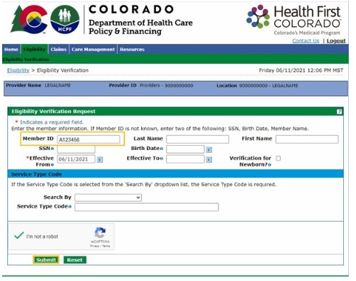
Verify Medicaid Eligibility
Request insurance information during client intake, including Medicaid ID
Log in to the Provider Medicaid Web Portal
Click on the Eligibility Tab
Enter client details and click “Submit”
If you do not have the member Medicaid ID, then enter two of the following: Social Security Number, date of birth, or member name
Notes:
Take the following steps:
(1) Request insurance information during client intake, including Medicaid ID.
(2) Log in to the Provider Medicaid Web Portal.
(3) Click on the Eligibility tab.
(4) Enter client details and click “Submit.” (5) If you do not have the member’s Medicaid ID, then enter two of the following: SSN, date of birth, or name.

Slide 54
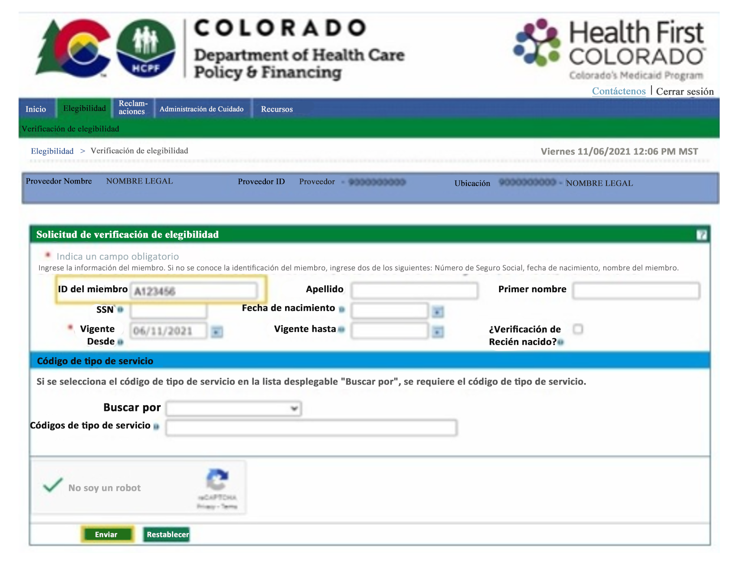
Verificar la elegibilidad para Medicaid
Solicita información del seguro durante la admisión del cliente, incluyendo el ID de Medicaid
Inicia sesión en el Portal Web de Proveedores de Medicaid.
Haz clic en la pestaña Elegibilidad.
Ingresa los detalles del cliente y haz clic en “Enviar”.
Si no tienes el ID de Medicaid del miembro, ingresa dos de los siguientes: Número de Seguro Social, fecha de nacimiento o nombre del miembro
Notes:
Take the following steps:
(1) Request insurance information during client intake, including Medicaid ID.
(2) Log in to the Provider Medicaid Web Portal.
(3) Click on the Eligibility tab.
(4) Enter client details and click “Submit.” (5) If you do not have the member’s Medicaid ID, then enter two of the following: SSN, date of birth, or name.

Slide 55

Help Your Clients Apply
The Colorado PEAK system supports enrollment into multiple programs, including Health First Colorado
County agencies provide enrollment support
Notes:
If the client is not enrolled in Health First Colorado, support enrollment by pointing the client to the Colorado PEAK system. Clients can also contact their County government agency, which may have trained enrollment specialists.

Slide 56

Ayuda a tus clientes a presentar una solicitud
El sistema Colorado PEAK apoya la inscripción en múltiples programas, incluido Health First Colorado
Las agencias del condado brindan apoyo para la inscripción
Notes:
If the client is not enrolled in Health First Colorado, support enrollment by pointing the client to the Colorado PEAK system. Clients can also contact their County government agency, which may have trained enrollment specialists.

Slide 57

Obtain Recommendation from Client’s Clinical Provider
Clients should let their clinical providers know they are working with a doula and obtain a recommendation
You should maintain these recommendation forms in your internal records and document the provider’s NPI
You will enter this NPI in the claim for payment
Notes:
Finally, to be eligible for doula services, members need to be recommended by a clinical provider, such as an OB/GYN, midwife, or therapist. This will promote better coordination across the clients’ providers, especially during labor and delivery.
Clients can obtain a recommendation form from their provider and give it to you. Keep this form in your records for auditing purposes and document the NPI for later submission. You must enter the provider’s NPI in your claim for payment.

Slide 58
Obtener recomendación del proveedor clínico del cliente
Los clientes deben informar a sus proveedores clínicos que están trabajando con una doula y obtener una recomendación.
Debes mantener estos formularios de recomendación en tus registros internos y documentar el NPI del proveedor
Este NPI se ingresará en la reclamación para el pago
Notes:
Finally, to be eligible for doula services, members need to be recommended by a clinical provider, such as an OB/GYN, midwife, or therapist. This will promote better coordination across the clients’ providers, especially during labor and delivery.
Clients can obtain a recommendation form from their provider and give it to you. Keep this form in your records for auditing purposes and document the NPI for later submission. You must enter the provider’s NPI in your claim for payment.

Slide 59

Well-Maintained Records Management:
Allows you to securely collect and store information
Enables you to support families and their preferences
v
Facilitates efficient communication
Helps you maintain client confidentiality and thus comply with state and federal regulations
Notes:
You should also develop and maintain a records management system that allows you to securely collect and store information about your clients and services.
These systems are crucial for effective care provision as they enable doulas to track the specific needs of each client and thus support families and their personal preferences.
(3) Well-maintained records also facilitate efficient communication between you, your clients, and other providers.
(4) In addition, a secure records management system can help you maintain client confidentiality and thus comply with state and federal regulations. Finally, if you are audited by Medicaid, you will be required to pull records for a sample of Health First Colorado members. Your records management system should allow you to quickly identify and share those records. Out-of-date records can delay the audit process and potentially lead to financial penalties.

Slide 60
Gestión de registros bien mantenida:
Te permite recopilar y almacenar información de manera segura
Te habilita para apoyar a las familias y sus preferencias
v
Facilita una comunicación eficiente
Ayuda a mantener la confidencialidad del cliente y, por lo tanto, a cumplir con las regulaciones estatales y federales
Notes:
You should also develop and maintain a records management system that allows you to securely collect and store information about your clients and services.
These systems are crucial for effective care provision as they enable doulas to track the specific needs of each client and thus support families and their personal preferences.
(3) Well-maintained records also facilitate efficient communication between you, your clients, and other providers.
(4) In addition, a secure records management system can help you maintain client confidentiality and thus comply with state and federal regulations. Finally, if you are audited by Medicaid, you will be required to pull records for a sample of Health First Colorado members. Your records management system should allow you to quickly identify and share those records. Out-of-date records can delay the audit process and potentially lead to financial penalties.

Slide 61
Examples of Key Information to Store in Records
Member name
Medicaid ID
Doula visits, including date(s), length, services provided, and mode (e.g., in member’s home or via telehealth)
Information about the birth plan or preferences
Notes:
Some examples of key information to store in records to promote a successful audit are (1) member name, (2) member Medicaid ID, (3) all visits including dates, length, services provided, and mode, and (4) essential client information.

Slide 62
Ejemplos de información clave para almacenar en registros
Nombre del miembro
ID de Medicaid
Visitas de la doula, incluyendo fecha(s), duración, servicios proporcionados y modalidad (por ejemplo, en el hogar del miembro o a través de telemedicina)
Información sobre el plan de parto o preferencias
Notes:
Some examples of key information to store in records to promote a successful audit are (1) member name, (2) member Medicaid ID, (3) all visits including dates, length, services provided, and mode, and (4) essential client information.

Slide 63

Data Management Systems
Paper charts
Paper charts in locked & secured location
Restricted access
Log in credentials
Electronic system
Firewalls
Encrypted emails
Notes:
Doulas may choose to manage their records (1) through paper charts, (2) by developing or purchasing an electronic data management system, or by relying on a combination of both. For example, clients may fill out intake forms via paper, and information is then entered into an electronic system.
Regardless, ensure you are following federal and state requirements related to data security. (1) Paper records should be securely locked. (2, 3, 4) Electronic data management systems should require log in credentials and have appropriate firewalls to protect personal health information or PHI. (5) Client communication and information sharing should also follow the highest security standards. For example, do not email client information unencrypted.

Slide 64
Sistemas de gestión de datos
Registros en papel
Registros en papel en un lugar cerrado y seguro
Acceso restringido
Credenciales de inicio de sesión
Sistema electrónico
Firewalls
Correos electrónicos cifrados
Notes:
Doulas may choose to manage their records (1) through paper charts, (2) by developing or purchasing an electronic data management system, or by relying on a combination of both. For example, clients may fill out intake forms via paper, and information is then entered into an electronic system.
Regardless, ensure you are following federal and state requirements related to data security. (1) Paper records should be securely locked. (2, 3, 4) Electronic data management systems should require log in credentials and have appropriate firewalls to protect personal health information or PHI. (5) Client communication and information sharing should also follow the highest security standards. For example, do not email client information unencrypted.

Slide 65
Meeting Health First Colorado Doula Requirements
Notes:
Next we’ll talk about meeting Health First Colorado Doula requirements.

Slide 66
Cumpliendo con los Requisitos de Doulas de Health First Colorado
Notes:
Next we’ll talk about meeting Health First Colorado Doula requirements.

Slide 67

Certification Pathway
Experience Pathway
Notes:
There are two pathways for doulas to satisfy requirements to become enrolled: the certification pathway and the experience pathway.
The certification pathway is for doulas who completed formal training with a Department-approved doula training organization.
The experience pathway does not require formal training but does have a higher requirement for birth attendance.

Slide 68
Ruta de certificación
Ruta de la experiencia
Notes:
There are two pathways for doulas to satisfy requirements to become enrolled: the certification pathway and the experience pathway.
The certification pathway is for doulas who completed formal training with a Department-approved doula training organization.
The experience pathway does not require formal training but does have a higher requirement for birth attendance.

Slide 69
All Individuals Must Meet Pathway Requirements
Sole Proprietors
Individuals within a Doula Group
Notes:
All individuals must meet pathway requirements, including all individuals within a group practice who want to bill for services.

Slide 70
Todos deben cumplir con los Requisitos de la Ruta
Propietarios únicos
Individuos dentro de un grupo de doulas
Notes:
All individuals must meet pathway requirements, including all individuals within a group practice who want to bill for services.

Slide 71
Documentation Requirements
 | Certification Pathway | Experience Pathway
Front of driver’s license/state ID | • | •
Back of driver's license/state ID | • | •
Copy of insurance policy | • | •
Voided check | • | •
W9 with Social Security Number | • | •
CPR card | • | •
Doula Attestation Form | • | •
Doula Code of Conduct | • | •
Lawful Presence Affidavit | • | •
Doula certification | •
Doula training certificate |  | •
Two letters of recommendation from previous clients |  | •
Letter of recommendation from colleague /doula |  | •
Letter of recommendation from a clinical provider |  | •
ADMINISTRATIVE
SHARED CRITERIA
PATHWAY
Notes:
The certification and experience pathway each have their own documentation requirements. Some documents, such as CPR certification, are required by both pathways. Some requirements, like a Letter of recommendation from a clinical provider, is just required for the experience pathways. A list of documentation requirements for each pathways is displayed on the screen.
I’d like to remind you again to use your legal name on all of these documents to expedite approval.

Slide 72
Requisitos de documentación
 | Ruta de certificación | Ruta de la experiencia
Frente de la licencia de conducir/ID estatal | • | •
Reverso de la licencia de conducir/ID estatal | • | •
Copia de la póliza de seguro | • | •
Cheque anulado | • | •
W9 con número de Seguro Social | • | •
Tarjeta de RCP | • | •
Formulario de certificación de Doula | • | •
Código de Conducta de Doula | • | •
Declaración jurada de presencia legal | • | •
Certificación de Doula | •
Certificado de capacitación en Doula |  | •
Dos cartas de recomendación de clientes anteriores |  | •
Carta de recomendación de un colega/doula |  | •
Carta de recomendación de un proveedor clínico |  | •
VÍA
CRITERIOS COMPARTIDOS
ADMINISTRATIVA
Notes:
The certification and experience pathway each have their own documentation requirements. Some documents, such as CPR certification, are required by both pathways. Some requirements, like a Letter of recommendation from a clinical provider, is just required for the experience pathways. A list of documentation requirements for each pathways is displayed on the screen.
I’d like to remind you again to use your legal name on all of these documents to expedite approval.

Slide 73
Certification Pathway
Training
Birth Attendance
CPR Certificate
Code of Conduct
Notes:
The certification pathway requires four signed attestations to be submitted, which we will go over in more detail.

Slide 74
Ruta de certificación
Capacitación
Asistencia al parto
Certificado de RCP
Código de conducta
Notes:
The certification pathway requires four signed attestations to be submitted, which we will go over in more detail.

Slide 75

I Attest…
    I have received training as a doula from one of the HCPF-approved training organizations
Notes:
First, “I attest that I have received training as a doula from one of the HCPF-approved training organizations.”
You will need to complete at least 18 hours of training, and you will attach a copy of your certification of training completion with your application in the Medicaid Provider Web Portal.
In order to become a Colorado State Certified Doula or Community Birthing Partner to serve Colorado members and be reimbursed for those services, training entities must complete the application requirements to be considered for the approval process. They must indicate the number of hours that correspond to each competency and attach a syllabus.

Slide 76
Doy fe de que…
    He recibido capacitación como doula de una de las organizaciones de capacitación aprobadas por HCPF
Notes:
First, “I attest that I have received training as a doula from one of the HCPF-approved training organizations.”
You will need to complete at least 18 hours of training, and you will attach a copy of your certification of training completion with your application in the Medicaid Provider Web Portal.
In order to become a Colorado State Certified Doula or Community Birthing Partner to serve Colorado members and be reimbursed for those services, training entities must complete the application requirements to be considered for the approval process. They must indicate the number of hours that correspond to each competency and attach a syllabus.

Slide 77


I Attest…
    I have received training as a doula from one of the HCPF-approved training organizations
    I have attended at least three births within the last five years
Notes:
Second, “I attest that I have attended at least three births within the last five years.”
Your own experience giving birth does not count for births attended. You will complete the Birth Attendance Attestation Form stating that you meet this requirement.

Slide 78
Doy fe de que…
    He recibido capacitación como doula de una de las organizaciones de capacitación aprobadas por HCPF
    He asistido a al menos tres partos en los últimos cinco años
Notes:
Second, “I attest that I have attended at least three births within the last five years.”
Your own experience giving birth does not count for births attended. You will complete the Birth Attendance Attestation Form stating that you meet this requirement.

Slide 79


I Attest…
    I have received training as a doula from one of the HCPF-approved training organizations
    I have attended at least three births within the last five years
    I have current CPR training credentials
Notes:
Third, “I attest that I have current CPR training credentials.”
Different training programs may have different durations – make sure that you’ve taken training recently enough to have active training credentials. Doulas are required to receive adult and infant CPR certification. You will upload a copy of your certifications with your application.
Please note that there may be costs associated with becoming CPR certified. For 2025, we found they ranged from approximately $30-$150 in Colorado.

Slide 80
Doy fe de que…
    He recibido capacitación como doula de una de las organizaciones de capacitación aprobadas por HCPF
    He asistido a al menos tres partos en los últimos cinco años
    Tengo credenciales actuales de capacitación en RCP
Notes:
Third, “I attest that I have current CPR training credentials.”
Different training programs may have different durations – make sure that you’ve taken training recently enough to have active training credentials. Doulas are required to receive adult and infant CPR certification. You will upload a copy of your certifications with your application.
Please note that there may be costs associated with becoming CPR certified. For 2025, we found they ranged from approximately $30-$150 in Colorado.

Slide 81


I Attest…
    I have received training as a doula from one of the HCPF-approved training organizations
    I have attended at least three births within the last five years
    I have current CPR training credentials
    To follow the doula Code of Conduct
Notes:
Finally, “I attest to follow the doula Code of Conduct.”
Review the code, sign it, and submit the signed copy.

Slide 82
Doy fe de que…
    He recibido capacitación como doula de una de las organizaciones de capacitación aprobadas por HCPF
    He asistido a al menos tres partos en los últimos cinco años
    Tengo credenciales actuales de capacitación en RCP
    Me comprometo a seguir el Código de Conducta de la doula
Notes:
Finally, “I attest to follow the doula Code of Conduct.”
Review the code, sign it, and submit the signed copy.

Slide 83
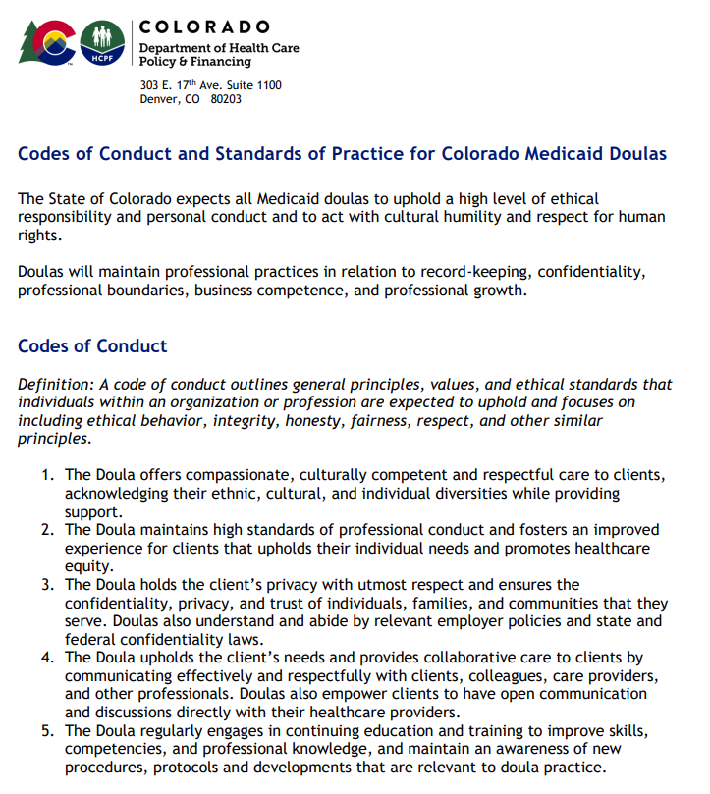
Culturally competent and respectful care
Professional conduct
Client privacy
Continuing education
Notes:
The doula code of conduct, which highlights your commitment to:
culturally competent and respectful care,
professional conduct,
client privacy, and
continuing education,
can be found on the HCPF website in English and Spanish.

Slide 84
Códigos de Conducta y Estándares de Práctica para Doulas de Medicaid en Colorado
El estado de Colorado espera que todas las doulas de Medicaid mantengan un alto nivel de responsabilidad ética y conducta personal, actuando con humildad cultural y respeto por los derechos humanos.
Las doulas deberán mantener prácticas profesionales en relación con la gestión de registros, la confidencialidad, los límites profesionales, la competencia empresarial y el crecimiento profesional.
Códigos de Conducta
Definición:Un código de conducta describe los principios generales, valores y estándares éticos que se espera que los individuos dentro de una organización o profesión mantengan, enfocándose en incluir el comportamiento ético, la integridad, la honestidad, la equidad, el respeto y otros principios similares.
La doula ofrece atención compasiva, culturalmente competente y respetuosa a los clientes, reconociendo sus diversidades étnicas, culturales e individuales mientras proporciona apoyo.
La doula mantiene altos estándares de conducta profesional y fomenta una experiencia mejorada para los clientes que respeta sus necesidades individuales y promueve la equidad en la atención médica.
La doula protege la privacidad de los clientes con el máximo respeto y asegura la confidencialidad, privacidad y confianza de las personas, familias y comunidades a las que sirve. Las doulas también comprenden y cumplen con las políticas relevantes del empleador y las leyes de confidencialidad estatales y federales.
La doula defiende las necesidades de los clientes y proporciona atención colaborativa al comunicarse de manera efectiva y respetuosa con los clientes, colegas, proveedores de atención y otros profesionales. Las doulas también empoderan a los clientes para que tengan una comunicación abierta y discusiones directamente con sus proveedores de atención médica.
La doula participa regularmente en educación continua y capacitación para mejorar habilidades, competencias y conocimientos profesionales, y mantiene una conciencia de nuevos procedimientos, protocolos y desarrollos que son relevantes para la práctica de la doula.
Cuidado culturalmente competente y respetuoso
Conducta profesional
Privacidad del cliente
Educación continua
Notes:
The doula code of conduct, which highlights your commitment to:
culturally competent and respectful care,
professional conduct,
client privacy, and
continuing education,
can be found on the HCPF website in English and Spanish.

Slide 85





Experience Pathway
    CPR Certification
    Birth Attendance
    Code of Conduct
    Letters of Recommendation
Demonstrated Competencies
Notes:
The experience pathway shares three attestations with the certification pathway. The experience pathway differs from the certification pathway in that it does not require any specific training other than CPR certification and lived experiences. Note that the birth attendance attestation requires the same paperwork but has different requirements, which we will go over now.

Slide 86
Ruta de la experiencia
    Certificado de RCP
    Asistencia al parto
    Código de conducta
    Cartas de recomendación
Competencias demostradas
Notes:
The experience pathway shares three attestations with the certification pathway. The experience pathway differs from the certification pathway in that it does not require any specific training other than CPR certification and lived experiences. Note that the birth attendance attestation requires the same paperwork but has different requirements, which we will go over now.

Slide 87
I Attest…
I have current CPR training credentials
To follow the doula Code of Conduct
Notes:
Two attestations are exactly the same as the certification pathway:
“I attest that I have current CPR training credentials.”
And
“I attest to follow the doula Code of Conduct.”

Slide 88
Doy fe de que…
Tengo credenciales actuales de capacitación en RCP
Me comprometo a seguir el Código de Conducta de la doula
Notes:
Two attestations are exactly the same as the certification pathway:
“I attest that I have current CPR training credentials.”
And
“I attest to follow the doula Code of Conduct.”

Slide 89

I Attest…
I have attended at least ten births in my role as a doula, and at least five births in the last two years
I have current CPR training credentials
To follow the doula Code of Conduct
Notes:
The experience pathway requires more lived experience in births than the certification pathway. For the experience pathway, you must “attest that I have attended at least ten births in my role as a doula, and at least five births in the last two years.”
As already mentioned, your own birth does not count for births attended. You will complete the Birth Attendance Attestation Form stating that you meet this requirement.

Slide 90
Doy fe de que…
He asistido a al menos diez partos en mi rol como doula, y al menos cinco partos en los últimos dos años
Tengo credenciales actuales de capacitación en RCP
Me comprometo a seguir el Código de Conducta de la doula
Notes:
The experience pathway requires more lived experience in births than the certification pathway. For the experience pathway, you must “attest that I have attended at least ten births in my role as a doula, and at least five births in the last two years.”
As already mentioned, your own birth does not count for births attended. You will complete the Birth Attendance Attestation Form stating that you meet this requirement.

Slide 91

I Attest…
I have attended at least ten births in my role as a doula, and at least five births in the last two years
I have attached four letters of recommendations
I have current CPR training credentials
To follow the doula Code of Conduct
Notes:
In addition, “I attest that I have attached four letters of recommendations.”
You will submit a total of four letters of recommendation with your application. Of the four letters, two must be from clinicians who were the primary obstetric provider at birth you have attended. The other two must be from previous clients that you worked with as a doula.

Slide 92
Doy fe de que…
He asistido a al menos diez partos en mi rol como doula, y al menos cinco partos en los últimos dos años
He adjuntado cuatro cartas de recomendación
Tengo credenciales actuales de capacitación en RCP
Me comprometo a seguir el Código de Conducta de la doula
Notes:
In addition, “I attest that I have attached four letters of recommendations.”
You will submit a total of four letters of recommendation with your application. Of the four letters, two must be from clinicians who were the primary obstetric provider at birth you have attended. The other two must be from previous clients that you worked with as a doula.

Slide 93

I Attest…
I have attended at least ten births in my role as a doula, and at least five births in the last two years
I have attached four letters of recommendations
To having knowledge and competency in the following areas:
I have current CPR training credentials
To follow the doula Code of Conduct
Notes:
Finally, you will need to submit an attestation that you have knowledge and competency in the following areas:

Slide 94
Doy fe de que…
He asistido a al menos diez partos en mi rol como doula, y al menos cinco partos en los últimos dos años
He adjuntado cuatro cartas de recomendación
Tengo conocimientos y competencias en las siguientes áreas:
Tengo credenciales actuales de capacitación en RCP
Me comprometo a seguir el Código de Conducta de la doula
Notes:
Finally, you will need to submit an attestation that you have knowledge and competency in the following areas:

Slide 95



I Attest to having the knowledge and competency in…
Prenatal
  Pregnancy/ Perinatal Support
  Childbirth Education
Labor and delivery
  Non-Medical Comfort Measures
  Labor Support Techniques
Postpartum
  Postpartum/Recovery Support
  Feeding/Lactation Support
  Newborn/Infant Care
Anatomy of Pregnancy, Childbirth, and Postpartum; Family/Partner Support; Developing a Community Resource List; Trauma-Informed Care; Diversity, Equity and Inclusion (Cultural Sensitivity)
Notes:
Prenatal, labor and delivery, and postpartum care. Initial beside each of the competencies and submit the form with your application.
Some of the competencies related to these domains are displayed on the screen. For example, doulas should have a good understanding of childbirth education in the prenatal period, labor support techniques during labor and delivery, and feeding and lactation support during the postpartum period.

Slide 96
Doy fe de tener el conocimiento y la competencia en...
Cuidado Prenatal
  Apoyo durante el Embarazo/Perinatal
  Educación sobre el Parto
Trabajo de parto y parto
  Medidas de Confort No Médicas
  Técnicas de Apoyo durante el Parto
Postparto
  Apoyo en el Postparto/Recuperación
  Apoyo en la Alimentación/Lactancia
  Cuidado de Recién Nacidos/Infantes
Anatomía del embarazo, parto y posparto; Apoyo familiar y de pareja; Desarrollo de una lista de recursos comunitarios; Atención adaptada al trauma; Diversidad, equidad e inclusión (sensibilidad cultural)
Notes:
Prenatal, labor and delivery, and postpartum care. Initial beside each of the competencies and submit the form with your application.
Some of the competencies related to these domains are displayed on the screen. For example, doulas should have a good understanding of childbirth education in the prenatal period, labor support techniques during labor and delivery, and feeding and lactation support during the postpartum period.

Slide 97
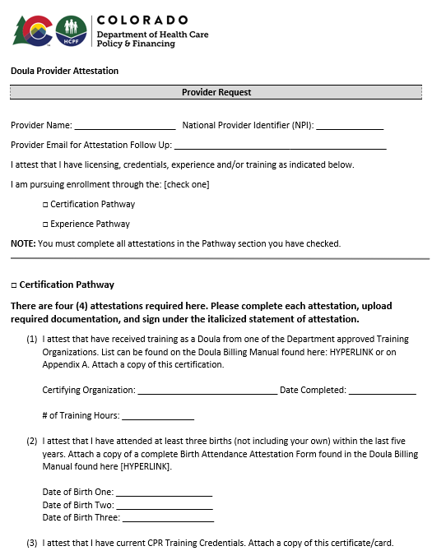
Submitting Attestations
Attestations should be filled out by each doula, signed, and uploaded to the Medicaid Provider Web Portal
Notes:
Attestations should be filled out by each doula, signed, and uploaded to the Medicaid Provider Web Portal.
The doula provider attestation form is displayed on this screen. These form can also be found on the HCPF website on English and Spanish.

Slide 98
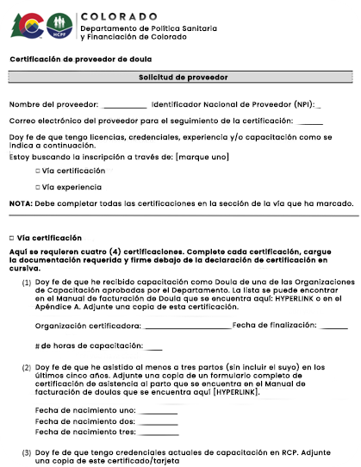
Presentación de Atestaciones
Las atestaciones deben ser completadas por cada doula, firmadas y subidas al Portal Web de Proveedores de Medicaid
Notes:
Attestations should be filled out by each doula, signed, and uploaded to the Medicaid Provider Web Portal.
The doula provider attestation form is displayed on this screen. These form can also be found on the HCPF website on English and Spanish.

Slide 99
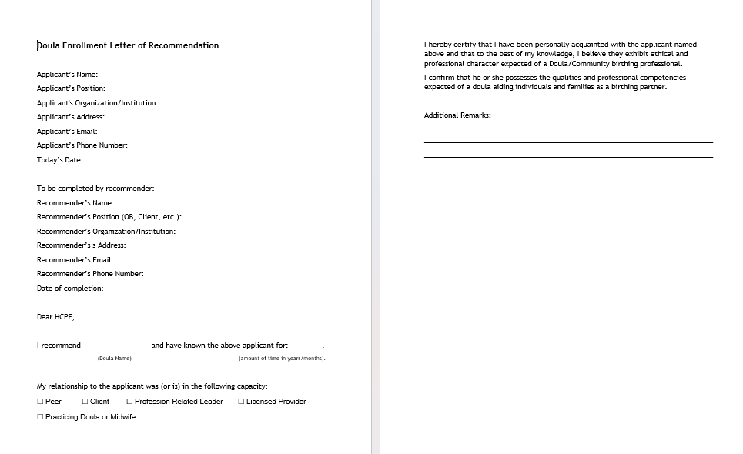
Letters of Recommendation
Notes:
The letter of recommendation form can also be found on the HCPF website in English and Spanish.

Slide 100
Cartas de recomendación
Carta de recomendación para la inscripción de Doula
Nombre del solicitante:
Cargo del solicitante:
Organización/institución del solicitante:
Dirección del solicitante:
Correo electrónico del solicitante:
Número de teléfono del solicitante:
Fecha de hoy:
A ser completado por el recomendador:
Nombre del recomendador:
Cargo del recomendador: (Obstetra, Cliente, etc.)
Organización/institución del recomendador:
Dirección del recomendador:
Correo electrónico del recomendador:
Número de teléfono del recomendador:
Fecha de finalización:
Estimado HCPF,
Recomiendo a ______________y he conocido al solicitante mencionado
(nombre de la doula)
anteriormente durante___________________
(cantidad de tiempo en años/meses)
.Mi relación con el solicitante fue (o es) en la siguiente capacidad:
Compañero- Cliente- Líder relacionado con la profesión-
Proveedor licenciado- Doula o partera en ejercicio
Por la presente, certifico que he estado personalmente familiarizado con el solicitante mencionado anteriormente y que, según mi leal saber y entender, creo que exhibe el carácter ético y profesional que se espera de un profesional de la comunidad en el ámbito del parto.
Confirmo que él o ella posee las cualidades y competencias profesionales esperadas de una doula que asiste a individuos y familias como compañero de parto.
Notas adicionales:
Notes:
The letter of recommendation form can also be found on the HCPF website in English and Spanish.

Slide 101
Additional Requirements
Background Checks: Make an appointment with IdentoGO and use code 25YQG9*
Insurance, either professional insurance or liability insurance through a doula group
Optional: Mandatory Reporting of Child Abuse and Neglect training
https://co4kids.org/child-abuse-prevention/mandatory-reporters/
Notes:
Doula care is a high-risk service, meaning you’ll have to go through a background check.
(1) Make an appointment with IdentoGO and use the code displayed on the screen. The Department will then check to ensure that all the owners listed in your application have received the completed background check.
(2) Doulas are also required to have insurance; it can be professional insurance or insurance through your doula group, such as liability insurance. There may be a cost associated with this insurance policy.
(3) Doulas are not mandatory reporters, but doulas may still take The Colorado Department of Human Services free mandatory reporting training if they want to. While doulas are not mandatory reporters, this training may empower providers to recognize the signs and symptoms of abuse and instill confidence their ability to take appropriate action should they suspect abuse.

Slide 102
Requisitos adicionales
Verificaciones de Antecedentes: Programa una cita con IdentoGO y utiliza el código 25YQG9*
Seguro, ya sea seguro profesional o de responsabilidad civil a través de un grupo de doulas
Opcional: Capacitación obligatoria sobre denuncia de abuso y negligencia infantil
https://co4kids.org/child-abuse-prevention/mandatory-reporters/
Notes:
Doula care is a high-risk service, meaning you’ll have to go through a background check.
(1) Make an appointment with IdentoGO and use the code displayed on the screen. The Department will then check to ensure that all the owners listed in your application have received the completed background check.
(2) Doulas are also required to have insurance; it can be professional insurance or insurance through your doula group, such as liability insurance. There may be a cost associated with this insurance policy.
(3) Doulas are not mandatory reporters, but doulas may still take The Colorado Department of Human Services free mandatory reporting training if they want to. While doulas are not mandatory reporters, this training may empower providers to recognize the signs and symptoms of abuse and instill confidence their ability to take appropriate action should they suspect abuse.

Slide 103
Enrolling Through the Medicaid Provider Web Portal
Notes:
Next we’ll talk about enrolling through the Medicaid provider web portal.

Slide 104
Inscribirse a través del portal web de proveedores de Medicaid
Notes:
Next we’ll talk about enrolling through the Medicaid provider web portal.

Slide 105

Registering for the System
All doulas must enroll in Health First Colorado through the Medicaid Provider Web Portal
You will need:
Your business license
The doula taxonomy code (374J00000X)
Your NPI number
Your address with nine-digit ZIP code
Copy of driver’s license/state ID
A voided check or bank letter
Completed IRS Form W-9
Insurance policy
CPR card, attestation, doula code of conduct
Certification, training certificate, or letters of recommendation (depending on your pathway)
Notes:
The first step to enrollment is to make sure you have everything you need to register through the Medicaid Provider Web Application.
(1) Providers must be registered and in good standing with the Colorado Secretary of State. Have this certificate available.
You will need your taxonomy code and NPI number.
You will also need the address where you provide services and a voided check or bank letter and a completed IRS Form W-9 to ensure payment.
Make sure to have other documents to upload, including a copy of your driver’s license, insurance policy, attestation, doula code of conduct, and information corresponding to your selected pathway.
Once again, use your legal name on all your documents and when filling out fields in the system.

Slide 106
Registro en el sistema
Todas las doulas deben inscribirse en Health First Colorado a través del Portal Web de Proveedores de Medicaid
Necesitarás:
Tu licencia de negocio
El Código de Taxonomía para Doulas: 374J00000X
Tu número de NPI
Tu dirección con código postal de nueve dígitos
Copia de la licencia de conducir/ID estatal
Cheque anulado/carta del banco
Formulario W-9 del IRS completado
Póliza de seguros
Tarjeta de RCP, atestación, código de conducta de la doula
CertifCertificación, certificado de capacitación o cartas de recomendación (dependiendo de tu ruta)
Notes:
The first step to enrollment is to make sure you have everything you need to register through the Medicaid Provider Web Application.
(1) Providers must be registered and in good standing with the Colorado Secretary of State. Have this certificate available.
You will need your taxonomy code and NPI number.
You will also need the address where you provide services and a voided check or bank letter and a completed IRS Form W-9 to ensure payment.
Make sure to have other documents to upload, including a copy of your driver’s license, insurance policy, attestation, doula code of conduct, and information corresponding to your selected pathway.
Once again, use your legal name on all your documents and when filling out fields in the system.

Slide 107
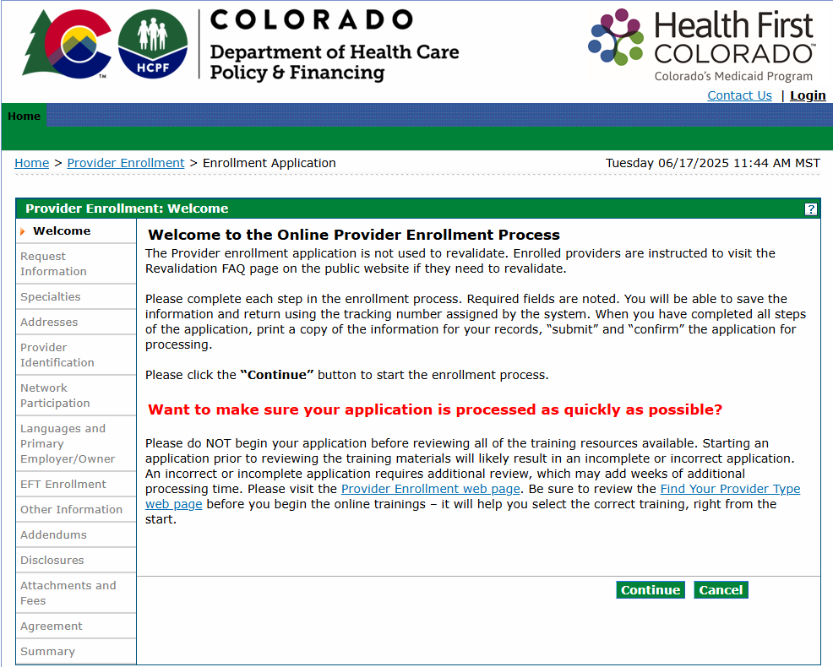
Notes:
To begin enrollment, access the Enrollment Application through the Medicaid Provider Web Portal. Then read the accompanying message and hit continue.

Slide 108
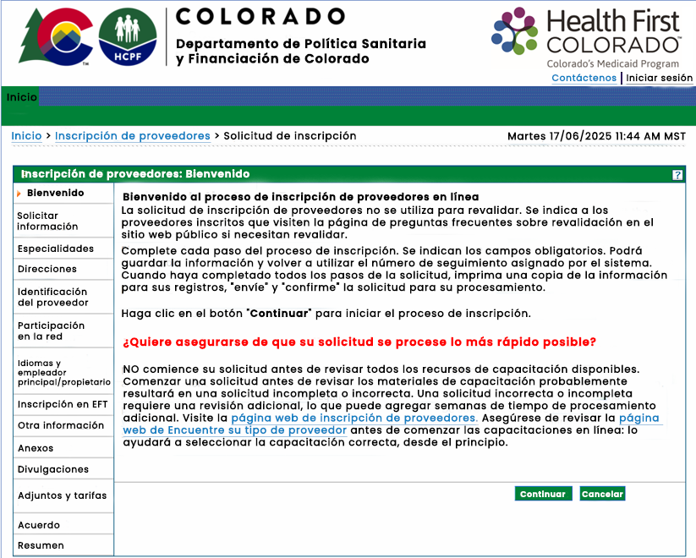
Notes:
To begin enrollment, access the Enrollment Application through the Medicaid Provider Web Portal. Then read the accompanying message and hit continue.

Slide 109
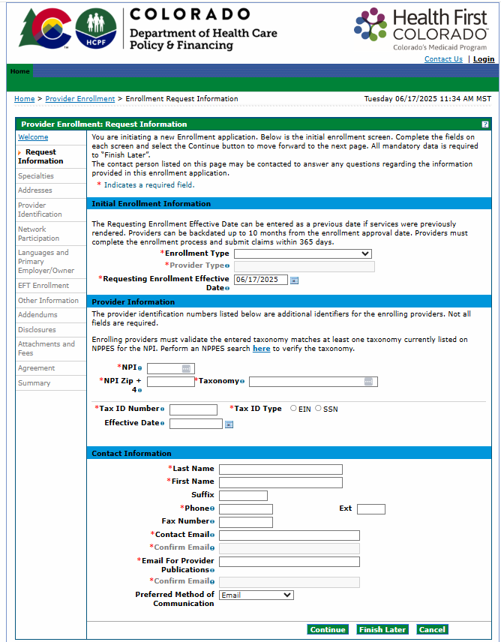
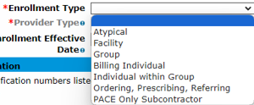
Notes:
On the next page, you’ll first select your enrollment type.

Slide 110
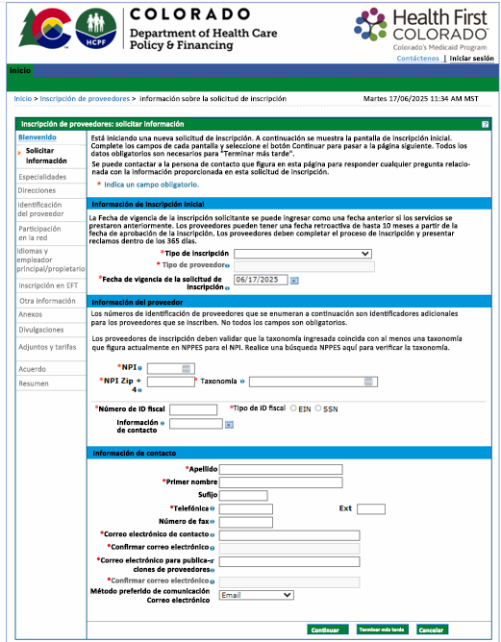
Notes:
On the next page, you’ll first select your enrollment type.

Slide 111
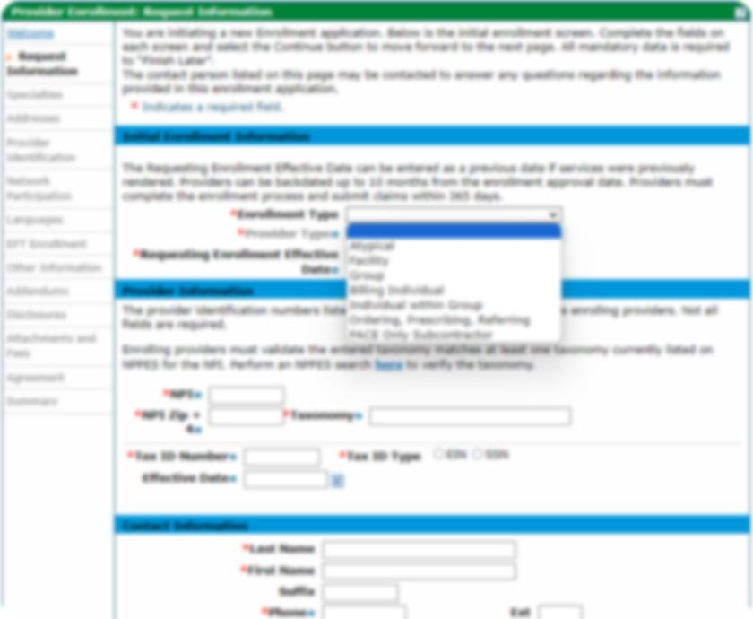
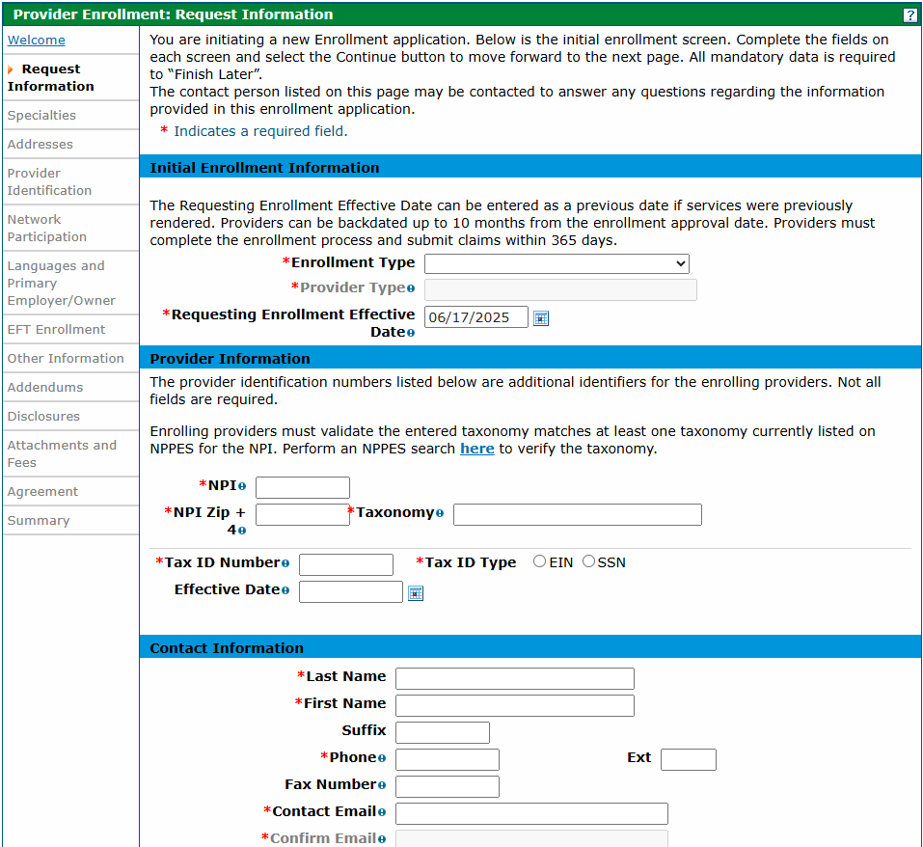
Notes:
There are three types that relate to doulas:
Group
Billing Individual
Individual within a Group
Doulas should select Billing Individual if they are a sole proprietor, or Individual within Group if they are a part of a doula group or health care group.
Note that the group must already be enrolled in the Medicaid program before you can apply as an individual within a group.

Slide 112
Solicitar Información
Tipo de Inscripción
Atípico
Instalación
Grupo
Individuo de facturación
Individuo dentro del grupo
Solicitante, Prescriptor, Referente
Subcontratista solo de PACE
Notes:
There are three types that relate to doulas:
Group
Billing Individual
Individual within a Group
Doulas should select Billing Individual if they are a sole proprietor, or Individual within Group if they are a part of a doula group or health care group.
Note that the group must already be enrolled in the Medicaid program before you can apply as an individual within a group.

Slide 113
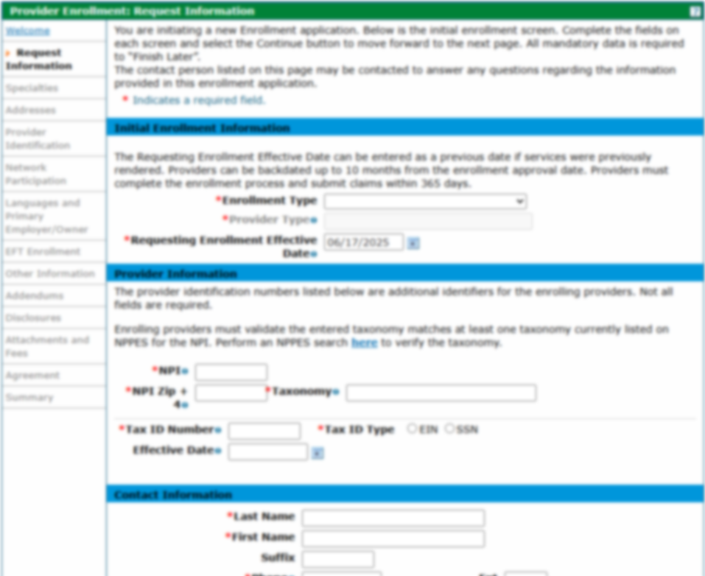
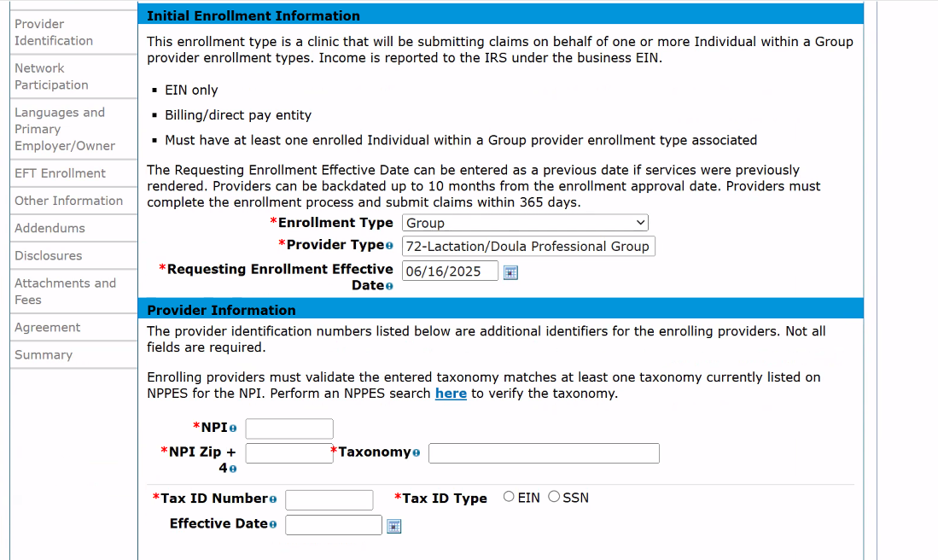
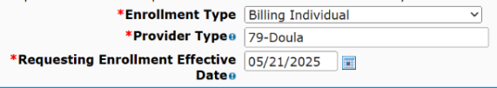
Notes:
Then, select your Provider Type. If you’re enrolling as a Group, you’ll select code 72, if you’re enrolling as a billing individual or individual with in a group, you’ll select code 79.
The requesting enrollment effective date should be the date you submit your application.

Slide 114
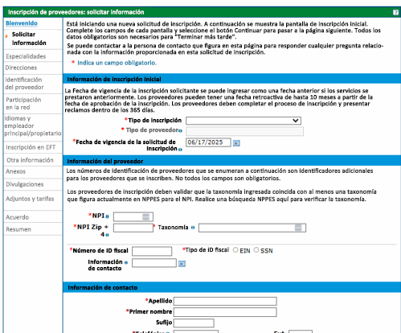
Tipo de Inscripción
Individuo de facturación
Tipo de Proveedor
Fecha de solicitud de inscripción
Notes:
Then, select your Provider Type. If you’re enrolling as a Group, you’ll select code 72, if you’re enrolling as a billing individual or individual with in a group, you’ll select code 79.
The requesting enrollment effective date should be the date you submit your application.

Slide 115


Doula Taxonomy Code:
374J00000X
USPS Website:
https://tools.usps.com/zip-code-lookup.htm
Notes:
Then enter your NPI.
When entering your zip code, use the nine-digit zip code associated with your NPI. You can find this ZIP code on the USPS website.
Next, enter your taxonomy code. The doula taxonomy code is displayed on the screen.
The tax ID should be your social security number if you’re enrolling as an individual or an EIN if you’re enrolling as a group.
The requesting enrollment effective date should be the date you submit your application.
Finally, you’ll enter your contact information.
Make sure to enter your legal name as it appears on all the documentation you’ll need to submit.

Slide 116
Código de Taxonomía para Doulas:
374J00000X
Sitio Web de USPS:
https://tools.usps.com/zip-code-lookup.htm
Taxonomía
Efectivo desde
Apellido
Nombre
Sufijo
Teléfono
Notes:
Then enter your NPI.
When entering your zip code, use the nine-digit zip code associated with your NPI. You can find this ZIP code on the USPS website.
Next, enter your taxonomy code. The doula taxonomy code is displayed on the screen.
The tax ID should be your social security number if you’re enrolling as an individual or an EIN if you’re enrolling as a group.
The requesting enrollment effective date should be the date you submit your application.
Finally, you’ll enter your contact information.
Make sure to enter your legal name as it appears on all the documentation you’ll need to submit.

Slide 117

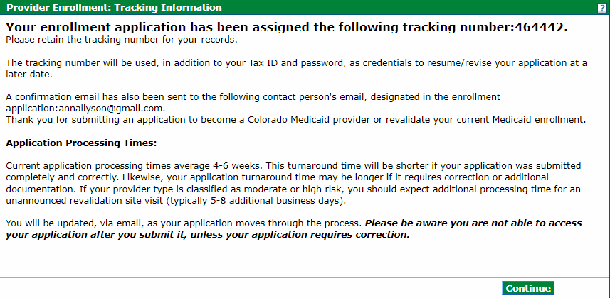
Notes:
After entering your contact information, you will create a password for your account and answer three security questions. This will allow you to pause and resume the application if needed by clicking “Finish Later.” You will also be provided with an Application Tracking Number, which can be used to check the application status. Make sure to save your username, password, and tracking number somewhere safe so you can reference it later.

Slide 118

Inscripción de Proveedores: Información de Seguimiento
Su solicitud de inscripción ha sido asignada con el siguiente número de seguimiento: 464442.
Por favor, conserve el número de seguimiento para sus registros.
El número de seguimiento se utilizará, además de su número de identificación fiscal (Tax ID) y contraseña, como credenciales para reanudar/revisar su solicitud en una fecha posterior.
También se ha enviado un correo electrónico de confirmación a la dirección de correo electrónico de la persona de contacto designada en la solicitud de inscripción: annallyson@gmail.com. Gracias por enviar una solicitud para convertirse en proveedor de Medicaid de Colorado o para revalidar su inscripción actual en Medicaid.
Tiempos de Procesamiento de la Solicitud:
Los tiempos de procesamiento actuales de la solicitud promedian de 4 a 6 semanas. Este tiempo de respuesta será menor si su solicitud se envió de forma completa y correcta. Del mismo modo, el tiempo de respuesta de su solicitud puede ser mayor si requiere corrección o documentación adicional. Si su tipo de proveedor se clasifica como de riesgo moderado o alto, debe esperar un tiempo de procesamiento adicional por una visita al sitio de revalidación no anunciada (normalmente de 5 a 8 días hábiles adicionales).
Se le informará por correo electrónico a medida que su solicitud avance en el proceso. Tenga en cuenta que no podrá acceder a su solicitud una vez que la envíe, a menos que su solicitud requiera corrección.
Notes:
After entering your contact information, you will create a password for your account and answer three security questions. This will allow you to pause and resume the application if needed by clicking “Finish Later.” You will also be provided with an Application Tracking Number, which can be used to check the application status. Make sure to save your username, password, and tracking number somewhere safe so you can reference it later.

Slide 119
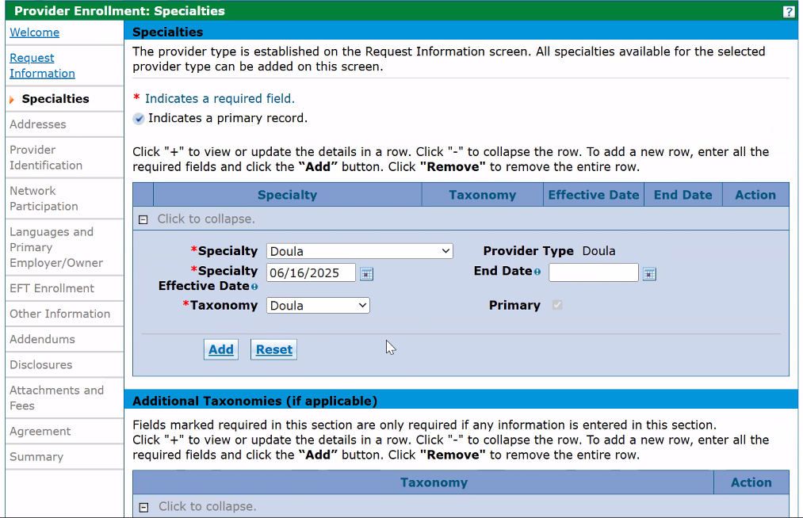

Notes:
When selecting a (1) specialty, you should select Doula for Specialty and Taxonomy, make today’s date the Specialty Effective Date, and leave the End Date blank.

Slide 120
Especialidades
Especialidad
Tipo de Proveedor
Fecha Efectiva
Fecha de Finalización
Taxonomía
Principal
Notes:
When selecting a (1) specialty, you should select Doula for Specialty and Taxonomy, make today’s date the Specialty Effective Date, and leave the End Date blank.

Slide 121
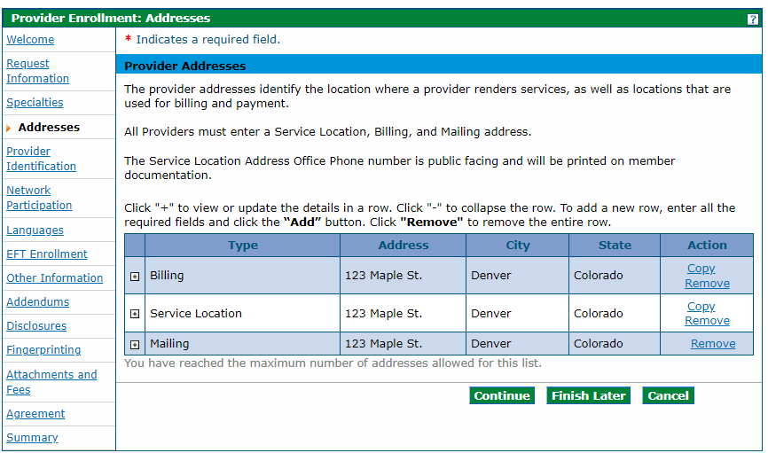
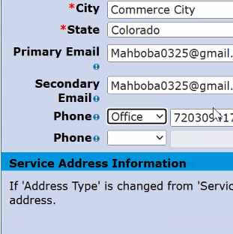
Notes:
On the following addresses tab, add the address where you (2) bill for services, (3) provide services, and (4) receive your mail. You need to enter an address for each of these address types, but they can be the same address. Use the address you registered for your business with the Colorado Secretary of State. When entering the addresses, click add at the bottom of the page to save the address. You’ll receive an error if you click submit before you add all three address types.
(5) Your must put office phone. You will receive an error if you only provide a cell phone number. It is okay if your office number is the same as your cell phone number.

Slide 122
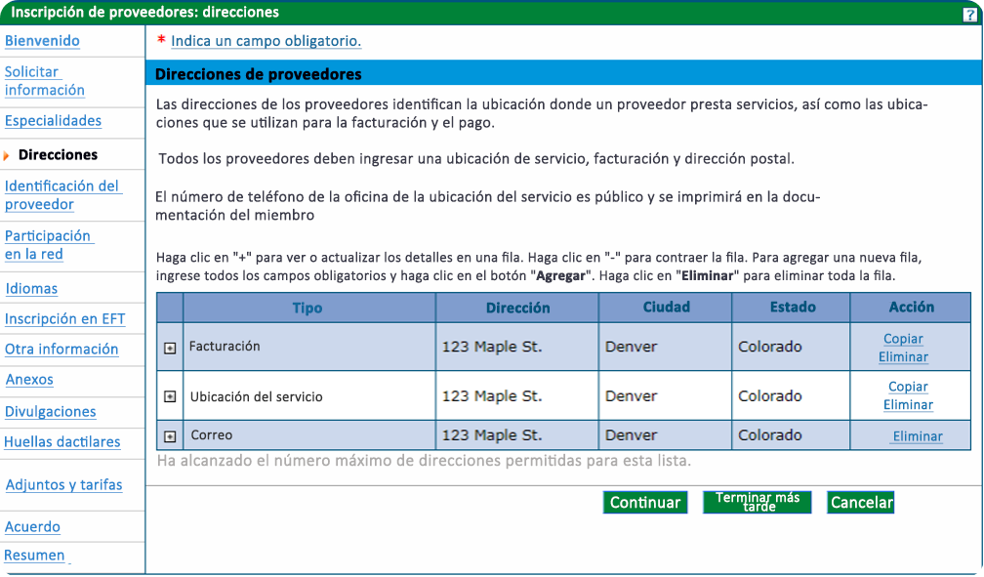
Tipo
Dirección
Ciudad
Estado
Acción
Estado
Copiar / Eliminar
Email principal
Facturación
Email secundario
Copiar / Eliminar
Ubicación de Servicio
Teléfono
Oficina
Teléfono
Eliminar
Notes:
On the following addresses tab, add the address where you (2) bill for services, (3) provide services, and (4) receive your mail. You need to enter an address for each of these address types, but they can be the same address. Use the address you registered for your business with the Colorado Secretary of State. When entering the addresses, click add at the bottom of the page to save the address. You’ll receive an error if you click submit before you add all three address types.
(5) Your must put office phone. You will receive an error if you only provide a cell phone number. It is okay if your office number is the same as your cell phone number.

Slide 123
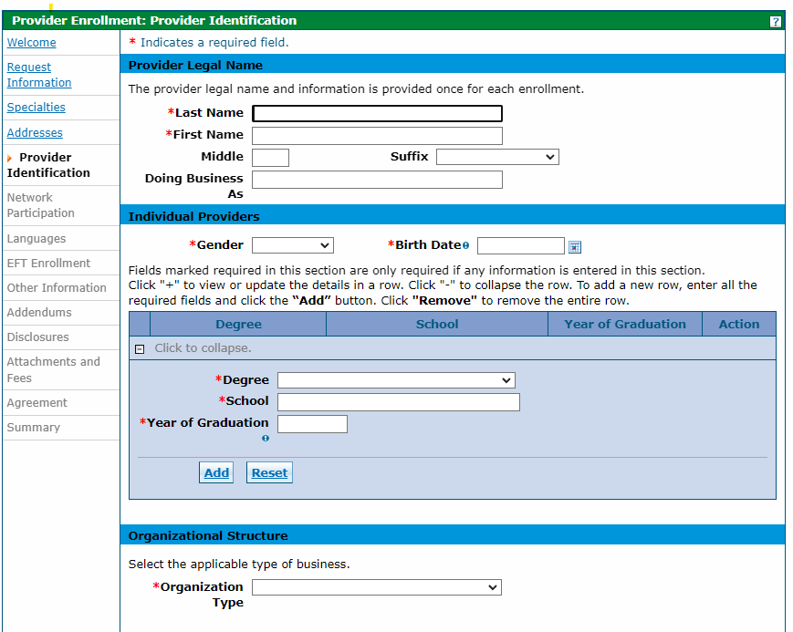



Notes:
On the next page complete the provider identification information. (2) Enter your legal provider name or (3) “doing business as” name. Please note that your legal name should be different from your DBA name. If you do not have a DBA name, leave it blank.
(4) Even if you have a relevant degree, you should leave the degree, school and year of graduation blank.
(5) Select your organization type. The organization type should be sole proprietor if you are a billing individual or individual within a group. If you’re applying as an individual within a group, you will enter your group’s type 2 NPI and select the type, such as an LLC or non-profit.

Slide 124
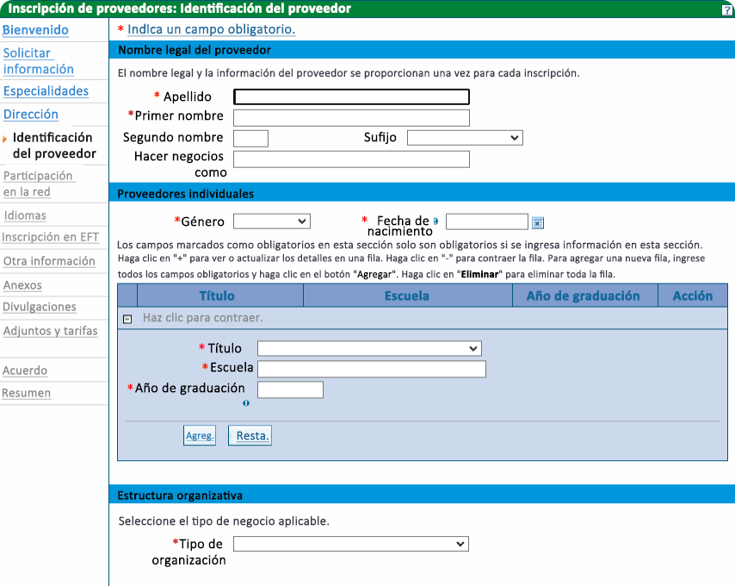
La información y el nombre legal del proveedor se proporcionan una vez por cada inscripción.
Apellido
Nombre
Identificación del Proveedor
Nombre Comercial
Notes:
On the next page complete the provider identification information. (2) Enter your legal provider name or (3) “doing business as” name. Please note that your legal name should be different from your DBA name. If you do not have a DBA name, leave it blank.
(4) Even if you have a relevant degree, you should leave the degree, school and year of graduation blank.
(5) Select your organization type. The organization type should be sole proprietor if you are a billing individual or individual within a group. If you’re applying as an individual within a group, you will enter your group’s type 2 NPI and select the type, such as an LLC or non-profit.

Slide 125
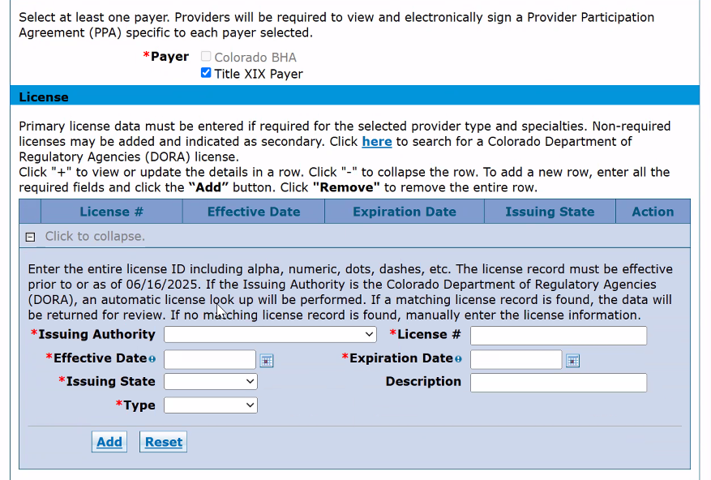
Notes:
Select Title XIX Payer. You should also skip the License section; it is not required.

Slide 126
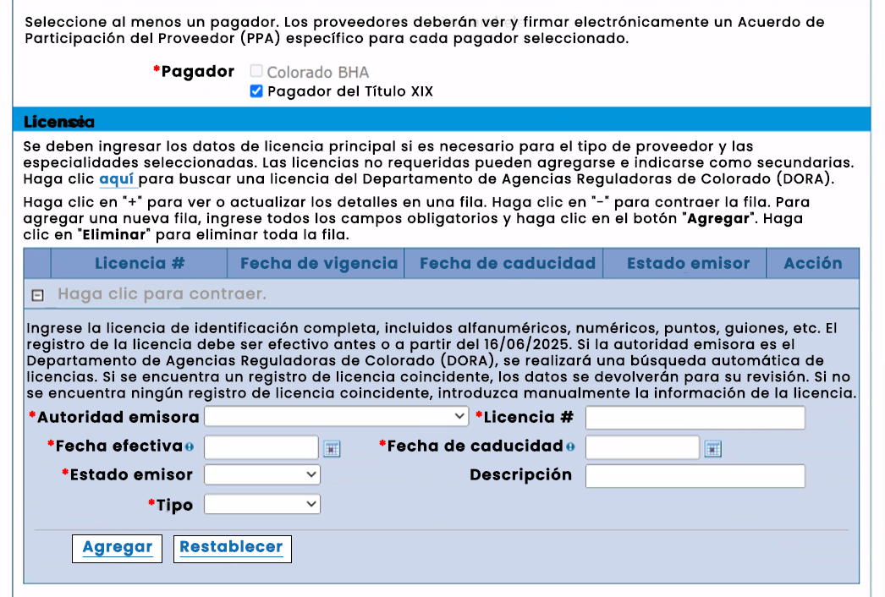
Notes:
Select Title XIX Payer. You should also skip the License section; it is not required.

Slide 127
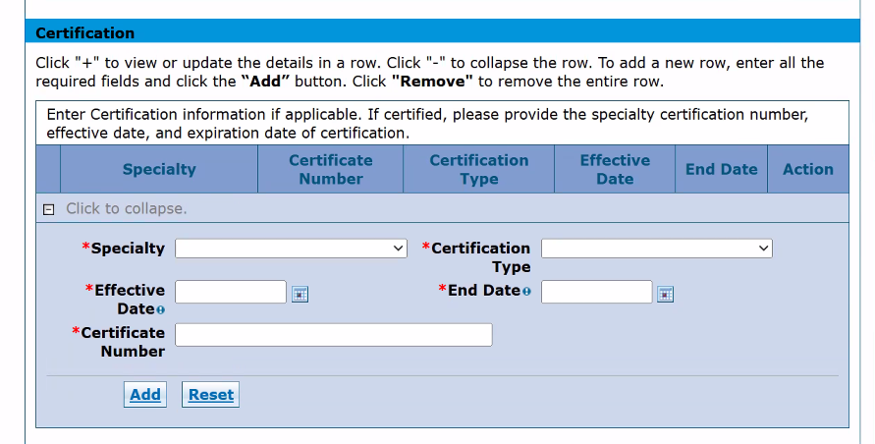
No Certificate Number?
Enter 00000
Notes:
All doulas should fill out the certification section regardless of the pathway they are applying under. Enter “doula” as the specialty and “other” for certification type. Input the effective start and end date of your certification or training certificate. (1) If you don’t have a certificate number, then enter 00000.
Make sure to click Add to save the information to your application.

Slide 128
¿Sin Número de certificado?
Ingresa 00000
Certificación
Haga clic en "+" para ver o actualizar los detalles de una fila. Haga clic en "-" para contraer la fila. Para añadir una nueva fila, introduzca todos los campos obligatorios y haga clic en el botón "Agregar". Haga clic en "Eliminar" para eliminar toda la fila.
Introduzca la información de certificación si corresponde. Si está certificado, proporcione el número de certificación de la especialidad, la fecha de inicio de vigencia y la fecha de finalización de la certificación.
Especialidad
Número de Certificado
Tipo de Certificado
Fecha Efectiva
Fecha Fin
Haz clic para contraer.
Especialidad
Tipo de Certificación
Fecha efectiva
Fecha fin
Número de Certificado
Agregar
Restablecer
Notes:
All doulas should fill out the certification section regardless of the pathway they are applying under. Enter “doula” as the specialty and “other” for certification type. Input the effective start and end date of your certification or training certificate. (1) If you don’t have a certificate number, then enter 00000.
Make sure to click Add to save the information to your application.

Slide 129
Skip
Medicare Participation
Managed Care Network Participation
Notes:
(1, 2) You don’t need to fill out information on Medicare and Managed Care Network participation.

Slide 130
Saltar
Participación en Medicare
Participación en la red de atención administrada
Notes:
(1, 2) You don’t need to fill out information on Medicare and Managed Care Network participation.

Slide 131
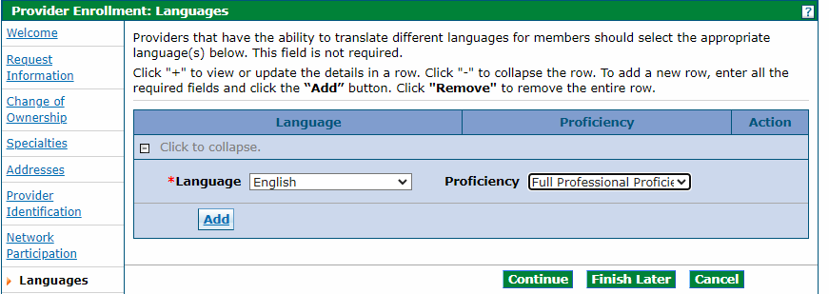

Notes:
(1 ) Add languages you speak on the languages page. (2) Add languages only if you speak them fluently. (3) You will need to select at least one language.

Slide 132
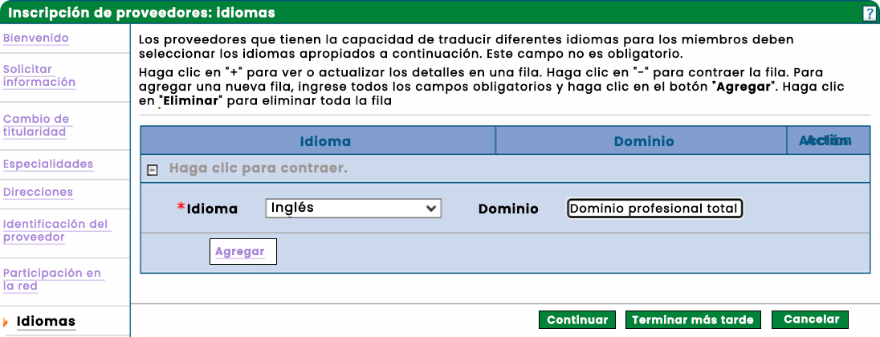
Inscripción de Proveedores: Idiomas
Idioma
Dominio
Acción
Idioma
Inglés
Dominio
Dominio Profesional Co
Idiomas
Continuar
Seguir luego
Cancelar
Notes:
(1 ) Add languages you speak on the languages page. (2) Add languages only if you speak them fluently. (3) You will need to select at least one language.

Slide 133
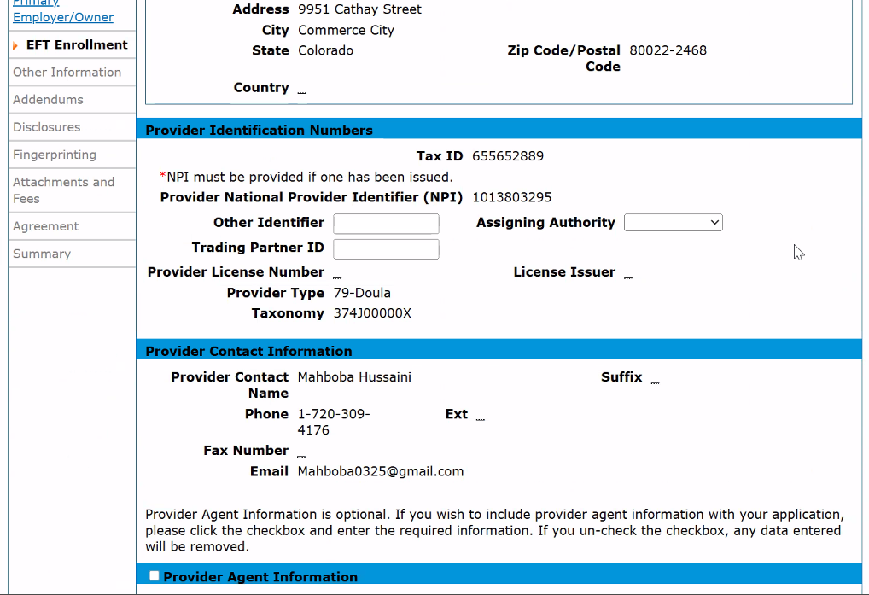
Notes:
In the EFT enrollment tab, you can skip over the (1) Other Identifier, (2) Trading Partner ID, and (3) Assigning Authority boxes.

Slide 134
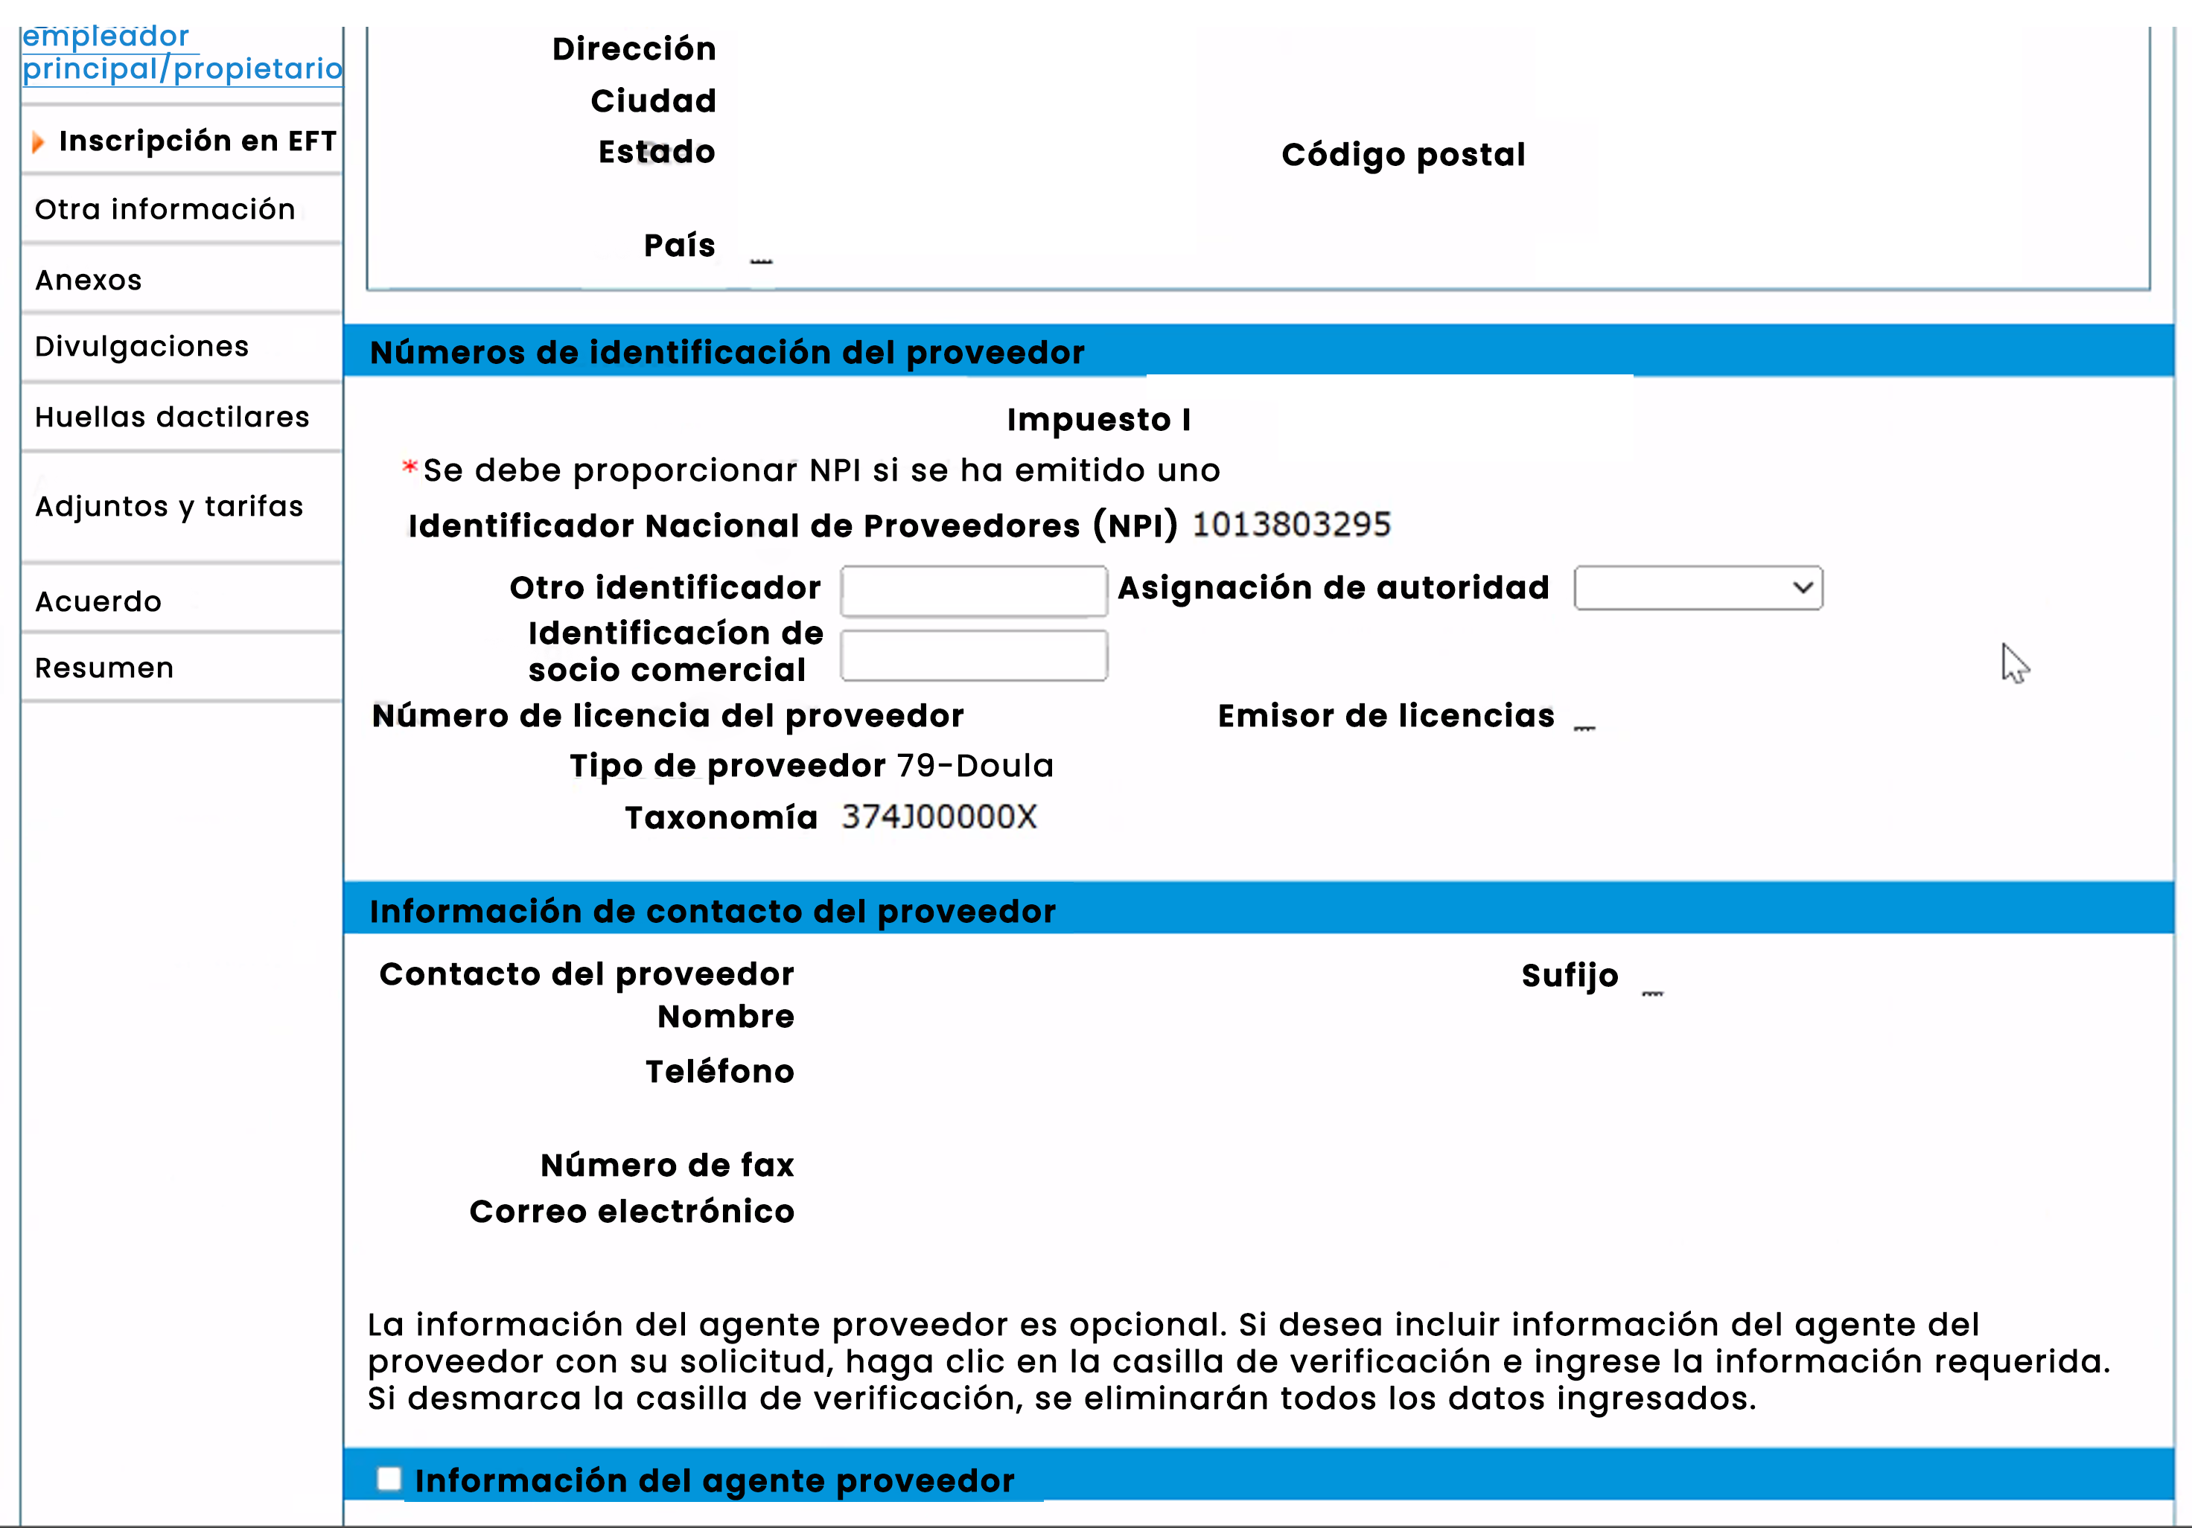
Notes:
In the EFT enrollment tab, you can skip over the (1) Other Identifier, (2) Trading Partner ID, and (3) Assigning Authority boxes.

Slide 135
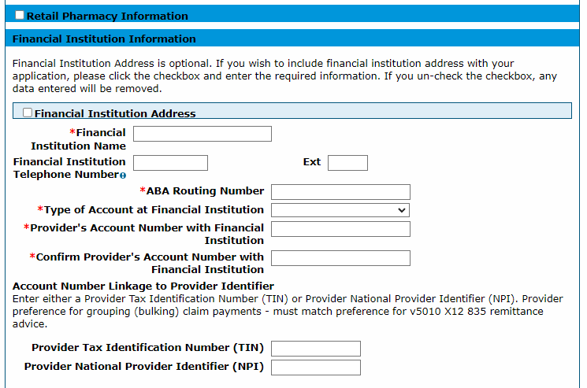

Notes:
Your will need to fill out bank information so you can receive automatic payment. Your NPI and tax ID will be prepopulated at the top of this page, check this information to ensure it is accurate. (1) Enter information into the Financial Institution screen at the bottom of the page to ensure payment. Make sure the information you enter matches the information in the voided check or bank letter you will need to upload later in the application. Please note that a direct deposit form is not an acceptable replacement for a voided check or bank letter.
Skip through the addendums page, as no additional addendums are required for doulas. Read any disclosures that appear on the disclosures page by clicking on the disclosure name, answering the accompanying questions, and then clicking add for each disclosure.
Make sure to only enter the (2) NPI number, not the (3) TIN on this screen.

Slide 136
Información de la Farmacia Minorista
Información de la Institución Financiera
La Dirección de la Institución Financiera es opcional. Si desea incluir la dirección de la institución financiera con su solicitud, marque la casilla e ingrese la información requerida. Si desmarca la casilla, cualquier dato ingresado será eliminado.
Dirección de la Institución Financiera
Nombre de la Institución Financiera
Nombre de la Institución Financiera
Número de Teléfono de la Institución Financiera
Número de Ruta ABA
Tipo de Cuenta en la Institución Financiera
Número de Cuenta del Proveedor en la Institución Financiera
Vinculación del Número de Cuenta con el Identificador del Proveedor
Ingrese el Número de Identificación Fiscal del Proveedor (TIN) o el Identificador Nacional de Proveedor (NPI) del Proveedor. La preferencia del proveedor para agrupar (agrupar) los pagos de reclamaciones debe coincidir con la preferencia para el aviso de remesa v5010 X12 835.
Notes:
Your will need to fill out bank information so you can receive automatic payment. Your NPI and tax ID will be prepopulated at the top of this page, check this information to ensure it is accurate. (1) Enter information into the Financial Institution screen at the bottom of the page to ensure payment. Make sure the information you enter matches the information in the voided check or bank letter you will need to upload later in the application. Please note that a direct deposit form is not an acceptable replacement for a voided check or bank letter.
Skip through the addendums page, as no additional addendums are required for doulas. Read any disclosures that appear on the disclosures page by clicking on the disclosure name, answering the accompanying questions, and then clicking add for each disclosure.
Make sure to only enter the (2) NPI number, not the (3) TIN on this screen.

Slide 137
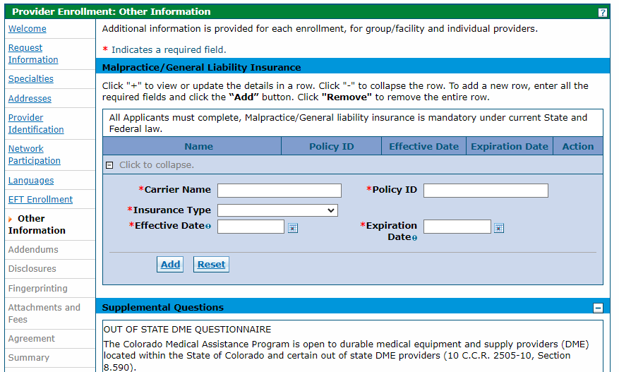


Notes:
Enter your insurance information under the (1) other information tab. This includes your (2) carrier name, (2) policy ID, (3) insurance tyle, (4) effective and (5) expiration date. (6) As a doula you must have liability or professional insurance.

Slide 138
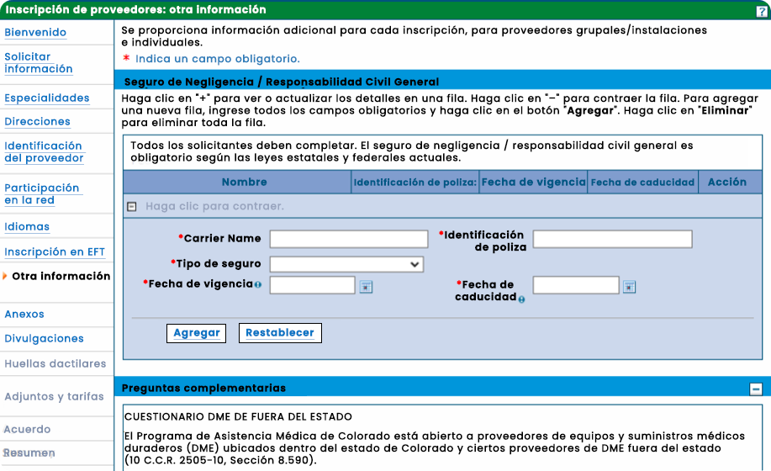
Se proporciona información adicional para cada inscripción, para proveedores de grupo/instalación e individuales.
Indica un campo obligatorio.
Indica un campo obligatorio.
Seguro de Negligencia/Responsabilidad General
Haga clic en "+" para ver o actualizar los detalles de una fila. Haga clic en "-" para contraer la fila. Para añadir una nueva fila, introduzca todos los campos obligatorios y haga clic en el botón "Agregar". Haga clic en "Eliminar" para eliminar toda la fila.
Todos los solicitantes deben completar, el seguro de Negligencia/Responsabilidad General es obligatorio según la ley estatal y federal actual.
Nombre
ID de Póliza
Fecha Efectiva
Vencimiento
Acción
Nombre de la Aseguradora
ID de Póliza
Tipo de Seguro
Fecha efectiva
Fecha de Vencimiento
Agregar
Restablecer
Preguntas Suplementarias
Notes:
Enter your insurance information under the (1) other information tab. This includes your (2) carrier name, (2) policy ID, (3) insurance tyle, (4) effective and (5) expiration date. (6) As a doula you must have liability or professional insurance.

Slide 139
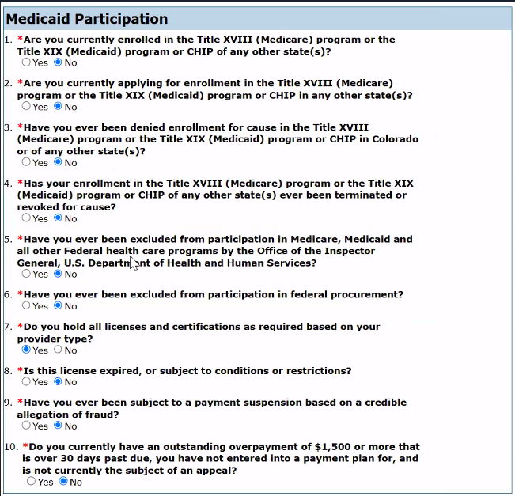
Notes:
Next you will complete the Medicaid Participation questions.

Slide 140
Participación en Medicaid
¿Está usted actualmente inscrito en el programa Título XVIII (Medicare) o en el programa Título XIX (Medicaid) o CHIP de cualquier otro estado?
Si
¿Está solicitando actualmente la inscripción en el programa Título XVIII (Medicare) o en el programa Título XIX (Medicaid) o CHIP en cualquier otro estado?
Si
¿Se le ha denegado alguna vez la inscripción por causa justificada en el programa Título XVIII (Medicare) o en el programa Título XIX (Medicaid) o CHIP en Colorado o en cualquier otro estado(s)?
Si
¿Se ha terminado o revocado alguna vez su inscripción en el programa Título XVIII (Medicare) o en el programa Título XIX (Medicaid) o CHIP de cualquier otro estado(s) por causa justificada?
¿Se ha terminado o revocado alguna vez su inscripción en el programa Título XVIII (Medicare) o en el programa Título XIX (Medicaid) o CHIP de cualquier otro estado(s) por causa justificada?
Si
¿Ha sido usted excluido alguna vez de la participación en Medicare, Medicaid y todos los demás programas federales de atención médica por la Oficina del Inspector General, Departamento de Salud y Servicios Humanos de EE. UU.?
Si
¿Ha sido usted excluido alguna vez de la participación en la contratación federal?
Si
¿Posee todas las licencias y certificaciones requeridas según su tipo de proveedor?
Si
¿Esta licencia está caducada o sujeta a condiciones o restricciones?
Si
¿Ha sido usted objeto de una suspensión de pagos basada en una alegación creíble de fraude?
Si
¿Tiene usted actualmente un sobrepago pendiente de $1,500 o más que tiene más de 30 días de vencimiento, no ha entrado en un plan de pagos y no es actualmente objeto de una apelación?
Si
Notes:
Next you will complete the Medicaid Participation questions.

Slide 141
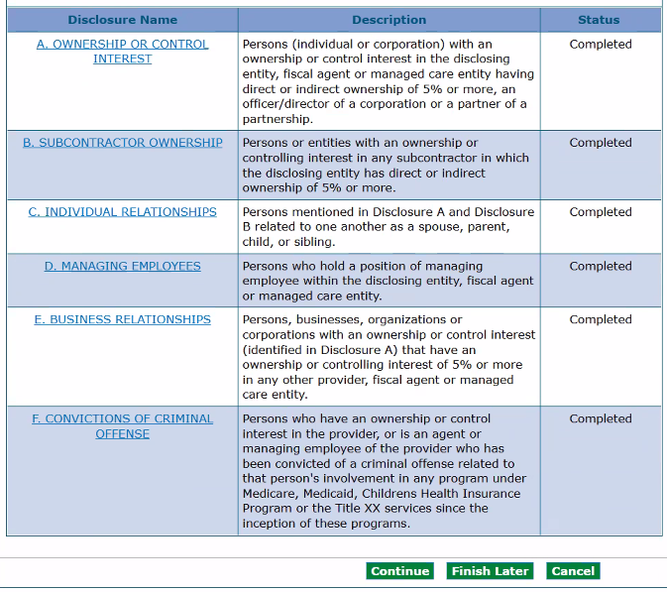
Notes:
Click on the link for each disclosure, complete information, and click add and submit.
Groups must list owners’ social security numbers, practice address, and date of birth. Once all are completed, click continue.

Slide 142
Nombre de la Declaración
Descripción
Estado
Personas (Individual o corporación) con una participación en la propiedad o control en la entidad declarante que tengan un interés fiscal o una entidad de atención administrada que posean directa o indirectamente el 5% o más, o un oficial/director de una corporación o un socio de una sociedad.
A. PARTICIPACIÓN EN LA PROPIEDAD O CONTROL
Personas (Individual o corporación) con una participación en la propiedad o control en la entidad declarante que tengan un interés fiscal o una entidad de atención administrada que posean directa o indirectamente el 5% o más, o un oficial/director de una corporación o un socio de una sociedad.
Completado
B. PROPIEDAD DEL SUBCONTRATISTA
Personas o entidades con una participación en la propiedad o control en cualquier subcontratista en el que la entidad declarante tenga una propiedad directa o indirecta del 5% o más.
Completado
C. RELACIONES INDIVIDUALES
Personas mencionadas en la Declaración A y la Declaración B relacionadas entre sí como cónyuge, padre, hijo o hermano.
Completado
D. EMPLEADOS DIRECTIVOS
Personas que ocupan un puesto de empleado directivo dentro de la entidad declarante, agente fiscal o entidad de atención administrada.
Completado
E. RELACIONES COMERCIALES
Personas, empresas, organizaciones o corporaciones con una participación en la propiedad o control (identificadas en la Declaración A) que tengan una participación en la propiedad o control del 5% o más en cualquier otro proveedor, agente fiscal o entidad de atención administrada.
Completado
F. CONDENAS POR DELITOS PENALES
Personas que tienen una participación en la propiedad o control en el proveedor, o son un agente o empleado directivo del proveedor que ha sido condenado por un delito penal relacionado con la participación de esa persona en cualquier programa bajo Medicare, Medicaid, Programa de Seguro de Salud para Niños o los servicios del Título XX desde el inicio de estos programas.
Completado
Continuar
Seguir luego
Cancelar
Notes:
Click on the link for each disclosure, complete information, and click add and submit.
Groups must list owners’ social security numbers, practice address, and date of birth. Once all are completed, click continue.

Slide 143
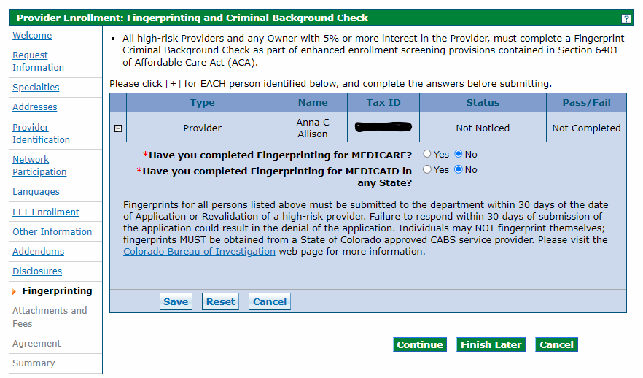

Be sure to use code 25YQG9* when making an appointment with IdentoGO!
IdentoGO website:
https://uenroll.identogo.com/
Cost Considerations: In 2025, fingerprinting costs $16.50 in Colorado
Notes:
Complete the background check information on the next page. (1) Fingerprinting background checks are required for doulas. You will need to pay to be fingerprinted. (2) Be sure to use the code displayed on the screen when making an appointment with IdentoGO, the agency that conducts the background check. HPCF will then check to ensure that all the individuals listed in your application have received the background check.
In 2025, the cost of fingerprinting was $16.50.

Slide 144
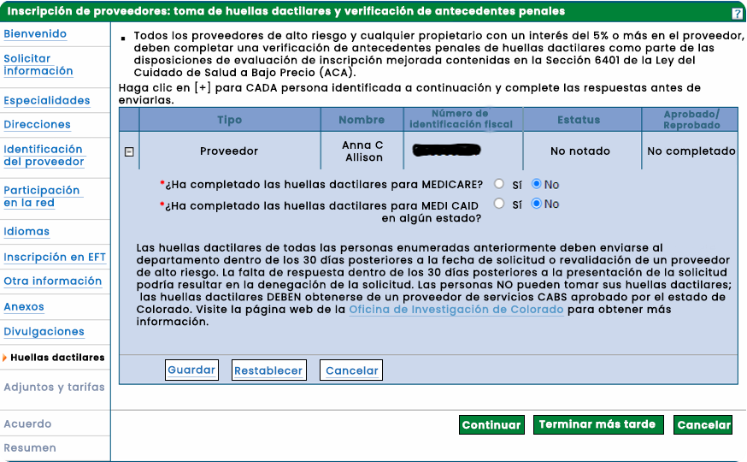
Asegúrate de usar el código 25YQG9* al hacer una cita con IdentoGO
Sitio web de IdentoGO:
https://uenroll.identogo.com/
Tipo
Nombre
ID Fiscal
Estado
Aprobado/Fallido
Proveedor
No Notificado
No completado
¿Ha completado la toma de huellas dactilares para MEDICARE?
Si
¿Ha completado la toma de huellas dactilares para MEDICAID en algún estado?
Si
Guardar
Reestablecer
Cancelar
Continuar
Seguir luego
Cancelar
Consideraciones de Costo: En 2025, el costo de la toma de huellas dactilares es de $16.50 en Colorado.
Notes:
Complete the background check information on the next page. (1) Fingerprinting background checks are required for doulas. You will need to pay to be fingerprinted. (2) Be sure to use the code displayed on the screen when making an appointment with IdentoGO, the agency that conducts the background check. HPCF will then check to ensure that all the individuals listed in your application have received the background check.
In 2025, the cost of fingerprinting was $16.50.

Slide 145
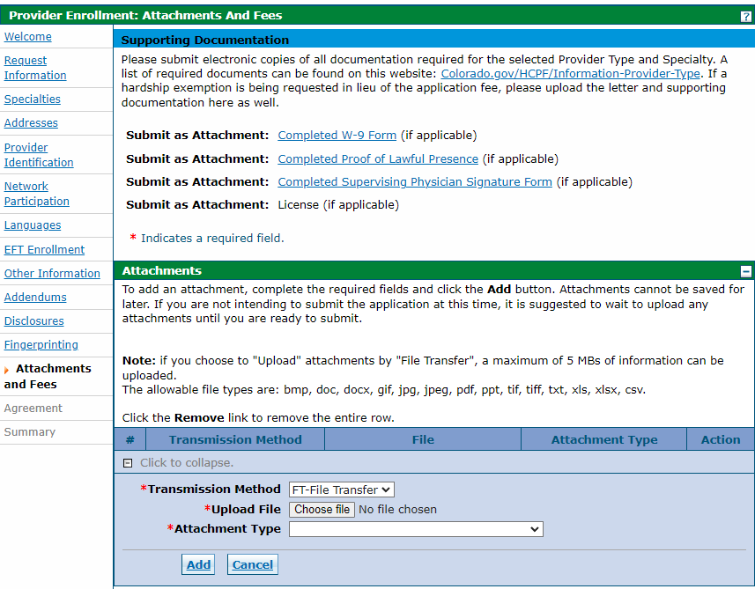

Attachment Type | Attachment
W-9 | W-9 with SSN
Voided Check or Bank Letter | Voided Check or Bank Letter
Other | Attestations
Other | Doula Code of Conduct
Other | CPR Card
Other | Lawful Presence Affidavit
Other | Front of Driver’s License/ State ID
Other | Back of driver’s license/ state ID
Other | Copy of Insurance Policy
Other | Doula Certification
Other | Doula Training Certificate
Other | Letters of Recommendation
Notes:
(1) Upload supporting documents on the attachments and fees page.
(2) Your W9 and Voided check/bank letter should be filed as their specific attachment type. All other documents will be listed as “Other.”

Slide 146
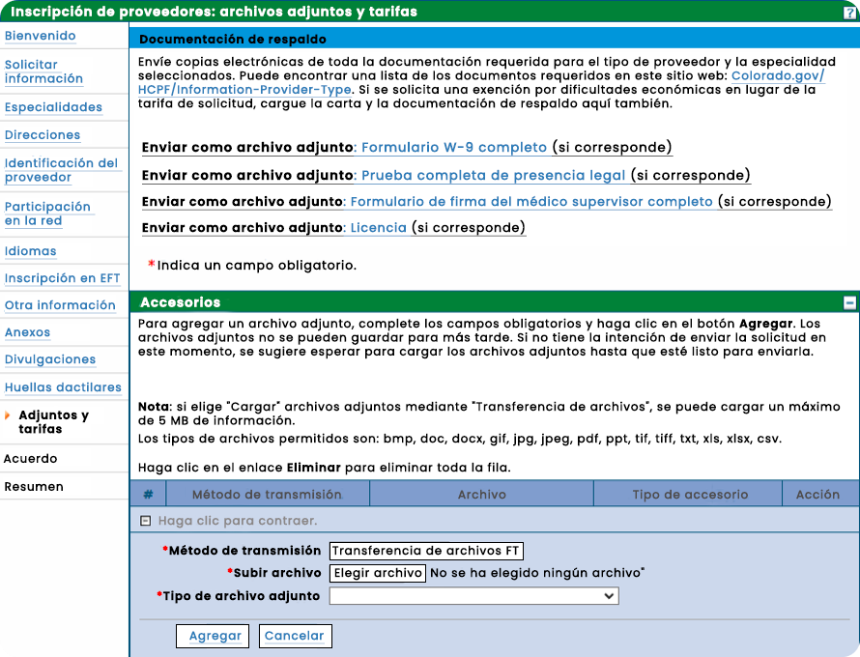
Tipo de Adjunto | Adjunto
W-9 | W-9 con SSN
Cheque anulado/carta del banco | Cheque anulado/carta del banco
Otro | Atestaciones
Otro | Código de Conducta de Doula
Otro | Tarjeta de RCP
Otro | Declaración jurada de presencia legal
Otro | Frente de la licencia de conducir/ID estatal
Otro | Reverso de la licencia de conducir/ID estatal
Otro | Copia de la póliza de seguro
Otro | Certificación de Doula
Otro | Certificado de capacitación en Doula
Otro | Cartas de recomendación
Indica un campo obligatorio.
Método de Transmisión
Archivo
Tipo de Anexo
Hacer clic para contraer.
Método de Transmisión
Cargar archivo
Tipo de Anexo
Agregar
Cancelar
Notes:
(1) Upload supporting documents on the attachments and fees page.
(2) Your W9 and Voided check/bank letter should be filed as their specific attachment type. All other documents will be listed as “Other.”

Slide 147






Registering for the System
Click submit, and you’re done!
Read and Agree to the Provider Enrollment Agreement
Print or Save
Review Final Summary
Notes:
(1)Read and agree to the Provider Enrollment Agreement on the agreement tab. Be sure to (2) print or save the agreement for your files or records. The final summary tab will give you a chance to (3) review the information you provided. (4) Click submit once the information is correct and you’re done!
Please note that some providers of moderate-to high-risk specialties undergo a virtual site visit with the Fiscal Agent to ensure that the provider is operating as a legitimate business. However, this is NOT required for doulas.

Slide 148
Registro en el sistema
Haz clic en Enviar y ¡listo!
Leer y Aceptar el Acuerdo de inscripción de Proveedores
Imprimir o guardar
Revisar el resumen final
Notes:
(1)Read and agree to the Provider Enrollment Agreement on the agreement tab. Be sure to (2) print or save the agreement for your files or records. The final summary tab will give you a chance to (3) review the information you provided. (4) Click submit once the information is correct and you’re done!
Please note that some providers of moderate-to high-risk specialties undergo a virtual site visit with the Fiscal Agent to ensure that the provider is operating as a legitimate business. However, this is NOT required for doulas.

Slide 149
Billing for Services
Notes:
Let’s move on to how you bill for services.

Slide 150
Facturación de servicios
Notes:
Let’s move on to how you bill for services.

Slide 151

Billing for Services
Provide services
Submit claims via the Medicaid Provider Web Portal (within 365 days of service)
Get reimbursed on a fee-for-service basis
Notes:
Once you are registered in the Medicaid Provider Web Portal and begin to provide services, you will submit electronic claims directly through the portal to be reimbursed for services to the bank account provided. The claim will include information on the services you provided and will be reimbursed on a fee-for-service basis, meaning that you get paid for exactly whatever services you rendered.
It is your responsibility to submit billing information. You will have up to 365 days from the date of service to submit your claim; after 365 days from the date of service, a claim is no longer eligible to be paid.

Slide 152
Facturación de servicios
Proporcionar servicios
Presentar reclamaciones a través del Portal Web de Proveedores de Medicaid (dentro de los 365 días posteriores al servicio)
Recibir reembolso en base a tarifa por servicio
Notes:
Once you are registered in the Medicaid Provider Web Portal and begin to provide services, you will submit electronic claims directly through the portal to be reimbursed for services to the bank account provided. The claim will include information on the services you provided and will be reimbursed on a fee-for-service basis, meaning that you get paid for exactly whatever services you rendered.
It is your responsibility to submit billing information. You will have up to 365 days from the date of service to submit your claim; after 365 days from the date of service, a claim is no longer eligible to be paid.

Slide 153
Billing Overview
Submit claims via the Medicaid Provider Web Portal (within 365 days of service)
Service Type | Diagnosis Code | HCPCS* Code | Rate | Max Units/$ per Pregnancy | Visit Structure Options
Prenatal | Z33.1 | T1032 | $25 | 12 units/$300 | 15-minute increments
Postpartum | Z39.2 | T1032 | $25 | 12 units/$300 | 15-minute increments
Labor & Delivery | Z33.1 | T1033 | $900 | 1 unit/$900 | 1 service
* Healthcare Common Procedure Coding System (HCPCS)
Notes:
(1) For prenatal and postpartum care, you will bill time in 15-minute increments up to a maximum of 180 minutes each. The number and length of visits is at your discretion (for example, three hour-long visits and six 30-minute visits are both equivalent to 12 units). For attending labor and delivery, you will bill one unit of service.

Slide 154
Resumen de facturación
Presentar reclamaciones a través del Portal Web de Proveedores de Medicaid (dentro de los 365 días posteriores al servicio)
Tipo de servicio | Código de diagnóstico | Código HCPCS* | Tarifa | Unidades máximas/$ por embarazo | Opciones de Estructura de Visitas
Cuidado Prenatal | Z33.1 | T1032 | $25 | 12 unidades/$300 | Incrementos de 15 minutos
Postparto | Z39.2 | T1032 | $25 | 12 unidades/$300 | Incrementos de 15 minutos
Trabajo de parto y parto | Z33.1 | T1033 | $900 | 1 unidad/$900 | 1 servicio
* Sistema de Codificación de Procedimientos Comunes de Atención Médica (HCPCS)
Notes:
(1) For prenatal and postpartum care, you will bill time in 15-minute increments up to a maximum of 180 minutes each. The number and length of visits is at your discretion (for example, three hour-long visits and six 30-minute visits are both equivalent to 12 units). For attending labor and delivery, you will bill one unit of service.

Slide 155
Required to submit a successful claim:
Medicaid Provider ID
Provided to you once you enroll in Health First Colorado
Notes:
The Following information is required to submit a successful claim:
(1) First, your Medicaid Provider ID. You will be provided this number once you are enrolled in Health First Colorado.

Slide 156
Requisitos para presentar una reclamación exitosa:
ID de Proveedor de Medicaid
Este número se te proporcionará una vez que te inscribas en Health First Colorado
Notes:
The Following information is required to submit a successful claim:
(1) First, your Medicaid Provider ID. You will be provided this number once you are enrolled in Health First Colorado.

Slide 157
Required to submit a successful claim:
Medicaid Provider ID
Provider (Doula) NPI Number
See “Preparing Your Business” for more info
Notes:
You will also need your provider NPI number: You included this code as part of your Health First Colorado application. See the Preparing Your Business for Health First Colorado training for more information.

Slide 158
Requisitos para presentar una reclamación exitosa:
ID de Proveedor de Medicaid
Número NPI del Proveedor (Doula)
Consulta “Prepara tu negocio” para más información
Notes:
You will also need your provider NPI number: You included this code as part of your Health First Colorado application. See the Preparing Your Business for Health First Colorado training for more information.

Slide 159
Required to submit a successful claim:
Medicaid Provider ID
Provider (Doula) NPI Number
Provider (Referring Clinician) NPI Number
See “Establishing Good Processes for Doula Practices” for more info
Notes:
You will also need the NPI number of the client’s recommending provider. See the Establishing Good Processes for Doula Practices section for more information.

Slide 160
Requisitos para presentar una reclamación exitosa:
ID de Proveedor de Medicaid
Número NPI del Proveedor (Doula)
Número NPI del Proveedor (Clínico Referente)
Consulta “Estableciendo buenos procesos para las prácticas de doula” para más información.
Notes:
You will also need the NPI number of the client’s recommending provider. See the Establishing Good Processes for Doula Practices section for more information.

Slide 161
Required to submit a successful claim:
Medicaid Provider ID
Provider (Doula) NPI Number
Provider (Referring Clinician) NPI Number
Member Medicaid ID
Assigned to those enrolled in Health First Colorado
Notes:
Make sure you include your member Medicaid ID: This code is assigned to people who are covered by Medicaid.
Note that clients enrolled in CHP+ are eligible for doula services, but the doula billing manual applies to both Health First Colorado and CHP+ enrollees.

Slide 162
Requisitos para presentar una reclamación exitosa:
ID de Proveedor de Medicaid
Número NPI del Proveedor (Doula)
Número NPI del Proveedor (Clínico Referente)
ID de Medicaid del Miembro
Asignado a quienes están inscritos en Health First Colorado
Asignado a quienes están inscritos en Health First Colorado
Notes:
Make sure you include your member Medicaid ID: This code is assigned to people who are covered by Medicaid.
Note that clients enrolled in CHP+ are eligible for doula services, but the doula billing manual applies to both Health First Colorado and CHP+ enrollees.

Slide 163

Required to submit a successful claim:
Medicaid Provider ID
Provider (Doula) NPI Number
Provider (Referring Clinician) NPI Number
Member Medicaid ID
Assigned to those enrolled in Health First Colorado
Check Medicaid eligibility and document the client’s Medicaid ID before providing services
Notes:
(1) Remember to check Health First Colorado eligibility and document the client’s Medicaid ID before providing services. The person must be eligible for Medicaid at the time services are rendered for you to be reimbursed.

Slide 164
Requisitos para presentar una reclamación exitosa:
ID de Proveedor de Medicaid
Número NPI del Proveedor (Doula)
Número NPI del Proveedor (Clínico Referente)
ID de Medicaid del Miembro
Asignado a quienes están inscritos en Health First Colorado
Asignado a quienes están inscritos en Health First Colorado
Verifica la elegibilidad de Medicaid y documenta el ID de Medicaid del cliente antes de proporcionar servicios
Notes:
(1) Remember to check Health First Colorado eligibility and document the client’s Medicaid ID before providing services. The person must be eligible for Medicaid at the time services are rendered for you to be reimbursed.

Slide 165
Required to submit a successful claim:
Medicaid Provider ID
Provider (Doula) NPI Number
Provider (Referring Clinician) NPI Number
Member Medicaid ID
Member Information
Member name, address, and date of birth
Notes:
Include the member information such as their name, address, and date of birth.

Slide 166
Requisitos para presentar una reclamación exitosa:
ID de Proveedor de Medicaid
Número NPI del Proveedor (Doula)
Número NPI del Proveedor (Clínico Referente)
ID de Medicaid del Miembro
Información del miembro
Nombre, dirección y fecha de nacimiento del miembro
Notes:
Include the member information such as their name, address, and date of birth.

Slide 167
Required to submit a successful claim:
Medicaid Provider ID
Provider (Doula) NPI Number
Provider (Referring Clinician) NPI Number
Member Medicaid ID
Member Information
Diagnosis Code
The condition being treated:
Notes:
You will also need a diagnosis code. These diagnostic codes communicate the condition being treated.

Slide 168
Requisitos para presentar una reclamación exitosa:
ID de Proveedor de Medicaid
Número NPI del Proveedor (Doula)
Número NPI del Proveedor (Clínico Referente)
ID de Medicaid del Miembro
Información del miembro
Código de diagnóstico
La condición que se está tratando:
Notes:
You will also need a diagnosis code. These diagnostic codes communicate the condition being treated.

Slide 169
Required to submit a successful claim:
Medicaid Provider ID
Provider (Doula) NPI Number
Provider (Referring Clinician) NPI Number
Member Medicaid ID
Member Information
Diagnosis Code
The condition being treated:
Z33.1 for “pregnant state” for prenatal visits and labor and delivery
Z39.2 for “routine postpartum follow-up” for postpartum visits
Notes:
Report a diagnosis code of Z33.1 indicating “pregnant state” for prenatal visits and labor and delivery. (1) Report Z39.2 for “routine postpartum follow up” for postpartum visits.

Slide 170
Requisitos para presentar una reclamación exitosa:
ID de Proveedor de Medicaid
Número NPI del Proveedor (Doula)
Número NPI del Proveedor (Clínico Referente)
ID de Medicaid del Miembro
Información del miembro
Código de diagnóstico
La condición que se está tratando:
Z33.1 para “estado de embarazo” para visitas prenatales y trabajo de parto y parto
Z39.2 para “seguimiento postparto rutinario” para visitas postparto
Notes:
Report a diagnosis code of Z33.1 indicating “pregnant state” for prenatal visits and labor and delivery. (1) Report Z39.2 for “routine postpartum follow up” for postpartum visits.

Slide 171
Required to submit a successful claim:
Medicaid Provider ID
Provider (Doula) NPI Number
Provider (Referring Clinician) NPI Number
Member Medicaid ID
Member Information
Diagnosis Code
HCPCS Code
What services were delivered:
Notes:
Include the (pronunciation: hick-picks) HCPCS Code. These procedure codes communicate what services were delivered.

Slide 172
Requisitos para presentar una reclamación exitosa:
ID de Proveedor de Medicaid
Número NPI del Proveedor (Doula)
Número NPI del Proveedor (Clínico Referente)
ID de Medicaid del Miembro
Información del miembro
Código de diagnóstico
Código HCPCS
Qué servicios se prestaron:
Notes:
Include the (pronunciation: hick-picks) HCPCS Code. These procedure codes communicate what services were delivered.

Slide 173
Required to submit a successful claim:
Medicaid Provider ID
Provider (Doula) NPI Number
Provider (Referring Clinician) NPI Number
Member Medicaid ID
Member Information
Diagnosis Code
HCPCS Code
What services were delivered:
T1032 for prenatal and postpartum visits
Notes:
Report a HCPCS code of T1032 indicating doula birth worker services for prenatal and postpartum visits.

Slide 174
Requisitos para presentar una reclamación exitosa:
ID de Proveedor de Medicaid
Número NPI del Proveedor (Doula)
Número NPI del Proveedor (Clínico Referente)
ID de Medicaid del Miembro
Información del miembro
Código de diagnóstico
Código HCPCS
Qué servicios se prestaron:
T1032 para visitas prenatales y postparto
Notes:
Report a HCPCS code of T1032 indicating doula birth worker services for prenatal and postpartum visits.

Slide 175
Required to submit a successful claim:
Medicaid Provider ID
Provider (Doula) NPI Number
Provider (Referring Clinician) NPI Number
Member Medicaid ID
Member Information
Diagnosis Code
HCPCS Code
What services were delivered:
T1032 for prenatal and postpartum visits
T1033 for labor and delivery
Notes:
Report a HCPCS code of T1033 indicating doula birth worker services for labor and delivery.

Slide 176
Requisitos para presentar una reclamación exitosa:
ID de Proveedor de Medicaid
Número NPI del Proveedor (Doula)
Número NPI del Proveedor (Clínico Referente)
ID de Medicaid del Miembro
Información del miembro
Código de diagnóstico
Código HCPCS
Qué servicios se prestaron:
T1032 para visitas prenatales y postparto
T1033 para Trabajo de parto y parto
Notes:
Report a HCPCS code of T1033 indicating doula birth worker services for labor and delivery.

Slide 177
Required to submit a successful claim:
Medicaid Provider ID
Provider (Doula) NPI Number
Provider (Referring Clinician) NPI Number
Member Medicaid ID
Member Information
Diagnosis Code
HCPCS Code
Units
The number of services:
Notes:
Units indicate the number of services represented in the claim.

Slide 178
Requisitos para presentar una reclamación exitosa:
ID de Proveedor de Medicaid
Número NPI del Proveedor (Doula)
Número NPI del Proveedor (Clínico Referente)
ID de Medicaid del Miembro
Información del miembro
Código de diagnóstico
Código HCPCS
Unidades
Número de servicios:
Notes:
Units indicate the number of services represented in the claim.

Slide 179
Required to submit a successful claim:
Medicaid Provider ID
Provider (Doula) NPI Number
Provider (Referring Clinician) NPI Number
Member Medicaid ID
Member Information
Diagnosis Code
HCPCS Code
Units
The number of services:
1 for each 15 minutes of a prenatal or postpartum visit
Notes:
Report one unit for each 15 minutes of a prenatal or postpartum visit. For example, an hour-long visit is 4 units of 15 minutes.

Slide 180
Requisitos para presentar una reclamación exitosa:
ID de Proveedor de Medicaid
Número NPI del Proveedor (Doula)
Número NPI del Proveedor (Clínico Referente)
ID de Medicaid del Miembro
Información del miembro
Código de diagnóstico
Código HCPCS
Unidades
Número de servicios:
1 por cada 15 minutos de una visita prenatal o postparto
Notes:
Report one unit for each 15 minutes of a prenatal or postpartum visit. For example, an hour-long visit is 4 units of 15 minutes.

Slide 181
Required to submit a successful claim:
Medicaid Provider ID
Provider (Doula) NPI Number
Provider (Referring Clinician) NPI Number
Member Medicaid ID
Member Information
Diagnosis Code
HCPCS Code
Units
The number of services:
1 for each 15 minutes of a prenatal or postpartum visit
1 for labor and delivery
Notes:
Report one unit for labor and delivery.

Slide 182
Requisitos para presentar una reclamación exitosa:
ID de Proveedor de Medicaid
Número NPI del Proveedor (Doula)
Número NPI del Proveedor (Clínico Referente)
ID de Medicaid del Miembro
Información del miembro
Código de diagnóstico
Código HCPCS
Unidades
Número de servicios:
1 por cada 15 minutos de una visita prenatal o postparto
1 por trabajo de parto y parto
Notes:
Report one unit for labor and delivery.

Slide 183
Required to submit a successful claim:
Medicaid Provider ID
Provider (Doula) NPI Number
Provider (Referring Clinician) NPI Number
Member Medicaid ID
Member Information
Diagnosis Code
HCPCS Code
Units
Date of Service
The date the service was performed
Report only the first date of labor
Notes:
For labor and delivery services that occur on multiple dates, report only the first day of labor in the claim.

Slide 184
Requisitos para presentar una reclamación exitosa:
ID de Proveedor de Medicaid
Número NPI del Proveedor (Doula)
Número NPI del Proveedor (Clínico Referente)
ID de Medicaid del Miembro
Información del miembro
Código de diagnóstico
Código HCPCS
Unidades
Fecha del servicio
La fecha en que se realizó el servicio
Reportar solo la primera fecha de trabajo de parto
Notes:
For labor and delivery services that occur on multiple dates, report only the first day of labor in the claim.

Slide 185
Steps to Submitting a Claim:
1. Log into the system
2. Fill out necessary information
3. Navigate between pages of the form
4. Submit claim
Notes:
The steps to submitting a claim include:
- (1, 2) Logging into the system
- (3, 4) Filling out necessary information
- (5, 6) Navigating between pages of the form
- (7, 8) and submitting the claim

Slide 186
Pasos para presentar una reclamación:
1. Inicia sesión en el sistema
2. Completa la información necesaria
3. Navegar entre las páginas del formulario
4. Presenta la reclamación
Notes:
The steps to submitting a claim include:
- (1, 2) Logging into the system
- (3, 4) Filling out necessary information
- (5, 6) Navigating between pages of the form
- (7, 8) and submitting the claim

Slide 187
After Submission:
You will receive real-time feedback and a claim status
Notes:
After submission you will receive immediate feedback on whether your claim is accepted directly in the Medicaid Provider Web Portal.

Slide 188
Después de la Presentación:
Recibirás comentarios en tiempo real y un estado de la reclamación
Notes:
After submission you will receive immediate feedback on whether your claim is accepted directly in the Medicaid Provider Web Portal.

Slide 189
After Submission:
You will receive real-time feedback and a claim status
Paid Status: claim is complete, does not require additional review, and no further action is necessary on your part.
Notes:
A paid status indicates that the claim is complete, does not require additional review, and no further action is necessary on your part. Claims will generally be paid within two weeks of receipt.

Slide 190
Después de la Presentación:
Recibirás comentarios en tiempo real y un estado de la reclamación
Estado Pagado: la reclamación está completa, no requiere revisión adicional y no es necesario que realices más acciones.
Notes:
A paid status indicates that the claim is complete, does not require additional review, and no further action is necessary on your part. Claims will generally be paid within two weeks of receipt.

Slide 191
After Submission:
You will receive real-time feedback and a claim status
Paid Status: claim is complete, does not require additional review, and no further action is necessary on your part.
Suspended Status: claim needs additional manual review by the Fiscal Agent.
Notes:
A suspended status means that the claim needs additional manual review by the Fiscal Agent. The claim will advance to “paid” status if subsequent review finds that no additional information is needed.

Slide 192
Después de la Presentación:
Recibirás comentarios en tiempo real y un estado de la reclamación
Estado Pagado: la reclamación está completa, no requiere revisión adicional y no es necesario que realices más acciones.
Estado Suspendido: la reclamación necesita una revisión manual adicional por parte del Agente Fiscal.
Notes:
A suspended status means that the claim needs additional manual review by the Fiscal Agent. The claim will advance to “paid” status if subsequent review finds that no additional information is needed.

Slide 193
After Submission:
You will receive real-time feedback and a claim status
Paid Status: claim is complete, does not require additional review, and no further action is necessary on your part.
Suspended Status: claim needs additional manual review by the Fiscal Agent.
Denied Status: the claim is returned to you with the reason for denial.
Notes:
A denied status means that the claim needs additional manual review A denied claim, either in the initial submission or after review, will be returned to you with the reason for denial. You may resubmit the claim the claim after addressing issues (e.g., missing or incorrect information).

Slide 194
Después de la Presentación:
Recibirás comentarios en tiempo real y un estado de la reclamación
Estado Pagado: la reclamación está completa, no requiere revisión adicional y no es necesario que realices más acciones.
Estado Suspendido: la reclamación necesita una revisión manual adicional por parte del Agente Fiscal.
Estado Denegado: la reclamación se te devuelve con la razón de la denegación.
Notes:
A denied status means that the claim needs additional manual review A denied claim, either in the initial submission or after review, will be returned to you with the reason for denial. You may resubmit the claim the claim after addressing issues (e.g., missing or incorrect information).

Slide 195
Submitting a Claim:
Denied Status: the claim is returned to you with the reason for denial.
Common reasons for denial include:
Client is not enrolled in Medicaid
Member Cap Exceeded
Claim does not align with approved NPI
Notes:
Common reasons for denial include:
The Client is not enrolled in Health First Colorado: Check the system to make sure the member is enrolled in Health First Colorado and eligible to receive services prior to providing services. If the client is not enrolled in Health First Colorado, refer the client to the Colorado PEAK system. Clients can also contact their county government agency, which may have trained enrollment specialists.

Slide 196
Presenta la reclamación
Estado Denegado: la reclamación se te devuelve con la razón de la denegación.
Razones comunes para la denegación incluyen:
El cliente no está inscrito en Medicaid
Se ha superado el límite del miembro
La reclamación no coincide con el NPI aprobado
Notes:
Razones comunes para la denegación incluyen:
The Client is not enrolled in Health First Colorado: Check the system to make sure the member is enrolled in Health First Colorado and eligible to receive services prior to providing services. If the client is not enrolled in Health First Colorado, refer the client to the Colorado PEAK system. Clients can also contact their county government agency, which may have trained enrollment specialists.

Slide 197
Submitting a Claim:
Denied Status: the claim is returned to you with the reason for denial.
Common reasons for denial include:
Client is not enrolled in Medicaid
Missing or incorrect diagnosis codes or HCPCS codes
Member Cap Exceeded
Claim does not align with approved NPI
Notes:
There may also be a Missing or incorrect Diagnosis Codes or HCPCS Codes: Make sure you use the correct combination of Diagnosis and HCPCS Codes.

Slide 198
Presenta la reclamación
Estado Denegado: la reclamación se te devuelve con la razón de la denegación.
Razones comunes para la denegación incluyen:
El cliente no está inscrito en Medicaid
Códigos de diagnóstico o códigos HCPCS faltantes o incorrectos
Se ha superado el límite del miembro
La reclamación no coincide con el NPI aprobado
Notes:
There may also be a Missing or incorrect Diagnosis Codes or HCPCS Codes: Make sure you use the correct combination of Diagnosis and HCPCS Codes.

Slide 199
Submitting a Claim:
Denied Status: the claim is returned to you with the reason for denial.
Common reasons for denial include:
Client is not enrolled in Health First Colorado
Missing or incorrect diagnosis codes or HCPCS codes
Member cap exceeded
Claim does not align with approved NPI
Notes:
It is possible the member cap has been exceeded: All benefits relate to the member. If more than one doula supports the member, then the combined time across those doulas cannot exceed the caps. For example, if one doula is reimbursed for one 60-minute visit and one 90-minute visit during the prenatal period, a second doula can only be reimbursed for one 30-minute visit or two 15-minute visits.

Slide 200
Presenta la reclamación
Estado Denegado: la reclamación se te devuelve con la razón de la denegación.
Razones comunes para la denegación incluyen:
El cliente no está inscrito en Health First Colorado
Códigos de diagnóstico o códigos HCPCS faltantes o incorrectos
Se ha superado el límite del miembro
La reclamación no coincide con el NPI aprobado
Notes:
It is possible the member cap has been exceeded: All benefits relate to the member. If more than one doula supports the member, then the combined time across those doulas cannot exceed the caps. For example, if one doula is reimbursed for one 60-minute visit and one 90-minute visit during the prenatal period, a second doula can only be reimbursed for one 30-minute visit or two 15-minute visits.

Slide 201
Submitting a Claim:
Denied Status: the claim is returned to you with the reason for denial
Common reasons for denial include:
Client is not enrolled in Health First Colorado
Missing or incorrect diagnosis codes or HCPCS codes
Member cap exceeded
Claim does not align with approved NPI
Notes:
It is also possible your claim does not align with an approved NPI. Make sure the NPI you include on the claim matches the NPI you used to enrolled as a Health First Colorado provider.

Slide 202
Presenta la reclamación
Estado Denegado: la reclamación se te devuelve con la razón de la denegación.
Razones comunes para la denegación incluyen:
El cliente no está inscrito en Health First Colorado
Códigos de diagnóstico o códigos HCPCS faltantes o incorrectos
Se ha superado el límite del miembro
La reclamación no coincide con el NPI aprobado
Notes:
It is also possible your claim does not align with an approved NPI. Make sure the NPI you include on the claim matches the NPI you used to enrolled as a Health First Colorado provider.

Slide 203
Submitting a Claim:
Denied Status: the claim is returned to you with the reason for denial
Common reasons for denial include:
Client is not enrolled in Health First Colorado
Missing or incorrect diagnosis codes or HCPCS codes
Member cap exceeded
Claim does not align with approved NPI
Claim does not have NPI of referring clinician
Provider Service Call Center:
1-833-468-0362
Notes:
Finally, the claim may not have the NPI of the recommending licensed provider. You should have collected and stored the provider recommendation form when you first enrolled the client in doula services.
If your claim is denied, you can make the needed corrections and resubmit the claim for payment. If you need help resubmitting your claim, you can contact the help number shown on the screen.

Slide 204
Presenta la reclamación
Estado Denegado: la reclamación se te devuelve con la razón de la denegación.
Razones comunes para la denegación incluyen:
El cliente no está inscrito en Health First Colorado
Códigos de diagnóstico o códigos HCPCS faltantes o incorrectos
Se ha superado el límite del miembro
La reclamación no coincide con el NPI aprobado
La reclamación no incluye el NPI del clínico referente
Centro de llamadas de servicio al proveedor:
1-833-468-0362
Notes:
Finally, the claim may not have the NPI of the recommending licensed provider. You should have collected and stored the provider recommendation form when you first enrolled the client in doula services.
If your claim is denied, you can make the needed corrections and resubmit the claim for payment. If you need help resubmitting your claim, you can contact the help number shown on the screen.

Slide 205
Provider Maintenance and Revalidation
Notes:
Finally, we’ll talk about provider maintenance and revalidation. It is essential that doulas keep information in the Medicaid Provider Web Portal up to date through regular provider maintenance. In addition, doulas, like all Health First Colorado providers, need to revalidate every five years. Please regularly read email communications from Health First Colorado and sign up for the MCH listserv to make sure that you stay current on the latest information and requirements.

Slide 206
Mantenimiento y revalidación de proveedores
Notes:
Finally, we’ll talk about provider maintenance and revalidation. It is essential that doulas keep information in the Medicaid Provider Web Portal up to date through regular provider maintenance. In addition, doulas, like all Health First Colorado providers, need to revalidate every five years. Please regularly read email communications from Health First Colorado and sign up for the MCH listserv to make sure that you stay current on the latest information and requirements.

Slide 207
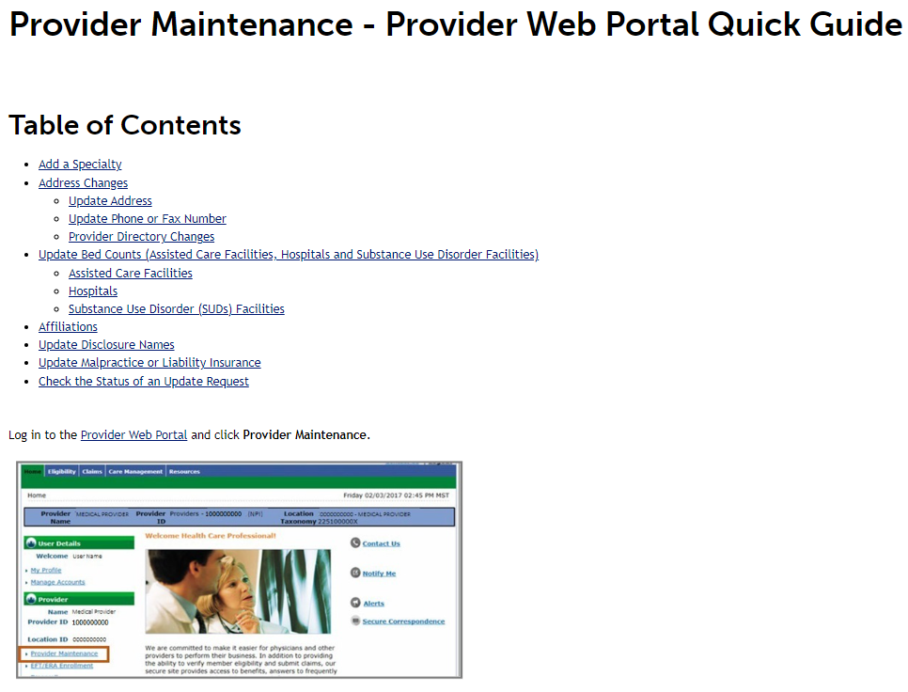
Provider Maintenance: General Information
Specialty
Address Change
Insurance
For more info on Provider Maintenance Requests, go to:
Provider Web Portal quick guide
Notes:
In order to keep their information up-to-date with Health First Colorado, occasionally providers must submit Provider Maintenance requests. This information includes your specialty, address changes, and insurance updates. If applicable, doulas should log into the Medicaid Provider Web Portal and click “Provider Maintenance” to update their information. Detailed information about Provider Maintenance requests can be found on the Provider Web Portal Quick Guide on the Department's website.

Slide 208
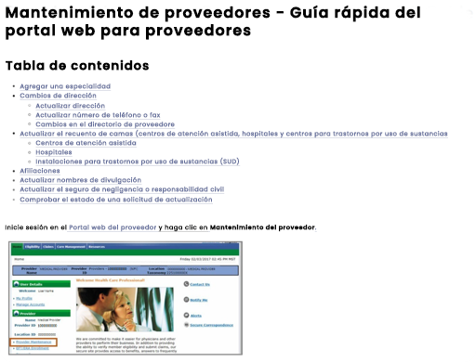
Mantenimiento del proveedor: información general
Especialidad
Cambio de dirección
Seguro
Para más información sobre las Solicitudes de Mantenimiento de Proveedores, visita:
Guía rápida del portal web del proveedor
Notes:
In order to keep their information up-to-date with Health First Colorado, occasionally providers must submit Provider Maintenance requests. This information includes your specialty, address changes, and insurance updates. If applicable, doulas should log into the Medicaid Provider Web Portal and click “Provider Maintenance” to update their information. Detailed information about Provider Maintenance requests can be found on the Provider Web Portal Quick Guide on the Department's website.

Slide 209
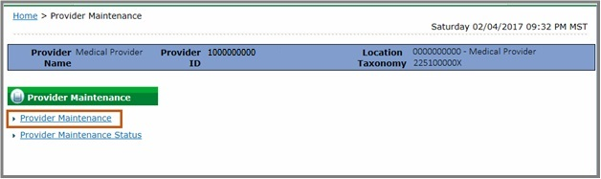
Provider Maintenance: Maintaining Current Doula Documentation
Doula Training Certification
CPR Certification
Notes:
Doulas will be expected to always maintain current doula training and CPR certificates, and you are responsible for uploading the required documentation to the Medicaid Provider Web Portal in accordance with the expiration dates of the relevant trainings. Since CPR certificates and Doula training certificates have different expiration dates than the rest of the Doula requirements, these must be updated through provider maintenance requests

Slide 210
Mantenimiento de Proveedores: Manteniendo la Documentación Actual de la Doula
Certificación de capacitación en Doula
Certificado de RCP
Inicio
Mantenimiento del Proveedor
Nombre del Proveedor
Médico
ID del Proveedor
Taxonomía de la Ubicación
Mantenimiento del Proveedor
Mantenimiento del Proveedor
Estado del Mantenimiento del Proveedor
Notes:
Doulas will be expected to always maintain current doula training and CPR certificates, and you are responsible for uploading the required documentation to the Medicaid Provider Web Portal in accordance with the expiration dates of the relevant trainings. Since CPR certificates and Doula training certificates have different expiration dates than the rest of the Doula requirements, these must be updated through provider maintenance requests

Slide 211


Revalidation: Every Five Years
Provider
The Department
Keeps enrollment information current
Suspends payment if incomplete
Updates certification and attestation documents
Removes ineligible and inactive providers
Notes:
Doulas will be expected to provide the Department with updated information on business practices through the revalidation process, which occurs every five years. This process is important to ensure that the information on file for each provider in the Medicaid Provider Web Portal remains current, including any needed certification and attestation forms. This information allows the Department to properly screen providers to ensure that they remain eligible and for providers to continue to offer services to members.
Ineligible and inactive providers will be removed during the revalidation process. Active providers that do not complete revalidation by the due date risk suspension of claims. You will be expected to re-sign the attestation documents that were required in the initial application and always maintain current doula certification documentation within the Medicaid Provider Web Portal, even between revalidations.

Slide 212
Revalidación: cada cinco años
Proveedor
Departamento
Mantiene la información de inscripción actualizada
Suspende el pago si está incompleto
Actualiza los documentos de certificación y atestación
Elimina a los proveedores no elegibles e inactivos
Notes:
Doulas will be expected to provide the Department with updated information on business practices through the revalidation process, which occurs every five years. This process is important to ensure that the information on file for each provider in the Medicaid Provider Web Portal remains current, including any needed certification and attestation forms. This information allows the Department to properly screen providers to ensure that they remain eligible and for providers to continue to offer services to members.
Ineligible and inactive providers will be removed during the revalidation process. Active providers that do not complete revalidation by the due date risk suspension of claims. You will be expected to re-sign the attestation documents that were required in the initial application and always maintain current doula certification documentation within the Medicaid Provider Web Portal, even between revalidations.

Slide 213



Preparing for Revalidation
Keep your email addresses current
Submit provider maintenance requests
Log into the Medicaid Provider Web Portal
Revalidate
Notes:
There are several steps to take to make sure your revalidation runs smoothly: keeping your email addresses current, submitting provider maintenance requests before revalidation, logging into the Medicaid Provider Web Portal, and applying for revalidation. We will dive deeper into each of these steps in the following slides.

Slide 214
Preparación para la revalidación
Mantén tus direcciones de correo electrónico actualizadas
Envía solicitudes de mantenimiento de proveedores
Inicia sesión en el Portal Web de Proveedores de Medicaid
Revalida
Notes:
There are several steps to take to make sure your revalidation runs smoothly: keeping your email addresses current, submitting provider maintenance requests before revalidation, logging into the Medicaid Provider Web Portal, and applying for revalidation. We will dive deeper into each of these steps in the following slides.

Slide 215

Keep Your Email Addresses Current
First notification 6 months prior to revalidation
Monthly reminder emails
To avoid missing emails:
  Keep email active and up to date
  Use a generic email in case employees leave
  Regularly check your inbox
Notes:
Doulas will receive an email six months before their revalidation deadline informing them of the need to revalidate; they will receive monthly reminders after the initial email. Once you receive this initial email, access the Medicaid Provider Web Portal and supply the necessary information. Revalidation notices will be sent to the email addresses listed in the Medicaid Provider Web Portal. To avoid missing critical emails: keep an active and up-to-date email address in the Medicaid Provider Web Portal. If you work for a doula organization, consider using a generic email address to ensure that the given email address is not linked to a staff member who may leave the organization, and regularly check your email for messages regarding revalidation.

Slide 216
Mantén tus direcciones de correo electrónico actualizadas
Primera notificación 6 meses antes de la revalidación
Recordatorios mensuales por correo electrónico
Para evitar perder correos electrónicos:
  Mantén el correo activo y actualizado
  Usa un correo genérico en caso de que los empleados se vayan
  Revisa regularmente tu bandeja de entrada
Notes:
Doulas will receive an email six months before their revalidation deadline informing them of the need to revalidate; they will receive monthly reminders after the initial email. Once you receive this initial email, access the Medicaid Provider Web Portal and supply the necessary information. Revalidation notices will be sent to the email addresses listed in the Medicaid Provider Web Portal. To avoid missing critical emails: keep an active and up-to-date email address in the Medicaid Provider Web Portal. If you work for a doula organization, consider using a generic email address to ensure that the given email address is not linked to a staff member who may leave the organization, and regularly check your email for messages regarding revalidation.

Slide 217
Submit Provider Maintenance Requests Before Revalidation
Business name
Address
Specialty
Insurance
Ownership
Notes:
Once you begin the revalidation application, you cannot submit Provider Maintenance Requests. This means that you cannot edit the prepopulated information (e.g., business name, address, insurance, specialty, and ownership) during revalidation. To prevent this, log into the Medicaid Provider Web Portal and review the information saved in the portal before beginning the revalidation application. If you find incorrect or out-of-date information in the portal, submit the Provider Maintenance Request before beginning the revalidation application.

Slide 218
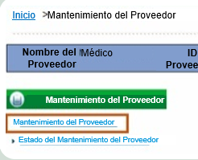
Enviar solicitudes de mantenimiento del proveedor antes de la revalidación
Nombre del negocio
Dirección
Especialidad
Seguro
Propiedad
Notes:
Once you begin the revalidation application, you cannot submit Provider Maintenance Requests. This means that you cannot edit the prepopulated information (e.g., business name, address, insurance, specialty, and ownership) during revalidation. To prevent this, log into the Medicaid Provider Web Portal and review the information saved in the portal before beginning the revalidation application. If you find incorrect or out-of-date information in the portal, submit the Provider Maintenance Request before beginning the revalidation application.

Slide 219


Thank you!
Questions? Contact HCPF at
hcpf_maternalchildhealth@state.co.us
or the Fiscal Agent at (833) 468-0362
Notes:
We’ve reached the end of this presentation. Thank you all for attending. If you have questions about the polices discussed during this presentation, contact the Department using the contact information displayed on the screen. If you have questions about enrolling in Health First Colorado, contact the fiscal agent using the contact information on the screen.

Slide 220
¡Gracias!
¿Tienes preguntas? Contacta a HCPF en
hcpf_maternalchildhealth@state.co.us
o al Agente Fiscal al (833) 468-0362
Notes:
We’ve reached the end of this presentation. Thank you all for attending. If you have questions about the polices discussed during this presentation, contact the Department using the contact information displayed on the screen. If you have questions about enrolling in Health First Colorado, contact the fiscal agent using the contact information on the screen.

