Slide 1
Seminario web sobre los requisitos laborales de Medicaid
Presentado por el Departamento de Políticas y Financiación de la Atención Sanitaria de Colorado
Notes:
Speaker: Kyra
Time: 2:30 // 1 min
Welcome to the Colorado Department of Health Care Policy & Financing webinar on Medicaid work requirements.
I’d like to let the Spanish interpreter introduce themselves right now.
SPANISH INTERPRETER COMES ON SCREEN and IS HIGHLIGHTED; Interpreter READS SCRIPT BELOW VERBATIM.
Interpreter reads (in Spanish, but this is what she is saying in English):
“My name is _____________and I will be providing Spanish interpretation services. In a moment, this service will be activated. To hear live Spanish interpretation of today’s event, select the “interpretation” pod from the Zoom toolbar and then select “Spanish”. You will have the option to select “mute original audio” if you want to hear only Spanish. This interpretation pod will be activated momentarily.”
Then [Webinar Leader] speaks once the interpreter is done:
Thank you, [Interpreter Name]. If you would like to listen to this webinar in Spanish, please select the “Interpretation” pod on your Zoom toolbar and select “Spanish”. We have also posted instructions for now to access language interpretation in the chat.
[Webinar Tech] Post in Chat:​
How to listen to Language Interpretation: https://support.zoom.com/hc/en/article?id=zm_kb&sysparm_article=KB0064768#h_6802bbbc-2ec9-47cb-a04c-6aac35914d82
If you would like to listen to this webinar in Spanish, please select the “Interpretation” pod on your Zoom toolbar (the “globe” icon) and select “Spanish.” If you wish to close the Spanish interpretation, select the “Interpretation” pod on your Zoom toolbar (the “globe” icon) and select “Original Audio (Interpretation Off).”
Si desea escuchar este seminario web en español, seleccione el módulo de “Interpretación” en su barra de herramientas de Zoom (el ícono de “globo”) y seleccione “Español.” Si desea desactivar la interpretación en español, seleccione el módulo de “Interpretación” en su barra de herramientas de Zoom (el ícono de “globo”) y seleccione “Audio original (Interpretación desactivada).”
To access American Sign Language interpretation, please select the “Interpretation” pod on your Zoom toolbar (the “globe” icon) and select “American Sign Language” (ASL). If you wish to close the ASL interpretation, select the “Interpretation” pod on your Zoom toolbar (the “globe” icon) and select “Sign Language Off.”
Para acceder a la interpretación en lenguaje de señas americano, seleccione el módulo de “Interpretación” en su barra de herramientas de Zoom (el ícono de “globo”) y seleccione “Lenguaje de señas americano” (American Sign Language, ASL). Si desea desactivar la interpretación en ASL, seleccione el módulo de “Interpretación” en su barra de herramientas de Zoom (el ícono de “globo”) y seleccione “Lenguaje de señas desactivado.”

Slide 2

Interpretación de idiomas
Language Interpretation
To access language interpretation, click Interpretation in your meeting/webinar controls.
If you do not see the Interpretation button, click More, then Interpretation.
Click the language that you would like to hear.
Para acceder a la interpretación de idiomas, haga clic en
Interpretación en los controles de su reunión/seminario web.
Si usted no ve el botón de Interpretación, haga clic en Más y luego en Interpretación.
Haga clic en el idioma que a usted le gustaría escuchar.
Notes:
Speaker: Kyra
Time: 2:30 // 1 min
I’d like to let the Spanish interpreter introduce themselves right now.
SPANISH INTERPRETER COMES ON SCREEN and IS HIGHLIGHTED; Interpreter READS SCRIPT BELOW VERBATIM.
Interpreter reads (in Spanish, but this is what she is saying in English):
“My name is _____________and I will be providing Spanish interpretation services. In a moment, this service will be activated. To hear live Spanish interpretation of today’s event, select the “interpretation” pod from the Zoom toolbar and then select “Spanish”. You will have the option to select “mute original audio” if you want to hear only Spanish. This interpretation pod will be activated momentarily.”
Then [Webinar Leader] speaks once the interpreter is done:
Thank you, [Interpreter Name]. If you would like to listen to this webinar in Spanish, please select the “Interpretation” pod on your Zoom toolbar and select “Spanish”. We have also posted instructions for now to access language interpretation in the chat.
[Webinar Tech] Post in Chat:​
How to listen to Language Interpretation: https://support.zoom.com/hc/en/article?id=zm_kb&sysparm_article=KB0064768#h_6802bbbc-2ec9-47cb-a04c-6aac35914d82
If you would like to listen to this webinar in Spanish, please select the “Interpretation” pod on your Zoom toolbar (the “globe” icon) and select “Spanish.” If you wish to close the Spanish interpretation, select the “Interpretation” pod on your Zoom toolbar (the “globe” icon) and select “Original Audio (Interpretation Off).”
Si desea escuchar este seminario web en español, seleccione el módulo de “Interpretación” en su barra de herramientas de Zoom (el ícono de “globo”) y seleccione “Español.” Si desea desactivar la interpretación en español, seleccione el módulo de “Interpretación” en su barra de herramientas de Zoom (el ícono de “globo”) y seleccione “Audio original (Interpretación desactivada).”
To access American Sign Language interpretation, please select the “Interpretation” pod on your Zoom toolbar (the “globe” icon) and select “American Sign Language” (ASL). If you wish to close the ASL interpretation, select the “Interpretation” pod on your Zoom toolbar (the “globe” icon) and select “Sign Language Off.”
Para acceder a la interpretación en lenguaje de señas americano, seleccione el módulo de “Interpretación” en su barra de herramientas de Zoom (el ícono de “globo”) y seleccione “Lenguaje de señas americano” (American Sign Language, ASL). Si desea desactivar la interpretación en ASL, seleccione el módulo de “Interpretación” en su barra de herramientas de Zoom (el ícono de “globo”) y seleccione “Lenguaje de señas desactivado.”

Slide 3

Subtítulos
Los subtítulos están disponibles en la barra de controles de la reunión, en la parte inferior de su pantalla. Para activarlos, haga clic en el icono Mostrar subtítulos.
Los subtítulos se pueden traducir a diferentes idiomas haciendo clic en la flecha hacia arriba situada junto al icono Mostrar subtítulos y seleccionando el idioma que prefiera.
Notes:
Speaker: Kyra
Time: 2:31 // 1 min
[Webinar Tech] Post in Chat:​
Captions are available through your zoom toolbar, by selecting "captions" and then "show captions."
Los subtítulos están disponibles a través de su barra de herramientas de Zoom, al seleccionar "subtítulos" y luego "mostrar subtítulos."
Translating captions are available through your zoom toolbar, by selecting "captions" and then "show captions." Turn "translation" on, and select the language for your captions at "my caption language.”
Los subtítulos traducidos están disponibles a través de su barra de herramientas de Zoom, al seleccionar "subtítulos" y luego "mostrar subtítulos." Active la opción "traducción," y seleccione el idioma para sus subtítulos en "mi idioma de subtítulos."
You can turn on subtitles by clicking “Show Subtitles.” This option is located in the Zoom toolbar.
Podrá activar los subtítulos si hace clic en “Mostrar subtítulos.” Esta opción está ubicada en la barra de herramientas de Zoom.

Slide 4
Información sobre la reunión
Estamos grabando. Las grabaciones y las diapositivas se publicarán en la página web de HCPF sobre HR 1.
Los asistentes estarán silenciados durante la presentación.
Las presentaciones, los enlaces y otros materiales se publicarán en el chat. Por lo demás, el chat está cerrado y se utiliza para las comunicaciones de los ponentes.
Durante el seminario web compartiremos una pregunta y un formulario para recabar retroalimentación.
Notes:
Kyra

Slide 5

Nuestra misión - foto
Nuestra misión
Mejorar la equidad, el acceso y los resultados en la atención sanitaria de las personas a las que atendemos, al tiempo que ahorramos dinero a los habitantes de Colorado en gastos médicos y aportamos valor a Colorado.
Notes:
Kyra
Without further ado, let’s get into the presentation this afternoon. Welcome to the first in a series of several webinars that we are coordinating to share information, as we learn it, about implementation of provisions in H.R. 1. Here at HCPF our mission is to improve health care equity, access and outcomes for the people we serve while saving Coloradans money on health care and driving value for Colorado.

Slide 6
Lo que hacemos
El Departamento de Políticas y Financiación de la Atención Sanitaria de Colorado (HCPF) administra Health First Colorado (el programa de Medicaid de Colorado), Child Health Plan Plus (CHP+) y otros programas de atención sanitaria para los habitantes de Colorado que cumplen los requisitos.
Notes:
Kyra
We are known by the acronym HCPF, and our full department name is the Colorado Department of Health Care Policy and Financing. We administer Health First Colorado (Colorado’s Medicaid program), Child Health Plan Plus (CHP+) and other health care programs for Coloradans who qualify.

Slide 7
Agenda
Introducción | Kyra Acuña
Resumen sobre HR 1 | Adela Flores-Brennan
Requisitos laborales | Marivel Klueckman
Cuándo y cómo cumplir con los requisitos laborales |
Marivel Klueckman
Próximos pasos y cómo participar | Kyra Acuña
Notes:
Speaker: Kyra
Time: 2:33 // 3 min
INTRO myself, Adela & Marivel with titles
Here is an overview of our agenda for today’s session. We will walk through an overview of H.R. 1 in general and its key eligibility provisions.
Then we will dive into Work Requirements, also known as Community Engagement, and the different ways to comply with work requirements.
Finally, we will discuss how to stay connected. In particular, after this webinar, we want to collect questions and topics that people want to learn more about.
We will use those questions and ideas in our work as we prepare upcoming communications and webinars.
Hand off to Adela Flores-Brennan (Medicaid Director) - to give an HR1 Overview
Intro both Adela & Marivel

Slide 8
Resumen sobre HR 1
Adela Flores-Brennan
Notes:
Kyra hands it over to Adela to present.

Slide 9
Cambios introducidos por HR 1 en la elegibilidad para Medicaid
La mayoría de los miembros de Medicaid no se verán afectados, pero hay algunos cambios importantes en la elegibilidad:
  Frecuencia de las renovaciones, cobertura retroactiva, cobertura para inmigrantes y requisitos laborales (también denominados “participación comunitaria”)
En general, los cambios de HR 1 se aplican a:
  Algunos adultos de entre 19 y 64 años cuyos ingresos no superan el 133 % del umbral federal de pobreza.
  Según la disposición, existen numerosas excepciones.
Objetivo principal de HCPF: reducir la pérdida de cobertura y las consecuencias negativas para los habitantes de Colorado, los proveedores y la economía
Notes:
Speaker: Adela
Time: 2:37 // 3 min
As many of you know, H.R. 1 is prompting sweeping changes to Medicaid, in Colorado and across the country. Some of the largest changes are to Medicaid eligibility, including how frequently some members will need to renew their coverage, changes to retroactive coverage, changes in coverage for certain immigrant groups, and work requirements.
Over the past 9 months, HCPF teams have been busy working to understand, implement, and communicate all of these changes. Sometimes this work is not seen (yet) by the public, but I can assure you that our staff are working hard, day in and day out, to mitigate impacts on our members and to share clear, consistent information and guidance as early as possible.
The first thing to know is that many Medicaid members will NOT be affected by these changes. We know that communicating clearly who is and is NOT affected is key to achieving our North Star, which is mitigating coverage losses and negative consequences to Coloradans, providers and the economy.
In general, H.R. 1 changes apply to SOME adults ages 19-64 who earn up to 133% of the federal poverty level {drop link to FPL chart}.
This is the group that was included in Medicaid as a result of the Affordable Care Act or ACA.
Depending on the provision, there are some people within this group that the new provisions do not affect, depending on, for example, their:
Medical conditions
Caregiver status
Enrollment in certain programs
And other reasons, which we’ll go through later in this presentation.

Slide 10

Resumen del calendario de trabajo
El calendario está sujeto a cambios a medida que se finalicen las directrices
2026
2027
Enero de 2027
Renovaciones cada 6 meses
Requisitos laborales
Reducción de la cobertura retroactiva
378.000 afectados
Octubre de 2026
Cambios en la cobertura para algunos inmigrantes
6.000 afectados
2027
Continúa la comunicación directa con los miembros en función de la fecha de renovación
Septiembre de 2026
Avisos, correos electrónicos y mensajes de texto enviados a los miembros sujetos a los requisitos laborales
Mayo de 2026
Avisos, correos electrónicos y mensajes de texto enviados a los miembros inmigrantes afectados
Noviembre de 2026
Avisos, correos electrónicos y mensajes de texto enviados para las renovaciones de enero
= 1.000 PERSONAS
Notes:
Speaker: Adela
Time: 2:40 // 3 min
Here is our working timeline of the H.R. 1 changes over the next 8 months and the key thing here is that this is subject to change as we continue to receive guidance and the interim final rules from the federal government.
First I will walk through the key policy changes & the effective dates:
In October 2026, the policy change that impacts some immigrants such as asylees and refugees takes effect.
In January 2027 are the major changes for moving some adult members from 12 month to 6 month renewals, implementing work requirements for certain Medicaid members, and changes to retroactive coverage for all Medicaid members.
There has been a lot of focus on work requirements, which are also called “community engagement requirements”, but we are also being thoughtful and considerate of the other policies, especially as there is often overlap among populations who are affected.
To prepare we have planned communications
At the end of last month, May 2026, we sent notices to all impacted immigrant members.
In September and again in November we will send out a required targeted notice to affected members giving them a heads up of the upcoming work requirements and guidance on how to prepare.
We are planning for applying work requirements for those current members who are due to renew in March of 2027. This means we will initiate the renewals in January and any that are not approved through the ex parte process (meaning the automatic process) will receive a renewal packet with a form asking for work requirements along with any other information required for eligibility determination.
All of this is subject to change as we continue to gain clarity from CMS

Slide 11




Complejidades en la implementación de HR 1
Plazos ajustados entre la publicación de las normas y su implementación
Cambios en los sistemas tecnológicos
Coordinación de la implementación de las políticas entre departamentos
Mayor carga de trabajo para el personal de atención directa
Notes:
Speaker: Adela
Time: 2:43 // 3 min
The changes required by H.R. 1 are complex and the timeline is short.
With only 18 months between the passage of the law and the implementation deadline, there is limited time available for planning, system updates, training, and communication. This creates pressure to move quickly while still being accurate.
We have just received the interim final rule from our federal partners, the Centers for Medicare and Medicaid Services, that we must plan to follow, which may change some of the policy decisions we’ve made. We’re reviewing and analyzing the rule as quickly as we can so we can keep moving forward.
Implementing H.R. 1 has meant substantial changes to technology systems, including CBMS, our eligibility system, and PEAK, our member portal. These changes are complex and a challenge to implement on a very short timeline.
For our county partners and eligibility sites who do the all the work of eligibility—that is, determining if someone can get Medicaid—including processing applications, H.R. 1 is a large change. And of course, there were changes to SNAP, as well, so our county partners are definitely feeling the scope and scale of the changes across departments and program.
They are expecting increased workloads and are managing other changes to their processes and systems. HCPF staff, our community partners and our county partners and eligibility sites are all working hard to keep as many eligible folks enrolled as possible and also to reduce confusion during this time.

Slide 12
1 de octubre: cambios para ciertos inmigrantes
La cobertura de Medicaid finalizará para algunos inmigrantes con presencia legal, incluidos refugiados, asilados, beneficiarios de permiso humanitario, entre otros.
Informaremos a los miembros afectados sobre las demás opciones de cobertura disponibles, incluida la posible cobertura de Medicaid de emergencia.
Calendario:
Mayo de 2026: HCPF envió un aviso a los miembros actuales que podrían verse afectados.
De junio a agosto de 2026: Divulgación comunitaria para concienciar sobre el tema.
Septiembre de 2026: Aviso a los miembros que perderán la cobertura.
1 de octubre de 2026: Se implementan los cambios.
Qué hacer ahora:
Asegúrese de que su estatus de ciudadanía/inmigración y su información de contacto estén actualizados.
Esté atento a los avisos oficiales y responda de inmediato.
Notes:
Speaker: Adela
Time: 2:58 // 3 min
One group to be disproportionately impacted are immigrants. HR1 has changed the definition for which immigrant can qualify, and restricted eligibility. Beginning this coming October, approximately 6,000 immigrants in Colorado will lose Medicaid coverage due to these changes. The resulting loss of care for vulnerable populations may lead to higher levels of emergency service use and uncompensated care.
On the Health First Colorado website, we have provided a full list of the groups of immigrants who will be affected by this change, primarily refugees, asylees, and other humanitarian groups, and who will not - primarily U.S. citizens, U.S. nationals, green card holders, children, lawfully present pregnant or postpartum individuals, and others.
Staff will paste the information in the chat.
https://www.healthfirstcolorado.com/im-an-immigrant-can-i-keep-my-health-first-colorado-coverage/
The timeline for these changes is tight. Last week, members in the affected groups should have received a notice by mail. For those who received this notice, it is very important that they act quickly to update their immigration status and relevant member information if needed.
Over the summer, our teams will ramp up engagement with our stakeholders and community partners to ensure that we reach as many affected individuals as possible to ensure they are aware of changes and actions they can take.
In September, as I mentioned before, members who will lose coverage will receive a notification, and then the changes will take effect in October.
Our team will continue to engage with our partners to ensure strong communication and updates are available. We will also continue to communicate with members so they know what other coverage options they have, including potential emergency Medicaid coverage.

Slide 13
1 de enero: otros cambios en Medicaid
Cobertura retroactiva:
  Esta cobertura paga las facturas médicas correspondientes a los meses anteriores a la solicitud de un nuevo miembro. Se reducirá a 1 o 2 meses de cobertura, en lugar de 3.
Renovaciones individualizadas:
  Los paquetes ya no se enviarán por caso/hogar, por lo que los miembros de una misma familia podrían tener fechas de renovación distintas.
Redeterminaciones de renovación cada 6 meses:
  Algunos adultos tendrán que renovar su cobertura cada 6 meses, en lugar de cada 12 meses.
Qué hacer ahora:
Asegúrese de que su información de contacto esté actualizada.
Esté atento a los avisos oficiales y responda de inmediato.
Notes:
Speaker: Adela
Time: 2:58 // 3 min
H.R. 1 is making changes to a number of other areas affecting Medicaid, starting January 1.
First, retroactive coverage will change for all new applicants. Retroactive coverage refers to amount of time that medical care prior to Medicaid enrollment is covered. This time period will go from 3 months to 1 month for some adults, those who must comply with work requirements, and from 3 months to 2 months for everyone else.
Another change that will affect everyone is the move to individualized renewals. This just means that every individual will receive a renewal packet, rather than every household, or case. So even within a single family, renewal dates will not all be the same. Some people might renew every 12 months while others might renew every 6 months. It’s important to know this is coming so that you do not get confused by the additional paperwork.
The reason this is happening is that some people in that adult group, age 19-64, will now have to renew every 6 months, unless they have a medical condition or other reason that qualifies them to renew every 12 months instead.
Members can learn more in the Health First Colorado FAQs https://www.healthfirstcolorado.com/ufaq/
And what you can do now, is to make sure your contact information is up to date and always, always respond immediately to official notices from Health First Colorado.
Hand off to Marivel for discussion of Work Requirements.

Slide 14
Requisitos laborales
Marivel Klueckman
Notes:
Hand off to Marivel for discussion of Work Requirements.

Slide 15
Requisitos laborales: lo que sabemos
Colorado espera recibir las directrices definitivas de nuestros socios federales en junio de 2026.
Hasta ahora nos hemos basado en las directrices informales recibidas para tomar decisiones sobre los cambios en el sistema de elegibilidad y las políticas.
CMS ha advertido a Colorado que no espere ninguna exención que retrase la implementación.
Colorado está diseñando ahora los cambios en sus sistemas.
  Deben estar operativos antes del 1 de enero de 2027.
Notes:
Speaker: Marivel
Time: 3:04 // 3 min
H.R.1 Section 71119 mandates that low-income Medicaid adults (ages 19–64) must comply with monthly work requirements (also known as community engagement requirements) starting January 1, 2027.
We received initial guidance from the federal level last November and December, and we just received [UPDATE] new guidance that our teams are now analyzing. [Per Adela’s comment: Add info about Good Faith Waiver?]
In general, we are finding that states have less flexibility than we would like and have to make sure that the decisions we make and processes we implement will pass review by our federal partners. We are balancing this with our goal of keeping as many eligible Coloradans enrolled as possible.
We are working hard to make sure the system is operational by January 1.
Let’s get into some details about what work requirements mean and who they will and won’t apply to.

Slide 16
Resumen de los requisitos laborales de HR 1
A quién:
Algunos adultos de entre 19 y 64 años con ingresos de hasta el 133 % del nivel federal de pobreza
Cuándo:
1 de enero de 2027 para
nuevas solicitudes
Renovaciones de marzo de 2027, con el primer paso de renovación en enero de 2027
Cómo:
Trabajo
Participación comunitaria no remunerada (voluntariado)
Programa de formación laboral
Educación
Una combinación
Notes:
Speaker: Marivel
Time: // min
So what are work requirements?
Sometimes you will also see work requirements referred to as community engagement. In Colorado, we use the term work requirements because we have found that robust local and national feedback indicates that this term is the most recognizable among members and the public.
Work requirements will apply to new applications received as of January 1, 2027.
All states have the option to require applicants to comply with work requirements 1, 2, or 3 months consecutively prior to the application. Colorado has elected to require only one month (the month prior to the application) for work requirements.
The effective date for renewals is March, for renewals initiated in January. [CAN SOMEONE CONFIRM?]
States must check to see if someone can receive Medicaid benefits during the application and renewal using reliable data or member-submitted documentation when necessary.
There are many ways that applicants and members can comply with work requirements, and work is just one of these. We will get into the details of these later in the presentation, but in general, folks can comply with work requirements through work, volunteering, work training programs, education, or a combination of these.

Slide 17
❌ Quiénes no se ven afectados
Muchas personas no se ven afectadas por los cambios y no tendrán que reportar las actividades laborales y de participación comunitaria.
Notes:
Speaker: Marivel
Time: // min
It’s important to recognize that many people will NOT be affected by the H.R. 1 federal changes to Medicaid, and specifically work requirements. We want to spend some time going through some of those groups who will NOT have to report work and community engagement activities, because we receive lots of questions about who is and is not subject to these requirements.

Slide 18



❌ No afectados: ciertas edades
Niños de 18 años o menos
Adultos de 65 años o más
Jóvenes extutelados de 19 a 26 años (que han salido del sistema de acogida)
Notes:
Speaker: Marivel
Time: // min
First are people who are not required to report work and community engagement activities due to their age. Children ages 18 and younger and adults age 65 and older are not required to comply with and report work requirements. Also not required to comply with the requirements are youth ages 19 to 26 who have aged out of foster care.

Slide 19




❌ No afectados: personas inscritas en ciertos programas
Inscritas en un programa de servicios y apoyos a largo plazo (LTSS)
Inscritas en programas de cofinanciación (buy-in) de Medicaid (para adultos trabajadores o niños)
En tratamiento o rehabilitación por un trastorno de salud mental o por consumo de sustancias
Cumplen los requisitos o están inscritas en Medicare
Reciben la Seguridad de Ingreso Suplementario (SSI) o el Seguro de Incapacidad del Seguro Social (SSDI)
Notes:
Speaker: Marivel
Time: // min
Next, we’ve received a number of questions about people with disabilities and whether they will be subject to work requirements. We want to be clear that people receiving Long Term Care Services and Supports and anyone who is in the Medicaid Buy In Program for Working Adults is NOT required to comply with work requirements. People enrolled in treatment or rehab for a mental health or substance use disorder are not required to comply with the requirements. Also people who qualify for or are enrolled in Medicare or who receive SSI or SSDI do not have to report work or community engagement activities.

Slide 20

❌ No afectados: personas con fragilidad médica
Personas con fragilidad médica:
Ciegas o con una discapacidad
Trastorno por consumo de sustancias
Trastorno de salud mental incapacitante
Discapacidad física, intelectual o del desarrollo que dificulta la realización de las actividades cotidianas
Enfermedad grave o compleja
Notes:
Speaker: Marivel
Time: 3:19 // 3 min
Medical frailty is an area where we at the state are still refining our understanding of the federal legislation. In general, the following people will not be subject to work requirements – people who are:
Blind or have a disability
Have a substance use disorder
Have a disabling mental health condition
Have a physical, intellectual, or developmental disability that makes it hard to do daily activities
Have a serious or complex medical condition
A series of questions will be built into our systems that will help determine if medical frailty applies in your situation. We should have more information about the details around medical frailty in the coming months, so check our website and FAQ [SHARE LINKS IN CHAT] and plan to attend our July 14 webinar about medical frailty.

Slide 21


❌ No afectados: ciertos cuidadores
Padres, tutores, familiares a cargo o cuidadores familiares responsables de un niño de 13 años o menos
Padres, tutores, familiares a cargo o cuidadores familiares responsables del cuidado de una persona con discapacidad de cualquier edad
Notes:
Speaker: Marivel
Time: 3:22 // 3 min
Caregivers are a group who will not have to report work and community engagement activities. Again, we are still learning how our federal partners are interpreting these categories, but our current understanding is that parents, guardians, caretaker relatives or family caregivers responsible for a child aged 13 or younger are not required to comply with work requirements.
Also, parents, guardians, caretaker relatives or family caregivers responsible for caring for a person of any age, who has a disability will not have to conply with the requirements.
We know that everyone’s situation is different, and there are nuances here, so we hope to learn more in the newest round of CMS guidance and then we can share more.

Slide 22




❌ No afectados: otras poblaciones
Miembros actuales de Health First Colorado que están embarazadas y algunas integrantes que han estado embarazadas durante los últimos 12 meses
Personas que viven en una cárcel, prisión o algunos centros de reinserción en la actualidad o durante los últimos 3 meses
Veteranos con una discapacidad relacionada con el servicio que el Departamento de Asuntos de los Veteranos de EE. UU. haya determinado como total y permanente
Nativos americanos y nativos de Alaska (AI/AN) que cumplen los requisitos para los Servicios de Salud Indígena (IHS)
Notes:
Speaker: Marivel
Time: 3:25 // 3 min
Finally, we have other populations who are not required to report work and community engagement. These are:
Current Health First Colorado members who are pregnant and some members who were pregnant within the last 12 months
People living in a jail, prison or some halfway houses now or in the past 3 months
Veterans with a service-connected disability that the U.S. Department of Veterans Affairs has determined to be total and permanent
American Indians and Alaska Natives (AI/AN) who qualify for Indian Health Services (IHS)

Slide 23




❌ Dificultades opcionales a corto plazo
Alta tasa de desempleo en el condado
Vivir en una zona declarada de catástrofe
Atención médica aguda/
hospitalización
Necesidad de desplazarse para recibir atención médica
Notes:
Speaker: Marivel
Time: 3:28 // 3 min
H.R. 1 created some circumstances under which people can be exempt from work requirements for a short period of time. As we understand it right now, some of those reasons may be a high unemployment rate in your county, living in a declared disaster zone, acute medical care or inpatient care, and the need to travel for medical care.
MK TP: Adela opinion is that we put some language on here that says we are awaiting the interim final rule and will explore what we are able to accomplish before Go Live.

Slide 24
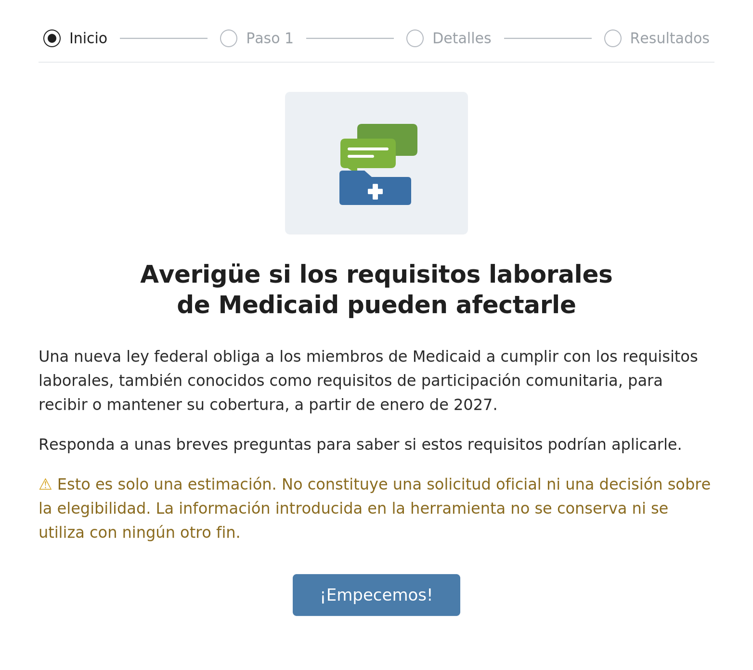
Herramienta de cribado para los requisitos laborales
Herramienta de cribado rápida y sencilla para ayudar a determinar si una persona debe o no debe cumplir con los requisitos laborales.
No se utiliza información de identificación personal.
Incluye preguntas sobre las circunstancias de la persona para identificar si está exenta o si debe cumplir los requisitos:
  Por ejemplo, preguntas sobre la edad, la seguridad social, el embarazo, Medicare, la condición de cuidador, etc.
Pregunta sobre los ingresos por un importe de 580 USD al mes (mínimo indispensable para cumplir los requisitos).
Notes:
Speaker: Marivel
Time: 3:28 // 3 min
To help people get a quick idea of whether work requirements may apply to them, the Department created an online screener tool. The tool does not use or store any personal information. It includes questions about age, income, and special situations that can give you a picture of whether or not you may need to report work and community engagement activities.
Click the link in the chat to open the screener tool and try it after the webinar.
It’s important to recognize that situations can change and the tool is only an estimate.

Slide 25
⚠️ Recordatorio: ¡esté atento a los avisos oficiales!
Las decisiones oficiales sobre la elegibilidad provendrán de Health First Colorado, que notificará a las personas afectadas.
Mantenga su información de contacto actualizada para poder recibir avisos importantes de nuestra parte.
  HCPF siempre enviará los avisos oficiales por correo postal.
  Las personas que hayan optado por las comunicaciones digitales y las notificaciones push también recibirán correos electrónicos o mensajes de texto.
Responda de inmediato a todos los avisos oficiales. ¡No espere!
Notes:
Speaker: Marivel
Time: 3:28 // 3 min
Official eligibility decisions will come from Health First Colorado, who will notify affected individuals.
Keep your contact information up to date so that you can receive important notices from us.
HCPF will always mail official notices. People who are opted in to digital comms and push notifications will receive emails or text messages as well.
Respond immediately to all official notices. Don’t wait!

Slide 26
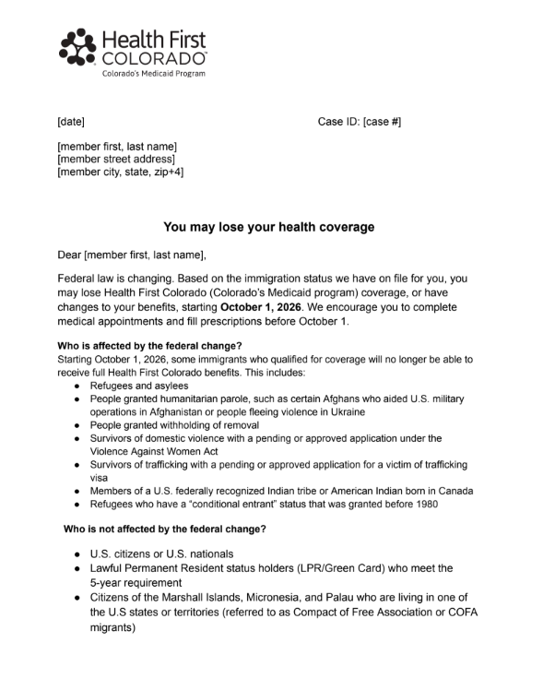
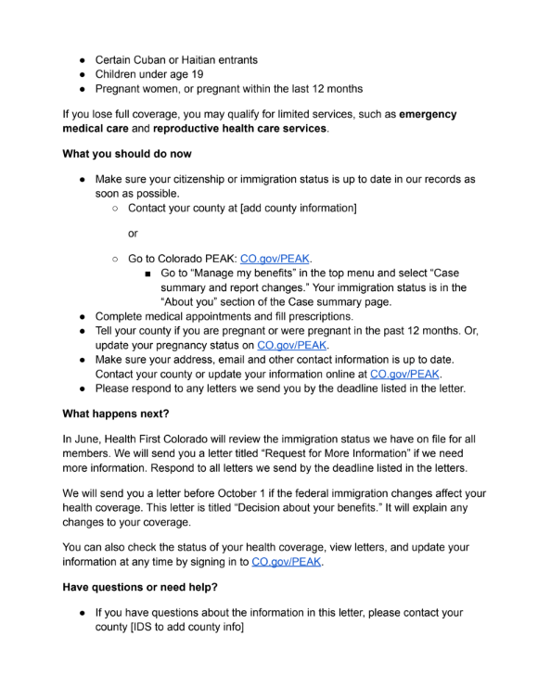
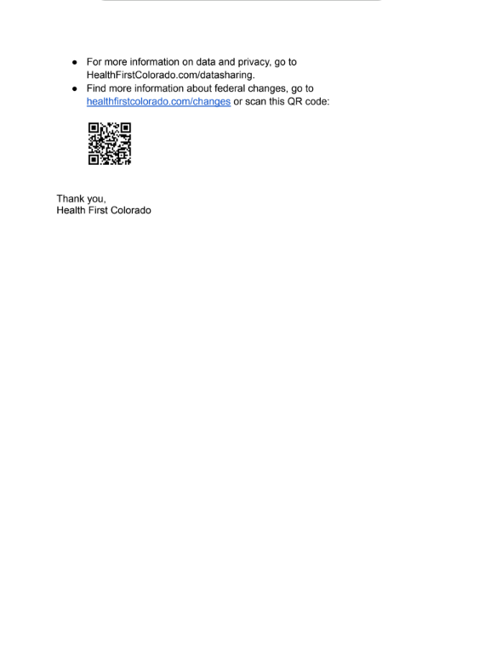
Aviso oficial: cambios para inmigrantes cualificados
Notes:
Speaker: Marivel
Time: 3:28 // 3 min
HCPF sent a letter to those who may be impacted by H.R. 1’s changes to Medicaid coverage for certain groups of immigrants. This letter went out the last week of May.

Slide 27
Cuándo y cómo cumplir con los requisitos laborales
Marivel Klueckman
Notes:
Marivel

Slide 28
¿Cuándo deben los miembros actuales en proceso de renovación cumplir con los requisitos laborales?
Los miembros actuales en proceso de renovación que deban cumplir los requisitos tendrán que demostrar que los han cumplido durante al menos 1 mes natural desde la fecha límite de su última renovación.
Notes:
Speaker: Marivel
Time: 3:52 // 3 min
Current renewing members will need to show they met the requirements in at least 1 calendar month since their last renewal deadline.
To find your last renewal date, you can either contact your county (paste in link to county offices) or visit the PEAK website (drop in link to PEAK).

Slide 29

Ejemplo: miembro actual en proceso de renovación
Su próxima redeterminación de renovación está prevista para abril de 2028.
Tiene entre 19 y 64 años.
Debe cumplir con los requisitos laborales (también conocidos como “participación comunitaria”) durante un mínimo de un mes entre octubre de 2027 y abril de 2028.
Si se le aprueban las prestaciones de Medicaid, su próxima redeterminación de renovación se establecerá para 6 meses después, en octubre de 2028.
Si hay otros miembros en el hogar, podrían tener una fecha de renovación distinta.
Notes:
Speaker: Marivel
Time: 3:52 // 3 min
Example for Renewing Member:
–Member’s next renewal redetermination is set for April 2027
–Member is between 19-64 years old
–Member does not have any qualifying exclusions or exemptions from work requirements [(I think “exemption” and “exception” can be problematic for a regular member. It’ll likely make it longer but I’m not sure there’s getting around it? Here are some additions/ideas for this part:) In this context, both words—exception and exemption—mean the person has an official reason to not have to meet the work requirement. If a member does not have an exception or exclusion, it means they do not have a reason to skip work requirements (also called “community engagement”). A person who does not have an exception or exclusion means that individual would still need to meet work requirements.]
–Member must meet the work requirements for a minimum of any ONE month from May 2026-April 2027
–If approved for MA benefits, next renewal redetermination will be set for 6 months

Slide 30
¿Cuándo deben los nuevos solicitantes cumplir con los requisitos?
Los nuevos solicitantes que deban cumplir los requisitos tendrán que demostrar que los han cumplido durante el mes natural anterior a la presentación de su solicitud.
Notes:
Speaker: Marivel
Time: 3:52 // 3 min
New applicants will need to show that they have met the requirements in the calendar month before they submit their application.

Slide 31
Ejemplo: nuevo solicitante
Presenta una nueva solicitud de Medicaid en enero de 2027.
Tiene entre 19 y 64 años.
Debe cumplir con los requisitos laborales en diciembre de 2026, ya que no tiene ningún motivo válido para no hacerlo.
Si se le aprueban las prestaciones de Medicaid, su próxima redeterminación de renovación se establecerá para 6 meses después, en julio de 2027.
Si hay otros miembros en el hogar, podrían tener una fecha de renovación a 12 meses, en diciembre de 2027.
Notes:
Speaker: Marivel
Time: 3:52 // 3 min
Example for New Applicants:
–Applicant submits a Medicaid application in January 2027
–Applicant is between 19-64 years old
–Applicant does not have any qualifying exclusions or exemptions from work requirements
–Applicant must meet work requirements in the month of December 2026
–If approved for Medicaid benefits, next renewal redetermination will be set for 6 months

Slide 32



Cómo cumplir con los requisitos laborales
SNAP
Su cumplimiento documentado de los requisitos laborales de SNAP/TANF
TRABAJO
Obtener 580 USD en un mes válido
FORMACIÓN LABORAL
Participar en un programa de formación laboral aprobado
Notes:
Speaker: Marivel
Time: 3:55 // 3 min
Now we get to HOW to meet work requirements. We at the Department are still refining details as we learn more from our federal partners, but we will share what we know now.
One way to comply with Medicaid work requirements is by meeting and reporting work requirements for SNAP. SNAP and Medicaid work requirements are NOT exactly the same. However, if a member complies with reporting SNAP work requirements, they should also be in compliance with Medicaid work requirements.
A second, and primary, way that new and current members will comply with work requirements is obviously through work. For current Medicaid members and applicants, we are making changes to our eligibility system so that we can determine if they comply with work requirements. While people can comply with the work requirements in a number of ways, one way is if they have earned $580 from a job. When current members are renewing, we will check a national database to determine if they have earned $580 in income in a month since their last renewal. For new applicants, we will use that same national database to determine if they earned $580 in the previous month.
Third, some applicants and members will comply with the work requirement through participating in an approved work training program. Participants must spend at least 80 hours in a work program in a qualifying month to satisfy the requirement.

Slide 33



Cómo cumplir con los requisitos laborales
VOLUNTARIADO
80 horas de actividades de voluntariado documentadas en un mes válido
EDUCACIÓN
Matrícula (al menos a media jornada) en una institución académica acreditada
COMBINACIÓN
80 horas combinando estas actividades en un mes válido
Notes:
Speaker: Marivel
Time: 4:07 // 3 min
Fourth, volunteering, also referred to as unpaid community engagement, can count for work requirements. Applicants and members must spend 80 hours participating in unpaid community service during a qualifying month. We have received questions about “what counts” as volunteering, and we plan to share additional details in the coming months. (CONFIRM)
Mk tentative note: Community service or volunteering includes these types of unpaid activities:
Volunteering at Nonprofits: Giving your time to recognized charities, food pantries, shelters, religious institutions, or hospitals.
Public Service: Working with local government, schools, or public parks.
Fifth, education is a key way that some members will meet the new requirements. Applicants and members must be enrolled in school at least half-time. Colorado’s benefits management system will connect to the National Student Clearinghouse, so if you are enrolled in classes the system should pick that up.
Finally, members can comply with work requirements through a combination of activities totals 80 hours in a qualifying month, depending on if you are renewing or are a new applicant.

Slide 34
Cómo notificar las actividades laborales y de participación comunitaria
No basta con REALIZAR las actividades laborales y de participación comunitaria. También debe asegurarse de NOTIFICAR las actividades de la forma adecuada.
Es posible que los miembros nuevos y actuales tengan que rellenar un formulario que ayudará a determinar si les son aplicables los requisitos laborales.
  Si una persona debe cumplir con los requisitos laborales/participación comunitaria, HCPF tratará en primer lugar de verificar la información a través de las fuentes de datos disponibles. Si esto no fuera posible, la persona deberá presentar los documentos solicitados dentro del plazo establecido.
Se proporcionarán los formularios correspondientes para cada vía de cumplimiento.
Los formularios cumplimentados pueden enviarse a través de PEAK o en formato impreso.
Notes:
Speaker: Marivel
Time: 4:01 // 3 min
It is not enough to DO work and community engagement activities. You also must make sure to REPORT the activities appropriately.
We anticipate that forms will be necessary, but ultimately we’ll see what the final CMS rule says. Our goal is to advance as many people through the system automatically by connecting with other systems and data sources, so that members have less paperwork to complete.
New and current members will need to fill out a form that will help determine if work requirements apply to them.
New form with checkboxes created to support members to attest to their WR exemptions or compliance efforts.
New applicants and existing members may complete new form as part of the eligibility determination process for applications, renewal process or verification processes.
Can be completed via application, phone, PEAK, or in person.
Documents may be requested to verify eligibility.
[Comment from Natalie: I think we should either have a TP ready for how we'll be reporting who complies/loses coverage because of inability to do the WR per Gretchen's comment today]
Hand off to Kyra to wrap things up.

Slide 35
Encuesta: si los requisitos laborales federales le son aplicables a usted o a alguien de su hogar, ¿cómo piensa cumplir con esos requisitos?
SNAP: cumplir con los requisitos laborales de SNAP/TANF
Trabajo: obtener más de 580 USD en un mes válido
Formación laboral: participar en un programa de formación laboral aprobado
Voluntariado: realizar 80 horas de voluntariado en un mes válido
Educación: matricularse en una institución académica acreditada
Combinación: una combinación de 80 horas de estas actividades
No estoy seguro/a
Los requisitos laborales no me son aplicables
Notes:
Speaker: Kyra
Time: 4:16// 3 min

Slide 36
Próximas oportunidades de participación
Kyra Acuña

Slide 37
Cómo se están preparando HCPF y nuestros socios
Avisos, correos electrónicos y mensajes de texto directamente a los miembros
Kit de comunicación para defensores, socios y organizaciones comunitarias
Programa de embajadores de la comunidad inmigrante
Coordinación de la divulgación con el Departamento de Servicios Humanos de Colorado (CDHS) y las Entidades Regionales Responsables (RAE)
Comunicaciones y formación para los condados
Más actualizaciones y eventos
Notes:
Speaker: Kyra
Time: // min
HCPF is engaged in a number of areas to get ready for these changes. We are preparing the noticing, emails and texts directly to members to alert them of the changes. For advocates, partners and community organizations, we are working together with the Center to Advance Consumer Partnership to publish a toolkit of member-tested messaging, social media posts, flyers, and more.
We are launching an Ambassador program to get the word out through trusted community partners, and we are also coordinating closely with Regional Accountable Entities, or RAEs, and with other state agencies, especially CDHS.
We are building out a comms and training plan for our county partners and eligibility sites. We know that these teams are the front door for many of our members and we want to ensure they are equipped with knowledge, tools and resources..
Finally, we are planning additional webinar updates to keep everyone as informed as possible.

Slide 38
Cómo mantener su participación
Asista a un evento:
  HCPF sigue organizando reuniones sobre Mejoras en la Correspondencia con los Miembros, que incluyen temas relacionados con HR 1.
  Próximos seminarios web:
    14 de julio: reunión pública general sobre fragilidad médica
    21 de julio: reunión pública general sobre conexiones con oportunidades de trabajo, voluntariado y educación
Visite la nueva página web de participación de las partes interesadas.
Suscríbase al boletín At a Glance, donde compartimos las próximas oportunidades.
Añada a favoritos nuestra página web sobre HR 1 para obtener más información.
Notes:
Speaker: Kyra
Time: // min
Here are some of those upcoming eventa. We are committed to engaging you and here is where we are at.
The Member Correspondence Team at HCPF is working hard, and their next meeting is:
Stay tuned for future webinars. Two that have already been planned are:
July 14: General Public Meeting on Medical Frailty
July 21: General Public Meeting on Connections to Work, Volunteer, & Education Opportunities
Any other opportunities are being shared in the At a Glance newsletter so please sign up if you haven’t already
In anticipating future opportunities, please fill out this public interest form. There could be smaller working group sessions where we need a dedicated group of experts to engage in working sessions, or broader engagement at a high level. Consider your ability and bandwidth to engage deeply on specific topics as you respond and indicate topics you are interested in.
You may be contacted in the coming months as this is a long term effort to be done thoughtfully
https://hcpf.colorado.gov/member-correspondence-improvements
https://docs.google.com/forms/d/e/1FAIpQLSfKmG1KBDHGbuKz6Ynkka_FHkaCfCxkKFXQHORuM0qw-T-CbA/viewform?usp=publish-editor
https://lp.constantcontactpages.com/sl/P5xXjrw
hcpf_hr1@state.co.us

Slide 39
Colabore con nosotros
Utilice nuestro nuevo kit de herramientas para ayudar a comunicarse con los miembros y con el público en general.
Comparta sus preguntas y ayude a dar forma a los próximos eventos
  Queremos saber: ¿qué preguntas tiene y sobre qué le gustaría saber más?
Envíe otros comentarios y sugerencias a hcpf_HR1@state.co.us.
Gracias por su colaboración y participación mientras trabajamos juntos para implementar HR 1 y centrarnos en nuestro objetivo principal.
Notes:
Speaker: Kyra
Time: // min
Thank you for attending this webinar and sharing your insights which support our planning. Here are some ways you can support us as well as members.
Use our toolkit to help communicate with members and the public. This toolkit will be published in phases, along with instructions on how to use the materials.
Bookmark our resource center, and sign up for HCPF newsletters to receive key implementation updates and understand how federal cuts impact Medicaid.
Send other comments and feedback to hcpf_HR1@state.co.us. We have staff available to answer questions - if you are a part of an existing group our HR1 inbox is open for questions or speaking requests that can be evaluated.
And a reminder, we are stronger together and in it together to support our north star of keeping people covered
Colorado.gov/hcpf/impact
We want to know: What questions do you have and what do you want to hear more about?
Fill out our Google Form to let us know.
Your questions will help shape future webinars, Q&As and other materials.
Use our new toolkit to help communicate with members and the public.
Share your questions and help shape future events
We want to know: What questions do you have and what do you want to hear more about?
Send other comments and feedback to hcpf_HR1@state.co.us.

Slide 40
¡Gracias!

Slide 41
Share Your Questions about Work Requirements
  We want to know: What questions do you have and what do you want to hear more about?
  Fill out our Google Form to let us know.
  Your questions will help shape future webinars, Q&As and other materials.
Notes:
Speaker: Kyra
Time: // min
How we'll use these questions in our work
Re-announce the July 21 resources webinar.
While we are not an agency that gets people to jobs etc we can help highlight the other opportunities in the state.

Slide 42
Federal Guidance: What We Know
Preliminary guidance received from the federal government, CMS,* in mid-November via PowerPoint with a CMCS Informational Bulletin on December 8
States will have less flexibility than what we expected under the law.
  Limited ability to leverage self-reporting or “self-attestation.”
  CMS to provide guidance on definition of “medically frail.”
  Strong emphasis on everything being auditable.
CMS has warned Colorado not to expect any waivers to delay implementation.
CMS is encouraging a Minimum Viable Product (MVP) at launch.
  Must be operational by all states by January 1, 2027.
  Colorado is designing its MVP model now.
Final rules for work requirements (community engagement) due in June 2026.
*CMS stands for the federal Centers for Medicare and Medicaid Services
Notes:
Preliminary guidance received from the federal government, Centers for Medicare and Medicaid Services or CMS, in mid-November via PowerPoint followed with a CMCS Informational Bulletin on December 8. We are incorporating informal guidance provided wherever possible with a balance of implementing in a way to support members and mitigate audit risks.
States will have less flexibility than what we expected under the law. The work for now is partnering with you in the areas we have flexibility to implement HR1 provisions
Limited ability to leverage self-reporting or “self-attestation.”
CMS to provide guidance on definition of “medically frail.”
Strong emphasis on everything being auditable. I’ll talk more about this in a little bit.
CMS is encouraging a Minimum Viable Product (MVP) at launch.
Must be operational by all states by January 1, 2027.
Colorado is designing its MVP model now and I’ll speak more to it in a little bit.
Final rules for work requirements (community engagement) due in June 2026.

Slide 43
Members: Watch for Communications
Make sure to keep your contact information updated so you don’t miss important notices.
  Members affected by immigrant coverage changes have been notified at the end of May 2026 and will also be notified in July 2026.
  Members affected by work requirements will receive letters by mail, text, or email in September and then again in November 2026.
Watch your mail and respond quickly to Health First Colorado renewal packets or letters from your health plan.
Know your renewal date so you can renew your Health First Colorado online or work with your local county department of human services or eligibility site if you do not receive notifications.
Visit Colorado.gov/hcpf/publications (click on sign up for newsletters, choose At A Glance)
Notes:
Speaker: Kyra
Time: 4:33 // 3 min

Slide 44
Overview of H.R. 1 Work Requirements
H.R.1 requires some adults ages 19–64 to report work and community engagement activities starting January 1, 2027.
Applies to:
  New applications received as of January 1, 2027, and
  March 2027 renewals that are initiated in January 2027.
Earn $580 per month
  Or complete 80 hours a month of work, education, volunteering, participation in a work program
Notes:
Speaker: Marivel
Time: 9:20 // 3 min
H.R.1 Section 71119 mandates that low-income Medicaid expansion adults (ages 19–64) must meet monthly work requirements (also known as community engagement requirements) starting January 1, 2027.
Applies to new applications received as of January 1, 2027.
All states have the option to require applicants to meet work requirements 1, 2, or 3 months consecutively prior to the application. Colorado has elected to require only one month (the month prior to the application) for work requirements.
As I mentioned, the effective date may apply to renewals due as early as January 2027. We will confirm and update once CMS guidance is confirmed with the exact renewal month.
All states have the option to select anywhere from 1-6 months during the renewal period to require work requirements. Colorado has elected to review one of six months prior to renewal for work requirements.
States must confirm compliance or exemption during application or renewal using reliable data or member-submitted documentation when necessary.

Slide 45
Who Is Impacted
Work requirements and 6-month renewals do not apply to everyone on Medicaid.
Adults ages 19–64 who earn up to 133% FPL.
Also includes parents/caretakers who have income between 69-133% FPL.
About 378,000 people
Currently we have data to determine compliance or exemption for over half of these people.
This means we are focused on supporting and mitigating coverage loss for 155,000 members.
Total CO Medicaid Enrollment
1,200,000
Potentially affected by WR & 6-month renewals
378,000
Population who will need to show compliance or exemption
155,000
Notes:
Speaker: Marivel
Time:
Work requirements and 6-month renewals do not apply to entire 1.2M Medicaid population.
Expansion population are adults ages 19–64 who earn up to 133% FPL.
It also includes parents/caretakers who have income between 69-133% FPL.
Of the remaining expansion population, approximately 378,000
We currently have data to determine compliance or exemption for over half of expansion population.
For example, this includes: Parents of children 13 and under or of a disabled individual, Pregnant or Postpartum individuals, Individuals that are Blind or Disabled. Also includes those that are working and meeting at least $580/month, and compliance with SNAP/TANF.
This means we are focused on supporting and mitigating coverage loss for 155,000 members who will need to either report an exemption or comply with work requirements through 80 hours of work, work training program, education at least half time, unpaid volunteer, or a combination of any of these to equal 80 hours. As we work through the process, we will provide more guidance on how individuals will report this information.
For the 378,500 Members Medicaid Expansion Adults, the MVP will provide Exemptions for approximately 18% and Compliance for 40-42% for a total of 58-60% of Medicaid Expansion Adults.
This includes: Parents of children 13 and under, Parents of a disabled individual, AI/AN, Incarcerated, Pregnant or Postpartum, Individuals Blind or Disabled, LIMITED medically frail or special med needs, LIMITED AUD/SUD treatment, LIMITED Veterans. Also includes those that are working and meeting at least $580/month, and compliance with SNAP/TANF.
The Remaining Medicaid Expansion Adults 42-40% (or about 155,000 Members) will need to attest to Exemptions or Compliance with Work Requirements via a standardized checkbox-based form, with quick progress to enable verification from third party.

Slide 46
What Members Can Expect
May 2026: We will be notifying affected members at the end of this month.
October 1, 2026: Coverage may end if not eligible for another category of Medicaid.
  We will let members know what other coverage options they have, including potential emergency Medicaid coverage.
Notes:
Speaker:
Time:
Clear Slide

Slide 47
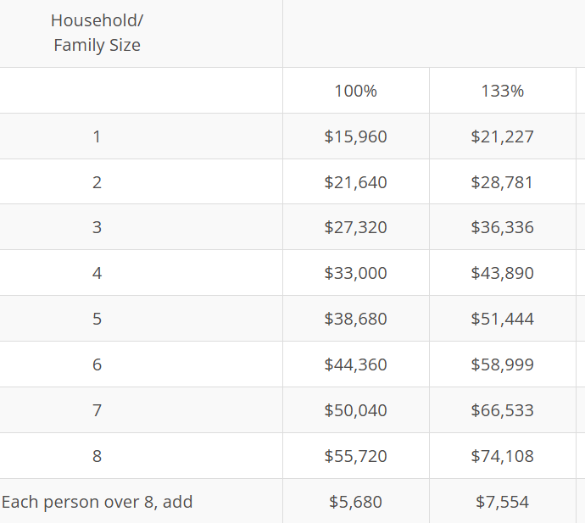
Who Do Most of the H.R. 1 Changes Apply To?
6-month renewal redeterminations:
SOME adults ages 19–64 who earn up to 133% FPL
Work requirements:
SOME adults ages 19–64 who earn up to 133% FPL
Retroactive coverage:
New applicants only
Immigrant eligibility:
Refugees, asylees, and some other noncitizens
Notes:
Speaker:
Time:

Slide 48
6-Month Renewal Redeterminations
Who:
SOME Individuals 19-64*
When:
January 1, 2027
New Applications
March 2027
Renewals initiating in March 2027
MOVE to 6-month renewal redetermination cycles
Individuals 19-64
Work Requirements MAY apply to SOME individuals 19-64
*Exceptions:
REMAIN on 12-month renewal determination cycles
American Indian / Alaska Native individuals age 19-64
Individuals
18 and younger
65 and older
Notes:
Speaker:
Time:
A significant change to eligibility is the move from a 12 month renewal cycle to a 6 month renewal cycle for certain Medicaid members. This change applies to members who are adults ages 19-64 who earn up to 133% of the federal poverty level (insert what that means in dollars for a single person and a family of four). The change also applies to parents and caretakers who have income between 69-133% of the federal poverty level (insert some numbers).
Unlike the work requirements, the 6-month has only one exemption for Alaska Native and American Indian members. All other members must comply.
Currently our renewal process is based on a household because policy is to do 12 months for all. With this new policy, we have to make significant changes to comply with 6 month renewals. For example, let’s say we have an expansion adult with a pregnant individual and a 2-year old child. In today’s world, we would send out one renewal packet for the household. Once we implement the 6 month renewal policy, the expansion adult will need to have a separate renewal packet, followed by the pregnant individual and then again by the 2-year old if the renewal timelines are not aligned. Check accuracy.

Slide 49
How to Report Work & Community Engagement Activities
New form with checkboxes created: Worksheet J
  New applicants and existing members may complete new form as part of the eligibility determination process for applications, renewal process or verification processes.
  Can be completed via application, phone, PEAK, or in person.
  Documents may be requested to verify eligibility.
Can we get some sort of visual with Worksheet J?
Notes:
Speaker: Marivel
Time: 4:01 // 3 min
New form with checkboxes created to support members to attest to their WR exemptions or compliance efforts.
New applicants and existing members may complete new form as part of the eligibility determination process for applications, renewal process or verification processes.
Can be completed via application, phone, PEAK, or in person.
Documents may be requested to verify eligibility.

Slide 50
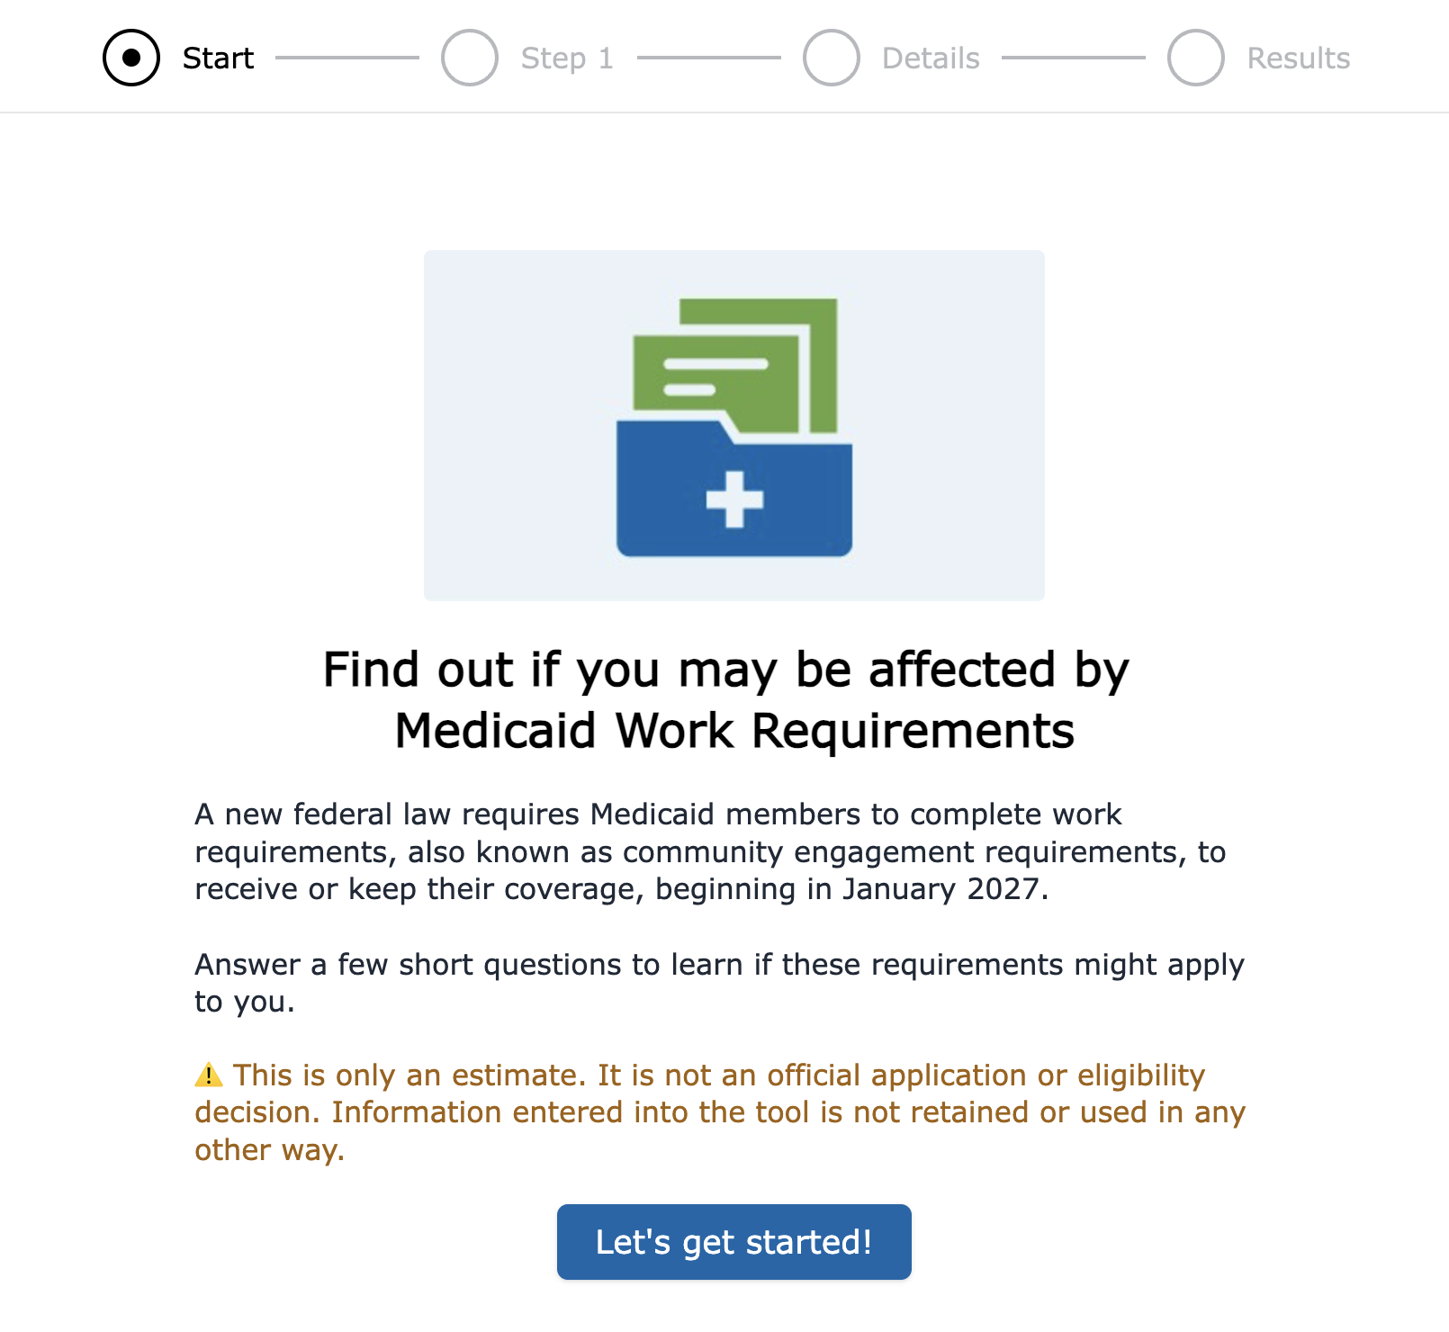
How Members Can Prepare
See if work requirements may apply to you using our new online screening tool.
Learn more about Medicaid changes on our H.R. 1 landing page on the Health First Colorado site.
Make plans to meet community engagement/work requirements criteria by Jan. 1, 2027.
Notes:
Speaker: Adela
Time: 10:40 // 2 min

Slide 51
Upcoming Session on Medical Frailty
Planned upcoming stakeholder engagement
Notes:
Speaker: Adela
Time: 3:49 // 3 min

Slide 52
Changes to Renewal Frequency
Moving to 6-Month Redetermination | Remaining with 12-Month Redetermination
Some adults ages 19-64 who earn up to 133% of the federal poverty level | Children age 0 to 18 Adults age 65 and older Pregnant women or women who were pregnant in the last 12 months People enrolled in long-term services and supports (LTSS) People enrolled in Medicaid buy-in programs (Working Adults or Children) People who qualify for or are enrolled in Medicare Former foster care youth age 19 to 26 American Indians and Alaska Natives (AI/AN) who qualify for Indian Health Services (IHS)
WHEN:
January 1, 2027 (New Applications)
March 2027 (Renewals initiating in March 2027)
Notes:
Speaker: Adela
Time: 2:46 // 3 min
Before we get into details on work requirements, which is the focus of this session, we want to take a few minutes to go through some of the OTHER eligibility (meaning who can get Medicaid coverage) changes happening due to H.R. 1.
A significant change to eligibility is the move from a 12-month renewal cycle to a 6-month renewal cycle for certain Medicaid members. This change applies to some members who are adults ages 19-64 who earn up to 133% of the federal poverty level (insert what that means in dollars for a single person and a family of four).
The change will go into effect on January 2027 for new applications and in March 2027 for renewals.

Slide 53
Changes to Household/Case Renewals
Health First Colorado (our state’s Medicaid program) will shift to individualized renewals.
Family members may have different renewal dates since some members may renew every 6 months and others every 12 months.
WHEN:
Renewals initiated after January 1, 2027
Notes:
Speaker: Adela
Time: 2:49 // 3 min
Connected with the change from 12 to 6 month renewals for some members, is the move from household, or case, renewals to individual renewals.
Currently our renewal process is based on a household because policy is to do 12 months for all. With this new federal change to Medicaid, we have to make significant changes to comply with 6 month renewals.
For example, let’s say we have a household consisting of an adult member, a pregnant member, and a 2-year old child. In today’s world, we would send out one renewal packet for the entire household. Once we implement the 6-month renewal policy, the adult member will need to have a separate renewal packet, followed by the pregnant member and then again by the 2-year old if the renewal timelines are not aligned, which they are likely not to be. Check accuracy.

Slide 54
Changes to Retroactive Coverage for All New Applicants
WHO
From 3 months to 1 month | From 3 to 2 months
Adults ages 19-64 who earn up to 133% of the federal poverty level who are not enrolled in LTSS or Buy-In programs (those subject to work requirements) | All applicants not subject to work requirements
WHEN:
Applications initiated after January 1, 2027
Notes:
Speaker: Adela
Time: 2:52 // 3 min
Another eligibility-related change due to H.R. 1 is the change to what’s called retroactive coverage.
Medicaid currently provides three months of retroactive coverage. This means, after you apply and are determined eligible for Medicaid, your Medicaid will cover the previous three months of medical bills.
Federal changes to this Medicaid policy on retroactive coverage includes:
Starting in January 2027 for new applicants.
Retroactive coverage for some adults ages 19-64 who earn up to 133% of the federal poverty level goes from three months to one month.
Retro coverage for most other members goes from three months to two months.

Slide 55
Changes for Certain Immigrants
Who Will No Longer Qualify | Who Is Not Affected
Refugees and asylees | U.S. citizens or U.S. nationals
People granted withholding of removal | Lawfully present children under age 19
Certain people granted humanitarian parole | Certain Lawful Permanent Resident status holders
Survivors of domestic violence under the Violence Against Women Act | Certain Cuban or Haitian entrants
Members of a U.S. federally recognized Indian tribe or American Indian born in Canada | Citizens of the Marshall Islands, Micronesia, and Palau living in one of the U.S states or territories
Refugees who have a “conditional entrant” status granted before 1980 | Lawfully present pregnant women, or pregnant within the last 12 months
October 1, 2026: Coverage may end if ineligible for another Medicaid category
We will let members know what other coverage options they have, including potential emergency Medicaid coverage.
Timeline:
May 2026: HCPF sent a notice to current members who may be affected.
June - August 2026: Outreach to ensure members and communities are aware
September, 2026: Notice to members who will lose coverage
October 2026: Changes implemented
Notes:
Speaker: Adela
Time: 2:58 // 3 min
One group to be disproportionately impacted are immigrants. HR1 has changed definitions for qualifying immigrants, and restricted eligibility and beginning this coming October, approximately 7,000 immigrants in Colorado will lose Medicaid coverage due to these changes. The resulting loss of care for vulnerable populations may lead to higher levels of emergency service use and uncompensated care.
Let’s look at the groups of people who will be impacted by this change. Beginning this coming October, the following groups, shown in the red lefthand column, will no longer qualify for Medicaid:
Members with Refugee or Asylee immigration status on legal documentation with corresponding class codes.
People granted humanitarian parole, such as certain Afghans who aided U.S. military operations in Afghanistan or people fleeing violence in Ukraine
People with a “Withholding of Deportation” status on formal documentation who receive protection from being deported to a specific country where their life or freedom is threatened
Survivors of domestic violence with a pending or approved application under the Violence Against Women Act(VAWA) identified through formal legal documentation or Prima Facie documentation
Survivors of trafficking with a pending or approved application for a victim of trafficking visa such as a T-Visa
Members of a U.S. federally recognized Indian tribe or American Indian born in Canada
Refugees who have a “conditional entrant” status granted before 1980
These immigrant groups will remain eligible for Medicaid:
U.S. citizens or U.S. nationals
Lawful Permanent Resident status holders (LPR/Green Card) who meet the 5-year requirement
Citizens of the Marshall Islands, Micronesia, and Palau who are living in one of the U.S states or territories (referred to as Compact of Free Association or COFA migrants)- Identified with legal documentation such a visas or I-94
Certain Cuban or Haitian entrants- Identified with legal documentation such I-94 and class codes.
Children under age 19
Pregnant women, or pregnant within the last 12 months
Prior to this provision taking effect, HCPF recently sent a notice in May to current members who may be affected by the loss of coverage. For those who received this notice, it is very important that they act quickly to update their immigration status and relevant member information if needed.
Over the summer, our teams will ramp up engagement with our stakeholders and community partners to ensure that we reach as many affected individuals as possible to ensure they are aware of changes and actions they can take.
In September, members who will lose coverage will receive a notification, and then the changes will take effect in October.
Our team will continue to engage with our partners to ensure strong communication and updates are available.
Hand off to Marivel for discussion of Work Requirements.

Slide 56
Changes for Certain Immigrants
October 1, 2026: Coverage may end if ineligible for another Medicaid category
  We will let members know what other coverage options they have, including potential emergency Medicaid coverage.
Impact approximately 7,000 members including:
  Refugees and asylees
  People granted withholding of removal
  People granted humanitarian parole, such as certain Afghans who aided U.S. military operations in Afghanistan or people fleeing violence in Ukraine
  Survivors of domestic violence applying under the Violence Against Women Act
  Members of a U.S. federally recognized Indian tribe or American Indian born in Canada
  Refugees who have a “conditional entrant” status granted before 1980
Timeline:
  May 2026: HCPF sent a notice to current members who may be affected.
  June - August 2026: Outreach to ensure members and communities are aware
  September, 2026: Notice to members who will lose coverage
  October 2026: Changes implemented
Notes:
Speaker: Adela
Time: 2:58 // 3 min
One group to be disproportionately impacted are immigrants. HR1 has changed definitions for qualifying immigrants, and restricted eligibility and beginning this coming October, approximately 7,000 immigrants in Colorado will lose Medicaid coverage due to these changes. The resulting loss of care for vulnerable populations may lead to higher levels of emergency service use and uncompensated care.
Let’s look at the groups of people who will be impacted by this change. Beginning this coming October, the following groups, shown in the red lefthand column, will no longer qualify for Medicaid:
Refugee or Asylees immigration status on legal documentation with corresponding class codes.
People granted humanitarian parole, such as certain Afghans who aided U.S. military operations in Afghanistan or people fleeing violence in Ukraine- Afghan Humanitarian Parolee or Ukrainian Humanitarian parolee status with corresponding documentation and class codes.
People granted withholding of removal receive protection from being deported to a specific country where their life or freedom is threatened - These members are identified as “Withholding of Deportation ” on formal documentation or legal document.
Survivors of domestic violence with a pending or approved application under the Violence Against Women Act(VAWA) identified through formal legal documentation or Prima Facie documentation
Survivors of trafficking with a pending or approved application for a victim of trafficking visa- T Visas or other legal documentation would provide these details.
Members of a U.S. federally recognized Indian tribe or American Indian born in Canada- These folks are recognized by legal documentation (Canadian or US) that would indicate they meet the requirements for the status.
Refugees who have a “conditional entrant” status granted before 1980- Identified with valid documentation such as I-94 with corresponding class codes.
These immigrant groups will remain eligible for Medicaid:
U.S. citizens or U.S. nationals
Lawful Permanent Resident status holders (LPR/Green Card) who meet the 5-year requirement
Citizens of the Marshall Islands, Micronesia, and Palau who are living in one of the U.S states or territories (referred to as Compact of Free Association or COFA migrants)- Identified with legal documentation such a visas or I-94
Certain Cuban or Haitian entrants- Identified with legal documentation such I-94 and class codes.
Children under age 19
Pregnant women, or pregnant within the last 12 months
Prior to this provision taking effect, HCPF recently sent a notice in May to current members who may be affected by the loss of coverage. For those who received this notice, it is very important that they act quickly to update their immigration status and relevant member information if needed.
Over the summer, our teams will ramp up engagement with our stakeholders and community partners to ensure that we reach as many affected individuals as possible to ensure they are aware of changes and actions they can take.
In September, members who will lose coverage will receive a notification, and then the changes will take effect in October.
Our team will continue to engage with our partners to ensure strong communication and updates are available.
Hand off to Marivel for discussion of Work Requirements.

Slide 57
More about Medical Frailty
Adela Flores-Brennan

Slide 58
Medical Frailty
People who are medically frail:
  Are blind or have a disability
  Have a substance use disorder
  Have a disabling mental health condition
  Have a physical, intellectual, or developmental disability that makes it hard to do daily activities
  Have a serious or complex medical condition
Notes:
Speaker: Adela
Time: 3:40 // 3 min
People who are determined to be medically frail do not have to meet work requirements.
What does “medical frailty” mean? CMS has not issued detailed guidance on the H.R.1 medically frailty exemption. Right now, we expect that for current members, we’ll be able to look at Recognizing that how we define medical frailty can change when we receive formal guidance from CMS in June,

Slide 59
Medical Frailty Screener
Do you have a physical or intellectual disability, mental health condition, or other special medical need that makes it hard or impossible for you to work
Are you medically frail? A medically frail person has significant health needs, such as a disabling mental health condition, substance use disorder, or other complex medical condition that limits daily functioning or requires ongoing medical care.
Notes:
Speaker: Adela
Time: 3:43 // 3 min
For new applicants after January 1, 2027, HCPF is including five questions in Worksheet J to determine if the applicant is medically frail. The questions are -
Do you have a physical or intellectual disability, mental health condition, or other special medical need that makes it hard or impossible for you to work
Are you medically frail? A medically frail person has significant health needs, such as a disabling mental health condition, substance use disorder, or other complex medical condition that limits daily functioning or requires ongoing medical care.

Slide 60
Medical Frailty Screener
Are you living with a physical, intellectual, or developmental disability that makes it hard to do daily activities?
Are you living with a mental health disorder (such as schizophrenia, major depression, or OCD)?
Are you living with a serious health condition that requires regular treatment (such as an autoimmune disorder, heart or kidney failure, or other severe condition)?
Notes:
Speaker: Adela
Time: 3:46 // 3 min
Are you living with a physical, intellectual, or developmental disability that makes it hard to do daily activities?
Are you living with a mental health disorder (such as schizophrenia, major depression, or OCD)?
Are you living with a serious health condition that requires regular treatment (such as an autoimmune disorder, heart or kidney failure, or other severe condition)?

Slide 61
H.R. 1 Changes to Medicaid Eligibility
Most Medicaid members will not be affected, but there are important eligibility changes to know about:
Changes to renewals
  Renewal frequency (6 months vs. 12 months)
  Individual vs. household renewals
Changes to retroactive coverage
Changes for certain immigrants
Work requirements (also called “community engagement”)
Notes:
Speaker: Adela
Time: 2:37 // 3 min
H.R. 1 has prompted sweeping changes to Medicaid, in Colorado and across the country. Some of the largest changes are to Medicaid eligibility, as outlined on this slide. These eligibility areas include changes to how frequently some members will need to renew their coverage, changes to retroactive coverage, changes in coverage for certain immigrant groups, and work requirements.
Over the past 9 months, HCPF teams have been busy working to understand, implement, and communicate all of these changes. Sometimes this work is not seen (yet) by the public, but I can assure you that our staff are working day in and day out to mitigate impacts on our members and to share clear, consistent information and guidance as early as possible.

Slide 62
Who Do H.R.1 Changes Apply To?
In general, H.R. 1 changes apply to:
Some adults ages 19-64 who earn up to 133% of the federal poverty level
Depending on the provision, there are many exceptions, for example:
Medical conditions
Caregiver status
Enrollment in certain programs
North Star: Reduce coverage losses and negative consequences to Coloradans, providers & economy
Notes:
Speaker: Adela
Time: 2:37 // 3 min
It is important to know that many Medicaid members will NOT be affected by these changes. We know that communicating clearly who is and is NOT affected is key to achieving our North Star, which is mitigating coverage losses and negative consequences to Coloradans, providers and the economy.
In general, H.R. 1 changes apply to SOME adults ages 19-64 who earn up to 133% of the federal poverty level {drop link to FPL chart}.
This is the group that was included in Medicaid as a result of the Affordable Care Act or ACA.
Depending on the provision, there are exceptions some people within this group that the new provisions do not affect, depending on, for example, their:
Medical conditions
Caregiver status
Enrollment in certain programs
And other reasons, which we’ll go through later in this presentation.

