Slide 1

Buy-In Program for Working Adults with Disabilities (WAwD) with Home & Community Based Services (HCBS)
Project Update
Presented by: Kyra Acuna & Marivel Klueckman
Notes:
Eligibility Division Director

Slide 2

Interpretación de idiomas
Language Interpretation
To access language interpretation, click Interpretation in your meeting/webinar controls.
If you do not see the Interpretation button, click More, then Interpretation.
Click the language that you would like to hear. Both American Sign Language (ASL) and Spanish are available.
Para acceder a la Interpretación de idiomas, haga click en Interpretaciónen los controles de su reunión/seminario web.
Si usted no ve el botón de interpretación, haga click en más y luego en interpretación
Haga click en el idioma que a usted le gustaría escuchar. Haga clic en el idioma que a usted le gustaría escuchar. Lengua de Señas Americana (ASL, por sus siglas en inglés) y español están disponibles.
Notes:
Stephanie and Liz will be our ASL interpreters for today’s meeting.
Additionally, I would like to invite our Spanish interpreter to introduce themselves and explain how to access live interpretation services. So Hans, please go ahead.
Welcome to the meeting.
I’d like to let the Spanish interpreter introduce themselves right now.
SPANISH INTERPRETER COMES ON SCREEN and IS HIGHLIGHTED; Interpreter READS SCRIPT BELOW VERBATIM.
Interpreter reads (in Spanish, but this is what she is saying in English):
“My name is _____________and I will be providing Spanish interpretation services. In a moment, this service will be activated. To hear live Spanish interpretation of today’s event, select the “interpretation” pod from the Zoom toolbar and then select “Spanish”. You will have the option to select “mute original audio” if you want to hear only Spanish. This interpretation pod will be activated momentarily.”
Then [Webinar Leader] speaks once the interpreter is done:
Thank you, [Interpreter Name]. If you would like to listen to this webinar in Spanish, please select the “Interpretation” pod on your Zoom toolbar and select “Spanish”. We have also posted instructions for now to access language interpretation in the chat.
[Webinar Tech] Post in Chat:​
Spanish version of interpreter script: Mi nombre es [Interpreter Name] y brindaré servicios de interpretación en español. En un momento, este servicio estará activado. Para escuchar la interpretación en vivo en español del evento de hoy, seleccione el módulo 'interpretaciones' en la barra de herramientas de Zoom y luego seleccione 'Español.' Tendrás la opción de seleccionar 'silenciar audio original' si deseas escuchar solo español. Este módulo de interpretación se activará momentáneamente.
How to listen to Language Interpretation: https://support.zoom.com/hc/en/article?id=zm_kb&sysparm_article=KB0064768#h_6802bbbc-2ec9-47cb-a04c-6aac35914d82

Slide 3

Subtítulos cerrados
Closed Captions
Closed Captions are available in the meeting controls toolbar at the bottom of your screen. To turn them on, click the Show Captions icon.
Captions can be translated into different languages by clicking on the up arrow next to the Closed Captions button and then selecting your preferred language.
Los subtítulos cerrados están disponibles en la barra de herramientas de controles de la reunión en la parte inferior de su pantalla. Para activarlos, haga click en el ícono Mostrar subtítulos.
Los subtítulos pueden ser traducidos en diferentes idiomas haciendo click en la flecha hacia arriba junto al botón de subtítulos cerrados y luego seleccionando su idioma preferido.
Notes:
Links:
How to turn on closed captions: https://support.zoom.com/hc/en/article?id=zm_kb&sysparm_article=KB0059762
How to turn closed captions on in another language: https://support.zoom.com/hc/en/article?id=zm_kb&sysparm_article=KB0060844
[Webinar Tech] Post in Chat:​
Closed Captions are available in the meeting controls toolbar at the bottom of your screen. To turn them on, click the Show Captions icon.
Los subtítulos están disponibles en la barra de herramientas de controles de la reunión en la parte inferior de su pantalla. Para activarlos, haga clic en el icono "Mostrar subtítulos".

Slide 4

Meeting Logistics
We are recording: avoid specific details about medical history or insurance/membership status in comments as this is considered Protected Health Information (PHI) and/or personally identifiable information (PII)
If PHI or PII is identified, it will need to be removed from the meeting recording
Attendees will be muted during the presentation
Use Q and A feature to ask questions
Chat will be disabled and used for HCPF staff to share links only
Attendees can also raise their hand to ask questions. Once called upon, you will be asked to un-mute to ask your question.
Notes:
Attendees will be muted during the presentation. At the end of the presentation, we will provide plenty of time for questions.
In order to ask a question you can either use the Q&A feature. The chat will not be monitor for questions. HCPF staff will only be using the chat space to share out links. So please use the Q&A feature.
Again, you can also raise your hand to ask questions and once called upon, you will be asked to unmute to ask your question. for those on the phone - to Raise your hand using *9, Mute/Unmute using *6
[Webinar Tech] Post in Chat:​
Enter specific Meeting logistics here

Slide 5
Who is HCPF?
HCPF = Colorado Department of Health Care Policy and Financing
Designated as Colorado’s single state Medicaid agency
Responsible for supervision and oversight of Colorado’s public insurance programs
Visit our website: https://hcpf.colorado.gov/
Notes:
Visit our website: https://hcpf.colorado.gov/

Slide 6

Our Mission:
Improving health care equity, access and outcomes for the people we serve while saving Coloradans money on health care and driving value for Colorado.

Slide 7
What We Do
The Department of Health Care Policy & Financing administers Health First Colorado (Colorado’s Medicaid program), Child Health Plan Plus (CHP+) and other health care programs for Coloradans who qualify.

Slide 8
Process & Expectations
Informational meeting with the chance for attendees to ask questions & provide comments
The slides will be emailed out to everyone who registered for today’s webinar
Notes:
Kyra
Slides will be provided in both english and spanish
The slides will also be posted to the Buy-in Program for working adults with disabilities webpage - https://hcpf.colorado.gov/buy-in-program-working-adults-disabilities

Slide 9
Purpose
The purpose of today’s meeting is to provide an update on the status of the June 2025 changes being made to the Working Adults Buy-In Program. Additionally, HCPF would like to address some of the issues and concerns that have been escalated in the last few months.
Notes:
Kyra’s final slide then hand over to Marivel

Slide 10
Overview
What is Working Adults Buy-In?
June 2025 Working Adults Buy-In project status
Background on Projects
Identified issues & action taken
Ongoing monitoring
Notes:
Marivel’s slide

Slide 11
What is Working Adults Buy-In?

Slide 12
Working Adults Buy-In
Working Adults with Disabilities lets adults with a disability who qualify to "buy-into" Health First Colorado (Colorado's Medicaid Program). If you work and earn too much to qualify for Health First Colorado you may qualify. If you qualify, you may pay a monthly premium. Your monthly premium is based on your gross monthly earned and unearned income after any applicable disregards.

Slide 13
Eligibility Guidelines
You must be 16 or older,
You must be employed,
You must have a qualifying disability, either through Social Security or the State Disability Determination vendor, even if you are 65 or older. The Social Security Administration (SSA) listings describe what disabilities qualify, and;
Your income after disregards must be below 450% of the Federal Poverty Level (FPL). For example, you can earn about $11,020 a month and qualify. You may have additional income that is disregarded.

Slide 14
Eligibility Guidelines cont.
Applicants should always complete the Health First Colorado Application to find out if their income qualifies.
You are not required to apply for SSA disability. If you do not have a current disability determination from the SSA, fill out the Health First Colorado Disability Application.
Resources/assets are not considered
  Example:checking & savings accounts

Slide 15
What is Working Adults Buy-In with Home & Community Based Services (HCBS)?

Slide 16
In addition to Health First Colorado benefits members may also qualify for extra long-term services and supports. These additional services are accessed through the following HCBS waivers:
  Brain Injury (BI) Waiver
  Community Mental Health Supports (CMHS) Waiver
  Complementary & Integrative Health (CIH) Waiver
  Developmental Disabilities (DD) Waiver
  Elderly, Blind & Disabled (EBD) Waiver
  Supported Living Services (SLS) Waiver
Working Adults Buy-In with HCBS

Slide 17
Working Adults Buy-In & LTC Comparison Chart
 | Working Adults Buy-In with HCBS | LTC with HCBS
Income | Approx. $5,648 | Approx. $2,829
Resources | No limit, not checked | Approx. $2,000
Age | 16 or older | Waiver dependent
Disability | Yes | Yes
Level of Care | Yes | Yes
Work Requirement | Yes | No
Premiums | Yes | No
Coverage | Full Health First Colorado Coverage, PLUS HCBS coverage | Full Health First Colorado Coverage, PLUS HCBS coverage

Slide 18
June 2025 Working Adult Buy-In Project Status

Slide 19
Discontinue auto-enrollment into Working Adults Buy-In with HCBS at enrollment & renewal so members wouldn’t be auto-enrolled in a program with premiums to pay
Members would need to opt-in to Working Adults Buy-In with HCBS
Members would be automatically reviewed for Long Term Care (LTC) eligibility
What Was Proposed

Slide 20
System issues and escalations when reinstating premiums
Complexity with Long Term Services & Supports (LTSS) stabilization and CHP+ Continuous Eligibility project
What Happened

Slide 21
June 2025 Working Adults Buy-In project has been DELAYED for at least a year
It is imperative that HCPF does not continue to introduce new system updates until Long Term Services & Supports (LTSS) stabilization is complete (planned through 2025)
What’s Happening Now
Notes:
For more information on LTSS stabilization, please refer to the LTSS stabilization webpage: https://hcpf.colorado.gov/stabilizing-LTSS

Slide 22
The process for determining eligibility between HCBS services and Working Adults Buy-In remains the same.
Any member, including those who are also receiving HCBS services, can opt out of Working Adults Buy-In at any time.
Premiums will be reinstated for Working Adults Buy-In members as previously planned.
What Does This Mean?

Slide 23
Background on Projects

Slide 24
Buy-In Project Background
Buy-In program revamped in February 2020 & then COVID happened
LTSS Stabilization work has been ongoing since February 2024
Premiums reinstated and letters began to be sent in April 2025
Upcoming June 2025 project requiring some members to opt into Buy-In has caused concerns and confusion and will be DELAYED
Notes:
For more information on LTSS stabilization, please refer to the LTSS stabilization webpage: https://hcpf.colorado.gov/stabilizing-LTSS

Slide 25
Identified Issues &
Action Taken

Slide 26
Incorrect Denials
Issue:
March - April 2025 CHP+ Continuous Eligibility project integration caused ~1,900 Buy-In members to receive unnecessary requests for information & incorrect denials
Action:
HCPF worked with Deloitte to correct this issue & sent out approvals to clear the denials
HCPF worked with the Colorado Medical Assistance Program (CMAP) to help identify and resolve issues.
The Buy-In phone line was updated to let callers know HCPF is aware of incorrect notices.

Slide 27
Incorrect 60-Day & Premium Letters
Issue:
6 cases were incorrectly given a 60-day extension with letters that indicated $0 premium was due
Action:
Cases fixed and new approvals sent May 2
Issue:
75 members were incorrectly charged a premium in electronic version of letters only
Action:
Letters paused, issue corrected and letters reinstated Apr 24

Slide 28
Premium Letters Mailed Late
Issue:
~23,000 premium letters not printed/mailed on time (but were electronically visible in CO PEAK)
Action:
New files sent to print vendor
May 15 due date remains as members have 60-day grace period to pay
Please help to spread the word!

Slide 29
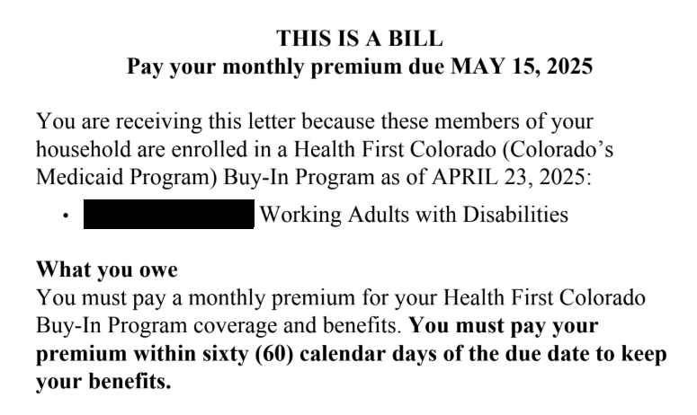
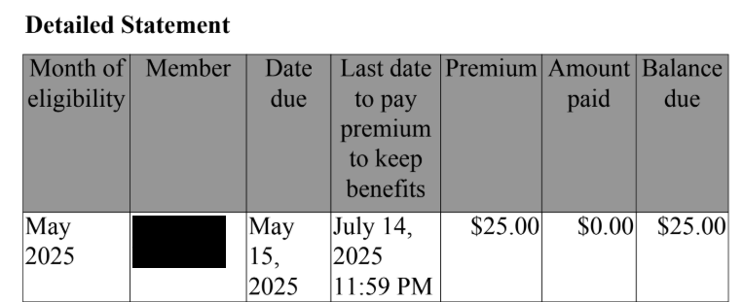
Snippets of Premium Letter

Slide 30
Change in Premium Letter
Issue:
Change in premium notices were sent out on March 24th (~15,000 letters)
  HCPF cleared all premium amounts in the system prior to reinstating premiums
  System logic triggers letters to members when premiums increase or decrease
Action:
No action to be taken, awareness on why this was sent.
  System logic will remain in place as members should be notified when there is an upcoming change in premiums.

Slide 31
$0 Premium & 60-Day Extension
HCPF ran eligibility for 23,000+ members to reinstate premiums
Issue:
Influx of eligibility results at one time due to removal of the help desk ticket as part of the 60-day extension logic
Action:
Going forward, eligibility is not run on cases to generate premiums. Premium amounts are updated on case by case as updates are made on case.
Issue:
Eligibility running on these cases accurately identified ~4,200 cases to fall into 60 day extension for reasons such as failure to provide verifications, respond to renewal, etc.
Action:
The premium letter was set to $0 and will continue as $0 until 60 day extension is resolved. If members do not respond to the 60 day extension, their coverage will be terminated.

Slide 32
Members on Buy-In Did Not Receive Premium Letter
Issue:
Members who are enrolled in Working Adults Buy-In did not receive any premium letter
  HCPF is still analyzing the reasons for this issue
  Currently there are ~475 members impacted
Action:
Once reason is identified, these members will receive premium letter in the next month
  Premiums will not be charged retroactively

Slide 33
Ongoing Monitoring

Slide 34
Ongoing Monitoring
HCPF discussed efforts to monitor and mitigate future issues for this population that include the following:
Verifying/validating the 60-day extension reports
Validating the next group for the premium letters
Staying on top of the help desk tickets
More frequent meetings with the Colorado Medical Assistance Program (CMAP) to identify issues & escalate
Monitor correspondence & unexpected influx for Working Adults Buy-In

Slide 35
Questions?
Notes:
Kyra’s slide - With that we are going to open it up to any questions or comments.
Typing a question/comment into the Q&A box
Raising your hand & you will be unmuted to talk
phone users - Raise hand using *9, Mute/Unmute using *6

Slide 36
Contact
For Working Adult Buy-In members and advocate questions call the Colorado Medical Assistance Program (CMAP) at 1-(800) 711-6994
For general Working Adults Buy-In program questions email:
nancy.brenes@state.co.us

Slide 37
Thank you!

