Slide 1

Notes:
Hello, and welcome to our provider training on the Health First Colorado doula benefit. The goal of this training is to support doulas in enrolling in Health First Colorado, the state’s Medicaid program, and to bill for services.
This training is sponsored by the Colorado Department of Health Care Policy and Financing or HCPF, sometimes referred to as "the Department“ in this presentation.

Slide 2

Notes:
Hello, and welcome to our provider training on the Health First Colorado doula benefit. The goal of this training is to support doulas in enrolling in Health First Colorado, the state’s Medicaid program, and to bill for services.
This training is sponsored by the Colorado Department of Health Care Policy and Financing or HCPF, sometimes referred to as "the Department“ in this presentation.

Slide 3
Benefits of Doula Care
“a trained professional who provides continuous physical, emotional and informational support to their client before, during and shortly after childbirth to help them achieve the healthiest, most satisfying experience possible.”
– DONA International
Provide education
Improve focus on patient-centered care
Help manage pain
Offer culturally appropriate birth practices
Improve health outcomes and advance health equity
Notes:
A doula is a “trained professional who provides continuous physical, emotional, and informational support to people before, during, and shortly after childbirth to help them achieve the healthiest, most satisfying experience possible.”¹
Examples of this support includes (1) providing information about what to expect at different stages of pregnancy and postpartum, (2) suggesting relaxation or breathing techniques to manage pain during labor, (3) improving the focus on patient-centered care, and (4) offering culturally appropriate birth practices. (5) This support is shown to improve health outcomes and advance health equity.
Let’s start with an overview of the benefit.

Slide 4



Covered Doula Benefit in Health First Colorado
Labor & Delivery
Prenatal
Postpartum
Notes:
Health First Colorado’s doula benefit covers three important services: (1) prenatal care, (2) labor and delivery, and (3) postpartum care.

Slide 5
Prenatal Care
Reimbursement for up to 180 minutes of prenatal care per member
$25 per 15 minutes of service
Cap of 12 units
or
$300 per member served in 12-month period
Notes:
A doula can be reimbursed for up to 180 minutes of prenatal care per member at (2) $25 per 15 minutes of service. (3) There is a cap of 12 units or $300 per member during a 12-month period.
The period starts at the time of the first doula claim.

Slide 6
Labor and Delivery
Reimbursement for up to $900
per delivery
Notes:
A doula can also be reimbursed for supporting the member during labor and delivery.

Slide 7
Postpartum Care
Reimbursement for up to 180 minutes of postpartum care per member
$25 per 15 minutes of service
Cap of 12 units
or
$300 per member served
Notes:
(1, 2, 3) The reimbursement structure for postpartum care is the same as that of prenatal care.

Slide 8
The Doula Benefit Offers Flexibility
Even distribution across prenatal and postpartum care
Three 60-minute visits
Labor and delivery
Three 60-minute visits
Higher frequency of postpartum visits
Two 90-minute visits
Labor and delivery
Six 30-minute visits
Late enrollment
Six 30-minute visits
Notes:
The doula benefit is meant to offer doulas and their clients flexibility, so services can best meet member needs.
(1,2) For example, one member may prefer to use benefits equally in the prenatal and postpartum period.
(3,4) Another may want more frequent, shorter visits during the postpartum period.
(5,6) Finally, a member may start accessing services after delivery and just receive postpartum doula care.

Slide 9



Important Considerations
A member cannot forfeit prenatal care for more postpartum care beyond the $300 postpartum cap.
All benefits relate to the member, not the doula.
Reimbursement per delivery is $900, regardless of how long labor and delivery lasts.
Delivery
Caps on service
Member focused
Notes:
Some important considerations.
Both prenatal care and postpartum care have individual caps. So, a member cannot forfeit prenatal care for more postpartum care beyond the $300 postpartum cap.
All benefits relate to the member. If more than one doula supports the member, then the combined time across those doulas cannot exceed the caps.
The reimbursement per delivery is $900 regardless of how long labor and delivery lasts. The doula and member should discuss expectations and processes should the labor and delivery exceed the time that the doula is able to assist.

Slide 10
Prenatal and postpartum care can be provided via telehealth
Labor and delivery support can only be provided in-person
Notes:
(1) Doulas can provide prenatal and postpartum care in the member’s home, in any other community-based setting (such as an office), or via telehealth. (2)
Labor and delivery services cannot be provided via telehealth. While doulas must provide in-person labor and delivery support, location can vary.

Slide 11
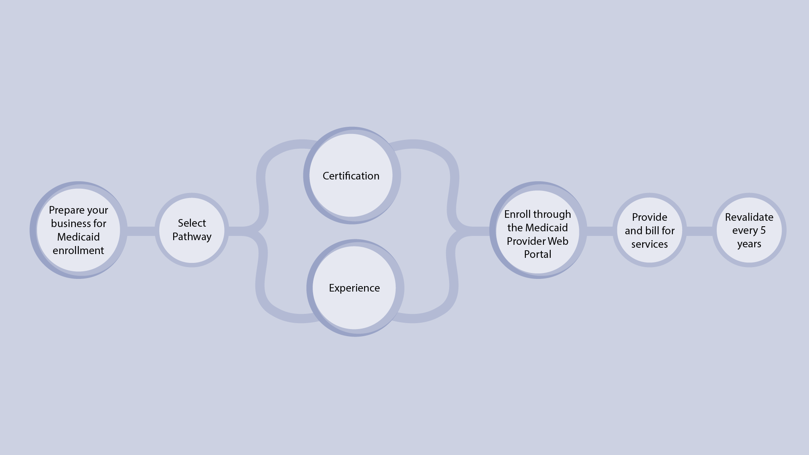
Enrollment Process
Notes:
Individuals and organizations interested in providing doula services to Health First Colorado members must first prepare their business for enrollment.
Then, doulas must determine how they will meet qualifying requirements. The Department does not require a specific doula certification. Instead, doulas select a pathway (certification or experience) and gather documentation and attestations demonstrating they meet requirements associated with the selected pathway.
Doulas then enroll through the Medicaid Provider Web Portal.
Once enrollment is complete, doulas provide and bill for services.
Doulas must revalidate through the Medicaid Provider Web Portal every five years to demonstrate ongoing compliance with the pathway and other requirements.

Slide 12
Overview of Required Documentation
 | Certification Pathway | Experience Pathway
Front of driver’s license/state ID | • | •
Back of driver's license/state ID | • | •
Copy of insurance policy | • | •
Voided check/bank letter | • | •
W9 with Social Security Number | • | •
CPR card | • | •
Doula Attestation Form | • | •
Doula Code of Conduct | • | •
Lawful Presence Affidavit | • | •
Doula certification | •
Doula training certificate |  | •
Two letters of recommendation from previous clients |  | •
Letter of recommendation from colleague /doula |  | •
Letter of recommendation from a clinical provider |  | •
ADMINISTRATIVE
SHARED CRITERIA
PATHWAY
Notes:
Before we go into each of these steps in more detail, we want to present the list of required documents you’ll need –to upload to the Medicaid Provider Web portal or to keep in your records. As you can see by the table, the documents depend on the enrollment pathway you select.
(1) All doulas will need administrative documents, including copies of a driver’s license or state ID, an insurance policy, a voided check, and a W-9 with Social Security Number.
(2) Doulas also need common forms that demonstrate they meet qualifying criteria.
(3) The final set of documents depend on the pathway. Those who pursue the Certification Pathway need a doula certification. Those who pursue the experience pathway, need a training certificate and letters of recommendation.
It is critically important to use your legal name across all these documents. This name should appear on your driver’s license, W-9, training certifications, liability insurance, and fingerprinting card. If your name is not consistent across all your required documents, your application could be rejected.
We’ll describe these documents later in the training.

Slide 13
Training Content
Notes:
This training will discuss each step in more detail.

Slide 14

Training Content
Preparing your Business
Establishing Good Processes
Meeting Requirements
Enrolling through the Web Portal
Billing for Services
Provider Maintenance and Revalidation
Notes:
First, it can help you prepare for Health First Colorado Enrollment. You may choose to register as a business with the Colorado Secretary of State and will need to obtain identifiers required for enrollment.
We’ll also discuss sound business practices, so you can provide person-centered care, maintain client confidentiality, and meet federal and state requirements.
Then, we’ll review general requirements and those specific to each pathway.
The next section walks you through how to register for the Medicaid Provider Web Portal and submit an application. In order to process your application as efficiently as possible, you’ll want to gather your documentation prior to starting your application on the Medicaid Provider Web Portal.
We’ll discuss the billing processes.
And, finally, provider maintenance and revalidation.

Slide 15
Preparing your Business for Health First Colorado Enrollment
Notes:
Now we will talk about preparing your business for Health First Colorado Enrollment.
Doulas must enroll in the Health First Colorado program to bill for services provided to members. To do so, some doulas may want to start a business; some doulas are operating within a group already enrolled in Health First Colorado.

Slide 16

Preparing Your Business for Health First Colorado Enrollment
1. Establish Business Name
2. Register with the Colorado Secretary of State
3. Apply for a National Provider Identifier (NPI)
Notes:
When preparing your business for enrollment into Health First Colorado, there are several steps to consider: you may want to establish a business name that is consistent across all your legal forms and enrollment documentation, registering with the Colorado Secretary of state, and applying for a national provider identifier or NPI. (1) There may also be minimal administrative costs associated with starting a business in Colorado, such as paying the Colorado Secretary of State’s filing fee. We dive deeper into each of these steps in the forthcoming slides.

Slide 17



Types of Doulas
Doulas may want to register as a business and will need an NPI.
Doulas need their own NPIs, but can be added to an existing group.
Doulas need their own NPIs, but can be added to an existing group.
Sole proprietors
Doulas within a group
Doulas within a health care group
Notes:
The steps you need to take depend on how you operate.
Sole proprietor doulas may want to register as a business and will need an NPI to enroll.
Each doula within an existing doula group or health care group will need an NPI and submit an individual application. Note that these groups need to already be enrolled in Health First Colorado.

Slide 18

1. Establish Business Name
Business name must be consistent across all platforms, including DBAs, if applicable:
Application Submitted through the Medicaid Provider Web Portal
Attestation Forms
Internal Revenue Service (IRS) Forms
Registration for an NPI
*Any slight discrepancy will prevent your application from being approved
Notes:
Establishing a business name and using it consistently throughout the enrollment process is crucial. (1) Your business name must be the same on your application submitted through the (2) Medicaid Provider Web Portal, (3) your attestation forms, (4) your Internal Revenue Service forms, (5) and your registration for an NPI. (6) Any slight mismatch can mean your application is not approved.
If you choose to use a “doing business as” or DBA, which is separate from your business name, it must also be consistent across the enrollment process.

Slide 19
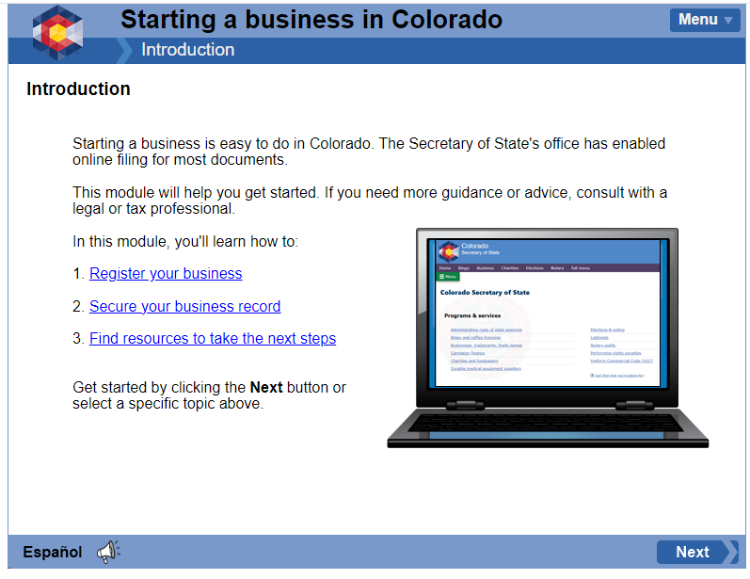
2. Register with the Colorado Secretary of State
On the Colorado Secretary of State Business Website:
“Starting a Business in Colorado” eLearning Module
Legal Structure
Creating Business Name
Filling Out Correct Forms
Be sure to save your login credentials
Save the business registration document and certificate of good standing
Notes:
If you decide to register as a business you will apply through the Colorado Secretary of State Business Organizations website. (1) The agency offers a Starting a Business in Colorado eLearning module that walks you through your (2) legal structure, (3) creating a business name, and (4) filing out the correct forms. Be sure to save your login credentials so you can access your account later. (7) It is also important to save the business registration document and Certificate of Good Standing. However, you can access these documents on the Colorado Secretary of State website anytime

Slide 20
2. Register with the Colorado Secretary of State
On the Colorado Secretary of State Business Website:
Know your business structure or organization type so you can enter it into the Medicaid Provider Web Portal
During business registration, be sure to add an abbreviation of the name depending on the type of business you choose, such as LLC., Ltd., etc.
Questions? Contact the Colorado Secretary of State at
(303)-894-2200 or business@coloradosos.gov
Notes:
You need your business structure or organization type to enter into the Medicaid Provider Web Portal. (1) When registering your business, be sure to follow the instructions clearly, including adding an abbreviation of the name depending on the type of business you choose, such as LLC.
(2) If you have questions, you can contact the Colorado Secretary of State using the contact information displayed on the screen.

Slide 21

3. Apply for a National Provider Identifier (NPI)
NPIs are needed for: billing, eligibility and enrollment, and referrals and authorizations
Individual practitioners, organizations, and individuals that are part of a group can all have an NPI
A doula organization =
Type 2 NPI
Individual practitioners and individuals who are part of a group = Type 1 NPI
Notes:
Doulas need an NPI, a unique 10-digit identification number for covered health care providers, obtained from the National Plan & Provider Enumeration System or NPPES (pronounced: N-PEZ). The NPPES assigns NPIs. You can apply online.
(1) NPIs are needed for billing, eligibility and enrollment, and referrals and authorizations. Individual practitioners, organizations, and individuals a part of a group can all have an NPI. (2) Individual practitioners and individuals a part of a group need their own NPI if they perform standard transactions on their own (separately from their parent organization).
(3) A doula group may have a Type 2 NPI.
(4) Sole proprietors and individuals within a doula group need their own NPI, a Type 1 NPI, for Health First Colorado enrollment and billing purposes.

Slide 22
3. Apply for a National Provider Identifier (NPI)
Taxonomy Code
Specifies the services you provide
Doula Taxonomy Code: 374J00000X
Taxonomy code in your application must match code used on NPI application or it will be rejected
Questions about NPIs:
Phone: (800) 465-3203
Email: mailto:customerservice@npinumerator.com
Mail: NPI Enumerator, 7125 Ambassador Rd STE 100, Windsor Mill MD 21244-2751
Notes:
Part of the information you need to apply for an NPI is your Taxonomy code. (1) The provider taxonomy code specifies the services you provide. (2) The doula taxonomy code is displayed on the screen. You must also enter this taxonomy code into the Medicaid Provider Web Portal.
(3) At least one of the taxonomy codes in the Health First Colorado application must match one of the codes you use when applying for the NPI. If not, your Health First Colorado application will be rejected. The NPPES NPI Registry lookup can be used to see the taxonomy codes currently associated with the NPI. You can always add a taxonomy code through NPPES to ensure that it matches the one in the Medicaid Enrollment Portal.
(4) If you have any questions about obtaining an NPI, you can contact NPPES using the contact information displayed on the screen.

Slide 23
Establishing Good Processes for Doula Practices
Notes:
Doulas enrolled in Health First Colorado must also establish sound business practices that allow them to provide person-centered and responsive client care, while maintaining client confidentiality.

Slide 24
Good Business Practices
Standardized intake process
Process to verify Medicaid eligibility
Maintaining secure client records
Client and provider communications
Notes:
There is a lot you can do to manage a successful business. Today, we’ll touch on just a couple of these.
Many relate to being good stewards of Medicaid funding, which comes from taxpayer dollars and has obligations. Make sure you understand your responsibilities as they relate to service compliance, accurate billing, and being prepared for audits.

Slide 25

Create a Standardized Intake Process
Intake forms can capture:
Client contact info
Insurance info (including Medicaid ID)
Mental and physical health conditions and support needs
Information on previous and current pregnancies
Health care providers
Birth desires and preferences
This info should be securely maintained and accessible to other doulas in your group who may serve the client
Notes:
First, you’ll want to create a standard client intake process.
Intake forms can capture (2, 3) client contact and demographic information and information to help you provide comprehensive care that is responsive to the client’s birth desires, including (4, 5, 6) health information and support needs and (7) birth preferences.
(8) We’ll talk about securing client information later in the presentation.

Slide 26

Ensure Client is Enrolled in Health First Colorado
Once you’re enrolled as a provider, you will have access to member eligibility in the Medicaid Provider Web Portal
Notes:
Part of your intake process should be to verify client enrollment into Health First Colorado.
Once you’re enrolled as a provider, you will have access to member eligibility in the Medicaid Provider Web Portal.

Slide 27
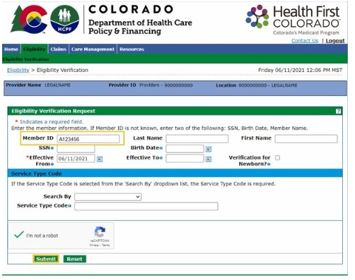
Verify Medicaid Eligibility
Request insurance information during client intake, including Medicaid ID
Log in to the Provider Medicaid Web Portal
Click on the Eligibility Tab
Enter client details and click “Submit”
If you do not have the member Medicaid ID, then enter two of the following: Social Security Number, date of birth, or member name
Notes:
Take the following steps:
(1) Request insurance information during client intake, including Medicaid ID.
(2) Log in to the Provider Medicaid Web Portal.
(3) Click on the Eligibility tab.
(4) Enter client details and click “Submit.” (5) If you do not have the member’s Medicaid ID, then enter two of the following: SSN, date of birth, or name.

Slide 28

Help Your Clients Apply
The Colorado PEAK system supports enrollment into multiple programs, including Health First Colorado
County agencies provide enrollment support
Notes:
If the client is not enrolled in Health First Colorado, support enrollment by pointing the client to the Colorado PEAK system. Clients can also contact their County government agency, which may have trained enrollment specialists.

Slide 29

Obtain Recommendation from Client’s Clinical Provider
Clients should let their clinical providers know they are working with a doula and obtain a recommendation
You should maintain these recommendation forms in your internal records and document the provider’s NPI
You will enter this NPI in the claim for payment
Notes:
Finally, to be eligible for doula services, members need to be recommended by a clinical provider, such as an OB/GYN, midwife, or therapist. This will promote better coordination across the clients’ providers, especially during labor and delivery.
Clients can obtain a recommendation form from their provider and give it to you. Keep this form in your records for auditing purposes and document the NPI for later submission. You must enter the provider’s NPI in your claim for payment.

Slide 30

Well-Maintained Records Management:
Allows you to securely collect and store information
Enables you to support families and their preferences
v
Facilitates efficient communication
Helps you maintain client confidentiality and thus comply with state and federal regulations
Notes:
You should also develop and maintain a records management system that allows you to securely collect and store information about your clients and services.
These systems are crucial for effective care provision as they enable doulas to track the specific needs of each client and thus support families and their personal preferences.
(3) Well-maintained records also facilitate efficient communication between you, your clients, and other providers.
(4) In addition, a secure records management system can help you maintain client confidentiality and thus comply with state and federal regulations. Finally, if you are audited by Medicaid, you will be required to pull records for a sample of Health First Colorado members. Your records management system should allow you to quickly identify and share those records. Out-of-date records can delay the audit process and potentially lead to financial penalties.

Slide 31
Examples of Key Information to Store in Records
Member name
Medicaid ID
Doula visits, including date(s), length, services provided, and mode (e.g., in member’s home or via telehealth)
Information about the birth plan or preferences
Notes:
Some examples of key information to store in records to promote a successful audit are (1) member name, (2) member Medicaid ID, (3) all visits including dates, length, services provided, and mode, and (4) essential client information.

Slide 32

Data Management Systems
Paper charts
Paper charts in locked & secured location
Restricted access
Log in credentials
Electronic system
Firewalls
Encrypted emails
Notes:
Doulas may choose to manage their records (1) through paper charts, (2) by developing or purchasing an electronic data management system, or by relying on a combination of both. For example, clients may fill out intake forms via paper, and information is then entered into an electronic system.
Regardless, ensure you are following federal and state requirements related to data security. (1) Paper records should be securely locked. (2, 3, 4) Electronic data management systems should require log in credentials and have appropriate firewalls to protect personal health information or PHI. (5) Client communication and information sharing should also follow the highest security standards. For example, do not email client information unencrypted.

Slide 33
Meeting Health First Colorado Doula Requirements
Notes:
Next we’ll talk about meeting Health First Colorado Doula requirements.

Slide 34

Certification Pathway
Experience Pathway
Notes:
There are two pathways for doulas to satisfy requirements to become enrolled: the certification pathway and the experience pathway.
The certification pathway is for doulas who completed formal training with a Department-approved doula training organization.
The experience pathway does not require formal training but does have a higher requirement for birth attendance.

Slide 35
All Individuals Must Meet Pathway Requirements
Sole Proprietors
Individuals within a Doula Group
Notes:
All individuals must meet pathway requirements, including all individuals within a group practice who want to bill for services.

Slide 36
Documentation Requirements
 | Certification Pathway | Experience Pathway
Front of driver’s license/state ID | • | •
Back of driver's license/state ID | • | •
Copy of insurance policy | • | •
Voided check | • | •
W9 with Social Security Number | • | •
CPR card | • | •
Doula Attestation Form | • | •
Doula Code of Conduct | • | •
Lawful Presence Affidavit | • | •
Doula certification | •
Doula training certificate |  | •
Two letters of recommendation from previous clients |  | •
Letter of recommendation from colleague /doula |  | •
Letter of recommendation from a clinical provider |  | •
ADMINISTRATIVE
SHARED CRITERIA
PATHWAY
Notes:
The certification and experience pathway each have their own documentation requirements. Some documents, such as CPR certification, are required by both pathways. Some requirements, like a Letter of recommendation from a clinical provider, is just required for the experience pathways. A list of documentation requirements for each pathways is displayed on the screen.
I’d like to remind you again to use your legal name on all of these documents to expedite approval.

Slide 37
Certification Pathway
Training
Birth Attendance
CPR Certificate
Code of Conduct
Notes:
The certification pathway requires four signed attestations to be submitted, which we will go over in more detail.

Slide 38

I Attest…
    I have received training as a doula from one of the HCPF-approved training organizations
Notes:
First, “I attest that I have received training as a doula from one of the HCPF-approved training organizations.”
You will need to complete at least 18 hours of training, and you will attach a copy of your certification of training completion with your application in the Medicaid Provider Web Portal.
In order to become a Colorado State Certified Doula or Community Birthing Partner to serve Colorado members and be reimbursed for those services, training entities must complete the application requirements to be considered for the approval process. They must indicate the number of hours that correspond to each competency and attach a syllabus.

Slide 39


I Attest…
    I have received training as a doula from one of the HCPF-approved training organizations
    I have attended at least three births within the last five years
Notes:
Second, “I attest that I have attended at least three births within the last five years.”
Your own experience giving birth does not count for births attended. You will complete the Birth Attendance Attestation Form stating that you meet this requirement.

Slide 40


I Attest…
    I have received training as a doula from one of the HCPF-approved training organizations
    I have attended at least three births within the last five years
    I have current CPR training credentials
Notes:
Third, “I attest that I have current CPR training credentials.”
Different training programs may have different durations – make sure that you’ve taken training recently enough to have active training credentials. Doulas are required to receive adult and infant CPR certification. You will upload a copy of your certifications with your application.
Please note that there may be costs associated with becoming CPR certified. For 2025, we found they ranged from approximately $30-$150 in Colorado.

Slide 41


I Attest…
    I have received training as a doula from one of the HCPF-approved training organizations
    I have attended at least three births within the last five years
    I have current CPR training credentials
    To follow the doula Code of Conduct
Notes:
Finally, “I attest to follow the doula Code of Conduct.”
Review the code, sign it, and submit the signed copy.

Slide 42
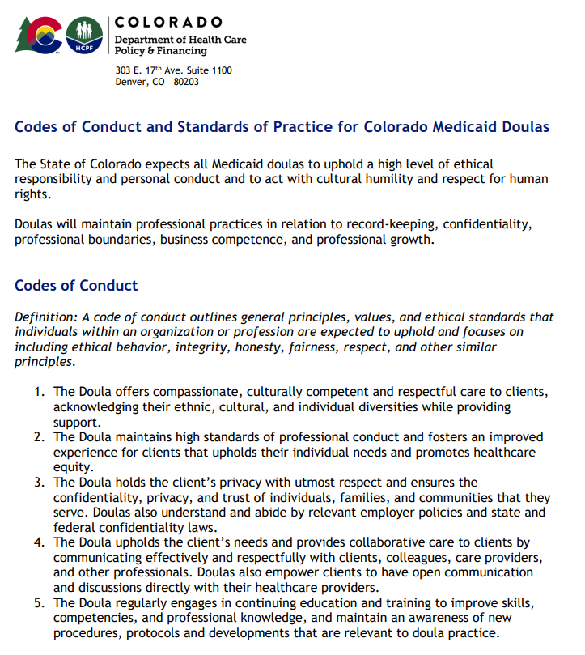
Culturally competent and respectful care
Professional conduct
Client privacy
Continuing education
Notes:
The doula code of conduct, which highlights your commitment to:
culturally competent and respectful care,
professional conduct,
client privacy, and
continuing education,
can be found on the HCPF website in English and Spanish.

Slide 43





Experience Pathway
    CPR Certification
    Birth Attendance
    Code of Conduct
    Letters of Recommendation
Demonstrated Competencies
Notes:
The experience pathway shares three attestations with the certification pathway. The experience pathway differs from the certification pathway in that it does not require any specific training other than CPR certification and lived experiences. Note that the birth attendance attestation requires the same paperwork but has different requirements, which we will go over now.

Slide 44
I Attest…
I have current CPR training credentials
To follow the doula Code of Conduct
Notes:
Two attestations are exactly the same as the certification pathway:
“I attest that I have current CPR training credentials.”
And
“I attest to follow the doula Code of Conduct.”

Slide 45

I Attest…
I have attended at least ten births in my role as a doula, and at least five births in the last two years
I have current CPR training credentials
To follow the doula Code of Conduct
Notes:
The experience pathway requires more lived experience in births than the certification pathway. For the experience pathway, you must “attest that I have attended at least ten births in my role as a doula, and at least five births in the last two years.”
As already mentioned, your own birth does not count for births attended. You will complete the Birth Attendance Attestation Form stating that you meet this requirement.

Slide 46

I Attest…
I have attended at least ten births in my role as a doula, and at least five births in the last two years
I have attached four letters of recommendations
I have current CPR training credentials
To follow the doula Code of Conduct
Notes:
In addition, “I attest that I have attached four letters of recommendations.”
You will submit a total of four letters of recommendation with your application. Of the four letters, two must be from clinicians who were the primary obstetric provider at birth you have attended. The other two must be from previous clients that you worked with as a doula.

Slide 47

I Attest…
I have attended at least ten births in my role as a doula, and at least five births in the last two years
I have attached four letters of recommendations
To having knowledge and competency in the following areas:
I have current CPR training credentials
To follow the doula Code of Conduct
Notes:
Finally, you will need to submit an attestation that you have knowledge and competency in the following areas:

Slide 48



I Attest to having the knowledge and competency in…
Prenatal
  Pregnancy/ Perinatal Support
  Childbirth Education
Labor and delivery
  Non-Medical Comfort Measures
  Labor Support Techniques
Postpartum
  Postpartum/Recovery Support
  Feeding/Lactation Support
  Newborn/Infant Care
Anatomy of Pregnancy, Childbirth, and Postpartum; Family/Partner Support; Developing a Community Resource List; Trauma-Informed Care; Diversity, Equity and Inclusion (Cultural Sensitivity)
Notes:
Prenatal, labor and delivery, and postpartum care. Initial beside each of the competencies and submit the form with your application.
Some of the competencies related to these domains are displayed on the screen. For example, doulas should have a good understanding of childbirth education in the prenatal period, labor support techniques during labor and delivery, and feeding and lactation support during the postpartum period.

Slide 49
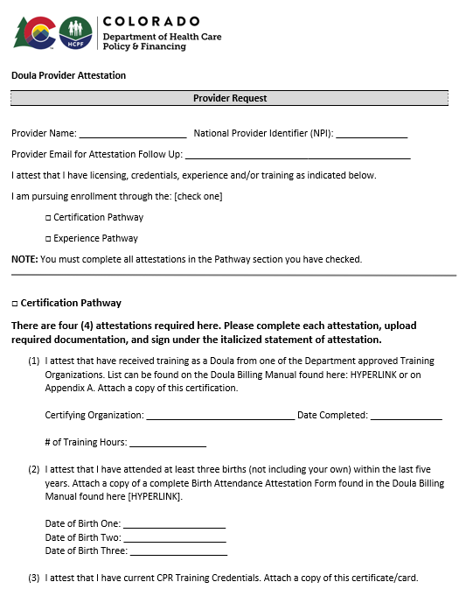
Submitting Attestations
Attestations should be filled out by each doula, signed, and uploaded to the Medicaid Provider Web Portal
Notes:
Attestations should be filled out by each doula, signed, and uploaded to the Medicaid Provider Web Portal.
The doula provider attestation form is displayed on this screen. These form can also be found on the HCPF website on English and Spanish.

Slide 50
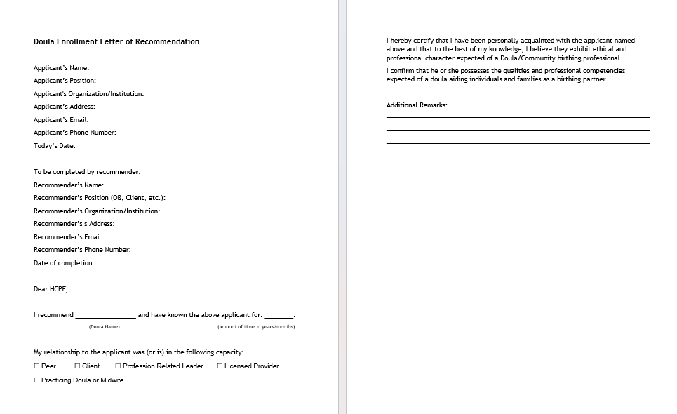
Letters of Recommendation
Notes:
The letter of recommendation form can also be found on the HCPF website in English and Spanish.

Slide 51
Additional Requirements
Background Checks: Make an appointment with IdentoGO and use code 25YQG9*
Insurance, either professional insurance or liability insurance through a doula group
Optional: Mandatory Reporting of Child Abuse and Neglect training
https://co4kids.org/child-abuse-prevention/mandatory-reporters/
Notes:
Doula care is a high-risk service, meaning you’ll have to go through a background check.
(1) Make an appointment with IdentoGO and use the code displayed on the screen. The Department will then check to ensure that all the owners listed in your application have received the completed background check.
(2) Doulas are also required to have insurance; it can be professional insurance or insurance through your doula group, such as liability insurance. There may be a cost associated with this insurance policy.
(3) Doulas are not mandatory reporters, but doulas may still take The Colorado Department of Human Services free mandatory reporting training if they want to. While doulas are not mandatory reporters, this training may empower providers to recognize the signs and symptoms of abuse and instill confidence their ability to take appropriate action should they suspect abuse.

Slide 52
Enrolling Through the Medicaid Provider Web Portal
Notes:
Next we’ll talk about enrolling through the Medicaid provider web portal.

Slide 53

Registering for the System
All doulas must enroll in Health First Colorado through the Medicaid Provider Web Portal
You will need:
Your business license
The doula taxonomy code (374J00000X)
Your NPI number
Your address with nine-digit ZIP code
Copy of driver’s license/state ID
A voided check or bank letter
Completed IRS Form W-9
Insurance policy
CPR card, attestation, doula code of conduct
Certification, training certificate, or letters of recommendation (depending on your pathway)
Notes:
The first step to enrollment is to make sure you have everything you need to register through the Medicaid Provider Web Application.
(1) Providers must be registered and in good standing with the Colorado Secretary of State. Have this certificate available.
You will need your taxonomy code and NPI number.
You will also need the address where you provide services and a voided check or bank letter and a completed IRS Form W-9 to ensure payment.
Make sure to have other documents to upload, including a copy of your driver’s license, insurance policy, attestation, doula code of conduct, and information corresponding to your selected pathway.
Once again, use your legal name on all your documents and when filling out fields in the system.

Slide 54
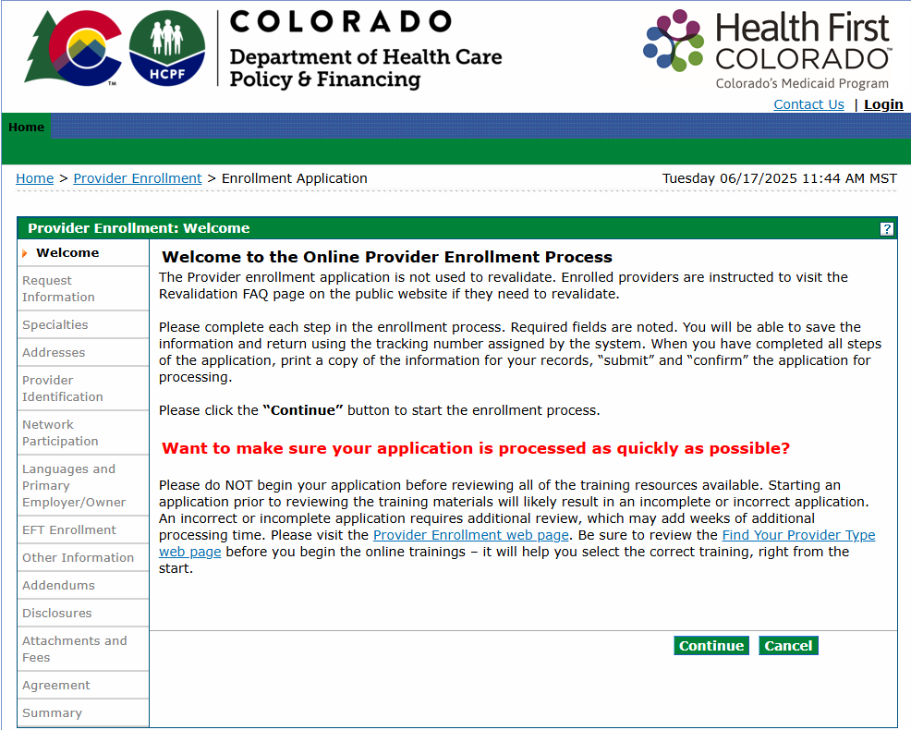
Notes:
To begin enrollment, access the Enrollment Application through the Medicaid Provider Web Portal. Then read the accompanying message and hit continue.

Slide 55
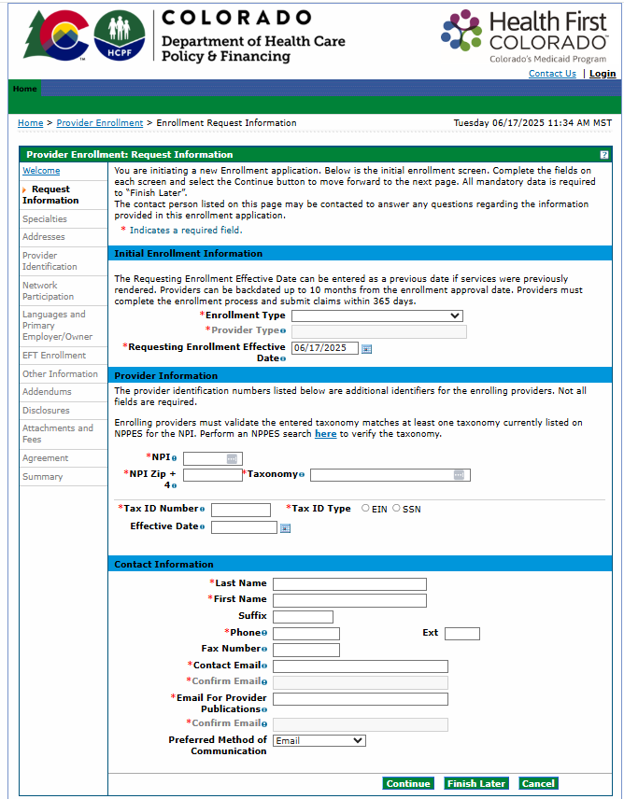
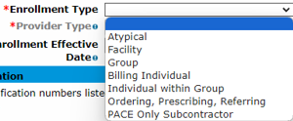
Notes:
On the next page, you’ll first select your enrollment type.

Slide 56
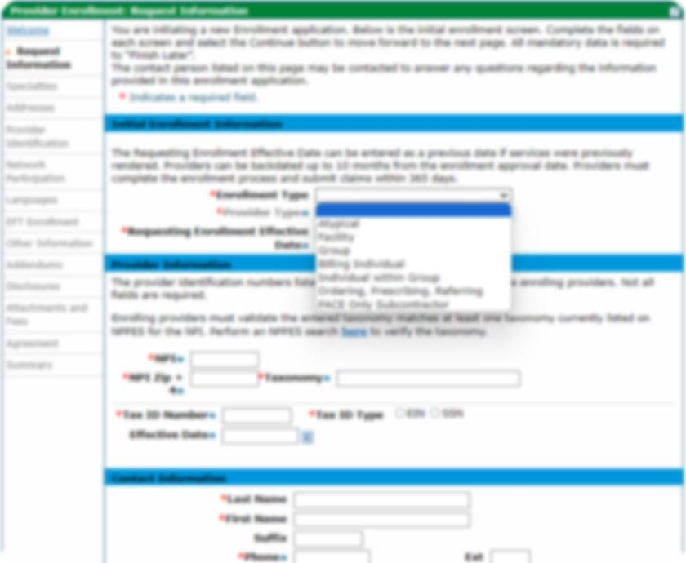
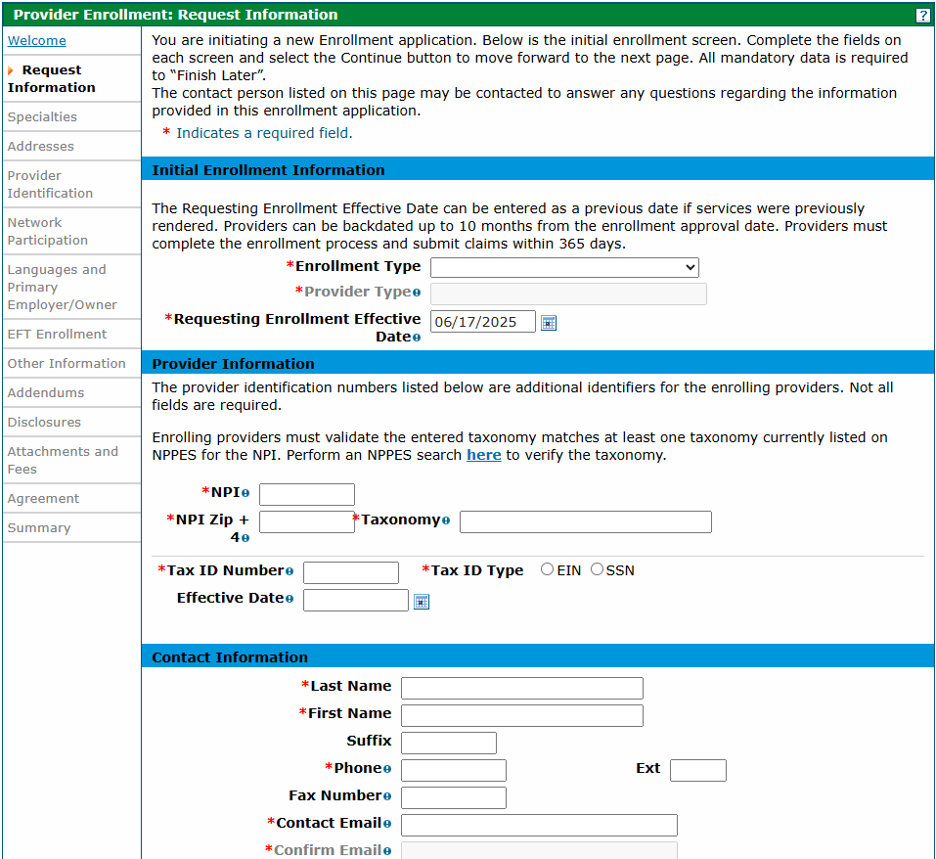
Notes:
There are three types that relate to doulas:
Group
Billing Individual
Individual within a Group
Doulas should select Billing Individual if they are a sole proprietor, or Individual within Group if they are a part of a doula group or health care group.
Note that the group must already be enrolled in the Medicaid program before you can apply as an individual within a group.

Slide 57
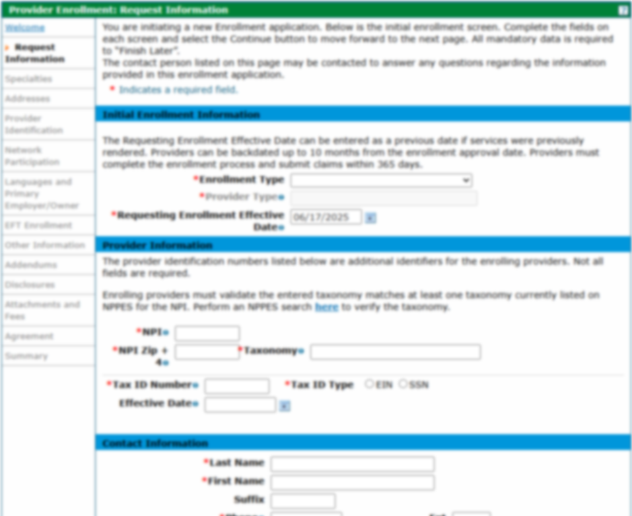
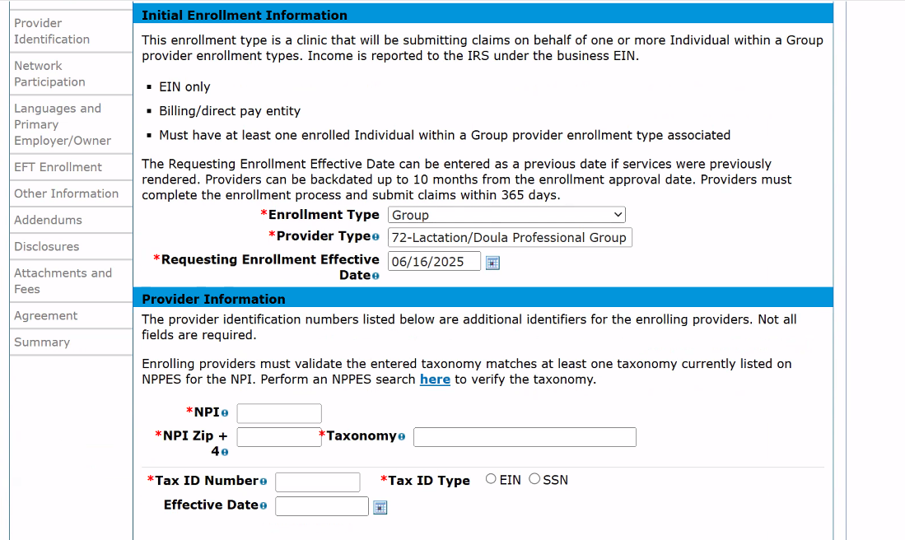
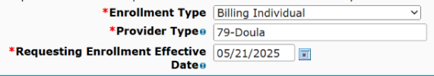
Notes:
Then, select your Provider Type. If you’re enrolling as a Group, you’ll select code 72, if you’re enrolling as a billing individual or individual with in a group, you’ll select code 79.
The requesting enrollment effective date should be the date you submit your application.

Slide 58


Doula Taxonomy Code:
374J00000X
USPS Website:
https://tools.usps.com/zip-code-lookup.htm
Notes:
Then enter your NPI.
When entering your zip code, use the nine-digit zip code associated with your NPI. You can find this ZIP code on the USPS website.
Next, enter your taxonomy code. The doula taxonomy code is displayed on the screen.
The tax ID should be your social security number if you’re enrolling as an individual or an EIN if you’re enrolling as a group.
The requesting enrollment effective date should be the date you submit your application.
Finally, you’ll enter your contact information.
Make sure to enter your legal name as it appears on all the documentation you’ll need to submit.

Slide 59

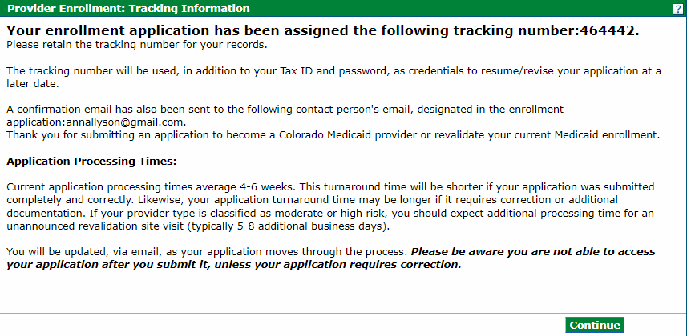
Notes:
After entering your contact information, you will create a password for your account and answer three security questions. This will allow you to pause and resume the application if needed by clicking “Finish Later.” You will also be provided with an Application Tracking Number, which can be used to check the application status. Make sure to save your username, password, and tracking number somewhere safe so you can reference it later.

Slide 60
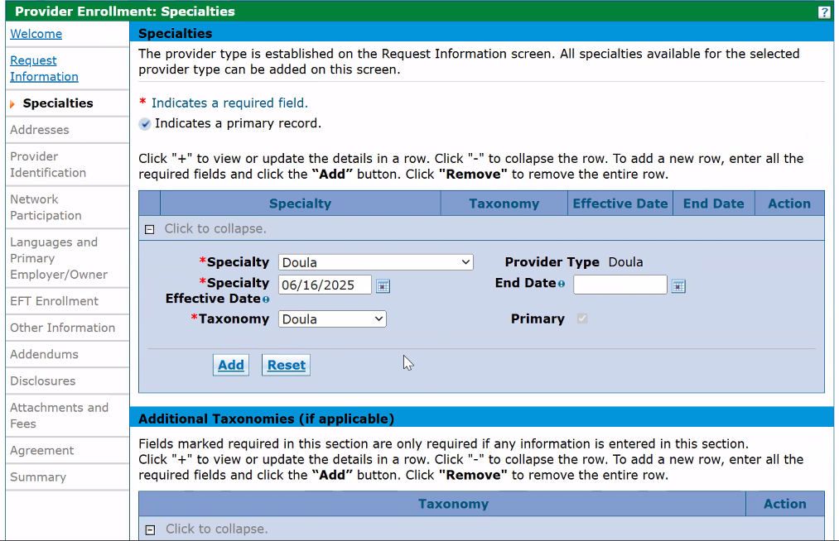

Notes:
When selecting a (1) specialty, you should select Doula for Specialty and Taxonomy, make today’s date the Specialty Effective Date, and leave the End Date blank.

Slide 61
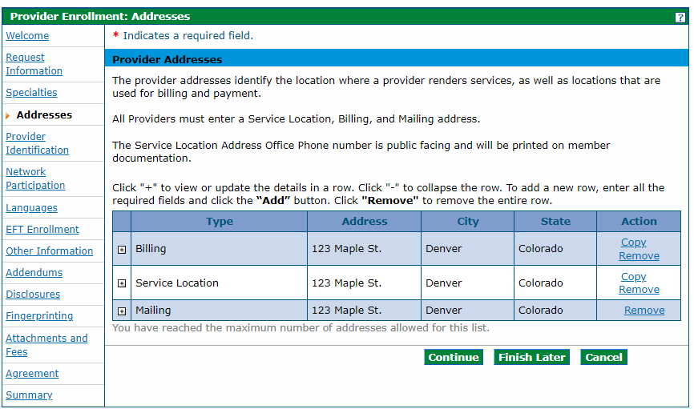
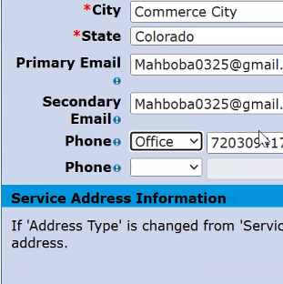
Notes:
On the following addresses tab, add the address where you (2) bill for services, (3) provide services, and (4) receive your mail. You need to enter an address for each of these address types, but they can be the same address. Use the address you registered for your business with the Colorado Secretary of State. When entering the addresses, click add at the bottom of the page to save the address. You’ll receive an error if you click submit before you add all three address types.
(5) Your must put office phone. You will receive an error if you only provide a cell phone number. It is okay if your office number is the same as your cell phone number.

Slide 62
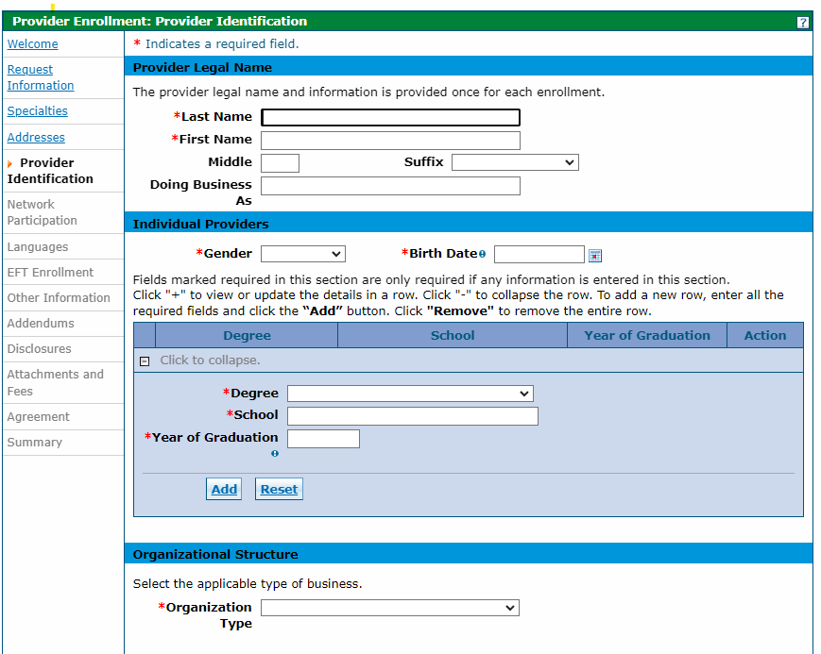



Notes:
On the next page complete the provider identification information. (2) Enter your legal provider name or (3) “doing business as” name. Please note that your legal name should be different from your DBA name. If you do not have a DBA name, leave it blank.
(4) Even if you have a relevant degree, you should leave the degree, school and year of graduation blank.
(5) Select your organization type. The organization type should be sole proprietor if you are a billing individual or individual within a group. If you’re applying as an individual within a group, you will enter your group’s type 2 NPI and select the type, such as an LLC or non-profit.

Slide 63
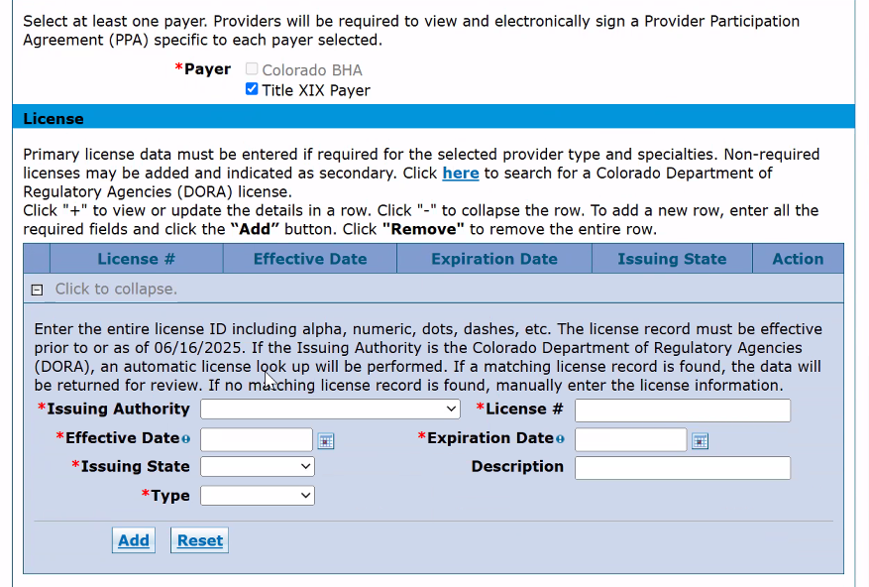
Notes:
Select Title XIX Payer. You should also skip the License section; it is not required.

Slide 64
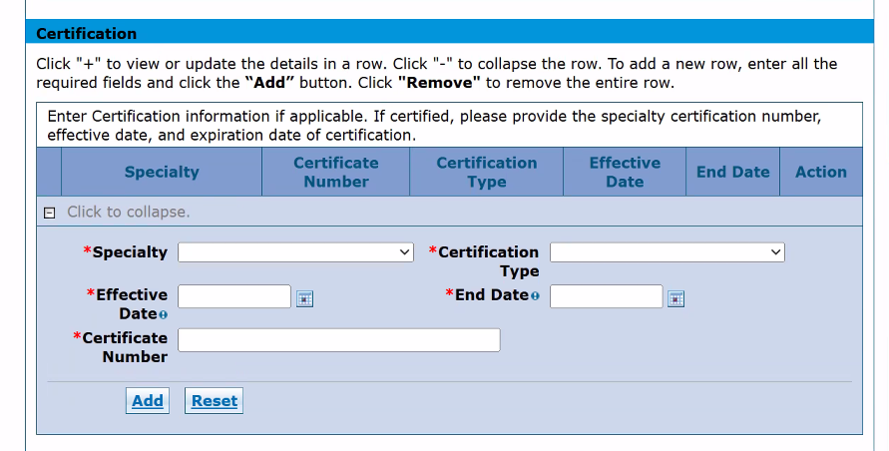
No Certificate Number?
Enter 00000
Notes:
All doulas should fill out the certification section regardless of the pathway they are applying under. Enter “doula” as the specialty and “other” for certification type. Input the effective start and end date of your certification or training certificate. (1) If you don’t have a certificate number, then enter 00000.
Make sure to click Add to save the information to your application.

Slide 65
Skip
Medicare Participation
Managed Care Network Participation
Notes:
(1, 2) You don’t need to fill out information on Medicare and Managed Care Network participation.

Slide 66
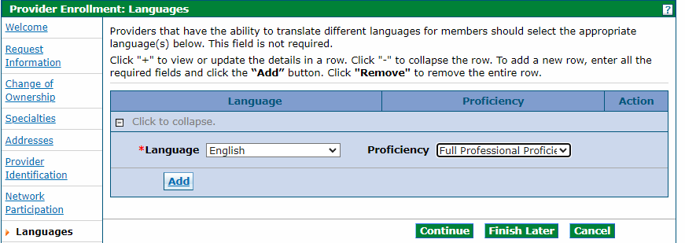

Notes:
(1 ) Add languages you speak on the languages page. (2) Add languages only if you speak them fluently. (3) You will need to select at least one language.

Slide 67
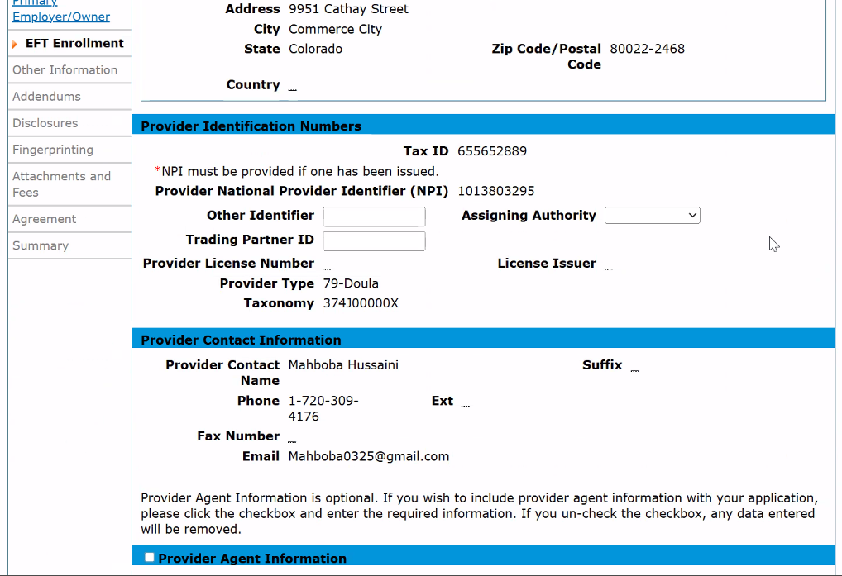
Notes:
In the EFT enrollment tab, you can skip over the (1) Other Identifier, (2) Trading Partner ID, and (3) Assigning Authority boxes.

Slide 68
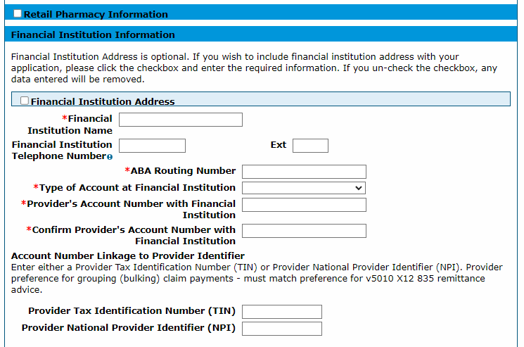

Notes:
Your will need to fill out bank information so you can receive automatic payment. Your NPI and tax ID will be prepopulated at the top of this page, check this information to ensure it is accurate. (1) Enter information into the Financial Institution screen at the bottom of the page to ensure payment. Make sure the information you enter matches the information in the voided check or bank letter you will need to upload later in the application. Please note that a direct deposit form is not an acceptable replacement for a voided check or bank letter.
Skip through the addendums page, as no additional addendums are required for doulas. Read any disclosures that appear on the disclosures page by clicking on the disclosure name, answering the accompanying questions, and then clicking add for each disclosure.
Make sure to only enter the (2) NPI number, not the (3) TIN on this screen.

Slide 69
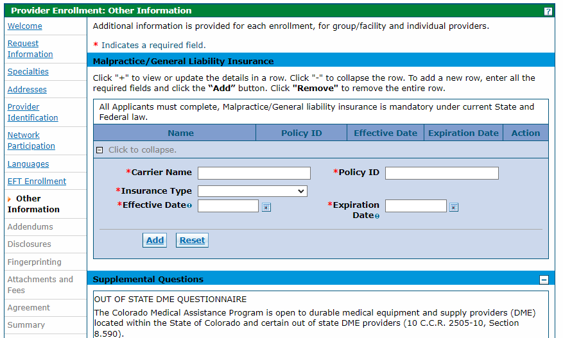


Notes:
Enter your insurance information under the (1) other information tab. This includes your (2) carrier name, (2) policy ID, (3) insurance tyle, (4) effective and (5) expiration date. (6) As a doula you must have liability or professional insurance.

Slide 70
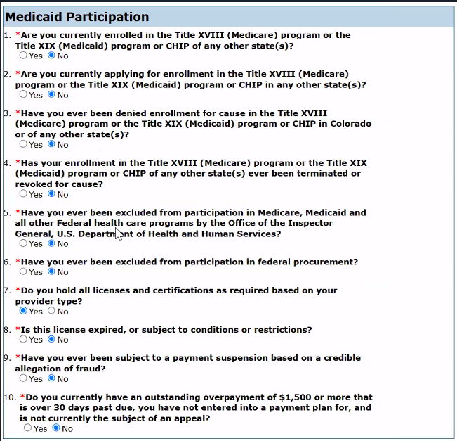
Notes:
Next you will complete the Medicaid Participation questions.

Slide 71
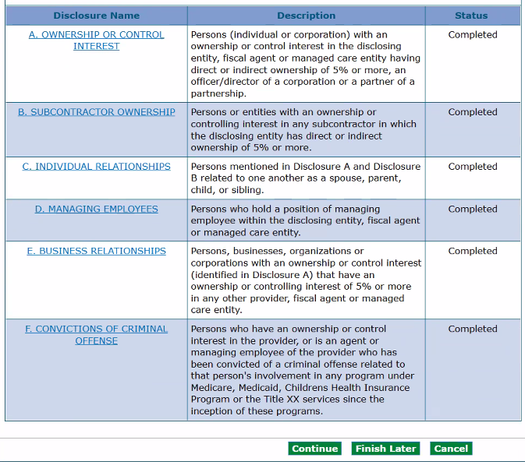
Notes:
Click on the link for each disclosure, complete information, and click add and submit.
Groups must list owners’ social security numbers, practice address, and date of birth. Once all are completed, click continue.

Slide 72
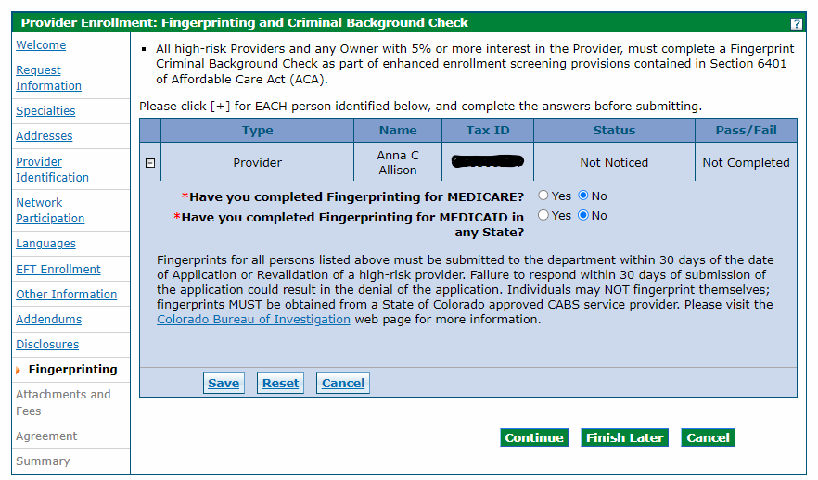

Be sure to use code 25YQG9* when making an appointment with IdentoGO!
IdentoGO website:
https://uenroll.identogo.com/
Cost Considerations: In 2025, fingerprinting costs $16.50 in Colorado
Notes:
Complete the background check information on the next page. (1) Fingerprinting background checks are required for doulas. You will need to pay to be fingerprinted. (2) Be sure to use the code displayed on the screen when making an appointment with IdentoGO, the agency that conducts the background check. HPCF will then check to ensure that all the individuals listed in your application have received the background check.
In 2025, the cost of fingerprinting was $16.50.

Slide 73
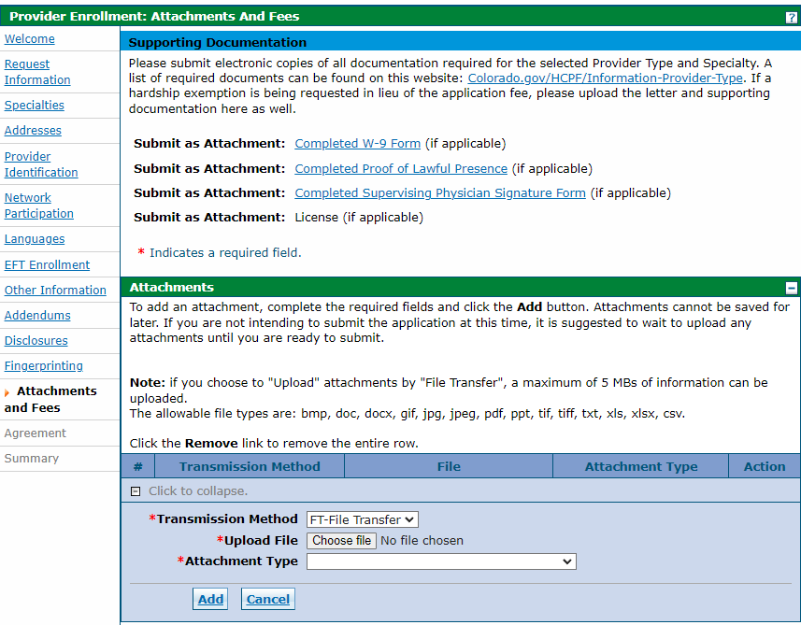

Attachment Type | Attachment
W-9 | W-9 with SSN
Voided Check or Bank Letter | Voided Check or Bank Letter
Other | Attestations
Other | Doula Code of Conduct
Other | CPR Card
Other | Lawful Presence Affidavit
Other | Front of Driver’s License/ State ID
Other | Back of driver’s license/ state ID
Other | Copy of Insurance Policy
Other | Doula Certification
Other | Doula Training Certificate
Other | Letters of Recommendation
Notes:
(1) Upload supporting documents on the attachments and fees page.
(2) Your W9 and Voided check/bank letter should be filed as their specific attachment type. All other documents will be listed as “Other.”

Slide 74






Registering for the System
Click submit, and you’re done!
Read and Agree to the Provider Enrollment Agreement
Print or Save
Review Final Summary
Notes:
(1)Read and agree to the Provider Enrollment Agreement on the agreement tab. Be sure to (2) print or save the agreement for your files or records. The final summary tab will give you a chance to (3) review the information you provided. (4) Click submit once the information is correct and you’re done!
Please note that some providers of moderate-to high-risk specialties undergo a virtual site visit with the Fiscal Agent to ensure that the provider is operating as a legitimate business. However, this is NOT required for doulas.

Slide 75
Billing for Services
Notes:
Let’s move on to how you bill for services.

Slide 76

Billing for Services
Provide services
Submit claims via the Medicaid Provider Web Portal (within 365 days of service)
Get reimbursed on a fee-for-service basis
Notes:
Once you are registered in the Medicaid Provider Web Portal and begin to provide services, you will submit electronic claims directly through the portal to be reimbursed for services to the bank account provided. The claim will include information on the services you provided and will be reimbursed on a fee-for-service basis, meaning that you get paid for exactly whatever services you rendered.
It is your responsibility to submit billing information. You will have up to 365 days from the date of service to submit your claim; after 365 days from the date of service, a claim is no longer eligible to be paid.

Slide 77
Billing Overview
Submit claims via the Medicaid Provider Web Portal (within 365 days of service)
Service Type | Diagnosis Code | HCPCS* Code | Rate | Max Units/$ per Pregnancy | Visit Structure Options
Prenatal | Z33.1 | T1032 | $25 | 12 units/$300 | 15-minute increments
Postpartum | Z39.2 | T1032 | $25 | 12 units/$300 | 15-minute increments
Labor & Delivery | Z33.1 | T1033 | $900 | 1 unit/$900 | 1 service
* Healthcare Common Procedure Coding System (HCPCS)
Notes:
(1) For prenatal and postpartum care, you will bill time in 15-minute increments up to a maximum of 180 minutes each. The number and length of visits is at your discretion (for example, three hour-long visits and six 30-minute visits are both equivalent to 12 units). For attending labor and delivery, you will bill one unit of service.

Slide 78
Required to submit a successful claim:
Medicaid Provider ID
Provided to you once you enroll in Health First Colorado
Notes:
The Following information is required to submit a successful claim:
(1) First, your Medicaid Provider ID. You will be provided this number once you are enrolled in Health First Colorado.

Slide 79
Required to submit a successful claim:
Medicaid Provider ID
Provider (Doula) NPI Number
See “Preparing Your Business” for more info
Notes:
You will also need your provider NPI number: You included this code as part of your Health First Colorado application. See the Preparing Your Business for Health First Colorado training for more information.

Slide 80
Required to submit a successful claim:
Medicaid Provider ID
Provider (Doula) NPI Number
Provider (Referring Clinician) NPI Number
See “Establishing Good Processes for Doula Practices” for more info
Notes:
You will also need the NPI number of the client’s recommending provider. See the Establishing Good Processes for Doula Practices section for more information.

Slide 81
Required to submit a successful claim:
Medicaid Provider ID
Provider (Doula) NPI Number
Provider (Referring Clinician) NPI Number
Member Medicaid ID
Assigned to those enrolled in Health First Colorado
Notes:
Make sure you include your member Medicaid ID: This code is assigned to people who are covered by Medicaid.
Note that clients enrolled in CHP+ are eligible for doula services, but the doula billing manual applies to both Health First Colorado and CHP+ enrollees.

Slide 82

Required to submit a successful claim:
Medicaid Provider ID
Provider (Doula) NPI Number
Provider (Referring Clinician) NPI Number
Member Medicaid ID
Assigned to those enrolled in Health First Colorado
Check Medicaid eligibility and document the client’s Medicaid ID before providing services
Notes:
(1) Remember to check Health First Colorado eligibility and document the client’s Medicaid ID before providing services. The person must be eligible for Medicaid at the time services are rendered for you to be reimbursed.

Slide 83
Required to submit a successful claim:
Medicaid Provider ID
Provider (Doula) NPI Number
Provider (Referring Clinician) NPI Number
Member Medicaid ID
Member Information
Member name, address, and date of birth
Notes:
Include the member information such as their name, address, and date of birth.

Slide 84
Required to submit a successful claim:
Medicaid Provider ID
Provider (Doula) NPI Number
Provider (Referring Clinician) NPI Number
Member Medicaid ID
Member Information
Diagnosis Code
The condition being treated:
Notes:
You will also need a diagnosis code. These diagnostic codes communicate the condition being treated.

Slide 85
Required to submit a successful claim:
Medicaid Provider ID
Provider (Doula) NPI Number
Provider (Referring Clinician) NPI Number
Member Medicaid ID
Member Information
Diagnosis Code
The condition being treated:
Z33.1 for “pregnant state” for prenatal visits and labor and delivery
Z39.2 for “routine postpartum follow-up” for postpartum visits
Notes:
Report a diagnosis code of Z33.1 indicating “pregnant state” for prenatal visits and labor and delivery. (1) Report Z39.2 for “routine postpartum follow up” for postpartum visits.

Slide 86
Required to submit a successful claim:
Medicaid Provider ID
Provider (Doula) NPI Number
Provider (Referring Clinician) NPI Number
Member Medicaid ID
Member Information
Diagnosis Code
HCPCS Code
What services were delivered:
Notes:
Include the (pronunciation: hick-picks) HCPCS Code. These procedure codes communicate what services were delivered.

Slide 87
Required to submit a successful claim:
Medicaid Provider ID
Provider (Doula) NPI Number
Provider (Referring Clinician) NPI Number
Member Medicaid ID
Member Information
Diagnosis Code
HCPCS Code
What services were delivered:
T1032 for prenatal and postpartum visits
Notes:
Report a HCPCS code of T1032 indicating doula birth worker services for prenatal and postpartum visits.

Slide 88
Required to submit a successful claim:
Medicaid Provider ID
Provider (Doula) NPI Number
Provider (Referring Clinician) NPI Number
Member Medicaid ID
Member Information
Diagnosis Code
HCPCS Code
What services were delivered:
T1032 for prenatal and postpartum visits
T1033 for labor and delivery
Notes:
Report a HCPCS code of T1033 indicating doula birth worker services for labor and delivery.

Slide 89
Required to submit a successful claim:
Medicaid Provider ID
Provider (Doula) NPI Number
Provider (Referring Clinician) NPI Number
Member Medicaid ID
Member Information
Diagnosis Code
HCPCS Code
Units
The number of services:
Notes:
Units indicate the number of services represented in the claim.

Slide 90
Required to submit a successful claim:
Medicaid Provider ID
Provider (Doula) NPI Number
Provider (Referring Clinician) NPI Number
Member Medicaid ID
Member Information
Diagnosis Code
HCPCS Code
Units
The number of services:
1 for each 15 minutes of a prenatal or postpartum visit
Notes:
Report one unit for each 15 minutes of a prenatal or postpartum visit. For example, an hour-long visit is 4 units of 15 minutes.

Slide 91
Required to submit a successful claim:
Medicaid Provider ID
Provider (Doula) NPI Number
Provider (Referring Clinician) NPI Number
Member Medicaid ID
Member Information
Diagnosis Code
HCPCS Code
Units
The number of services:
1 for each 15 minutes of a prenatal or postpartum visit
1 for labor and delivery
Notes:
Report one unit for labor and delivery.

Slide 92
Required to submit a successful claim:
Medicaid Provider ID
Provider (Doula) NPI Number
Provider (Referring Clinician) NPI Number
Member Medicaid ID
Member Information
Diagnosis Code
HCPCS Code
Units
Date of Service
The date the service was performed
Report only the first date of labor
Notes:
For labor and delivery services that occur on multiple dates, report only the first day of labor in the claim.

Slide 93
Steps to Submitting a Claim:
1. Log into the system
2. Fill out necessary information
3. Navigate between pages of the form
4. Submit claim
Notes:
The steps to submitting a claim include:
- (1, 2) Logging into the system
- (3, 4) Filling out necessary information
- (5, 6) Navigating between pages of the form
- (7, 8) and submitting the claim

Slide 94
After Submission:
You will receive real-time feedback and a claim status
Notes:
After submission you will receive immediate feedback on whether your claim is accepted directly in the Medicaid Provider Web Portal.

Slide 95
After Submission:
You will receive real-time feedback and a claim status
Paid Status: claim is complete, does not require additional review, and no further action is necessary on your part.
Notes:
A paid status indicates that the claim is complete, does not require additional review, and no further action is necessary on your part. Claims will generally be paid within two weeks of receipt.

Slide 96
After Submission:
You will receive real-time feedback and a claim status
Paid Status: claim is complete, does not require additional review, and no further action is necessary on your part.
Suspended Status: claim needs additional manual review by the Fiscal Agent.
Notes:
A suspended status means that the claim needs additional manual review by the Fiscal Agent. The claim will advance to “paid” status if subsequent review finds that no additional information is needed.

Slide 97
After Submission:
You will receive real-time feedback and a claim status
Paid Status: claim is complete, does not require additional review, and no further action is necessary on your part.
Suspended Status: claim needs additional manual review by the Fiscal Agent.
Denied Status: the claim is returned to you with the reason for denial.
Notes:
A denied status means that the claim needs additional manual review A denied claim, either in the initial submission or after review, will be returned to you with the reason for denial. You may resubmit the claim the claim after addressing issues (e.g., missing or incorrect information).

Slide 98
Submitting a Claim:
Denied Status: the claim is returned to you with the reason for denial.
Common reasons for denial include:
Client is not enrolled in Medicaid
Member Cap Exceeded
Claim does not align with approved NPI
Notes:
Common reasons for denial include:
The Client is not enrolled in Health First Colorado: Check the system to make sure the member is enrolled in Health First Colorado and eligible to receive services prior to providing services. If the client is not enrolled in Health First Colorado, refer the client to the Colorado PEAK system. Clients can also contact their county government agency, which may have trained enrollment specialists.

Slide 99
Submitting a Claim:
Denied Status: the claim is returned to you with the reason for denial.
Common reasons for denial include:
Client is not enrolled in Medicaid
Missing or incorrect diagnosis codes or HCPCS codes
Member Cap Exceeded
Claim does not align with approved NPI
Notes:
There may also be a Missing or incorrect Diagnosis Codes or HCPCS Codes: Make sure you use the correct combination of Diagnosis and HCPCS Codes.

Slide 100
Submitting a Claim:
Denied Status: the claim is returned to you with the reason for denial.
Common reasons for denial include:
Client is not enrolled in Health First Colorado
Missing or incorrect diagnosis codes or HCPCS codes
Member cap exceeded
Claim does not align with approved NPI
Notes:
It is possible the member cap has been exceeded: All benefits relate to the member. If more than one doula supports the member, then the combined time across those doulas cannot exceed the caps. For example, if one doula is reimbursed for one 60-minute visit and one 90-minute visit during the prenatal period, a second doula can only be reimbursed for one 30-minute visit or two 15-minute visits.

Slide 101
Submitting a Claim:
Denied Status: the claim is returned to you with the reason for denial
Common reasons for denial include:
Client is not enrolled in Health First Colorado
Missing or incorrect diagnosis codes or HCPCS codes
Member cap exceeded
Claim does not align with approved NPI
Notes:
It is also possible your claim does not align with an approved NPI. Make sure the NPI you include on the claim matches the NPI you used to enrolled as a Health First Colorado provider.

Slide 102
Submitting a Claim:
Denied Status: the claim is returned to you with the reason for denial
Common reasons for denial include:
Client is not enrolled in Health First Colorado
Missing or incorrect diagnosis codes or HCPCS codes
Member cap exceeded
Claim does not align with approved NPI
Claim does not have NPI of referring clinician
Provider Service Call Center:
1-833-468-0362
Notes:
Finally, the claim may not have the NPI of the recommending licensed provider. You should have collected and stored the provider recommendation form when you first enrolled the client in doula services.
If your claim is denied, you can make the needed corrections and resubmit the claim for payment. If you need help resubmitting your claim, you can contact the help number shown on the screen.

Slide 103
Provider Maintenance and Revalidation
Notes:
Finally, we’ll talk about provider maintenance and revalidation. It is essential that doulas keep information in the Medicaid Provider Web Portal up to date through regular provider maintenance. In addition, doulas, like all Health First Colorado providers, need to revalidate every five years. Please regularly read email communications from Health First Colorado and sign up for the MCH listserv to make sure that you stay current on the latest information and requirements.

Slide 104
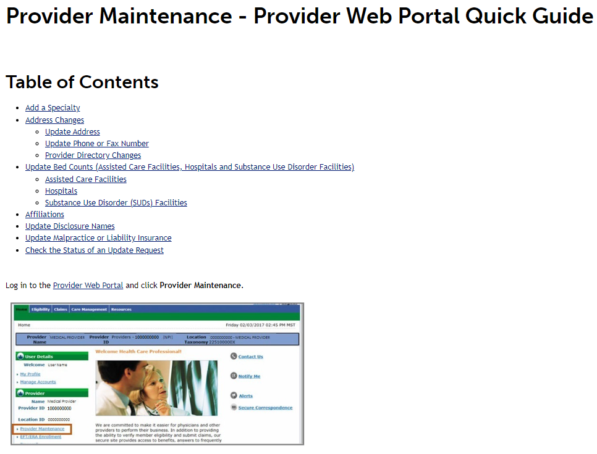
Provider Maintenance: General Information
Specialty
Address Change
Insurance
For more info on Provider Maintenance Requests, go to:
Provider Web Portal quick guide
Notes:
In order to keep their information up-to-date with Health First Colorado, occasionally providers must submit Provider Maintenance requests. This information includes your specialty, address changes, and insurance updates. If applicable, doulas should log into the Medicaid Provider Web Portal and click “Provider Maintenance” to update their information. Detailed information about Provider Maintenance requests can be found on the Provider Web Portal Quick Guide on the Department's website.

Slide 105
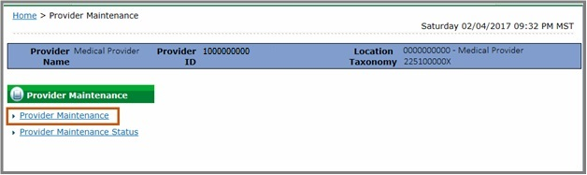
Provider Maintenance: Maintaining Current Doula Documentation
Doula Training Certification
CPR Certification
Notes:
Doulas will be expected to always maintain current doula training and CPR certificates, and you are responsible for uploading the required documentation to the Medicaid Provider Web Portal in accordance with the expiration dates of the relevant trainings. Since CPR certificates and Doula training certificates have different expiration dates than the rest of the Doula requirements, these must be updated through provider maintenance requests

Slide 106


Revalidation: Every Five Years
Provider
The Department
Keeps enrollment information current
Suspends payment if incomplete
Updates certification and attestation documents
Removes ineligible and inactive providers
Notes:
Doulas will be expected to provide the Department with updated information on business practices through the revalidation process, which occurs every five years. This process is important to ensure that the information on file for each provider in the Medicaid Provider Web Portal remains current, including any needed certification and attestation forms. This information allows the Department to properly screen providers to ensure that they remain eligible and for providers to continue to offer services to members.
Ineligible and inactive providers will be removed during the revalidation process. Active providers that do not complete revalidation by the due date risk suspension of claims. You will be expected to re-sign the attestation documents that were required in the initial application and always maintain current doula certification documentation within the Medicaid Provider Web Portal, even between revalidations.

Slide 107



Preparing for Revalidation
Keep your email addresses current
Submit provider maintenance requests
Log into the Medicaid Provider Web Portal
Revalidate
Notes:
There are several steps to take to make sure your revalidation runs smoothly: keeping your email addresses current, submitting provider maintenance requests before revalidation, logging into the Medicaid Provider Web Portal, and applying for revalidation. We will dive deeper into each of these steps in the following slides.

Slide 108

Keep Your Email Addresses Current
First notification 6 months prior to revalidation
Monthly reminder emails
To avoid missing emails:
  Keep email active and up to date
  Use a generic email in case employees leave
  Regularly check your inbox
Notes:
Doulas will receive an email six months before their revalidation deadline informing them of the need to revalidate; they will receive monthly reminders after the initial email. Once you receive this initial email, access the Medicaid Provider Web Portal and supply the necessary information. Revalidation notices will be sent to the email addresses listed in the Medicaid Provider Web Portal. To avoid missing critical emails: keep an active and up-to-date email address in the Medicaid Provider Web Portal. If you work for a doula organization, consider using a generic email address to ensure that the given email address is not linked to a staff member who may leave the organization, and regularly check your email for messages regarding revalidation.

Slide 109
Submit Provider Maintenance Requests Before Revalidation
Business name
Address
Specialty
Insurance
Ownership
Notes:
Once you begin the revalidation application, you cannot submit Provider Maintenance Requests. This means that you cannot edit the prepopulated information (e.g., business name, address, insurance, specialty, and ownership) during revalidation. To prevent this, log into the Medicaid Provider Web Portal and review the information saved in the portal before beginning the revalidation application. If you find incorrect or out-of-date information in the portal, submit the Provider Maintenance Request before beginning the revalidation application.

Slide 110


Thank you!
Questions? Contact HCPF at
hcpf_maternalchildhealth@state.co.us
or the Fiscal Agent at (833) 468-0362
Notes:
We’ve reached the end of this presentation. Thank you all for attending. If you have questions about the polices discussed during this presentation, contact the Department using the contact information displayed on the screen. If you have questions about enrolling in Health First Colorado, contact the fiscal agent using the contact information on the screen.

