Slide 1


Slide 2

Webinar Logistics
>3k Registrants: Questions for Speakers: Use Q&A feature on the toolbar. We may not get to every question live. HCPF experts are answering online.
Please leverage the event pop-up polls to help us capture aggregate perspectives.
Presentations, links and materials will be posted in the Chat.
Otherwise, the Chat is closed and is being used for behind the scenes communications.
Materials will also be posted to CO.gov/HCPF/events
Accessibility: American Sign Language, audio only, Spanish interpretation, closed captioning

Slide 3

Today’s Agenda
9:00 Welcome, Logistics, Agenda
9:05 Overview of Challenges and Our Plan
9:20 Medicaid Cost Trend Drivers and Solutions to Address Them
9:55 Federal H.R.1 Medicaid Impact and What’s Next
10:25 HCPF Priorities
10:30 Q&A
10:50 Closing Remarks and Next Steps

Slide 4
Speakers Today
Kim Bimestefer, HCPF Executive Director
Tom Leahey, Pharmacy Office Director
Cristen Bates, Deputy Medicaid Director and Office of Medicaid and CHP+ Behavioral Health Initiatives & Coverage Director
Bonnie Silva, Office of Community Living Director
Adela Flores-Brennan, Medicaid Director and Health Policy Office Director
David Ducharme, Accountable Care Collaborative Division Director
Nancy Dolson, Special Financing Division Director
Bettina Schneider, Finance Office Director and CFO
Rachel Reiter, Policy, Communications and Administration Office Director
Joshua Montoya, Partner Relations and Administration Division Director

Slide 5
Our HCPF/Medicaid Fiscal Challenges - State
State Fiscal Challenges Impacting HCPF
TABOR generally limits revenue growth to inflation. Balanced budget provision. Need voter approval to raise taxes.
In the last 40 years, no commercial or Medicaid health plan has consistently controlled its trends at or below general inflation.
Medical inflation for 2026 is projected to continue in the 8% range
HCPF represents about one-third of the state’s budget, with Medicaid trends that run higher than medical inflation.
Last year, CO had a $1.2B budget shortfall to close. This year, because of H.R.1, we are out of balance with a >$1B shortfall.
  Special Session beginning Aug. 21
More information at: CO.gov/tax/TABOR and pwc.com/us/en/industries/health-industries/library/behind-the-numbers.html

Slide 6
Our HCPF/Medicaid Fiscal Challenges - Federal
Federal Challenges
COVID related federal stimulus dollars are gone.
Federal Medicaid funding and general perspectives of its purpose have changed.
H.R.1 tax reductions are reducing state revenues, pushing the state out of balance for this year’s budget and future budgets as well
H.R.1 ratchets down fed funding to Colorado via its Medicaid Provider Tax provisions by 0.5%/yr from 2028-2032, reducing fed revenues by $1B-$2.5B
Federal funding is going down through H.R.1 while admin burden is going up for federal mandates like Work Requirements and more frequent eligibility determinations
Threat to coverage, higher due to the short time to implement systems
More information at: CO.gov/tax/TABOR and pwc.com/us/en/industries/health-industries/library/behind-the-numbers.html

Slide 7











HCPF : Colorado Dept. of
Health Care Policy & Financing
Health First Colorado (Colorado’s Medicaid program)
Child Health Plan Plus
Buy-In Programs
Hospital Discounted Care
Covering 1.3 million or 22% of Coloradans, 40%+ state’s children, 40%+ births
Administer the programs on the left
FY2025-26 budget $18.2B total funds, $5.5B General Fund, about 1/3 state budget
96% budget pays providers, 4% admin including 0.5% staff
Long Term Services and Supports
Senior Dental Program
Family Planning
Cover All Coloradans
Federal Match, Continuous Coverage
Health Related Social Needs
School Health Services
Resource available at CO.gov/hcpf/HereForYou

Slide 8
Fiscal Yr | Year End GF (in millions) | % Growth | GF Actuals Growth
FY 2014-15 | $2,210.6 | 22% | $404.10
FY 2015-16 | $2,364.0 | 7% | $153.40
FY 2016-17 | $2,407.5 | 2% | $43.50
FY 2017-18 | $2,679.6 | 11% | $272.10
FY 2018-19 | $2,824.8 | 5% | $145.20
FY 2019-20 | $2,822.5 | 0% | ($2.30)
FY 2020-21 | $2,556.6 | -9% | ($265.90)
FY 2021-22 | $2,865.7 | 12% | $309.10
FY 2022-23 | $3,452.3 | 20% | $586.60
FY 2023-24 | $4,362.0 | 26% | $909.70
FY 2024-25 | TBD | **16% | **Based on forecast
Outlier budget growth last 4 years, aligned with COVID stim investments and other actions.
Our fiscal realities have changed.
We must change, too.
We must manage within budget realities.

Slide 9
Medicaid Sustainability Framework helps us
better manage Medicaid trends and avoid draconian cuts
Address Drivers of Trend: Better address all the controllable factors that drive Medicaid cost trends
Maximize Federal Funding: Leverage and maximize HCPF’s ability to draw down additional federal dollars
Invest in Coloradans: Continue investing in initiatives to drive a Colorado economy and educational system to reduce the demand for Medicaid over the long term as Coloradans rise and thrive
Make Reasonable Medicaid Cuts or Adjustments: Identify where programs, benefits, and reimbursements are comparative outliers or designed in such a way that we are seeing - or will experience - higher than intended trends or unintended consequences
Reassess New Policies: Consider pausing or adjusting recently passed policies not yet implemented
Exercise Caution in Crafting Increases to the Medicaid program going forward

Slide 10
H.R.1 Medicaid Coverage Threats
Medicaid Expansion population - 377,000 Medicaid members:
Federal CHASE Funding Reductions impacting this population
Eligibility redeterminations increased from every 12 months to every 6, starting Jan. 1, 2027
Work requirements for most “able-bodied adults”, starting Jan. 1, 2027
  Working, Going to school, or Volunteering at least 80 hrs/mo to qualify
Coloradans may lose coverage because they don’t meet the new requirements or because of administrative complications
North Star: Mitigate coverage losses and its catastrophic consequences to Coloradans, providers, economy

Slide 11
Why this North Star Focus? Coverage Loss Impact!
Negative Population Health Impact: Care delays, not filling Rx, missing preventive screenings
When care is sought, increased medical debt/bankruptcies
Uncompensated Care Costs: higher use of ER, uncompensated care for doctors, hospitals and other providers - especially
concerning for providers without margins to
cover, like rural providers. Access decisions.
Layoffs.
Economy: Health Care is the largest component
of Colorado’s and U.S. economies
2025 FEDERAL POVERTY LEVELS
by Family Size*
FAMILY OF 1
$20,820
FAMILY OF 4
$42,768
*Some earning more may still qualify

Slide 12
Loss of health coverage risk to
Connect for Health Marketplace enrollment, too
Family of Four Premium Increase
Rating Area | 2026 Annual Premium | Approx. Net Premium Increase - 400% FPL | Percent Change
1. Boulder | $24,453 | $13,353 | 26.7%
2. CO Springs | $26,027 | $15,027 | 24.2%
3. Denver | $25,129 | $14,129 | 25.4%
4. Fort Collins | $25,676 | $14,676 | 29.4%
5. Grand Junction | $29,091 | $18,091 | 38.4%
6. Greeley | $25,686 | $14,686 | 29.0%
7. Pueblo | $26,419 | $15,419 | 30.4%
8. East | $32,309 | $21,309 | 33.4%
9. West | $36,832 | $25,832 | 38.8%
Enhanced Premium Tax Credits expire Dec. 31, 2025. Premium increases will impact 321,000 Coloradans
Est. 100,000 - 110,000 Coloradans will lose coverage due to affordability
40% cut to reinsurance program due to less funding, which will raise premiums
2026: 28% avg. requested prem. increase
  Much higher in rural communities
  Avg. statewide increases were 5.6% in 2025, 9.7% in 2024, 10.4% in 2023 and 1.1% in 2022
More info at doi.colorado.gov

Slide 13
Robust HCPF Plan to help navigate our realities
Discipline to Medicaid Sustainability Framework
  Grounded in facts/insights and alignment around shared goals
  State budget challenges, Medicaid trend drivers, solutions
Understanding H.R.1 impacts and aligned goals: North Star - prevent inappropriate loss of coverage; No draconian cuts to Medicaid
  System builds and investments and eligibility processor investments
Leverage ACC Phase III and Innovations (eConsults, Prescriber Tools, Value Based Payments, etc.) to control trends and improve quality
Leverage third party insights, state comparisons, learnings
Prioritize engagement, transparency, partnership, leadership
Visit Colorado.gov/hcpf/publications (click on sign up for newsletters, choose At A Glance)

Slide 14
Sample Medicaid Cost Trend Drivers
and Options to Address Them
Kim Bimestefer, Executive Director and CEO
Tom Leahey, Pharmacy Office Director
Cristen Bates, Deputy Medicaid Director and Office of Medicaid and CHP+ Behavioral Health Initiatives & Coverage Director
Bonnie Silva, Office of Community Living Director
Adela Flores-Brennan, Medicaid Director and Health Policy Office Director

Slide 15
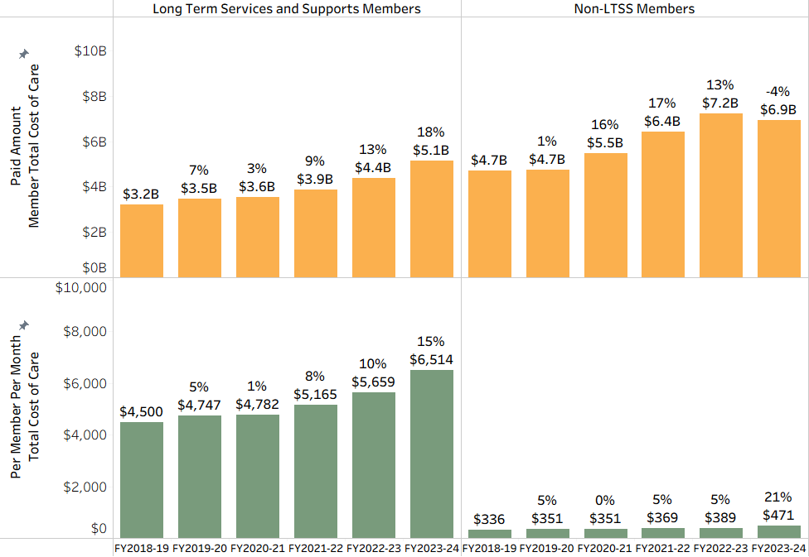
Long Term Services and Supports
LTSS ~5% of members: 42% of spend at higher trend of 9-12%
Non-LTSS ~95% of members: 56% of spend at a lower trend of 8-9%
Taking care of people with disabilities is core to Medicaid programs.
LTSS Members
Non-LTSS Members

Slide 16
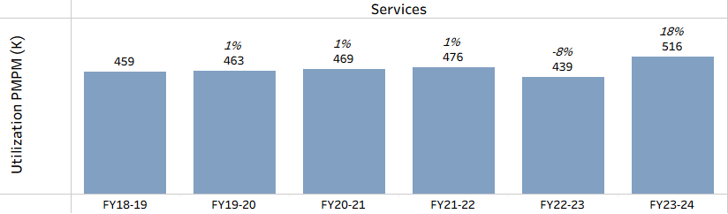
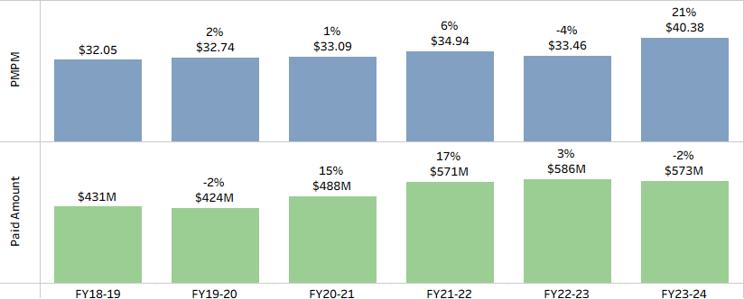
Physician+ Care
Trends
Flat utilization
<1% PMPM trends until FY23/24 uptick
+6.5% paid trend
Solutions:
Increase eConsults uptake
Reimbursements

Slide 17
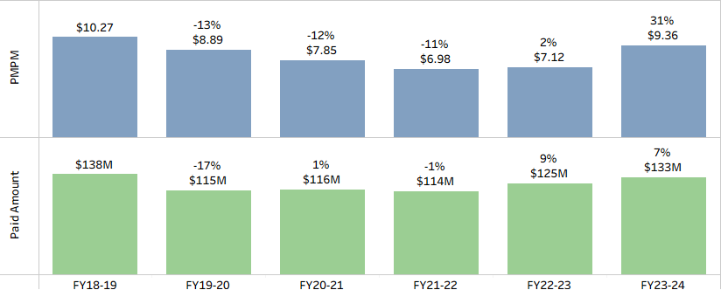
Independent Labs
PMPM trend is -9% and Paid Amount trend is -3.6% between FY18/19 and FY23/24. But recent uptick!
Current Controls
Claim processing software prevents overbillings
Policies on genetic testing and other abuses
Retrospective claim reviews via RAC
Outlier lab and outlier drug testing, FWA, termination

Slide 18
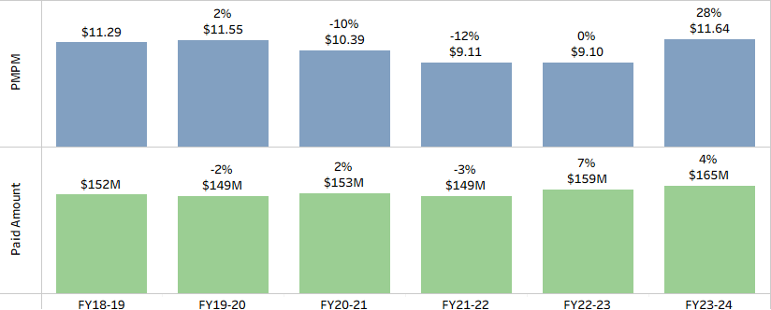
Generic Prescription Drugs
PMPM trend is <1% per year. Paid trend is <2% per year. Generics trend is below TABOR trend.
Generics: 85%+ of Medicaid dispensed drugs, running at <2% annual trend
$165M Generic Rx spend for 85% of drug therapy.
Strategies:
Payment policy
Prescriber Tool
Prior Auth to promote generic use

Slide 19
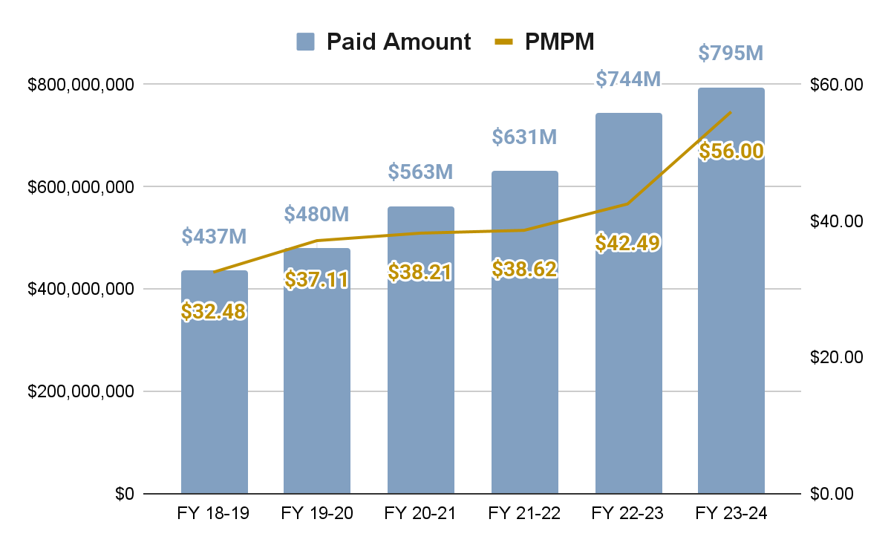
Specialty Prescription Drugs
+82%
Increase in paid $$ from FY18/19 to FY23/24. Trend is +16% per year.
Driver:
<2% of scripts are so expensive, driving 50% of Medicaid (& Commercial) Rx costs. Trend 14-16%/yr.
$800M in Paid $$ (pre-rebate reduction)
Solutions:
Right care, right price, right outcome
Medicaid states price negotiations
Manufacturer rebates
Value-based contracts
Canadian Importation

Slide 20
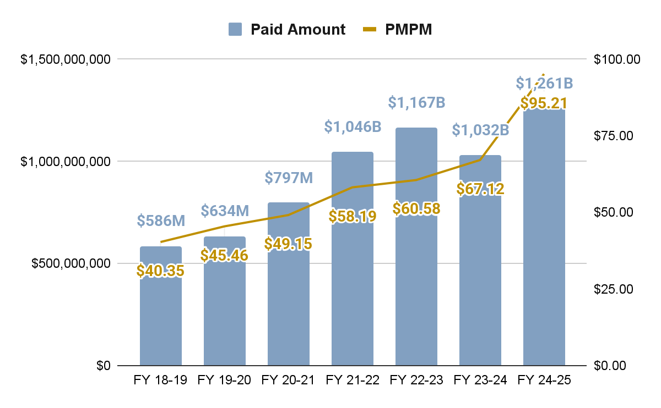
Behavioral Health Services
+115%
Increase in Paid $$, FY18/19 to FY23/24; +23% trend/year.
Drivers:
Network growth: 6k to 13k+
Increased provider rates
Added new benefits
Medicaid intended to sustain BH transformation initiatives
Potential Solutions:
Nat’l standards for service limits
Address unexpected, outlier growth in specific services
Address providers with outlier utilization
Limit services and directed payments to specific provider types or settings
Much higher BH trends forecasted

Slide 21
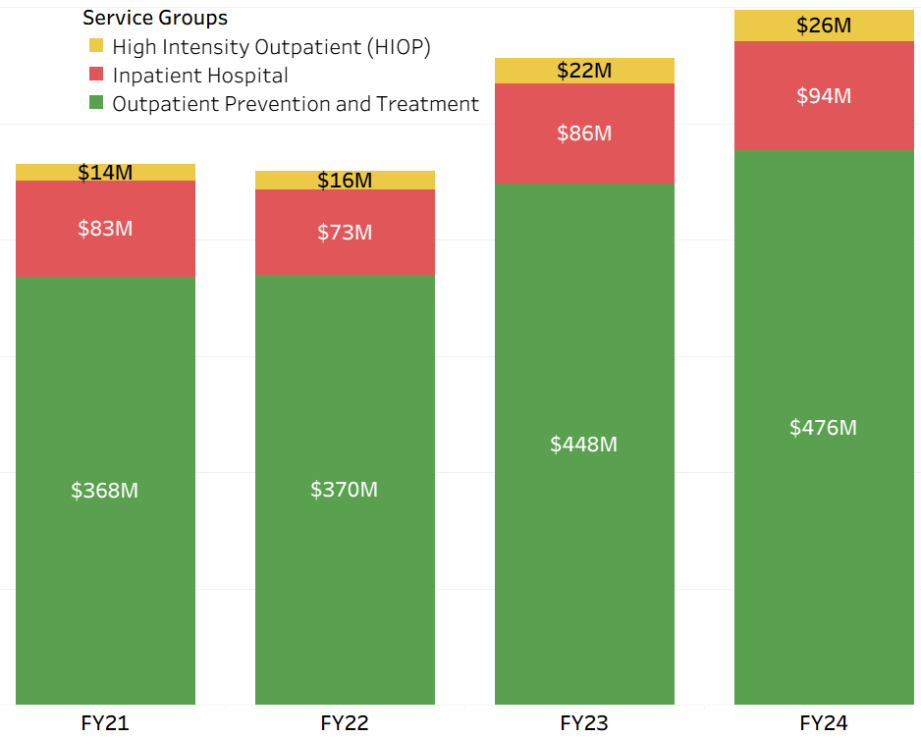
Monitoring Cost Trends In BH
Payments to Providers
Supported and funded expanded benefits, increased access and rates
Substance Abuse Disorder (SUD) full continuum of care
Increase intensive outpatient for adults & youth to decrease inpatient needs
Provider recruitment and workforce supports
Monitor for unexpected, unfunded growth
Impacts of ending prior auth on psychotherapy services
  1 yr PHE Unwind: +$38M increase
  61% increase in 25+ visits/yr
  98% increase in 56+ visits/yr
Peer support utilization

Slide 22
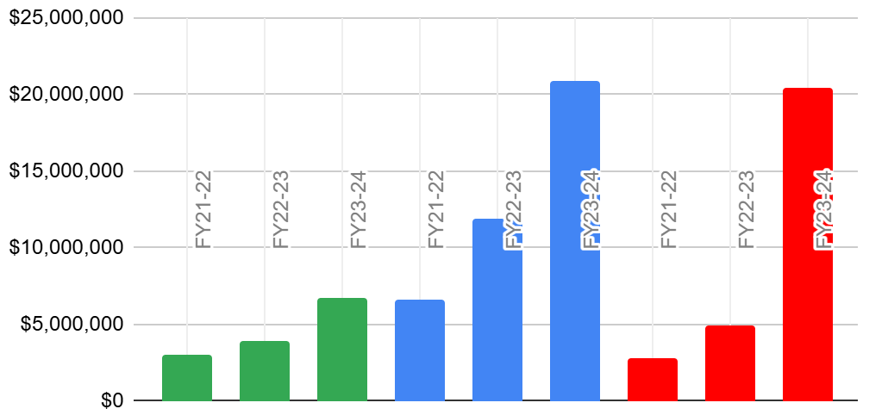
Peer Support Services Growth Trends
+286%
increase in paid $ from FY21/22 to FY23/24. That’s +95% trend per year.
Drivers:
No limits on daily hours, place of care
Outlier provider utilization/billings
Solution:
Eff July 2025, adjusted providers who could bill for services and when
Tracking/educating providers
Corrective actions
Peer Payments to Providers
Behavioral Health Outreach Service (H0023)
Self-Help/Peer Services (H0038)
Skills Training and Development (H2014)

Slide 23
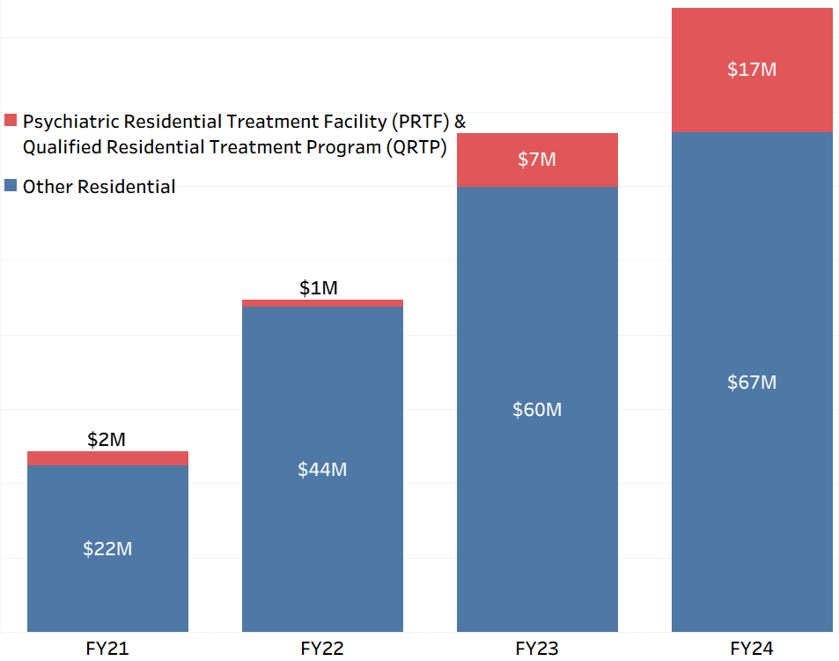
Residential and Step Down Care
Payments to
Residential Providers
Right care. Right place.
Medicaid Systems of Care services cost 80% less than residential.
Invest upstream to reduce condition escalation
Intensive Outpatient and Partial Hosp.
Mental Health Transitional Living
1115 waiver supports

Slide 24
LTSS Cost Growth: FY20-21 to FY23-24
44% increase in costs: From $2.9B to $4.1B
11.0% is enrollment
Enrollment is skewed towards more complex pop’s & expensive waivers (ex.DD waiver avg. cost is $98k vs $36k for EBD waiver)
JBC added 796 enrollments to DD waiver
39.3% is utilization
70+% of increases due to utilization come from LTHH and IHSS
Utilization per member has increased 33% for these two services
Cost Growth Factors
49.3% is
rate increases
LTSS Base Wage to meet local minimum wage adjustments
Across the board provider rate increases
Targeted rate increases
Statutorily required rate increases
Approx 0.4% is due to JBC/Legislative and HCPF benefit changes

Slide 25
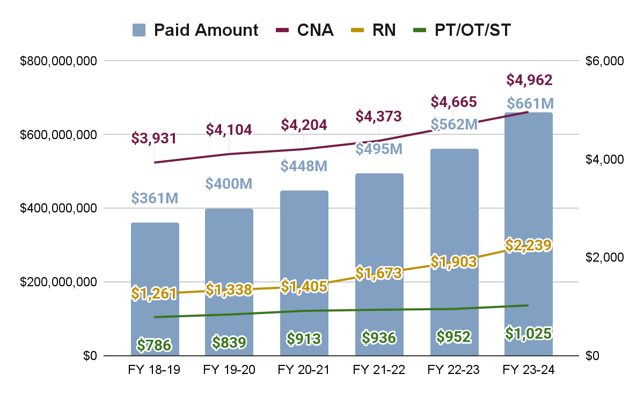
Long-term Home Health
increase in paid $ from FY18/19 to FY23/24. That’s +17% trend per year.
+83%
Strategies Completed or In Process
Clarify duplication across services
Launch prior authorization review process for Long Term Home Health (LTHH)
Launch the Nurse Assessor Program
Strategies Under Review
Rate methodology adjustments

Slide 26
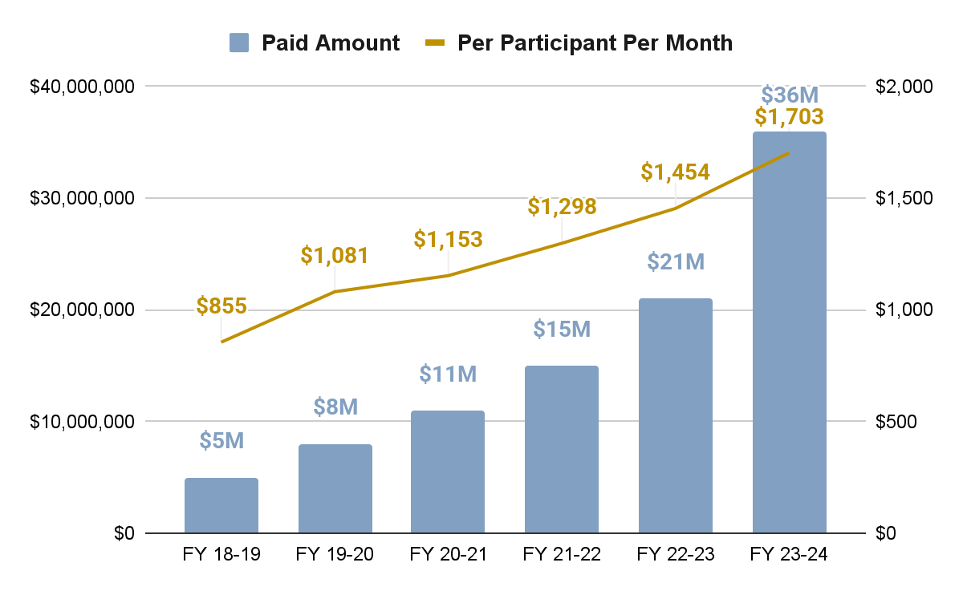
LTSS: Community Connector
increase in paid $$ from FY18/19 to FY23/24. That’s +124% avg. trend per year.
+620%
Strategies Completed or In Process
Cap units for legally responsible persons
Cap service to 2,080 units/520 hours per year per child, for all caregivers
Required additional training for CMAs on effective service authorization
Required ages and stages assessment
Review of high billing/utilizing agencies
Strategies Under Review
Rate methodology adjustments
Changes to eligibility
Revise allowable activities

Slide 27
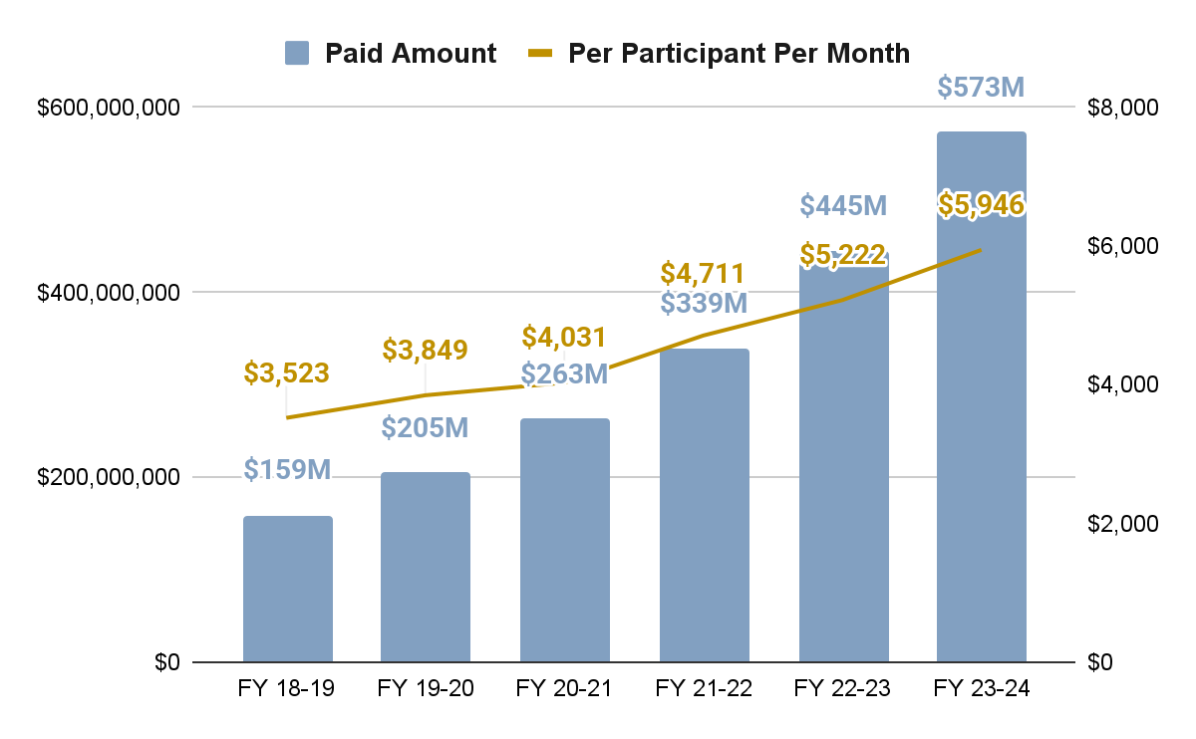
LTSS: In-Home Support Services (IHSS)
+260%
increase in paid $$ from FY18/19 to FY23/24. That’s +52% trend per year.
Strategies Completed or In Process
Duplication reviews
Initial daily and weekly cap for caregivers for certain service lines
UM process for Health Maintenance Activities
Eliminated IHSS Agency as Authorized Rep (AR); introduced Shared Responsibility Plans
Developed IHSS Member/AR training; Launched Info & Assistance for Participant Direction via CDCO
Launched the Nurse Assessor Program
Strategies Under Review
Caps/limits on utilization
Rate methodology adjustments

Slide 28
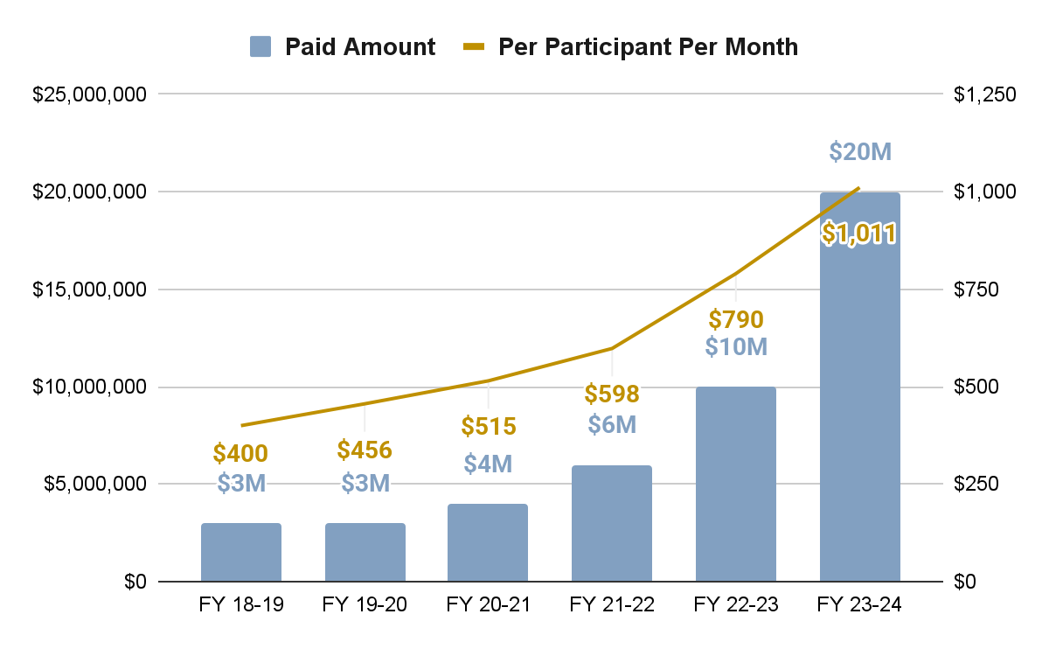
LTSS: Homemaker (CES Waiver)
+566%
increase in paid $$ from FY18/19 to FY23/24. Trend is +113% per year.
Strategies Completed or In Process
Decreased Enhanced Homemaker rate
Additional requirements/cap on family caregivers requiring homemaker for children
Strategies Under Review
Rate methodology adjustments
Caps/limits on utilization

Slide 29
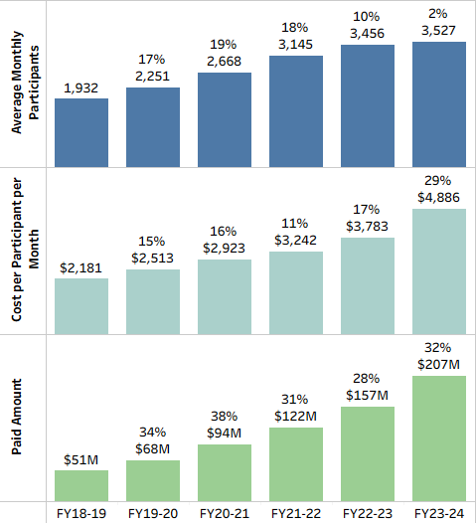
Pediatric Behavioral Therapies (PBT/ABA)
306%
increase in paid $ FY18/19 to FY23/24.
+61% paid trend/yr. +30% PMPM trend/yr.
Drivers:
Private equity provider behavior
Requiring minimum patient hrs/wk
Billing for uncredentialed providers
Billing for nontherapeutic and noncontact hours like naps/playtime
Potential Solutions:
Policy change
Address Private Equity Behaviors
Benefit design changes
Advancing prior auth criteria
Pre & post payment review
Rollback of rate increases
Additional fraud referrals
https://cepr.net/publications/pocketing-money-meant-for-kids-private-equity-in-autism-services/

Slide 30
Additional Bold Solutions
David Ducharme, Accountable Care Collaborative Division Director
Nancy Dolson, Special Financing Division Director
Bettina Schneider, Finance Office Director and CFO
Kim Bimestefer, Executive Director and CEO

Slide 31
ACC Phase III: Our most prominent tool to battle trend
1
Thank you all for ACC Phase III design engagement.
Phase III went live July 1: Medicaid delivery system
Key advancements:
  Expanded expectations for RAEs to support members’ transitions of care.
  Streamlined payment model for PCMPs.
  Redesigned quality incentive program to reduce costs & promote health
  Enhanced accountability for RAEs. Increased program transparency.
  Incorporates Innovations: eConsults, Prescriber Tool, ACO-like tools for rural/independent PCMPs, soon - CO SHIE
Improve quality care for members
2
Close health disparities. Promote health equity for members
3
Improve care access for members
4
Improve member and provider experience
Manage costs to protect member coverage, benefits, provider reimbursements
5
More information at CO.gov/HCPF/accphaseIII

Slide 32
Addressing Medicaid Cost Drivers: ACC Phase III
Connects key Medicaid innovations, creating a cohesive, cost effective program that supports members & providers.
ACC Phase III webpage:
Member Messaging Resource Center
Provider and Stakeholder Resource Center
Partnership with BHA
Manage
costs
Value-
based payments
Providers of Distinction
Improve quality care
Advancing
rural
provider
ACO technology
Improve member & provider experience
Prescriber Tool
Primary care integration
SHIE
Supporting high acuity youth
Improve care
access
Promote health
equity
eConsults
Member Incentives
Subscribe to the ACC Program Updates newsletter to stay up-to-date!

Slide 33
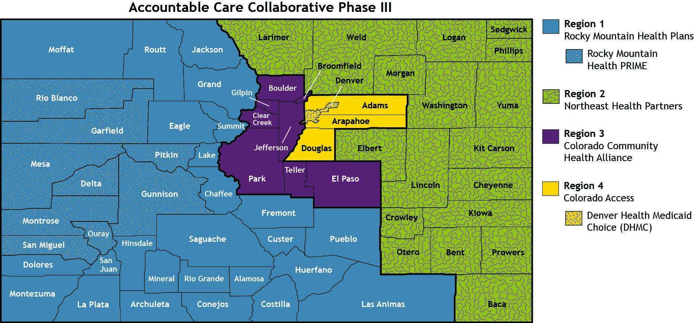
ACC Phase III Regions: July 1, 2025
ACC Regions align with Behavioral Health Administrative Service Organizations (BHASOs).

Slide 34
Maximize Federal Funding:
State-Directed Payment (SDP) Proposal
HCPF submitted to CMS a SDP proposal that boosts hospital payments
Hospital SDP bolster payments for inpatient and outpatient services, now including psychiatric hospitals
If approved, SDP could increase net new funds by $378 million in FY 2025-26
HCPF submitted its new SDP program before H.R.1 was signed, meaning we will have higher payment rate and draw more federal funds as a legacy SDP. But, that payment rate will begin decreasing as part of H.R. 1 starting in January 2028
State-Directed Payments are a mechanism used to allow additional, targeted payments under Medicaid managed care like RAEs and MCOs

Slide 35
Drive value based payments (VBPs) to incent quality outcomes, equity and affordability
VBP impact 50%+ of Medicaid Payments
Part | Program | Participation
Hospital | Hospital Transformation Program | 100% of hospitals
Primary Care | Moving to full or partial capitation | 53% members and 29% of PCMPs
Prescription Drugs | Value-based Rx contracts Prescriber Tool shared savings | 6 contracts w/ manufacturers 66% prescribers using tool
Maternity Care | Bundled payment program | ~35% deliveries
Behavioral Health | Prospective Payment System | 100% of Comprehensive Safety Net Providers
Cost and Quality Indicators, eConsults: to drive right care, right place
For more info: CO.gov/HCPF/value-based-payments

Slide 36
Investing in Coloradans: Rural Providers, Access and Affordability
Hospital Transformation Program Rural Support Fund - $60M over 5 yrs to help 23 critical access and rural hospitals modernize (thru Sept. 2025)
  CHASE Board approved 1 yr extension of $12M thru Sept. 2026 for same hospitals, providing over $500k per hospital
  Working on next version of this program, effective Oct. 2026
Improving Rural Access and Affordability - $10.6M rural access & affordability grants plus $0.5M remote patient monitoring grants
Leverage SB23-298 and SB24-168 - help rural hospitals partner to drive efficiencies in other ways, i.e., licensure; joint purchasing of supplies, equipment, pharmaceuticals; shared back office and data services; and more
Actions for Rural Providers - leverage funding and collaborative partnerships opportunities above, operationalize PCMP ACO-like option, utilize tools (eConsults, Prescriber Tools, Providers of Distinction, Value Based Payments), etc.
CO.gov/HCPF/rural-provider-access-and-affordability-stimulus-grant-program, CO.gov/HCPF/public-rural-hospital-collaboration
CO.gov/HCPF/telehealth-remote-monitoring-grant and Broadband.colorado.gov

Slide 37
H.R.1 - Rural Health Transformation Program
Application: One-time state submission due Fall 2025, with a Rural-Health Transformation Plan (8 required topics) + certification no dollars will fund state match.
Implementation Date: Disbursements to approved states expected early 2026
Estimated Impact:
  Increased federal funding for targeted projects.
  50% "base" pot divided equally among all approved states
  Other 50% is targeted toward “not less than ¼ of approved states”
HCPF will follow best practices from administering SB22-200 Rural Access & Affordability grants and similar programs to engage stakeholders, create an advisory board, etc.
$50B in Federal Funding Available
$10B/yr x 5yrs
FFY 2026-2030
See our Fact Sheet here

Slide 38
Federal Medicaid Changes and What’s Next
Rachel Reiter, Policy, Communications and Administration Office Director
Joshua Montoya, Partner Relations and Administration Division Director

Slide 39
H.R.1 Overview: Key Medicaid Takeaways
Rewrites major eligibility, financing, and compliance rules over the next 2-8 years that will negatively impact nearly 400,000 Coloradans
Forces states to make difficult decisions that influence how costly or disruptive these shifts become for enrollees, providers, state budgets (our General Fund)
Provides very limited funding for states to implement changes and will drive higher administrative and IT costs
Drives administrative & bureaucratic barriers, coverage loss & cost shifts to commercial coverage
Our Commitment: In partnership with all stakeholders, our North Star priority is to mitigate inappropriate coverage losses while avoiding draconian cuts wherever possible.

Slide 40
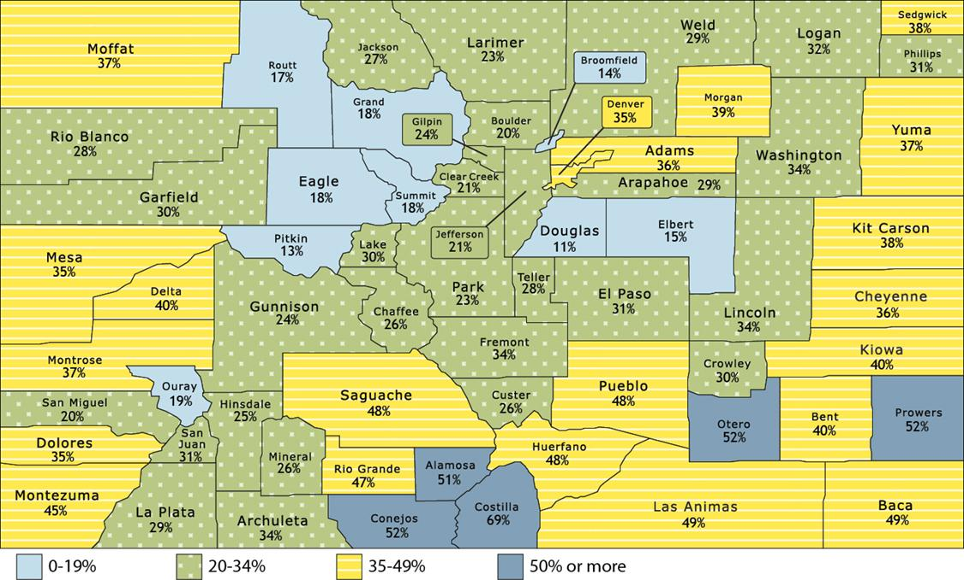
More detailed county level enrollment and spending available at CO.gov/hcpf/county-fact-sheets
More information on those we serve at CO.gov/hcpf/2024-report-to-community
Who we Serve
% of population enrolled in Medicaid & CHP+ by county
In fiscal year 2023-2024:
55%: adults ages 19-64
39%: children, ages 18 and younger
6%: adults age 65 and older
5% are people with disabilities
87% live in urban areas
14% live in rural/frontier
2025 Federal Poverty Levels (Medicaid Eligibility)
Family of 1: $20,820
Family of 4: $42,768
*some earning more may still qualify

Slide 41
H.R. 1 Medicaid Coverage & Eligibility Provisions
High Level Implementation Timeline
CMS Guidance Expected - Initial no later than 180 days after enactment, final rules in June 2026
2025
2026
2027
2028
Jan
July
Dec
Jan
July
Dec
Jan
July
Dec
Jan
July
Dec
Prohibited Entity Funding
July 2025, 14,000 impacted
“Qualified Alien” Changes
Oct. 2026, 7,000 impacted
6 month verifications
Complicated NEW System Builds/Launching programs usually takes 18+ months
Jan. 2027, 377,000 impacted
NEW Work Requirements
Jan. 2027, 377,000 impacted
Retro Coverage Rollbacks
Jan. 2027 ~new enrollees impacted
LTC Asset Ceiling Change
Jan. 2028, impact TBD
Expansion Cost Sharing
Oct 2028, 60k+ impacted

Slide 42
Expansion Population Impacts
Increased Paperwork Effective Jan. 2027
Eligibility renewals every 6 months vs 12. Effects 377k low income adults.
Retroactive coverage changes for all new applicants.
Work requirements
Adults aged 19-64 must document 80 hours/month of work, job training, education or community service.
Exempt populations: pregnant; AI/AN; parents of kids with disabilities or a child 13 years of age or younger; veterans; medically frail; already meet TANF or SNAP work requirements or have Medicare.
Implementation Date: January 1, 2027 (Shouldn’t rely on CMS waiver extension)
Impact:
  Administrative burden and costs
  New technology need and costs
  Non exempt individuals at risk of disenrollment due to procedural or not meeting the requirements

Slide 43
H.R.1 Key Medicaid Provisions, Continued
Fed Administrative Changes effective over coming years:
Fraud, Waste and Abuse: HCPF existing processes address elements of new H.R.1 provisions:
  Address verifications & data matches with other states to check for dual enrollment, disenrolling members covered by other states
  Processes to ensure deceased members or providers are respectfully removed from systems to mitigate inappropriate payments
Fed has changed PERM audit provisions, increasing risks of federal clawbacks if eligibility errors exceed 3% (current averages 3-4%)
Financing Changes: Caps on State Directed Payments - eff July 4, 2025 and a NEW Rural Health Transformation Program
For more info on HCPF’s fraud, waste, abuse programs, see detailed fact sheet.

Slide 44
Changes Begin in October 2027:
Reductions in Provider Fees and Federal Funds
Rates decrease for expansion states
Implementation Date: Oct. 1, 2027
Impact: Hospital provider-fee will be dialed back and will lead to lost federal match annually through 2028-2032.
$1B to $2.5B federal funds reduction when fully implemented
425K covered by this funding includes ACA expansion population, kids and pregnant women on CHP+ and Working Adults and Children with Disabilities on the Medicaid Buy-In Program
6%*
Current
3.5%
FY32
*Percentage of hospital net patient revenue

Slide 45
Partnering to Meet H.R. 1 Challenges Ahead
No Existing Roadmap for Medicaid Work Requirement
  Technology connections to verify exemptions as outlined in H.R.1 and processes to verify individuals subject to the requirement has met the requirement do not exist in Medicaid
  Working on connectivity to boost automation - like CDLE, EquiFax
  States working together to tackle this reality
  Leveraging learnings from SNAP/TANF & other states who have tried work requirements
Very Tight Timelines - Oct 2026 release for Jan 2027 renewals
Leveraging Lessons Learned
Opportunity for HCPF-stakeholder partnerships to achieve North Star

Slide 46
Driving Efficiencies Together
Partnering with Counties to Improve Operations
  Identifying shared business process standards in partnership with providers and members.
  Collaborating with county leaders and staff to eliminate inefficiencies, outdated steps, and duplicative work.
  Modernizing outdated rules that are administratively burdensome
Finding Efficiencies Amid Limited Funding
  Targeting cross-agency savings and shared solutions.
  Aligning, where ever possible with CDHS for greater impact
Invest in technology, automation and administration in partnership with counties: FY 2024-25 R7 budget request, Joint Agency Interoperability and future investments

Slide 47
Our Ask of YOU: Share Resources and Partner with us on implementation of federal changes
Share Our Member Message from Exec. Dir. Bimestefer - a short, high level overview of what is in H.R. 1 and when members may see changes. Critical that we reach members along the way.
Bookmark our resource center Colorado.gov/hcpf/impact and sign up for HCPF newsletters to receive key implementation updates and understand how federal cuts impact Medicaid.
Thank you for your partnership and engagement as we work together to implement H.R. 1 and focus on our North Star.
Visit Colorado.gov/hcpf/publications (click on sign up for newsletters, choose At A Glance)

Slide 48
HCPF Priorities
FY2025/26
Kim Bimestefer
Executive Director and CEO

Slide 49
Top 10 Priorities within our 39 2025/26 Goals
Medicaid Sustainability Framework
Navigate budget challenges: finalize budget reduction considerations to address outlier and overall trends; avoid draconian cuts to Medicaid/CHP+.
Transparent communications. Data sharing. Look for partnership discussions.
Funding for hospitals/rurals: CMS approval of new CHASE State Directed Payments (+$378M). Settle outstanding CHASE challenges. Rural Transformation $ release.
New H.R.1 Federal Admin Regulations Mitigate coverage losses
Implement eligibility system design/programming/automate. County efficiency, accuracy, timeliness initiatives. Avoid Fed penalties/clawbacks.
Ready the state for work requirements and redeterminations every 6 vs 12 months.
Broadly collaborate across stakeholders to help members understand, comply, submit work requirement info (80 hours - work, school, volunteer)
More info at: CO.gov/HCPF/performance-plan

Slide 50
Top 10 Priorities within our 39 2025/26 Goals
Retain our amazing, expert, passionate leaders/staff. They do the work!
Long Term Services and Supports:
  Continue transitioning members in congregant settings to community care
  Stabilize Care & Case Management (CCM) tool and advance all modules
  Implement the Nurse Assessor Program and the Skilled Care Assessment tool
Smooth Feb 1, 2026 implementation of new Medicaid PBM (8M+ claims)
Smooth implementation of ACC Phase III to control trend and improve quality
Advance Value Based Payments, rewarding value over volume
More info at: CO.gov/HCPF/performance-plan

Slide 51
Top 10 Priorities within our 39 2025/26 Goals
Comprehensive CO Medicaid review, stakeholder, implement select advances
Cost Control & Fraud, Waste & Abuse opportunities to control trend, ensure Federal compliance, mitigate Fed clawbacks & overpayments. Restart modernized RAC audits.
Children and Youth BH System of Care - increase access to intensive community services, returning children to their homes
More info at: CO.gov/HCPF/performance-plan

Slide 52
Questions?

Slide 53
Thank You!
We have a lot to do
And so much risk
We need Alignment. Partnership. Focus.
Thank you in advance for your engagement to achieve shared goals.
North Star to guide our work:
Mitigate coverage losses and its catastrophic consequences to Coloradans, providers, economy
Leverage the Medicaid Sustainability Framework with thoughtful reductions and trend management. Avoid draconian cuts.

