Slide 1
H.R. 1 Medicaid Coverage, Eligibility, & Implementation Updates Webinar
Presented by the Department of Health Care Policy and Financing
February 24, 2026

Slide 2

Webinar Logistics
Accessibility: American Sign Language, audio only, Spanish interpretation, and closed captioning are available. They can be accessed via the Zoom toolbar by clicking on Interpretation at the bottom of your screen and selecting to watch American Sign Language or listen in Spanish.
Attendee Questions for Speakers: Use Q&A feature on the toolbar. We may not get to every question.
Recordings and slides will also be posted to HCPF’s H.R. 1 webpage.
Presentations, links and other materials will be posted in the Chat. Otherwise, the Chat is closed and is being used for presenter communications.
Please leverage the event pop-up polls to help us capture aggregate perspectives.

Slide 3
Agenda
Introduction | Kim Bimestefer
Implementation Updates | Marivel Klueckman
Q&A| Adela Flores-Brennan
Impacts| Adela Flores-Brennan, Rachel Reiter
What’s Next & How to Engage | Adela Flores-Brennan
Q&A | Adela Flores-Brennan

Slide 4
Introduction
Kim Bimestefer, Executive Director of HCPF

Slide 5
Poll Question #1
What role best describes you? (Choose 1.)
Health First Colorado (Medicaid) member/patient/family
Health Care Provider
Other Service Provider (such as Non-Emergent Medical Transportation, care coordination, or others)
Nonprofit/Advocacy Organization
Legislator
Media
County representative
Local government other than county
State government
Federal government
Managed Care Organization/Health Plan
Vendor Partner
Other

Slide 6
Poll Question #2
What is your level of knowledge about H.R. 1 at the start of today’s webinar? (Choose 1.)
Extremely knowledgeable
Knowledgeable
Somewhat knowledgeable
Little to no knowledge

Slide 7
H.R.1 Medicaid Coverage Threats
Federal funding reductions due to provider tax provisions
  CHASE funding impact to hospitals and coverage
Disenrollments
  Immigrant eligibility changes take effect October 1, 2026
  Eligibility redeterminations every 6 months vs 12 months eff. January 1, 2027
  Work requirements for most “able-bodied adults,” eff. January 1, 2027
    Work, work program, school, volunteering at least 80 hours/month to qualify
Eligibility determination: Clawbacks for errors above 3% (federal PERM audits)
For more information on H.R.1, please visit our resource center at Colorado.gov/hcpf/impacts
Recognize other federal impacts outside of H.R.1
North Star: Mitigate coverage losses and its catastrophic consequences to Coloradans, providers, economy

Slide 8
Why This North Star Focus? Coverage Loss Impact.
Negative population health impact: Care delays, not filling prescriptions, missing preventive screenings
When care is sought by uninsured individuals, increased medical debt/bankruptcies. Higher use of costly ER.
Growing provider uncompensated care - esp. concerning for providers with lower margins.
Tough provider access decisions. Layoffs.
Economy: Health Care is the largest component of Colorado’s and U.S. economies
Annual income range by household size for Medicaid Expansion (effective April 2026)
Household Size | Income range (0-133% FPL*)
1 | up to $21,227
2 | $28,781
3 | $36,336
4 | $43,890
5 | $51,444
*FPL stands for the federal poverty level

Slide 9
H.R. 1 Medicaid Coverage, Eligibility and Financing
(not comprehensive of all changes)
Federal Guidance - preliminary guidance in December 2025, final rules in June 2026
2025
2026
2027
2028
Jan
July
Dec
Jan
July
Dec
Jan
July
Dec
Jan
July
Dec
Prohibited Entity Funding
July 2025, 14,000 impacted
“Qualified Immigrant” Changes
Oct. 2026, 7,000 impacted
6 month verifications
Complicated NEW System Builds/Launching programs usually takes 18+ months
Jan. 2027 ~ 378,000 impacted
NEW Work Requirements
Jan. 2027 subset of ~378,000 impacted
Retro Coverage Rollbacks
Jan. 2027 new enrollees impacted
Provider Fee Changes
Begins October 2027, funds coverage for more than 420,000

Slide 10
Implementation Updates
Marivel Klueckman, Eligibility Division Director
What to expect over the next 6–12 months and beyond

Slide 11
Federal Guidance: What We Know
Preliminary guidance received from the federal government, CMS,* in mid-November via PowerPoint with a CMCS Informational Bulletin on December 8
States will have less flexibility than what we expected under the law.
  Limited ability to leverage self-reporting or “self-attestation.”
  CMS to provide guidance on definition of “medically frail.”
  Strong emphasis on everything being auditable.
CMS has warned Colorado not to expect any waivers to delay implementation.
CMS is encouraging a Minimum Viable Product (MVP) at launch.
  Must be operational by all states by January 1, 2027.
  Colorado is designing its MVP model now.
Final rules for work requirements (community engagement) due in June 2026.
*CMS stands for the federal Centers for Medicare and Medicaid Services

Slide 12

Working Timeline Overview
Timing is subject to change as guidance is finalized
2026
2027
August 2026
Notices sent to members subject to work requirements
October 2026
Qualified Immigrant Changes
7,000 impacted
January 2027
- 6-Month Renewals
- Work Requirements
- Retro Coverage Rollback
378,000 impacted
October 2027
Provider Fee Reductions
Funds coverage for more than 420,000
November 2026
Notices for January renewals sent (6-month renewals start)
July 2026
Notices sent to affected immigrant members
July 2026
Information on coming changes sent to all members
= 1,000 PEOPLE

Slide 13
Overview of H.R. 1 Work Requirements
H.R.1 Section 71119 mandates that low-income Medicaid expansion adults (ages 19–64) must meet monthly work requirements (also known as community engagement requirements) starting January 1, 2027.
  Outreach noticing must go out either August or September 2026 (at least 3 months prior to application month that will need to comply with work requirements)
Applies to new applications received as of January 1, 2027.
  Colorado has elected to review one month (the month prior to the application) for work requirements.
The effective date may apply to renewals due as early as January 2027. We will confirm and update once CMS guidance is confirmed with the exact renewal month.
  Colorado has elected to review one of six months prior to renewal for work requirements.
States must confirm compliance or exemption during application or renewal using reliable data or member-submitted documentation when necessary.

Slide 14
CMS Work Requirements (WR)
MVP Checklist of Requirements
CMS communications reference that states can release a “Minimum Viable Product” or “MVP” for Medicaid Expansion Work Requirements (WR) versus completing all the IT work and connectivity required in H.R.1 by January 1, 2027.
  We are building the MVP for January 1 and longer term Track 2 H.R. 1 requirements concurrently.
  States are required to complete a WR MVP checklist with regular monitoring by CMS on progress of implementation.
Checklist has three main categories:
System Updates
Oversight/Compliance
Communications & Noticing
CMS requires that states maximize use of data sources and other auditable information to verify exemptions and to limit states’ use of self-declaration to the greatest extent possible.

Slide 15
Expansion Population Impacts
Work requirements and 6-month renewals do not apply to entire 1.2M Medicaid population.
Expansion population are adults ages 19–64 who earn up to 133% FPL.
Also includes parents/caretakers who have income between 69-133% FPL.
Expansion population: about 378,000
Currently we have data to determine compliance or exemption for over half of expansion population.
This means we are focused on supporting and mitigating coverage loss for 155,000 members.
Total CO Medicaid Enrollment
1,200,000
Potentially affected by WR & 6-month renewals
378,000
Population who will need to show compliance or exemption
155,000

Slide 16
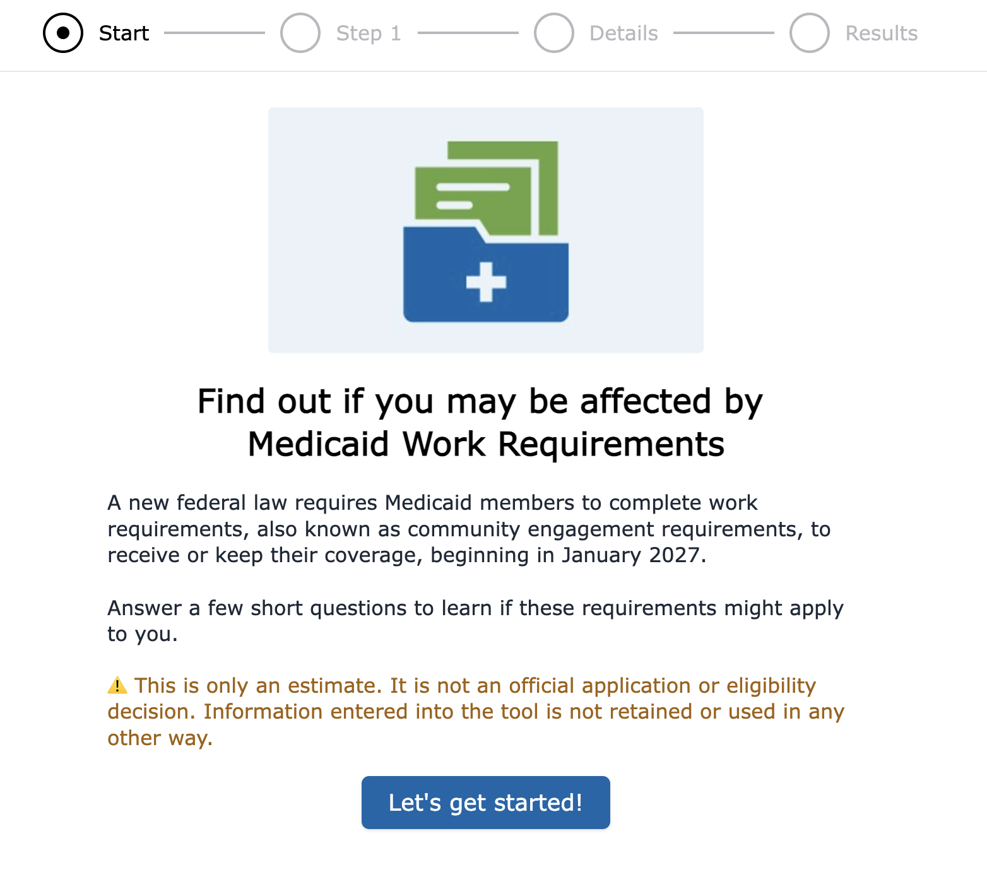
Work Requirements Screener Tool
Quick and easy Work Requirements Screener Tool to help identify if an individual may need to comply or is exempt from work requirements.
No personal identifying information is used.
Includes questions on individual’s circumstances to identify if exempt or may need to comply:
  For example, questions regarding age, social security, pregnancy, Medicare, parent of child under 14 or disabled, etc.
Income question for $580/month (bare minimum to comply).

Slide 17
New Work Requirements (WR) Form
New form with checkboxes created to support members to attest to their WR exemptions or compliance efforts.
  New applicants and existing members may complete new form as part of the eligibility determination process for applications, renewal process or verification processes.
  Can be completed via application, phone, PEAK, or in person.
  Documents may be requested to verify eligibility.
Automation of this form:
  Planning to leverage document scanning processes and image repository workflow focus (a Shared Service).
  Apply Intelligent Character Recognition (ICR) to recognize the scanned form and input/upload data into eligibility system.
  Goals: mitigate coverage loss & errors, reduce workload, control admin costs.

Slide 18
Colorado’s Strategy on the Implementation of Work Requirements
Continuous system updates and enhancements after Jan. 1, 2027.
  Phased approach, referred to as Track 2.
  Implement CMS policy or guidance provided too late for the MVP.
  Systems Quarterly Build Schedule for multiple connections to third-party data sources over the next 2–3 years.
    Focus on new interfaces to secure data, as well as increasing ex parte and automated verification options.
Colorado is following CMS’s initial verbal guidance to follow “Principles that Graduate over time” using existing information and interfaces, while deferring broader verification until formal federal guidance & new interface capabilities become available.

Slide 19
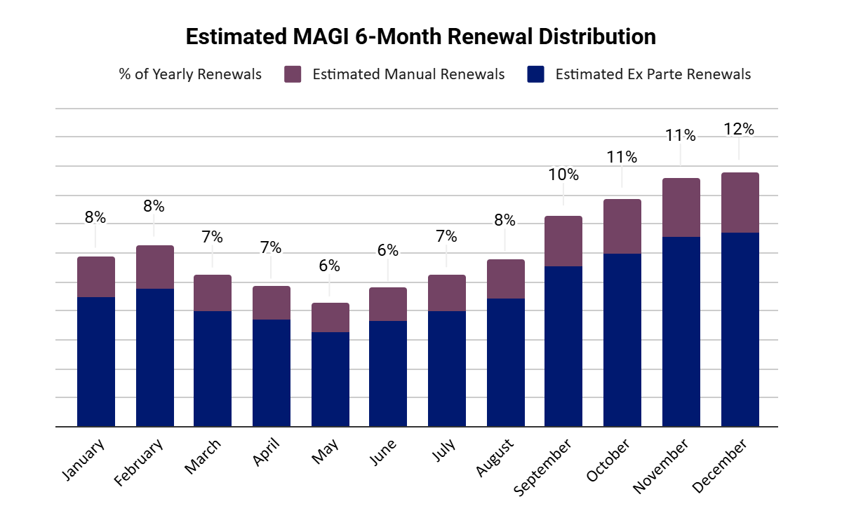
6-Month Renewals
All expansion pop (~378k members) will have to do renewals semi-annually instead of once a year.*
Moving to individual renewals in January 2027:
  Significant change to the renewal process for ALL members in a household.
Future improvements planned:
  Reducing packet length & unnecessary fields in 2026.
  Complete redesign in 2027 in partnership with members and stakeholders.
*Only exemption is Alaska Native and American Indian members

Slide 20
Other Implementation Updates
Changes to who qualifies based on immigration status:
  Awaiting additional policy clarification from CMS.
  Notifying affected members in July 2026.
  Coverage may end October 1, 2026, if not eligible for another category of Medicaid.
  We will let members know what other coverage options they have, including potential emergency Medicaid coverage.
Retroactive coverage limitations:
  Starting in January 2027 for new applicants and renewals.
  Retro coverage for expansion members goes from three months to one month.
  Retro coverage for all other members goes from three months to two months.

Slide 21
Q & A
Adela Flores-Brennan, Medicaid Director

Slide 22
Statewide Impacts
Adela Flores-Brennan, Medicaid Director
How we’re managing H.R.1 impacts on coverage and the state budget and making Medicaid sustainable for the future

Slide 23
H.R. 1 Survey Results
This fall, a survey was sent out to Health First Colorado members and other stakeholders to understand their concerns with the upcoming H.R. 1 changes.
Over 740 responses were received, with 65% from members; spanned the entire state.
Priorities
Services covered by Medicaid (coverage threats)
State budget challenges and Medicaid sustainability work
Provider fees, payments and tax provisions

Slide 24
H.R. 1 Medicaid Coverage Threats
Loss of eligibility for some immigrants October 2026.
Administrative burdens cause loss of coverage due to not meeting new requirements or admin complications.
  Increased eligibility redeterminations - every 12 months to every 6, starting Jan. 1, 2027.
  Work requirements starting Jan. 1, 2027.
Reduced federal funding for 425,000 members due to decrease in provider fee starting in 2027 (coverage through CHASE funding).
Researching most at-risk populations of losing coverage.

Slide 25
Impacts on Certain Immigrants
Beginning Oct. 1, 2026, eligibility restricted to:
  Legal permanent residents (“green card” holders).
  Certain Cuban and Haitian immigrants, citizens of the Freely Associated States (COFA migrants) lawfully residing in the U.S.
  Lawfully residing children and pregnant adults in states that cover them under the Immigrant Children's Health Improvement Act (ICHIA) option.
Why it matters:
  ~7,000 lawfully present immigrants will lose Medicaid coverage due to redefining of “qualified immigrant” for Medicaid/CHP+ eligibility.

Slide 26
H.R. 1 Impact on CHASE Provider Fees
Federal Funding Reductions due to H.R.1 “Provider Tax” provisions
  Ratchets fee 0.5% per year beginning Oct. 2027
Impact to health care coverage
  By FFY 2032, shortfall of $853M non-federal share and reduced federal revenues by $3.9B annually
  Current hierarchy - hospitals are funded before coverage
  425,000 covered including ACA expansion population, kids and pregnant women on CHP+ and Working Adults and Children with Disabilities on the Medicaid Buy-In Program.

Slide 27
Medicaid Sustainability
The Medicaid Sustainability Framework helps us better target our trend management efforts in a thoughtful and reasonable way to help us avoid draconian cuts.
Address Drivers of Trend
Maximize Federal Funding
Invest in Coloradans
Make Reasonable Medicaid Cuts or Adjustments
Reassess New Policies
Exercise Caution in Crafting Increases to the Medicaid Program

Slide 28
Poll Question #3
What technical assistance related to H.R. 1 would most help you support your community? (Select up to 3.)
Clear, plain-language policy summaries
Implementation timelines and guidance
Training webinars or workshops
Communication toolkits (templates, flyers, talking points)
Access to subject matter experts (Q&A or office hours)
Data on impacted populations
Multilingual materials

Slide 29
County System Impacts
Rachel Reiter, Office Director for Policy, Communications & Administration
How we’re partnering with counties to reduce administrative burden and improve efficiency

Slide 30
H.R. 1 & Driving Efficiencies in County Administration
Colorado is one of a handful state supervised county administered states for Medicaid, SNAP, TANF and other programs.
Learnings from Public Health Emergency and Unwind informing H.R. 1 approach
Colorado is preparing for H.R. 1 changes by:
  Focus on automation wherever possible
  Implementing foundational technology to promote “sharing of work” across counties (ICR/OCR, shared work management)
  Improving current technology while planning for the future
  Proposing Districts (sharing work across counties) and Shared Services (ex: joint call center & document scanning) to drive:
    Consistent Member Experience
    Administrative Cost Containment
    Quality & Mitigation of Federal Penalties
Visit Our Resource Center: Colorado.gov/hcpf/county-resource-center

Slide 31
Goals to Drive Efficiencies in County Administration
Consistent Member Experience | Admin Cost Containment | Quality & Federal Penalty Mitigation
Learnings from the public health emergency & Unwind District Agreements with Business Process Standards, i.e.: Hours of operations & access to support One Tier 1 Call Center model Shared Service | County Administration Increases of ~14% annually are not sustainable State budget crisis, provider fee & federal funding reductions Leverage emerging technologies to share work: Intelligent Character Recognition (ICR), Joint Agency Interoperability | Performance Based Contracts HCPF Performance Error Rate Measure (PERM) & CDHS Payment Error Rate (PER) accuracy focus Quality Assurance Shared Service Reducing Fraud Waste & Abuse Shared Services
Visit Our Resource Center: Colorado.gov/hcpf/county-resource-center

Slide 32
What’s Next
Adela Flores-Brennan, Medicaid Director
How you can partner with us

Slide 33
Where You Can Effect Change
We are federally mandated to achieve a great amount in a very short period of time.
  System overhaul to implement 6-month renewals and community engagement requirements in January 2027.
Much of what H.R. 1 requires is not up for negotiation.
Stronger together! We want your input, and are identifying areas where stakeholders can influence decisions.

Slide 34
How to Get Engaged
HCPF continues to host Member Correspondence Improvements meetings, which include H.R. 1 topics.
To learn about future engagement opportunities and indicate interest in participating, please respond to the H.R. 1 Engagement General Interest Form.
All opportunities will be shared in the At a Glance newsletter, so make sure you are signed up.
Contact the H.R. 1 team: hcpf_hr1@state.co.us.

Slide 35
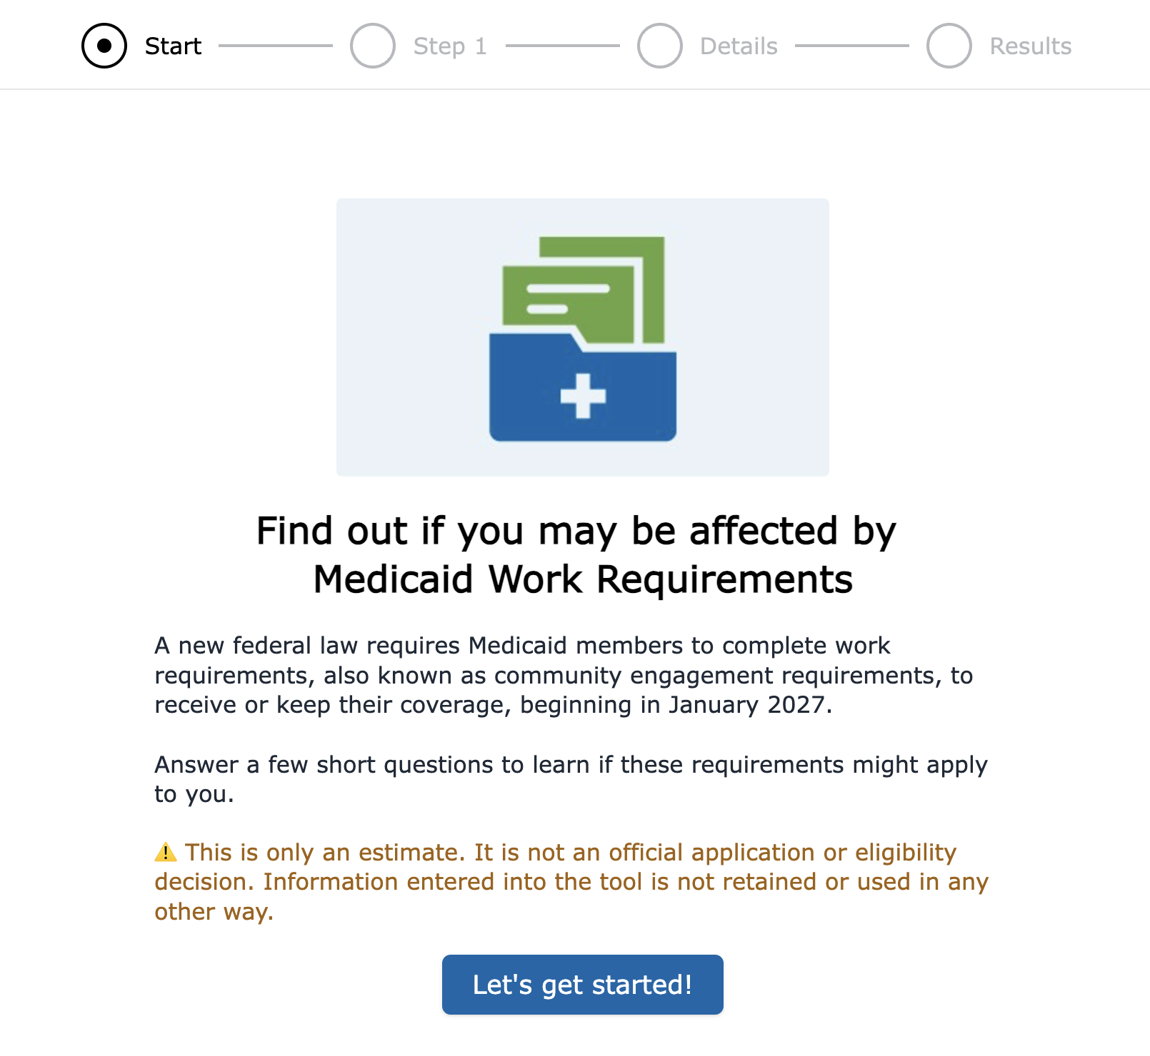
How Members Can Prepare
See if these provisions may apply to you using our new online screening tool.
Learn more about Medicaid changes on our H.R. 1 landing page on the Health First Colorado site.
Make plans to meet community engagement/work requirements criteria by Jan. 1, 2027.

Slide 36
Members: Watch for Communications
We will notify all members this summer of the coming changes to Medicaid.
Members affected by immigrant coverage changes will be notified in July 2026.
Members affected by community engagement/work requirements will receive letters by mail, text, or email in August or September 2026.
  Make sure to keep your contact information updated so you don’t miss important notices.
Watch your mail and respond quickly to Health First Colorado renewal packets or letters from your health plan.
Know your renewal date so you can renew your Health First Colorado online or work with your local county department of human services or eligibility site if you do not receive notifications.
Thank you for your partnership and engagement as we work together to implement H.R. 1 and focus on our North Star.
Visit Colorado.gov/hcpf/publications (click on sign up for newsletters, choose At A Glance)

Slide 37
Poll Question #4
Are there specific groups you think may need additional support to receive, act on, or understand changes to Medicaid due to H.R. 1? (Select up to 3)
Rural communities
Individuals with limited English proficiency
Older adults
People with disabilities
Families with children
Individuals experiencing housing insecurity
Communities of color
Individuals without reliable internet access
Immigrant communities
LGBTQ+ individuals

Slide 38
Share Resources and Partner with Us
Share our current and future Member Messages from HCPF Executive Director Bimestefer with colleagues and members - short, high-level overviews of what is in H.R. 1 and when members may see changes.
Bookmark our resource center, and sign up for HCPF newsletters to receive key implementation updates and understand how federal cuts impact Medicaid.
Send all questions, comments, and feedback to hcpf_HR1@state.co.us.
Stay tuned for future webinars.
Visit Colorado.gov/hcpf/publications (click on sign up for newsletters, choose At A Glance)

Slide 39
Q & A
Adela Flores-Brennan, Medicaid Director

Slide 40
Thank you!

