Slide 1
Member Correspondence Improvements
Fiscal Year 2025-26
April 16, 2026
Notes:
[Webinar Tech] Post in Chat:​
Thank you for joining us online, we'll begin shortly.
Gracias por conectarse, empezaremos en breve.
Presentation (English): https://docs.google.com/presentation/d/1zJWhcAi2AoMCoY9e8Ij7QWewf1qdSNMJeHzPM6w-Oro/view?usp=sharing
Presentación (español): https://docs.google.com/presentation/d/1vmxObma8RmF0cLhm8Cu7he49jY09q8poqYgzVPlFy7Y/view?usp=sharing

Slide 2

Interpretación de idiomas
Language Interpretation
To access language interpretation, click Interpretation in your meeting/webinar controls.
If you do not see the Interpretation button, click More, then Interpretation.
Click the language that you would like to hear.
Para acceder a la Interpretación de idiomas, haga clic en
Interpretación en los controles de su reunión/seminario web.
Si usted no ve el botón de interpretación, haga clic en Más y luego en Interpretación.
Haga clic en el idioma que a usted le gustaría escuchar.

Slide 3

Closed Captions
Closed Captions are available in the meeting controls toolbar at the bottom of your screen. To turn them on, click the Show Captions icon.
Captions can be translated into different languages by clicking on the up arrow next to the Closed Captions button and then selecting your preferred language.

Slide 4
Meeting Logistics
We are recording: avoid specific details about medical history or insurance/membership status in comments as this is considered Protected Health Information (PHI) and/or personally identifiable information (PII).
  If PHI or PII is identified, it will need to be removed from the meeting recording.
Attendees will be muted during the presentation.
The chat will not be monitored for questions. Staff will use the chat space to share links.

Slide 5

Meeting Logistics
Use the Q and A feature to ask questions.
Attendees can also raise their hand to ask questions. Once called upon, you will be asked to un-mute to ask your question.
Due to the number of attendees, each speaker will have up to 3 minutes to ask their question aloud. Attendees can request additional time to accommodate a disability.

Slide 6

Our Mission - photo
Our Mission
Improving health care equity, access and outcomes for the people we serve while saving Coloradans money on health care and driving value for Colorado.

Slide 7
What We Do
The Colorado Department of Health Care Policy (HCPF) and Financing administers Health First Colorado (Colorado’s Medicaid program), Child Health Plan Plus (CHP+) and other health care programs for Coloradans who qualify.

Slide 8
Today’s Expectations
Attendees: Ask questions and provide feedback after the presentation.
Meeting norms: Respect, stay on topic, and keep an eye on the length of feedback or question.
Time limit: Due to the number of attendees, we will need to limit questions to three minutes.

Slide 9
Commitment to Stakeholders
HCPF will:
Thoroughly and thoughtfully evaluate all questions and feedback.
Identify what feedback can be incorporated now or potentially in the future.
Transparently communicate the outcomes of feedback and questions.
Refer individuals to appropriate HCPF resources for out-of-scope topics.

Slide 10
Present Today
Facilitators
  Ryan Lazo, Stakeholder Engagement Advisor
  Lucien Meadows, Stakeholder Engagement Coordinator
Speakers
  Kristen Lundy, Member Content Strategy and Compliance Manager -
  Colorado Department of Health Care Policy and Financing
  Melinda Karp, President and CEO -
  The Center to Advance Consumer Partnership
Subject Matter Experts
  Natalie Coulter, Director of Communications
  Shawn Bodiker, Eligibility Policy Manager

Slide 11
Agenda
Overview of upcoming HR1 noticing
Introduction to the Center to Advance Consumer Partnership
Future opportunities to learn more and share feedback

Slide 12
THANK YOU!
The feedback period for the Notice of Adverse Benefit Determination letter and Worksheet J: Work Requirements has closed.
We received a great response from all of you and significant changes were made as a result of your feedback.
Thank you for your ongoing partnership!!

Slide 13
Overview of Upcoming HR1 Noticing

Slide 14
Narrow Audience Notice
Audience: Medicaid Expansion Population
Title: Changes Coming to Health First Colorado
Purpose of Communication:
Direct noticing to those impacted by upcoming federal changes.
Specific information about work requirements and 6 month renewal frequencies.
Information on what counts as eligible activities, who is exempt, steps to take to remain eligible, and what happens if you do not comply.
Distribution Date: September 2026.

Slide 15
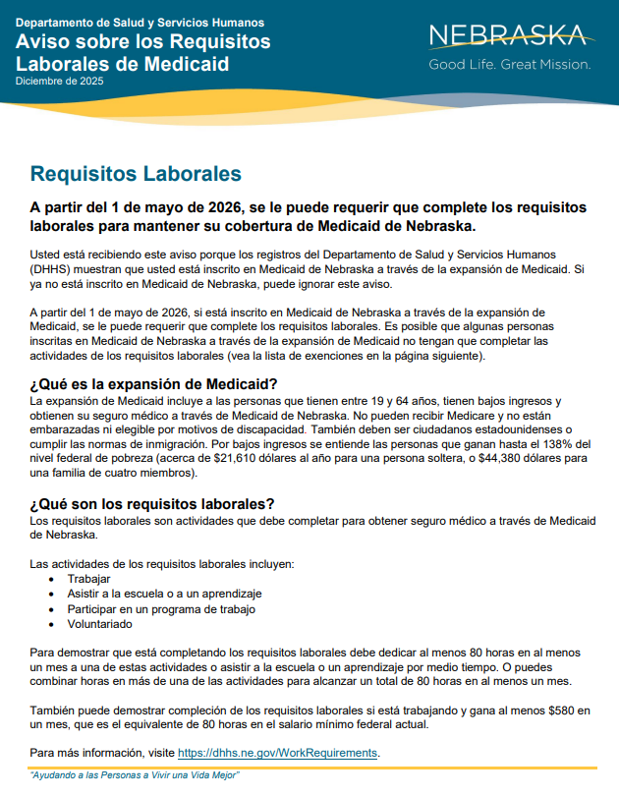

Slide 16
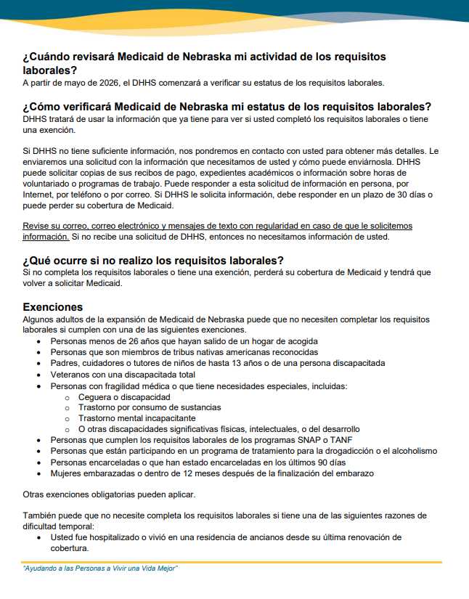

Slide 17


Slide 18
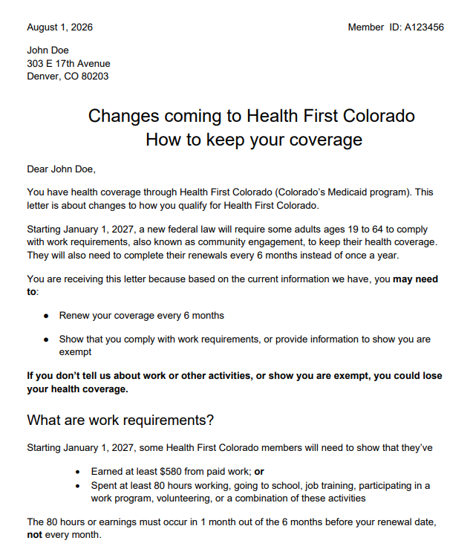
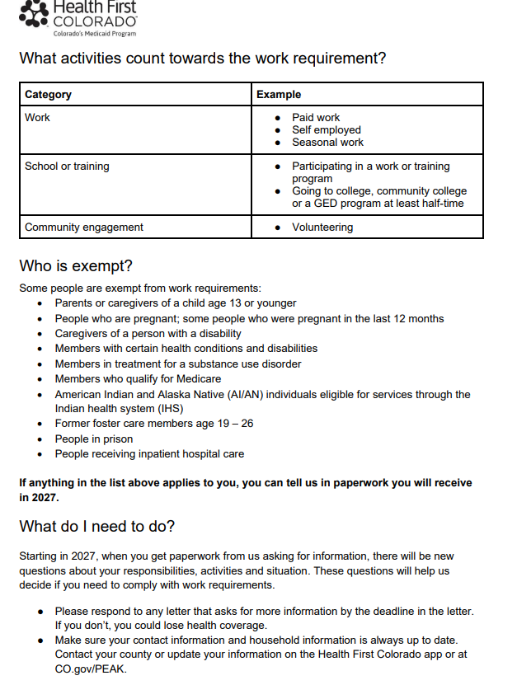

Slide 19
Summary of Projects Posted for Feedback
Currently posted to the website:
Changes coming to Health First Colorado (expansion population only)
This notice is to be sent to members of the Medicaid expansion population (ages 19-64 without a disability) to inform them of upcoming federal changes.
    Feedback on this notice will be accepted through April 30, 2026.

Slide 20


Slide 21


HCPF Member Correspondence Workgroup
April 16, 2026

Slide 22


Centering People with Lived Experience in Colorado’s Medicaid Future
The Colorado Health Foundation has funded the Center to Advance Consumer Partnership (CACP) to work together with HCPF, Medicaid members, and organizations across the state to strengthen how Medicaid members receive information.
We want to ensure members receive understandable, accessible, consistent, and timely information about federal changes to Medicaid:
  what the changes mean for them
  what (if anything) they need to do
  where they can turn for help or answers
Our Shared Goal
No member should lose coverage or experience confusion because they didn’t understand a change

Slide 23
Our Approach to This Work:
Focusing on the Member Journey
What benefits will most help me or my family member?
How do I see a PCP or a specialist?
How do I get BH services?
How do I get the medicines I need?
How do I access other benefits like transportation, care services at home?
Who can help me get the most from my benefits?
What is Medicaid and how can it help my family and me?
How do I know if I quality?
How can I learn more?
Who can help me?
What do I do if I lose my coverage?
What kind of support can I get?
Who can help me?
Awareness and Interest | Applying for Medicaid | Understanding and Using Benefits to Access Care and Services | Maintaining Medicaid Benefits | Transitioning out of Coverage
How do I sign up?
How long will it take?
What information do I need to provide?
Who can help me if I have problems or questions?
How will I know when I need to renew?
What do I need to do and what information will I need?
What happens if I miss my renewal?
How can I get help?

Slide 24
Our Approach to This Work:
Creating Collaboration and Coordination
Medicaid Members
Ongoing engagement statewide through existing and new channels
    Prioritizing pain points and challenges
    Understanding needs, expectations & trusted messengers
    Testing messages and communication channels
RAEs & MCOs
Understand perspectives on:
Interdependencies across organizations
Member outreach and communications—strengths, challenges, opportunities for coordination
Member challenges navigating the ecosystem
Review/Align On:
Shared and stakeholder specific roles & accountabilities for member outreach, communications, support
Draft toolkit elements
Disseminate Communications Playbook /Toolkit
Training Sessions for all stakeholders
Counties
Providers and Case Mgmt. Orgs
CBOs & Advocacy
Other State Agencies
March-April
May
June
July-August

Slide 25

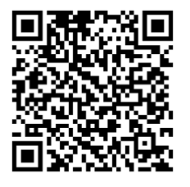
Join Us at the Medicaid Member Table
Share your experiences receiving information and updates about the Medicaid program.
Your input will help improve how important information is shared with Medicaid members and families across Colorado.
You pick the way you want to participate! Virtually or in person. Through listening sessions, surveys, or reviewing materials.
Questions or Need Help Completing the Interest Form?
Email: Brittany Jackson
(bjackson@inspire-ce.org).
or Call: 562-354-6121.
CLICK HERE TO JOIN US OR
USE YOUR SMARTPHONE TO SCAN THE QR CODE

Slide 26





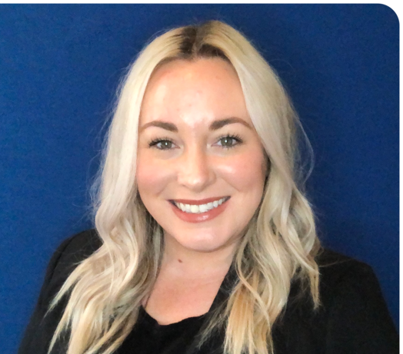

Our Team
Overall project leadership and accountability
Stakeholder engagement
Communications strategy and toolkit development (with creative partner JumpingFish)
Melinda Karp,
President and CEO
mkarp@
consumerpartnership.org
Abigail Santmyer,
Senior Advisor, Communications & Lead, JumpingFish
Abigail@jumpingfishco.com
Kat Ferguson-Mahon,
Senior Advisor, Medicaid
klatet@
consumerpartnership.org
Medicaid member engagement
Project Management
Libby Hoy,
President and CEO
Libby@pfccpartners.com
Lindsey Galli,
Vice President of Programs
Lindsey@pfccpartners.com
Brittany Jackson,
Community Connections Coordinator
Brittany@pfccpartners.com

Slide 27
Resources
HCPF H.R. 1 Landing Page
    Frequently Asked Questions
H.R. 1 Landing Page for Health First Colorado
    Work Requirements Screener
Communication toolkit for providers and partners (in development)

Slide 28
Future Opportunities to Learn More and Share Feedback

Slide 29
Next Feedback Sessions
July 16 at 12 p.m.
Plan to review proposed renewal redesign plan based on feedback previously received
October 15 at 12 p.m.
TBD

Slide 30
Questions?

Slide 31
Resources
Member Correspondence Improvements website
Member Correspondence Improvements email notifications
All HCPF newsletters and publications
Register for upcoming Member Correspondence Improvements Meetings
  July 16, 2026
  October 15, 2026

Slide 32
Contact Information
Kristen Lundy
Member Content Strategy and Compliance Manager
kristen.lundy@state.co.us

Slide 33
Thank you!

