Slide 1
Federal Medicaid Changes Impacting
Colorado’s Immigrant Communities
Presented by the Colorado Health Institute (CHI)
and Colorado Department of Health Care Policy and Financing (HCPF)
Notes:
CHI
For Speaker Notes, please see our Google Doc.

Slide 2

Language Interpretation
To access language interpretation, click Interpretation in your meeting/webinar controls.
If you do not see the Interpretation button, click More, then Interpretation.
Click the language that you would like to hear.
Notes:
CHI

Slide 3

Closed Captions
Closed captions are available in Zoom.
To turn them on, click the Show Captions icon.
To translate captions, click the arrow next to Show Captions and choose your language.

Slide 4

Q&A Instructions
Use the Q and A feature to ask questions.
Attendees can also click the Raise Hand icon to provide a comment. Once called upon, you will be asked to un-mute to speak.
Due to the number of attendees, each speaker will have up to two minutes to ask their question aloud. Attendees can request additional time to accommodate a disability.
Notes:
[Presenter]: for those calling in you may mute and unmute using *6 and raise your hand using *9
[Webinar Tech] Post in Chat:​
Enter specific Meeting logistics here

Slide 5
Meeting Logistics
We are recording. Recordings and slides will be posted to HCPF’s H.R. 1 stakeholder engagement webpage.
Attendees will be muted during the presentation.
Links and other materials will be posted in the chat.
Please submit questions via the Q&A feature.
Do not include medical history, insurance status, or member details in questions or comments.
We will share a poll question during the webinar and a survey form to collect valuable feedback.
Notes:
CHI

Slide 6
Agenda
Introduction | Colorado Health Institute (CHI)
Medicaid Eligibility Changes for Immigrants| HCPF
H.R. 1 Communications Toolkit | CHI
Cover All Coloradans Changes| HCPF
Questions and Answers (Q&A) | CHI and HCPF
Resources and Next Steps | CHI

Slide 7


Slide 8

Our Mission
Improving health care equity, access and outcomes for the people we serve while saving Coloradans money on health care and driving value for Colorado.
Notes:
Adela

Slide 9
What We Do
The Colorado Department of Health Care Policy and Financing (HCPF) administers Health First Colorado (Colorado’s Medicaid program), Child Health Plan Plus (CHP+) and other health care programs for Coloradans who qualify.
Notes:
Adela

Slide 10
Commitment to Stakeholders
HCPF will:
Thoroughly and thoughtfully evaluate all questions and feedback.
Identify what feedback can be incorporated now or potentially in the future.
Transparently communicate the outcomes of feedback and questions.
Refer individuals to appropriate HCPF resources for out-of-scope topics.

Slide 11
H.R. 1 Overview
Notes:
Adela

Slide 12
Federal Medicaid Changes
The federal government, through a bill called H.R. 1, is making changes to state Medicaid programs.
Colorado’s Medicaid program is called Health First Colorado.
These changes will:
  Disenroll certain members such as refugees and asylees.
  Add restrictions to others who still qualify for Medicaid.
  Impact Colorado’s Medicaid funding
Notes:
Adela

Slide 13
Working Timeline Overview
Timing is subject to change as guidance is finalized
2026
2027
May 2026
Notices, emails and texts sent to affected immigrant members
September 2026
Notices, emails and texts sent to members subject to qualified immigrant changes
October 2026
Changes to coverage for some immigrants
Estimated 7,000 impacted
November 2026
Notices, emails and texts for January renewals sent
January 2027
6-Month Renewals
Work Requirements
Retro Coverage Rollback
Estimated 378,000 impacted
2027
Direct outreach to members continues based on renewal date
Notes:
Adela

Slide 14






H.R. 1 Implementation Complexities
Tight timelines between issuance of rules and implementation
Technology systems changes
Coordinating policy implementation across departments
Increased workload for frontline workers
Increase in uncompensated care and use of emergency services
Increase in costs and reductions in funding for services
Notes:
Adela
Policy guidance continues to develop and we are waiting on the analysis of the interim final rules received from CMS on June 1, which will be finalized later this summer.

Slide 15
Medicaid Eligibility Changes for Immigrants
Notes:
Adela

Slide 16
October 1: Changes for Certain Immigrants
Medicaid coverage will end for some lawfully present immigrants, including refugees, asylees, humanitarian parolees, and others.
We will let affected members know what other coverage options they have, including potential emergency Medicaid coverage.
Notes:
Adela
Medicaid coverage will end for some lawfully present immigrants, including refugees, asylees, humanitarian parolees, and others. We will walk through this in the next few slides.
We will let affected members know what other coverage options they have, including potential emergency Medicaid coverage. Impacted individuals received a letter in the mail in May, and those who will be disenrolled will receive another notice in September 2026 prior to disenrollment in October.

Slide 17
Who Will Continue to Qualify? (1 of 2)
These groups will continue to qualify for Medicaid after October 1:
Children age 18 and younger
Pregnant people, or people who were pregnant in the past 12 months
Notes:
Adela

Slide 18
Who Will Continue to Qualify? (2 of 2)
These groups will continue to qualify for Medicaid after October 1:
U.S. citizens and U.S. nationals
Lawful Permanent Residents who meet the 5-year requirement
Citizens of the Marshall Islands, Micronesia, and Palau who are living in the U.S.
Certain Cuban or Haitian entrants
Notes:
Adela
People who continue to qualify may be subject to work requirements.

Slide 19
Who is Losing Medicaid Coverage on Oct. 1? (1 of 3)
Unless an exemption applies, people in these groups will lose coverage:
Refugees and asylees
People granted humanitarian parole
People granted withholding of removal
Notes:
Adela
Unless an exemption related to age, pregnancy or postpartum status apply, the following will no longer qualify for Health First Colorado on October 1st. They could be eligible for CAC or Emergency Medicaid and Reproductive health care services if eligible.

Slide 20
Who is Losing Medicaid Coverage on Oct. 1? (2 of 3)
Unless an exemption applies, people in these groups will lose coverage:
Noncitizen survivors of domestic violence with a pending or approved application under the Violence Against Women Act who were not born in the U.S.
Noncitizen survivors of trafficking with a pending or approved application for a victim of trafficking visa who were not born in the U.S.
Notes:
Adela
A Canadian-born member of a U.S. tribe or American Indian is a Native person born in Canada whose Indigenous heritage or tribal membership gives them a special status and connection to tribes in the United States.

Slide 21
Who is Losing Medicaid Coverage on Oct. 1? (3 of 3)
Unless an exemption applies, people in these groups will lose coverage:
Canadian-born American Indians or Canadian-born members of a U.S. federally recognized Indian tribe.
Refugees who have a “conditional entrant” status granted before 1980.
Notes:
Adela
A Canadian-born member of a U.S. tribe or American Indian is a Native person born in Canada whose Indigenous heritage or tribal membership gives them a special status and connection to tribes in the United States.

Slide 22
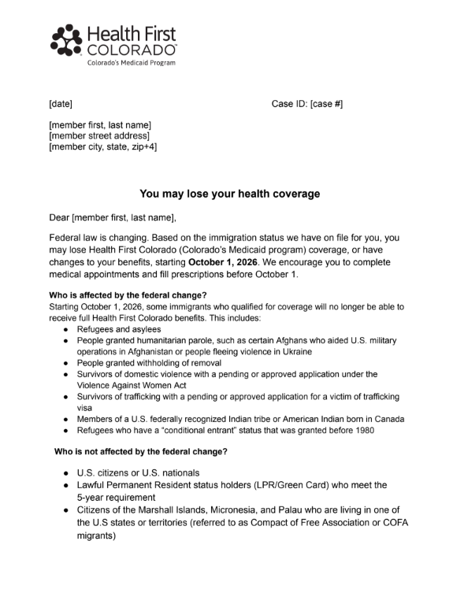
How do I know for certain if I am losing coverage?
If you received a notice in May (pictured), you might lose coverage.
If impacted, you will receive official notice in September.
Notes:
Adela or SME

Slide 23
If I am losing coverage, what can I do? (1 of 3)
Prepare ahead of October 1
Verify your specific immigration category.
Update your contact information in PEAK.
If you are pregnant, make sure your information is updated with your county and on PEAK.
Make preparations for possible loss of coverage by scheduling appointments and filling prescriptions.
Review HCPF and Health First Colorado FAQs.
If you still qualify, check if you are subject to work requirements.
Notes:
Adela
When updating your information online or checking your status, you will have to share certain personal information. HCPF only shares Medicaid information with CMS and does not share information with federal immigration officials. However, we cannot directly control what CMS shares. If you are already signed up for Health First Colorado, SNAP, or other benefits, your information is already shared with relevant systems.

Slide 24
If I am losing coverage, what can I do? (2 of 3)
Other coverage options to apply for now may include:
  Use the Connect for Health Colorado Marketplace to find out if you qualify for private health insurance and for financial assistance to lower the cost of insurance.
  If employed, check with employer.
  Omnisalud through Connect for Health Colorado.
  Cover All Coloradans, if eligible.
  Emergency Medicaid, if eligible.
  CHP+, if eligible.
Notes:
Adela or SME or CHI -
Use the Connect for Health Colorado Marketplace to find out if you qualify for private health insurance and for financial assistance to lower the cost of insurance
Omnisalud through Connect for Health Colorado. OmniSalud is a program that provides undocumented Coloradans with a safe way to compare affordable health insurance plans and enroll on a secure online platform. This service is for people who do not qualify for Health First Colorado (Colorado’s Medicaid Program), Child Health Plan Plus (CHP+), or Connect for Health Colorado due to immigration status
Cover All Coloradans, if eligible.
Emergency Medicaid, if eligible. Apply as soon as able.
CHP+, if eligible.

Slide 25
If I am losing coverage, what can I do? (3 of 3)
Other care options:
  Safety-net providers
    Federally Qualified Health Centers
    Community Behavioral Health Centers
    Other free or low-cost clinics
  Prescription Drug Discount Resources
Notes:
Adela or SME

Slide 26
H.R. 1 Communications Toolkit
Notes:
CHI

Slide 27
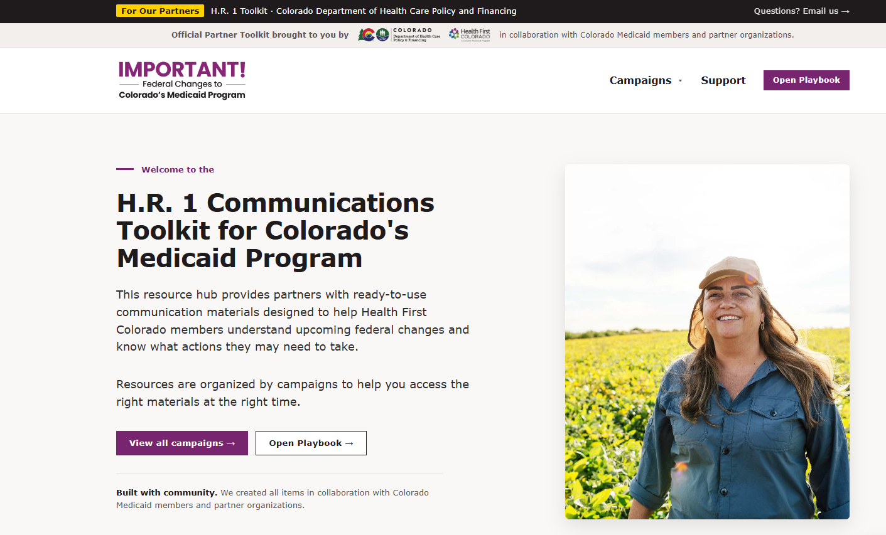
H.R. 1 Toolkit Overview
Official partner toolkit
Designed to help members understand upcoming federal changes
Outlines actions some members may need to take
Features flyers, social media images, messaging and other resources
hr1toolkit.healthfirstcolorado.gov
Notes:
CHI — The H.R. 1 toolkit was created in partnership with the Center to Advance Consumer Partnership (CACP), which is funded by the Colorado Health Foundation as a resource to help community partners, advocacy organizations, providers, and others support members in getting ready for the changes H.R. 1 will bring. It is receiving updates throughout the summer and features member-tested messaging, social media posts, flyers, and more.
This toolkit will ultimately contain information about ALL HR 1 related changes, with some specific resources for the immigrant/refugee specific changes already available.

Slide 28

Inside the Toolkit
The toolkit provides multiple ways to share messages.
Current content includes:
Simple actions to help members stay informed, prepared and connected.
Co-brandable, ready-to-use material on immigrant eligibility changes in English and Spanish.
Toolkit playbook to help partners use and share material.
Notes:
CHI

Slide 29
Core Messages
01
Update your information
Call or visit your county human services office, or update online at Colorado PEAK: co.gov/PEAK
02
Use your coverage now
Schedule medical, dental and behavioral health appointments. Refill prescriptions to the limit allowed. Don’t wait.
03
Watch for official letters
Health First Colorado will mail a notice before anything changes. Open and respond to any letters you receive.
04
Reach out to someone you trust
Contact the person at your clinic or community who has helped you with Medicaid before. Local organizations are ready to help.
Visit HealthFirstColorado.com/Changes for up-to-date information and guidance
Notes:
CHI

Slide 30
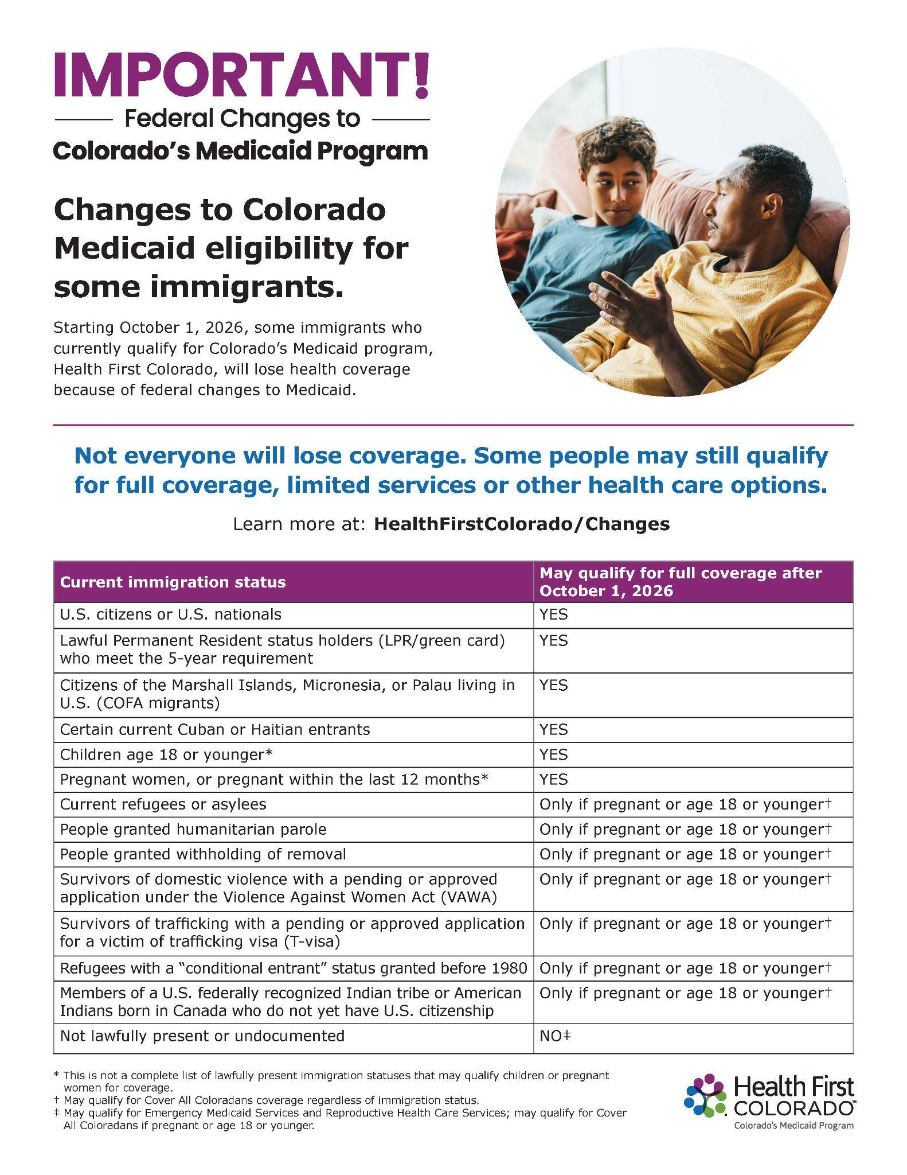
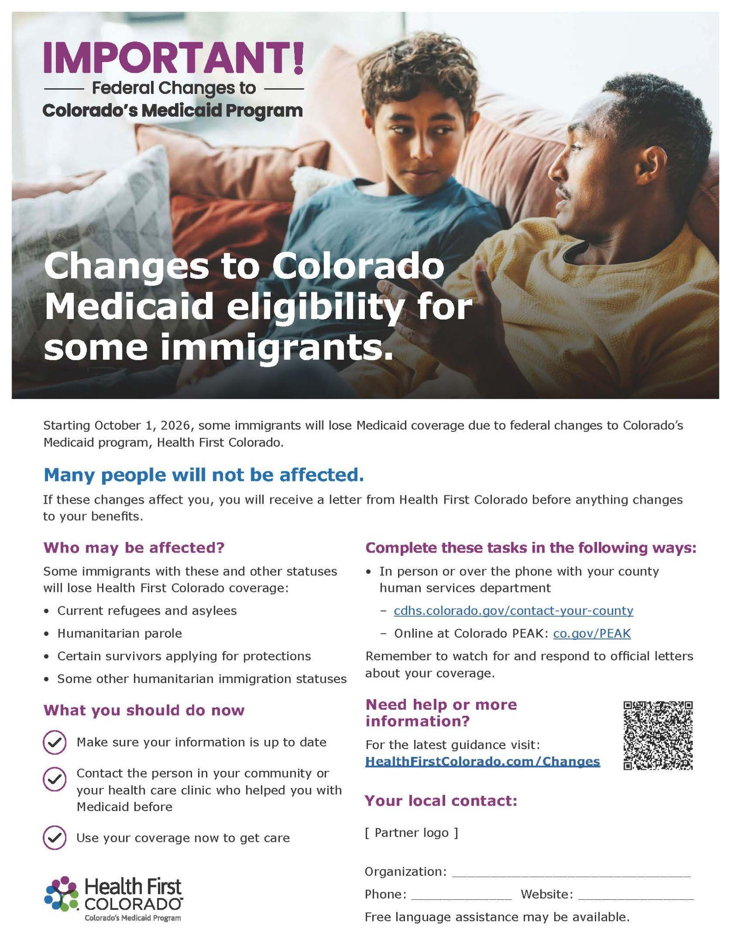
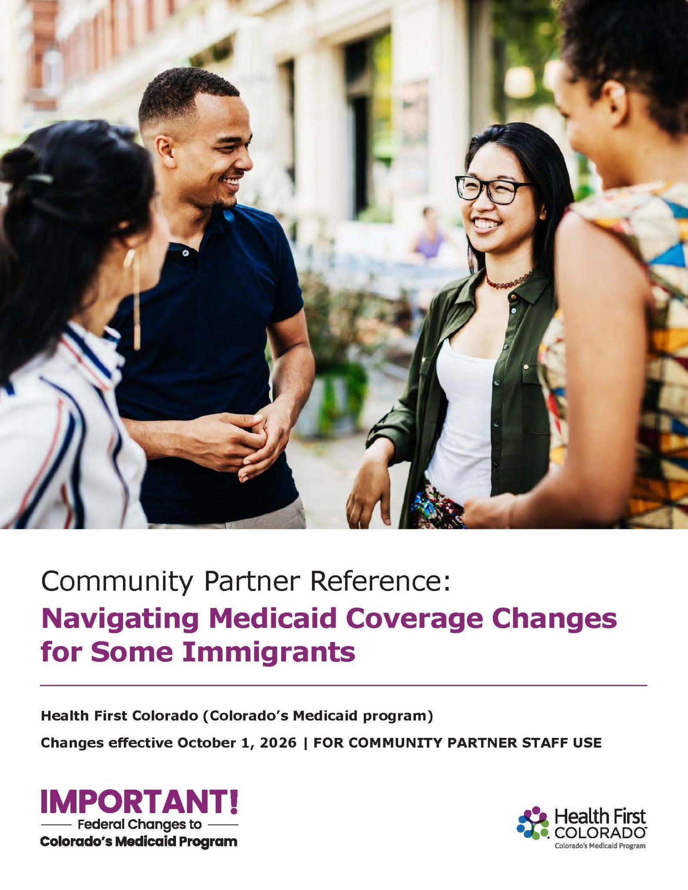
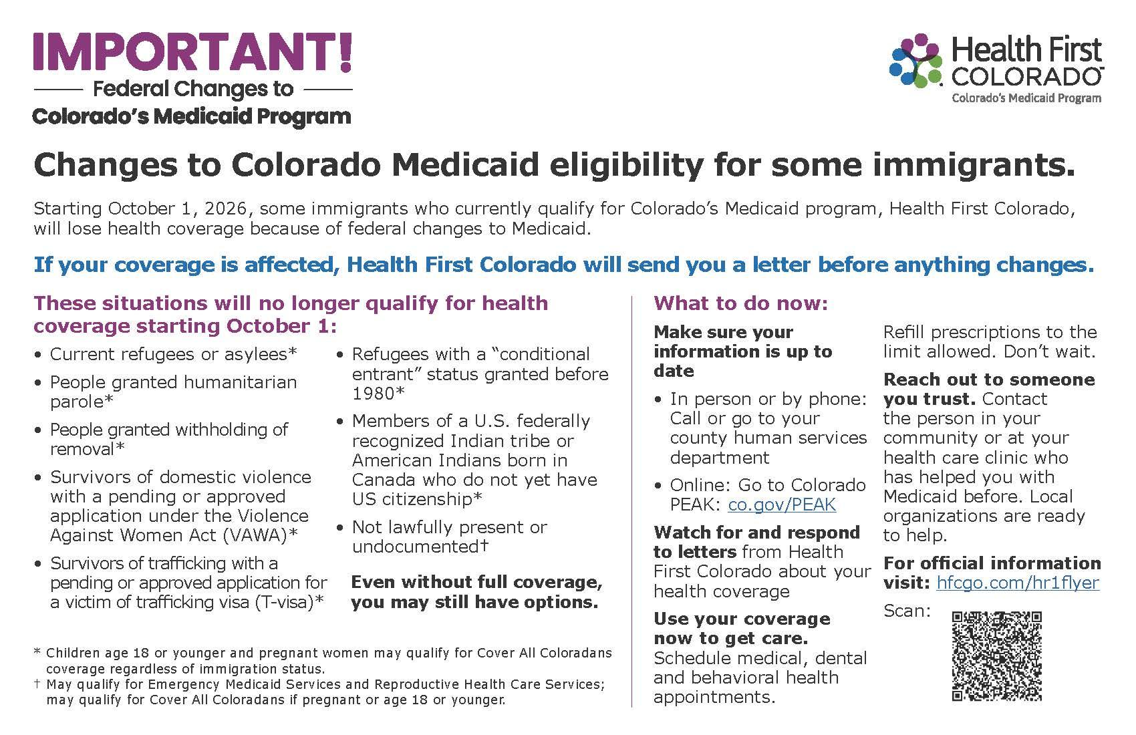
Immigrant Eligibility Material
Outlining which immigrant groups may be affected by federal Medicaid changes and where to point members for help
Half-page flyer
Full-page flyer
Walk-by poster
Partner reference
Notes:
CHI

Slide 31
Cover All Coloradans
Changes
Notes:
Lisa/Brittany

Slide 32
CAC Overview
Cover All Coloradans (CAC) is a health coverage program for pregnant and postpartum people and children (18 and younger) regardless of immigration status.

Slide 33
CAC Eligibility
As of January 1, 2025, Colorado children ages 18 or younger and pregnant people living in Colorado, regardless of their immigration status, can apply to get health coverage.
Who qualifies?
Through CAC, you may qualify for Health First Colorado or CHP+ if you:
Live in Colorado, and
Meet the income and household eligibility requirements, and
Are pregnant or
Are 18 years old or younger.

Slide 34
More CAC Information
Sign up for the CAC newsletter
Visit the CAC webpage
Register for an upcoming stakeholder meeting about CAC
  July 15, 2026, from 1 to 2:30 p.m.
Contact hcpf_coverallco@state.co.us

Slide 35
Questions and Answers (Q&A)
Notes:
CHI and HCPF

Slide 36
Resources and Next Steps
Notes:
CHI

Slide 37
Refugee Resources
The Office of New Americans Refugee Services
Find support in your area
Federal resources
Notes:
CHI

Slide 38
Next Steps for Members
Make sure your citizenship/immigration status and contact information are up to date.
Watch for and respond immediately to official notices.
Take preparations for possible loss of coverage (schedule appointments and fill prescriptions) before October 1.
Notes:
CHI

Slide 39
Stay Engaged
Visit the HCPF webpage for policy information
Visit the Health First Colorado page for member guidance
Contact hcpf_HR1@state.co.us to connect with HCPF staff
Contact the member center for member specific questions, and provider center for provider and billing questions
Notes:
CHI

Slide 40
Thank you!
Notes:
CHI

