Slide 1

Stakeholder Forum to Discuss Health Benefits for Colorado Children and Pregnant Persons (HB26-1411)
Changes to Cover All Coloradans
July 15, 2026

Slide 2

Interpretación de idiomas
Language Interpretation
To access language interpretation, click Interpretation in your meeting/webinar controls.
If you do not see the Interpretation button, click More, then Interpretation.
Click the language that you would like to hear.
Para acceder a la Interpretación de idiomas, haga clic en
Interpretación en los controles de su reunión/seminario web.
Si usted no ve el botón de interpretación, haga clic en Más y luego en Interpretación.
Haga clic en el idioma que a usted le gustaría escuchar.
Notes:
Speaker:
I’d like to let the Spanish interpreter introduce themselves right now.
SPANISH INTERPRETER COMES ON SCREEN and IS HIGHLIGHTED; Interpreter READS SCRIPT BELOW VERBATIM.
Interpreter reads (in Spanish, but this is what she is saying in English):
“My name is _____________and I will be providing Spanish interpretation services. In a moment, this service will be activated. To hear live Spanish interpretation of today’s event, select the “interpretation” pod from the Zoom toolbar and then select “Spanish”. You will have the option to select “mute original audio” if you want to hear only Spanish. This interpretation pod will be activated momentarily.”
Then [Webinar Leader] speaks once the interpreter is done:
Thank you, [Interpreter Name]. If you would like to listen to this webinar in Spanish, please select the “Interpretation” pod on your Zoom toolbar and select “Spanish”. Additionally, we have Amerian Sign Language or ASL available. You can access that the same way - by clicking the interpretation icon at the bottom of your screen and selecting American Sign Language. We have also posted instructions for now to access language interpretation in the chat.
[Webinar Tech] Post in Chat:​
How to listen to Language Interpretation: https://support.zoom.com/hc/en/article?id=zm_kb&sysparm_article=KB0064768#h_6802bbbc-2ec9-47cb-a04c-6aac35914d82
If you would like to listen to this webinar in Spanish, please select the “Interpretation” pod on your Zoom toolbar (the “globe” icon) and select “Spanish.” If you wish to close the Spanish interpretation, select the “Interpretation” pod on your Zoom toolbar (the “globe” icon) and select “Original Audio (Interpretation Off).”
Si desea escuchar este seminario web en español, seleccione el módulo de “Interpretación” en su barra de herramientas de Zoom (el ícono de “globo”) y seleccione “Español.” Si desea desactivar la interpretación en español, seleccione el módulo de “Interpretación” en su barra de herramientas de Zoom (el ícono de “globo”) y seleccione “Audio original (Interpretación desactivada).”
To access American Sign Language interpretation, please select the “Interpretation” pod on your Zoom toolbar (the “globe” icon) and select “American Sign Language” (ASL). If you wish to close the ASL interpretation, select the “Interpretation” pod on your Zoom toolbar (the “globe” icon) and select “Sign Language Off.”
Para acceder a la interpretación en lenguaje de señas americano, seleccione el módulo de “Interpretación” en su barra de herramientas de Zoom (el ícono de “globo”) y seleccione “Lenguaje de señas americano” (American Sign Language, ASL). Si desea desactivar la interpretación en ASL, seleccione el módulo de “Interpretación” en su barra de herramientas de Zoom (el ícono de “globo”) y seleccione “Lenguaje de señas desactivado.”

Slide 3

Closed Captions
Closed captions are available in Zoom.
To turn them on, click the Show Captions icon.
To translate captions, click the arrow next to Show Captions and choose your language.

Slide 4
Meeting Logistics
We are recording this webinar.
Do not include medical history, insurance status, or member details in questions or comments.
  This information may be protected health information (PHI) or personally identifiable information (PII).
  If a question includes PHI or PII, staff may not read the full question aloud.

Slide 5

Meeting Logistics
Attendees will be muted during the presentation.
Chat is turned off for participants. Staff will use chat to share links.
Use Q and A feature to ask questions.
If you have technical or Zoom-related questions, please also use the Q and A feature. A team member will do their best to assist you.
Notes:
Note we are showing the Q and A icon on the slides.

Slide 6

Our Mission
Improving health care equity, access and outcomes for the people we serve while saving Coloradans money on health care and driving value for Colorado.

Slide 7
What We Do
The Colorado Department of Health Care Policy (HCPF) and Financing administers Health First Colorado (Colorado’s Medicaid program), Child Health Plan Plus (CHP+) and other health care programs for Coloradans who qualify.

Slide 8
Today’s Expectations
Attendees: Ask questions and provide feedback after the presentation.
Meeting norms: Respect, stay on topic, and keep an eye on the length of your feedback or question.
Time limit: Due to the number of attendees, we will only be taking questions using the Q and A feature in your Zoom toolbar.
Notes:
Ryan
Note:

Slide 9
Commitment to Stakeholders
HCPF will:
Thoroughly and thoughtfully evaluate all questions and feedback.
Identify what feedback can be incorporated now or potentially in the future.
Transparently communicate the outcomes of feedback and questions.
Refer individuals to appropriate HCPF resources for out-of-scope topics.
Notes:
Ryan
Note XXX number of questions received ahead of time. Thank You. We have time dedicated to the most common questions we received during registration at the beginning of the ‘Questions’ section.
leads me into agenda

Slide 10
Agenda
Cover All Coloradans (CAC) Overview​
CAC History and Definitions
CAC Population Differences
CAC Upcoming Changes ​
Federal Changes
OmniSalud Program
Resources
Questions
Notes:
Susanna starts here

Slide 11
Presentation Team
HCPF
  Susanna Snyder, Child and Family Health Division Director
  Ryan Lazo, Stakeholder Engagement Advisor
  Lucien Meadows, Stakeholder Engagement Coordinator
Division of Insurance
  Laura Mortimer, Reinsurance Program Director
  Maria Rodriguez, Healthcare Equity and Outreach Specialist
Q and A Support Staff
Notes:
Note: ensure that folks introduce them self during Q&A

Slide 12

Cover All Coloradans Overview
A program with similar benefits to Health First Colorado (Colorado’s Medicaid Program) and the Children’s Health Insurance Plus (CHP+) for pregnant and postpartum people and children regardless of immigration status.
Notes:
Children (until 19th birthday) and Pregnant People (until 12 mos postpartum)​
Children state only and perinatal people CHP+ authorities (FCEP + HSI)​

Slide 13
CAC History and Definitions
HB22-1289: Creates program
Eligibility
  Pregnant = Pregnant through 12 mos postpartum
  Children = Age 18 and younger
  Medicaid and CHP+ incomes (Up to 260% Federal Poverty Level (FPL))
  Lives in Colorado
Jan 2025: Go Live
HB26-1411: Program Changes

Slide 14
CAC Population Differences
Children | Pregnant and Postpartum
Eligible at Medicaid and CHP+ income levels | Eligible at Medicaid and CHP+ income levels
Previously eligible for lookalike services | Previously eligible for lookalike services
State only authority | Has federal authority
State only funding | Receives federal match (65%)
~20,000 enrollees | ~7,000 enrollees

Slide 15
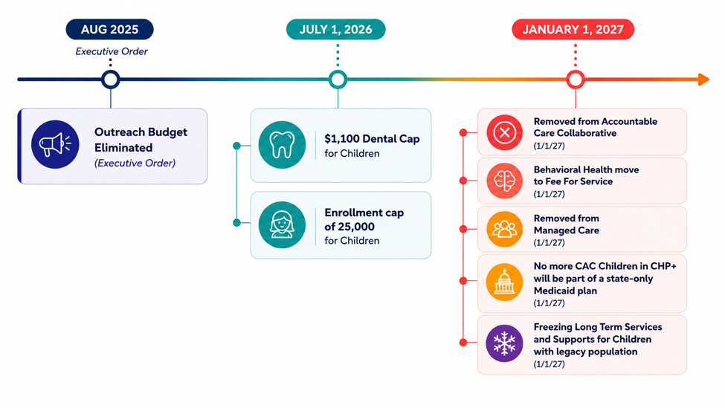
Timeline of Changes
Notes:
Outreach Budget Eliminated (Aug 2025, Exec Order)
$1100 Dental Cap for Children (7/1/26)
Enrollment cap of 25,000 for Children (7/1/26)
Removed from Accountable Care Collaborative ( 1/1/27)
Behavioral Health move to Fee For Service (1/1/27)
Removed from Managed Care (1/1/27)
No more CAC Children in CHP+ will be part of a state-only Medicaid plan (1/1/27)
Freezing Long Term Services and Supports for Children with legacy population (1/1/27)

Slide 16
Timeline of Changes
August 2025: Executive Order
  Outreach Budget Eliminated
July 1, 2026
  $1100 Dental Cap for Children
  Enrollment cap of 25,000 for Children
January 1, 2027
  Removed from Accountable Care Collaborative
  Behavioral Health move to Fee For Service
  Removed from Managed Care
  No more CAC Children in CHP+ will be part of a state-only Medicaid plan
  Freezing Long Term Services and Supports for Children with legacy population
Notes:
Outreach Budget Eliminated (Aug 2025, Exec Order)
$1100 Dental Cap for Children (7/1/26)
Enrollment cap of 25,000 for Children (7/1/26)
Removed from Accountable Care Collaborative ( 1/1/27)
Behavioral Health move to Fee For Service (1/1/27)
Removed from Managed Care (1/1/27)
No more CAC Children in CHP+ will be part of a state-only Medicaid plan (1/1/27)
Freezing Long Term Services and Supports for Children with legacy population (1/1/27)

Slide 17
Dental Benefit Changes ​
Who:​
  Child enrollees
When: 7/1/26​
Key Points​
  Annual dental limit will be $1,100.
  Members should work with their dental providers on care plans.
Notes:
Note on special services like orthodontia

Slide 18
Enrollment Cap​
Who:​
  Child enrollees
When: 7/1/26​
Key Points​
  Cover All Coloradans new child enrollment will be frozen if:
    Child enrollment reaches 25,000, or
    HCPF exceeds projected expenditures.
Additional resources
  Emergency Medicaid Services/Reproductive Health Care Services (EMS/RHCS)
Notes:
Beginning July 1, 2026, enrollment for new Cover All Coloradans children will be frozen if:
Child enrollment reaches 25,000, or
HCPF exceeds projected expenditures.
As of July 2026, expenditures remain well below the limit and fewer than 19,000 children are enrolled.
There will be a 60-day grace period after reaching the enrollment/expenditure limit criteria before the freeze is implemented.
Notification of an enrollment freeze will be shared through public stakeholder meetings and the Cover All Coloradans newsletter.
Children who are no longer able to enroll in Cover All Coloradans due to the enrollment cap should still apply to see if they qualify for Emergency Medicaid Services/Reproductive Health Care Services (EMS/RHCS).
HCPF is developing a process for re-opening the program when enrollment decreases and notifying potential CAC members that they can enroll again.

Slide 19
Removed from Accountable Care Collaborative​
Who:​
  Child (all) and Pregnant/Postpartum enrollees (Medicaid)
When: 1/1/27​
Key Points​
  No Regional Accountable Entity (RAE) assignments
    Behavioral Health changes
    No RAE care coordination
  No managed care assignments (Denver Health & RMHP PRIME)
Notes:
Beginning January 1, 2027, the Cover All Coloradans population will be removed from the Accountable Care Collaborative. As a result:
Members will not be assigned to a Regional Accountable Entity (RAE).
Members can find their own providers. Search for providers.
Members will no longer receive general care coordination resources from our Regional Accountable Entities but may receive other wraparound support from community providers.
CAC members will no longer receive Behavioral Health services through their RAEs but will still qualify for many Behavioral Health services.
Behavioral Health Benefit information.
Residential and inpatient services are excluded.

Slide 20
CAC Kids Medicaid Only ​
Who:​
  Child enrollees
When: 1/1/27​
Key Points​
  All children will be consolidated in the Medicaid delivery system.
  Households enrolled in CHP+ will be notified of changes.

Slide 21
Long Term Support Services Changes​
Who:​
  Child enrollees
When: 1/1/27​
Key Points​
  Children will no longer qualify for Long Term Support Services (LTSS), including: Home-and community-based services (HCBS), Community first choice, Long-term home health, Private duty nursing, Hospice care, Nursing home care.
  Those enrolled December 31, 2026, will continue to receive LTSS services (if eligible).
Notes:
CMA TPs from Eileen
It is important for members to respond to any HCPF communication so that they do not lose coverage because they will not be able to re-enroll in LTSS services.

Slide 22
CAC Population Visibility​
Who: ​
  All CAC​
When: 7/1/26 (dental); 1/1/27 (all providers)
Key Points:​
  Provider knowledge will be required to support patient navigation (e.g. behavioral health referrals).
  The details are still in development.

Slide 23
Federal Medicaid Changes
The federal government, through a bill called H.R. 1, is making changes to state Medicaid programs.
Colorado’s Medicaid program is called Health First Colorado.
These changes will:
  Disenroll certain members such as refugees and asylees.
  Add restrictions to others who still qualify for Medicaid.
  Impact Colorado’s Medicaid funding
Notes:
Adela
The populations enrolled in these programs are separate but we understand community partners are working with families who are impacted by both of these changes or that you may even have mixed status households who are impacted by changes…

Slide 24
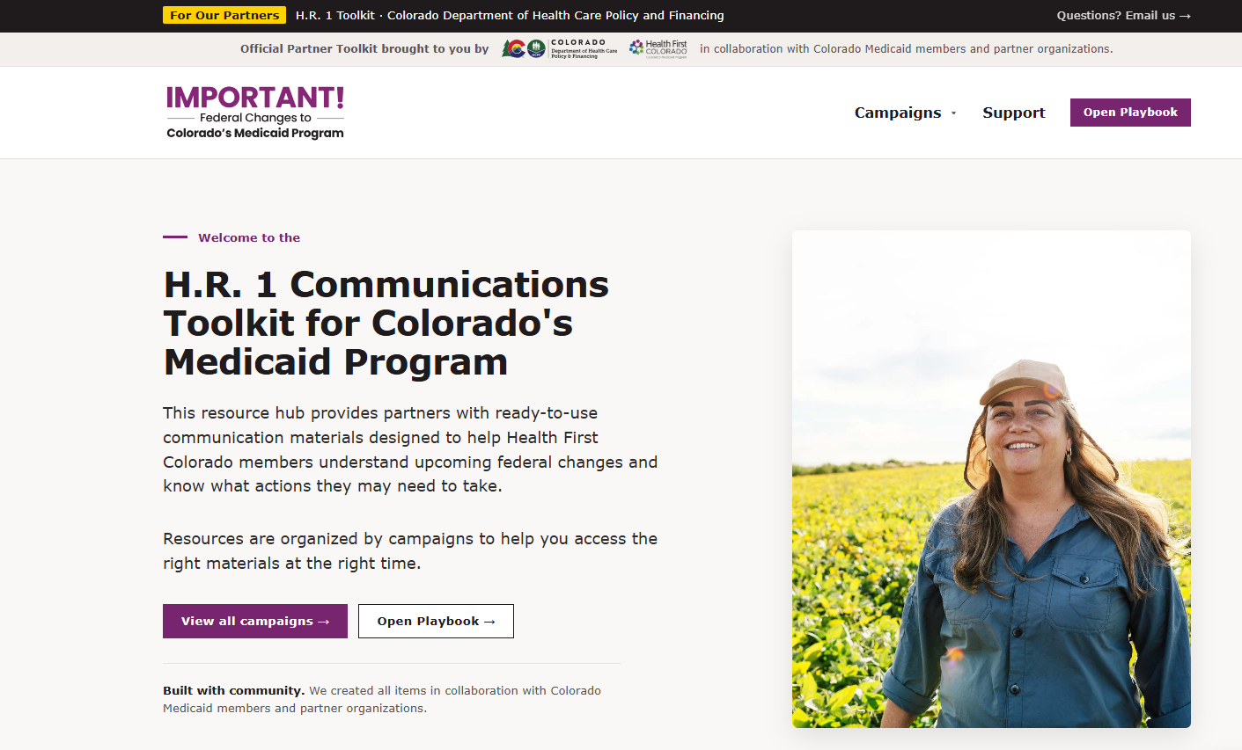
H.R. 1 Toolkit Overview
Official partner toolkit
Designed to help members understand upcoming federal changes
Outlines actions some members may need to take
Features flyers, social media images, messaging and other resources
H.R. 1 Toolkit is available now
Notes:
CHI — The H.R. 1 toolkit was created in partnership with the Center to Advance Consumer Partnership (CACP), which is funded by the Colorado Health Foundation as a resource to help community partners, advocacy organizations, providers, and others support members in getting ready for the changes H.R. 1 will bring. It is receiving updates throughout the summer and features member-tested messaging, social media posts, flyers, and more.
This toolkit will ultimately contain information about ALL HR 1 related changes, with some specific resources for the immigrant/refugee specific changes already available.
Links to share:
H.R. 1 Toolkit: https://hr1toolkit.healthfirstcolorado.gov/

Slide 25
OmniSalud

Slide 26
OmniSalud
What we’ll cover today:
Proposed 2027 OmniSalud plan design
Premiums, benefits, and coverage options
Number of available spots
What is still being finalized
Enrollment dates
Who can enroll
How to enroll
We will continue to provide updates as additional information becomes available.

Slide 27



Programs Overview
OmniSalud (2026)
Who’s eligible:
Individuals and families earning <150% FPL, who do not qualify for Medicaid, Medicare, or federal exchange subsidies
Benefits:
$0 monthly premium, 73% Actuarial Value Colorado Option “Silver Enhanced Savings” plan
Enrollment cap:
6,700
Notes:
For most people, CPA was automatically applied. If you received financial help lowering your monthly premium through the Marketplace, you were likely already receiving CPA even if you didn’t sign up separately.
The HIAE Board will make decisions regarding CPA on June 12th make sure to register for the meeting. At the end of the presentation we will share the link

Slide 28
Health Insurance Affordability Enterprise (HIAE) Legislation: SB 26-178
Senate Bill 26-178:
“Concerning Measures to Address the Affordability of Health Insurance”
Passed on May 12th, signed by Governor Polis on June 2nd
Program Funding | OmniSalud
Provides one-time funding for 2027 to help maintain and expand OmniSalud enrollment capacity. | All OmniSalud enrollees required to pay a premium >$0 starting in 2027
Notes:
We are not going to get into all the details of the bill today, but overall, this bill helps continue funding these programs into 2027.
Reinsurance will still help lower premiums in 2027, although the savings are expected to be slightly lower than they are today.
Colorado Premium Assistance, or CPA, will continue at the same 2026 program level into 2027, with relatively minor changes.
For OmniSalud, the program will continue in 2027, but the biggest change is that all enrollees will be required to pay a monthly premium. These changes are intended to help maintain the current enrollment capacity.
Links to share:
View Senate Bill 26-178 at: https://leg.colorado.gov/bills/sb26-178

Slide 29
What Should OmniSalud Prioritize in 2027?
Because funding is limited, we can’t improve everything at the same time.
What matters most to you?
Covering as many people as possible
Keeping monthly payments affordable
Keeping doctor visits and medicines affordable
Having different plan choices
 | Option 1: LESS coverage + LOW premium | Option 2: MORE coverage + HIGH premium
Plan Coverage Level | Less coverage (73 AV) | More coverage (94 AV)
Monthly Premium | ~$15/month | ~$140/month
Enrollment | ~6,700 | ~6,300
Notes:
Cost community pay –
HIAE Board votes on 2027 Omni parameters on JULY 16th
IF NEEDED – 87AV plan = 6400 folks, $85 premium

Slide 30

All OmniSalud Plans are Colorado Option Plans
Colorado Option plans were designed with community and stakeholder input to help make healthcare more affordable. Certain services have $0 or low-cost copays, no matter what coverage level you have.
Colorado Option Benefits
$0 Primary Care, Non-Preventative Visits
$0 Mental/Behavioral Health/Substance Use Disorder Visits
$0 Prenatal and Postnatal Visits
$0 Diabetic Supplies, Including Continuous Glucose Monitors
$5 Diabetes Self-Management Education
Notes:
This seems like a good time to highlight that these are Colorado Option plans. The only plans sold on Colorado Connect are Colorado Option plans. Potential TP: "CO Option plans are stakeholder informed* plans that have been designed to provide $0 copays on "high value" services such as non-preventive primary care visits, MH office visits, and pre and post natal care."
*We actually can't change the standardized plans/CO Option plans without going through a stakeholder process (so 1006 updates reinforced this requirement)
For the slide, you might change this to say "Additionally, it is important to note that these plans are all CO Option plans which regardless of AV provide the following services at $0."
Sharing in case you want to use our logo: https://drive.google.com/file/d/1CJ7aT3W0Hb9XkfwiPicnRC-UaO3sux2Q/view
Here is our 1 pgr which you have probably seen: https://doi.colorado.gov/sites/doi/files/documents/The-Colorado-Option-FINAL-2025-ENG.pdf

Slide 31




What is next?
Stay involved and continue sharing your feedback
Upcoming Community Forums:
Sat, July 11 from 10 to 11 a.m.
Tues, July 14 from 12 to 1 p.m.
Thank you for joining us today!
HIAE Board Meetings:
Thurs, July 16 from 10 a.m. to 12 p.m.
Tap or scan the QR code to register for the Board meeting!
HIAE Public Comment Form:
Share written feedback anytime
Tap or Scan the QR code to leave a written comment
Notes:
Links to share:
HIAE Public Comment Form: https://forms.gle/33GgmwY4hCPMbdya6

Slide 32
What is next?
Stay involved and continue sharing your feedback
Community Forums
Sat, July 11 from 10 to 11 a.m.
Tues, July 14 from 12 to 1 p.m.
  Register for an upcoming community forum
Tap or scan the QR code to register for the Board meeting!
Notes:
Links to share:
Register for an upcoming community forum: https://us06web.zoom.us/webinar/register/WN_qinLphhMSEO1C1ctUvHwmg#/registration
HIAE Public Comment Form: https://forms.gle/33GgmwY4hCPMbdya6

Slide 33

What is next?
Stay involved and continue sharing your feedback
HIAE Board Meetings
Thursday, July 16 from 10 a.m. to 12 p.m.
Register for the next HIAE board meeting
Share Feedback
HIAE Public Comment Form
Notes:
Links to share:
Register for the next HIAE board meeting on July 16: https://us06web.zoom.us/meeting/register/67SKpXWJQpipKZU_DazkUw#/registration
HIAE Public Comment Form: https://forms.gle/33GgmwY4hCPMbdya6

Slide 34
Resources
Updated materials coming soon
  Member Benefit Change Letter (dental)
  Key Messaging
  Toolkit (updated scenarios, CO Health Policy Comparison Tool)
  Member Handbook
  Website Updates
Sign up for CAC Newsletter
Notes:
Sign up for the CAC newsletter: https://lp.constantcontactpages.com/su/UzY7aDO

Slide 35
Questions?

Slide 36
Contact Information
hcpf_coverallco@state.co.us
Notes:
Contact information: hcpf_coverallco@state.co.us

Slide 37
Thank you!

Slide 38
Beginning January 1, 2027, the Cover All Coloradans population will be removed from the Accountable Care Collaborative. As a result:
Members will not be assigned to a Regional Accountable Entity (RAE).
Members can find their own providers. Search for providers.
Members will no longer receive general care coordination resources from our Regional Accountable Entities but may receive other wraparound support from community providers.
CAC members will no longer receive Behavioral Health services through their RAEs but will still qualify for many Behavioral Health services.
Behavioral Health Benefit information.
Residential and inpatient services are excluded.

