Slide 1
Medicaid Work Requirements Webinar
Presented by the Colorado Department of Health Care Policy and Financing
Notes:
For Speaker Notes, please see our Google Doc.

Slide 2

Closed Captions
Closed Captions are available in the meeting controls toolbar at the bottom of your screen. To turn them on, click the Show Captions icon.
Captions can be translated into different languages by clicking on the up arrow next to the Show Captions icon and then selecting your preferred language.

Slide 3
Meeting Logistics
We are recording. Recordings and slides will be posted to HCPF’s H.R. 1 Stakeholder Support Hub webpage.
Slides, links, and other materials will be posted in the Chat.

Slide 4

Our Mission
Improving health care equity, access and outcomes for the people we serve while saving Coloradans money on health care and driving value for Colorado.

Slide 5
What We Do
The Colorado Department of Health Care Policy and Financing (HCPF) administers Health First Colorado (Colorado’s Medicaid program), Child Health Plan Plus (CHP+) and other health care programs for Coloradans who qualify.

Slide 6
Purpose
Connect our stakeholders, providers and partners with resources related to the implementation of H.R. 1.
HCPF’s North Star: Reduce coverage losses and negative consequences to Coloradans, providers and economy

Slide 7
Agenda
Overview (Colorado Department of Health Care Policy and Financing)
  SNAP/TANF (Guest speaker: Colorado Department of Human Services)
  Work and Work Programs (Guest speaker: Colorado Department of Labor and Employment)
  Volunteer (Guest speaker: Prime Health)
  Education (Guest speaker: Colorado Department of Higher Education)
Upcoming Events & Resources

Slide 8
Overview of H.R. 1 Work Requirements
Adults ages 19–64 who are not enrolled in long-term services and supports (LTSS) or a buy-in program, and who do not qualify for an exclusion or an exception.
WHO?
January 2027 for new applicants (looking back to December 2026)
March 2027 for renewals initiated in January 2027
WHEN?
SNAP/TANF, Work, Work Programs, Volunteer, Education, Combination
HOW?

Slide 9
What We Know (and Don’t Know)
Interim Final Rule issued by CMS on June 1
What has changed?
  Self-attestation for work requirements, including medical frailty
    We will still be requesting information to identify exclusions, exceptions, or qualifying activities if data sources are not available
  Requires that “medical frailty” significantly impairs the individual's ability to work
What we don’t know
  Federal guidance may continue to evolve
  Operational processes are not finalized, but we’ll share our current understanding

Slide 10
Compliance through SNAP/TANF

Slide 11
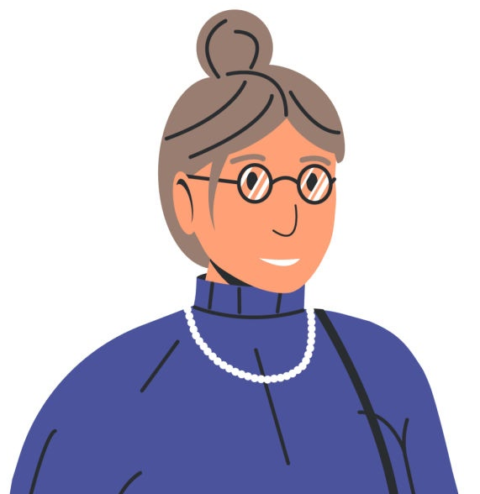
Top Question: SNAP/TANF & Medicaid
“What sorts of system updates are being implemented to make it easier for SNAP/Medicaid recipients to only need to report once?”

Slide 12
Colorado Department of Human Services

Slide 13
Employment First:
Helping Coloradans Meet Program
Work Requirements
Notes:
Introduce self and slide deck
TAKE A BEAT FOR TRANSLATION, AND SPEAK SLOWLY

Slide 14


Agenda
H.R. 1: Impacts on Coloradans
  H.R. 1 and Potential Medicaid Work Requirement Changes
  TANF Work Requirements
  SNAP Work Requirements
What is Employment First?
  About Employment First
  Employment First Counties
  Other Benefits to Participating with Employment First
  Resources
14
Notes:
(Optional to review.)

Slide 15

H.R. 1:
Impacts on Coloradans: Work Requirements
Notes:
TAKE A BEAT FOR TRANSLATION, AND SPEAK SLOWLY

Slide 16
H.R. 1 and Potential Medicaid Work Requirement Changes
H.R. 1
By January of 2027:
Approximately 375,000 members* between 19-64 must comply with work requirements when applying for or renewing their coverage.
How to comply with the work requirement:
Either (1) completing 80 hours of approved activities or (2) earning at least $580 from paid work or (3) a combination of these per month.
* before exemptions
What this means: Coloradans who do not comply with the work requirement in 2027 are at risk of losing their coverage.
Notes:
TAKE A BEAT FOR TRANSLATION, AND SPEAK SLOWLY
By January of 2027, it is anticipated that approximately 375,000 members will need to comply with new federally mandated work requirements when applying for or reviewing their Medicaid coverage. In order to comply with this policy change, members can either:
Complete 80 hours of approved activities
Earn at least $580 from paid work or
A combination of these per month
This means that in the new year, Coloradans who do not comply with the federally mandated work requirement are as risk of losing coverage. It is essential that we find ways to mitigate this risk.

Slide 17
TANF Work Requirements
Temporary Assistance for Needy Families (TANF)
What is it?
Colorado Works is Colorado's Temporary Assistance for Needy Families (TANF) program. TANF work rules require most adult recipients to participate in approved work or job preparation activities for a minimum of 20 to 30 hours per week. This helps parents find jobs and become financially independent.
How to comply with the work requirement:
Complete an Assessment within 90 days of applying
Sign an Individual Responsibility Plan (IRP)
Participate in Approved Activities
Report Your Hours
NOTE: Coloradans who who receive Colorado Works and SNAP benefits are exempt from the SNAP work requirement.
HOWEVER, Coloradans who receive Colorado Works benefits do not automatically comply with Medicaid work requirement.
Notes:
TAKE A BEAT FOR TRANSLATION, AND SPEAK SLOWLY
To maintain eligibility for TANF benefits, most adult recipients recipients must participate in an approved work or job preparation activities for a minimum of 20-30 hours per week.
To get and stay comply with TANF work requirements:
Complete an Assessment: Within 90 days of applying, recipients must meet with a caseworker.
Sign an Individual Responsibility Plan (IRP): Recipients and their caseworker must create a step-by-step roadmap outlining the job goals and the activities required.
Participate in Approved Activities: This includes unsubsidized employment, on-the-job training, job search, or education directly tied to getting a job.
Report Your Hours: Recipients must track and report their hours to your caseworker on time to keep their benefits active.

Slide 18
SNAP Work Requirements
Supplemental Nutrition Assistance Program (SNAP)
What is it?
To maintain eligibility for SNAP, non-exempt recipients must participate in an approved work activity 20 hours per week (or 80 hours per month).
How to comply with the work requirement:
Paid Work
Unpaid (or volunteer work)
Participation in another employment and training program
Participation in Employment First (Colorado’s SNAP Employment & Training program)
Combination of these
NOTE: Coloradans who comply with the SNAP work requirement automatically comply with the Medicaid work requirement.
HOWEVER, Coloradans who comply with the Medicaid work requirement do not automatically comply with Medicaid work requirement.
Notes:
TAKE A BEAT FOR TRANSLATION, AND SPEAK SLOWLY
Many recipients of another well-known federally funded program are also subject to a similar work requirement. This is the Supplemental Nutrition Assistance Program or SNAP.
To maintain eligibility for SNAP benefits, non-exempt recipients must participate in an approved work activity for 20 hours per week or 80 hours per month.
There are several ways to do this:
Paid work
Unpaid work (volunteering/in-kind work)
Participation in Employment First
Participation in another qualifying work program (ex: Workforce Innovation and Opportunity Act (WIOA), Trade Adjustment Assistance (TAA), employment and training for veterans operated by the Department of Labor or the Department of Veterans Affairs)
Combination of these
Because many Medicaid members also qualify for SNAP, complying with the SNAP work requirement could satisfy the Medicaid work requirement as well. While there are several ways to meet the work requirements, the remainder of this presentation will cover the basics of Employment First.

Slide 19

What is Employment First?
Notes:
TAKE A BEAT FOR TRANSLATION, AND SPEAK SLOWLY

Slide 20
About Employment First (EF)
A federal Employment and Training (E&T) program that prepares Coloradans applying for or receiving Supplemental Nutrition Assistance Program (SNAP) benefits for meaningful employment through work-related education and training activities.
EF participants work with a case manager to monitor employment and training goals and log participation hours.
The EF program is administered in 31 Colorado counties at local county human/social services offices and through organizations around the state, known as Third-Party Partners.
Notes:
TAKE A BEAT FOR TRANSLATION, AND SPEAK SLOWLY
Read from slide

Slide 21
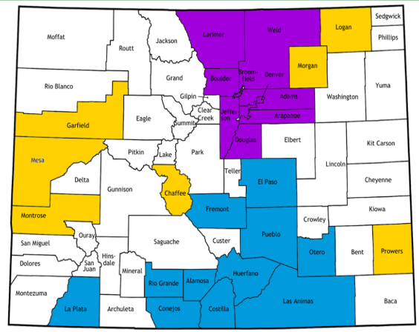
Employment First Counties
Adams
Alamosa
Arapahoe
Boulder
Broomfield
Chaffee
Clear Creek
Conejos
Costilla
Denver
Douglas
El Paso
Elbert
Fremont
Garfield
Gilpin
Huérfano
Jefferson
La Plata
Larimer
Las Animas
Lincoln
Logan
Montrose
Morgan
Otero
Prowers
Pueblo
Rio Grande
Teller
Weld
Purple: County Operated and Third-Party Partners
Yellow: County Operated Only
Blue: Third-Party Partners Only
Note: This list is subject to change in federal fiscal year 2027 starting October 1st, 2026.
Notes:
TAKE A BEAT FOR TRANSLATION, AND SPEAK SLOWLY
To the left is a list of all counties supported by Employment First partners. To the left is a map of what kinds of providers can be found there.
Purple counties are supported by both county Departments of Human Services and Third Party Partners
Yellow counties are operated by counties only
And blue counties are operated by Third Party Partners only
Please note, these service areas are subject to change as federal fiscal years change.

Slide 22
Other Benefits to
Participating with Employment First
In addition to benefiting from work related education and training, EF Participants can also receive:
Assistance with transportation, work clothes and equipment, and training fees
Access to work experiences and other job programs
Interview skills and resume assistance
English language learning programs
Access to short-term and long-term technical education
Volunteer opportunities
Connections to community resources that can help clients with child care, transportation, healthcare, and other needs that support their participation in EF
Final note: Participation in EF is voluntary. This means that SNAP recipients are not required to participate in EF to comply with their work requirement.
Notes:
TAKE A BEAT FOR TRANSLATION, AND SPEAK SLOWLY
Read from slide

Slide 23
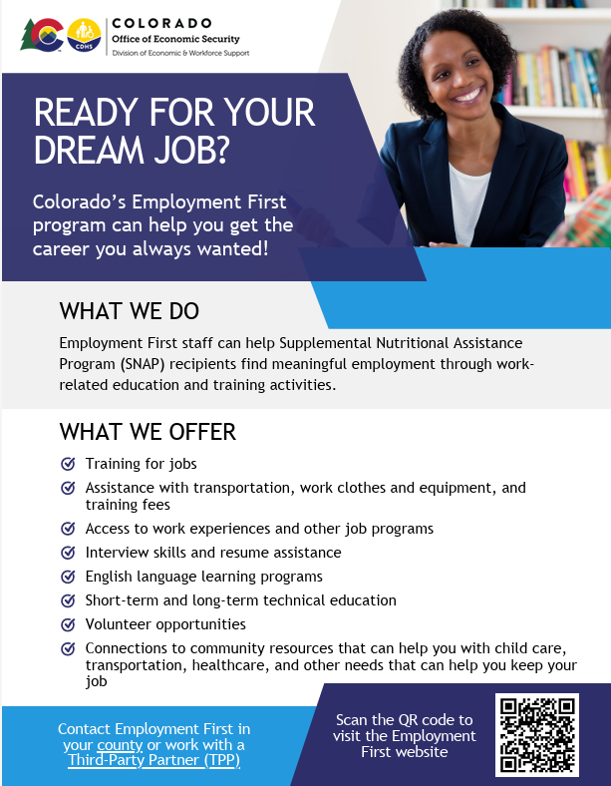
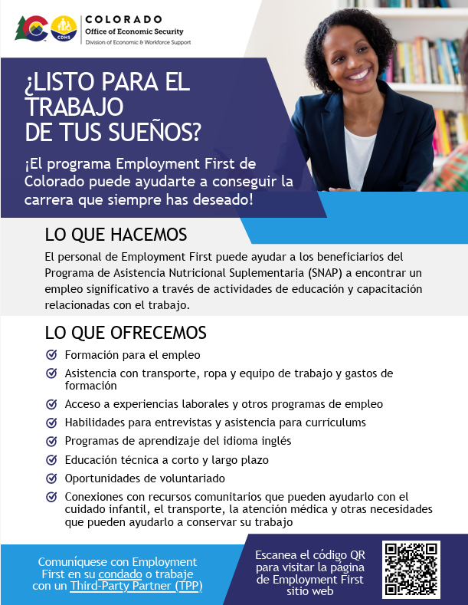
Employment First Flyer (English)
Employment First Flyer (Spanish)
23
Notes:
TAKE A BEAT FOR TRANSLATION, AND SPEAK SLOWLY
Here are resources that we welcome you to share in your offices and with clients.

Slide 24
Questions?
Questions on the Colorado Works and Employment First programs, and how we assist Coloradans with meeting work requirements can also be emailed to us at cdhs_dews_policy_inbox@state.co.us.
Notes:
TAKE A BEAT FOR TRANSLATION, AND SPEAK SLOWLY

Slide 25
Compliance through Work and Work Programs
25

Slide 26

Top Questions: Work and Work Programs
“Can you satisfy the work requirements by showing you are searching for a job?”
“What if I am self-employed for over 40 hours a week but I don’t make over $500 a month?”
“I am compensated in room and board. How does in-kind compensation count?”

Slide 27

Top Questions: Work and Work Programs
“How might one prove hours from self-employment?”
“How does caregiving meet the work requirement?”
“How can seasonal workers meet the work requirement?”

Slide 28

Top Questions: Work and Work Programs
“What constitutes an approved work training program? What requirements are needed to be met by the program and how is approval made?”

Slide 29
Colorado Department of Labor and Employment

Slide 30

Connecting Colorado
connectingcolorado.gov
30

Slide 31


Workforce Colorado
A Statewide System with Local Impact
Workforce Colorado is the Colorado Public Workforce System, a network of:
10 local workforce areas
50+ workforce center locations statewide
State and local partners working together
We deliver workforce solutions across Colorado through local communities.
31

Slide 32

How We Help Job Seekers
Supporting Individuals at Every Stage
Career guidance and coaching.
Resume and interview support.
Access to training, upskilling and certifications.
Work-based learning opportunities.
Supportive services to reduce barriers to employment.
Career pathway navigation.
Find a workforce center near you at cdle.colorado.gov/wfc
32

Slide 33
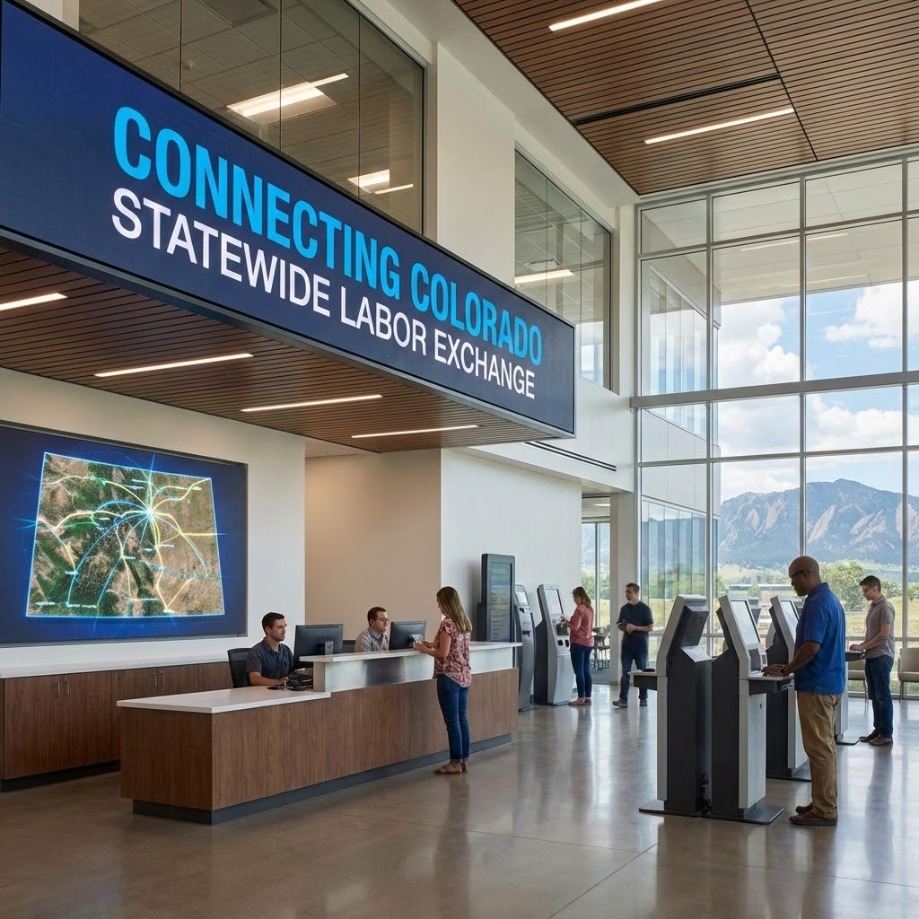

Connecting Colorado
Built For Coloradans
Easy to create profile
Find modern tools
Find a great job!
33
Notes:
A system for all.
Connecting Colorado was designed specifically to support both customers in the workforce, the job seeker and the employer.
This modernized system has streamlined tools to connect job seekers and employers based on the skills employers need, and the skills that job seekers have.

Slide 34
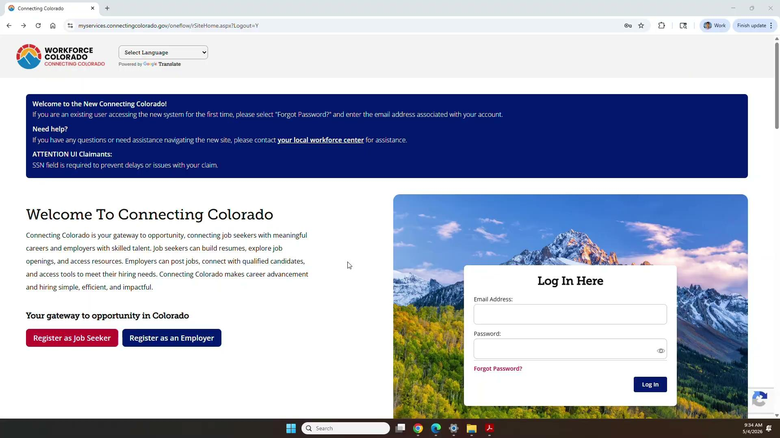
Refreshed Logo, Technology, and Look
34
Notes:
It is much easier to sign up and start using this powerful tool

Slide 35
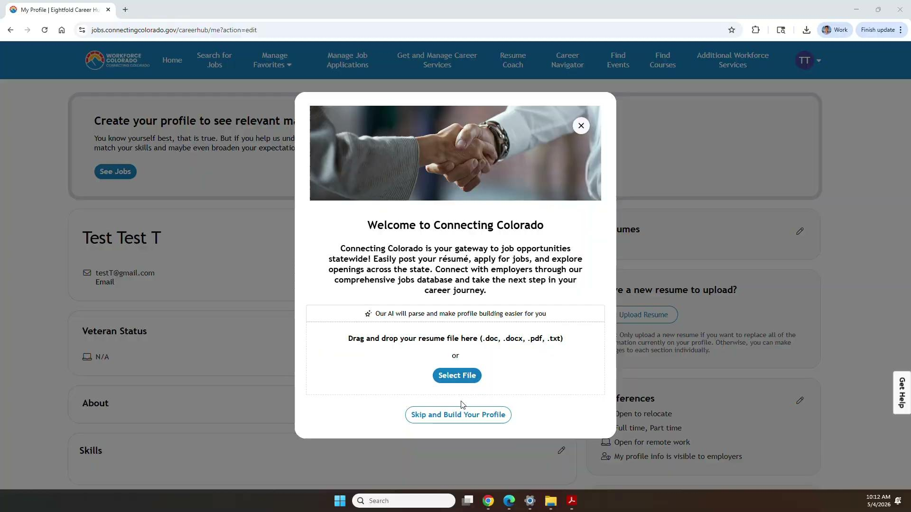
Drop in Your Resume
35
Notes:
Easily create, or update your profile. Drop in your resume, or skip and quickly build your profile.

Slide 36
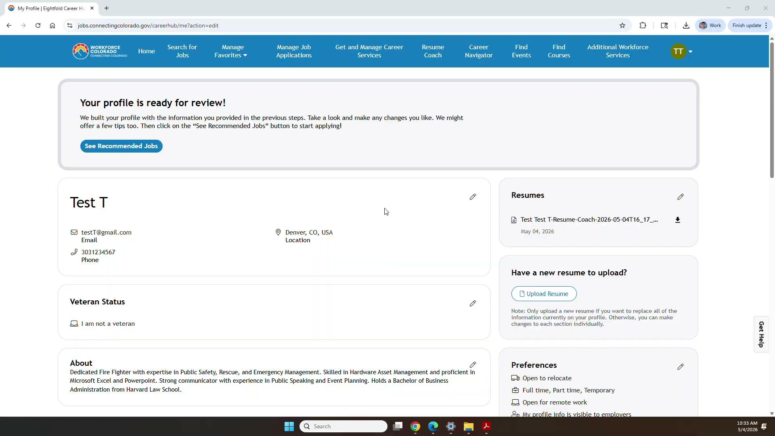
Edit Your Profile Page
36
Notes:
Easily update your profile

Slide 37
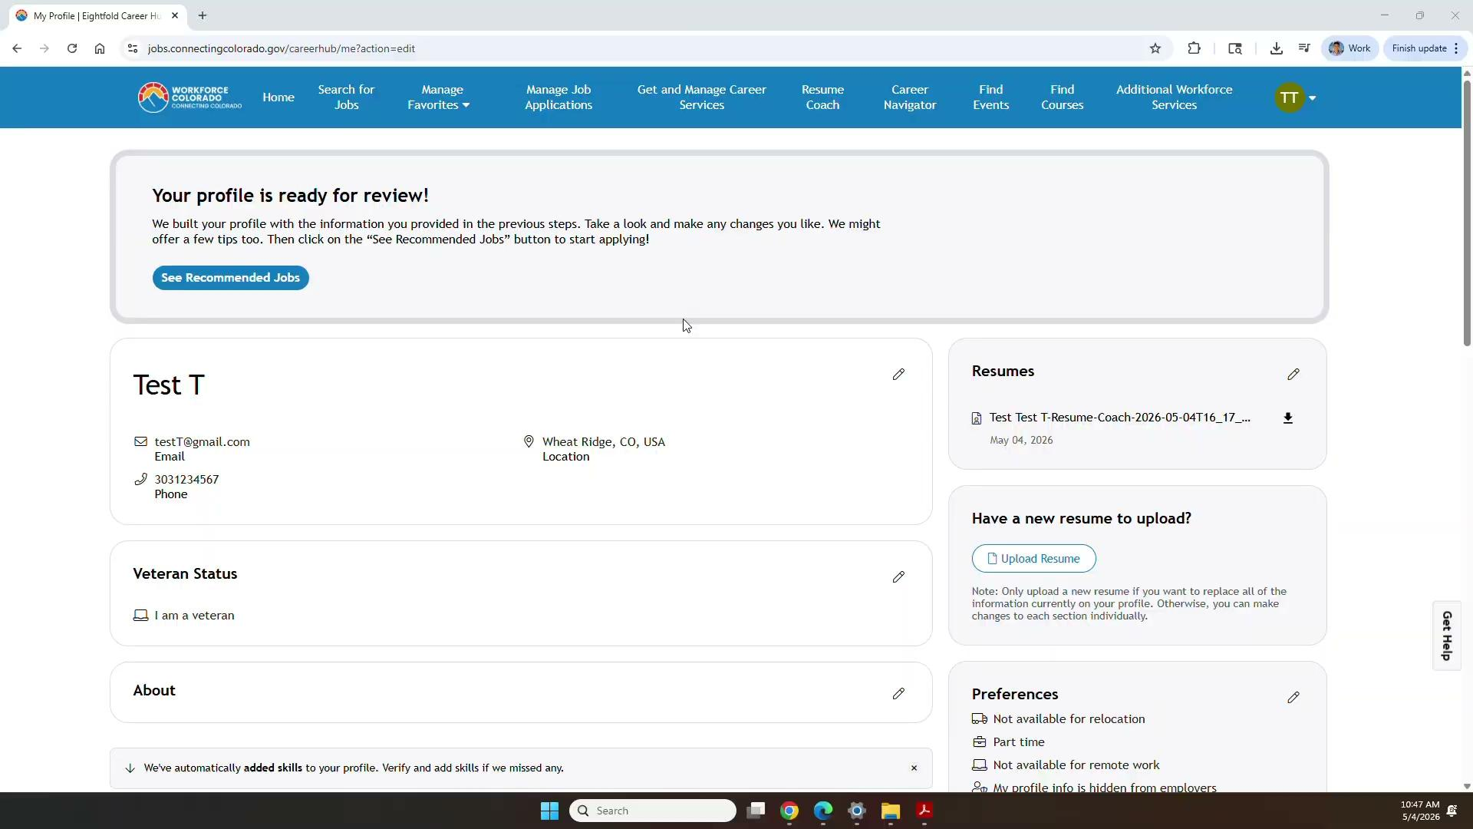
Find Position that Match Your Skills
37
Notes:
Find positions that match your skills and apply. You can also build a targeted resume for the position in seconds. Identify which skills you have that match the position.

Slide 38
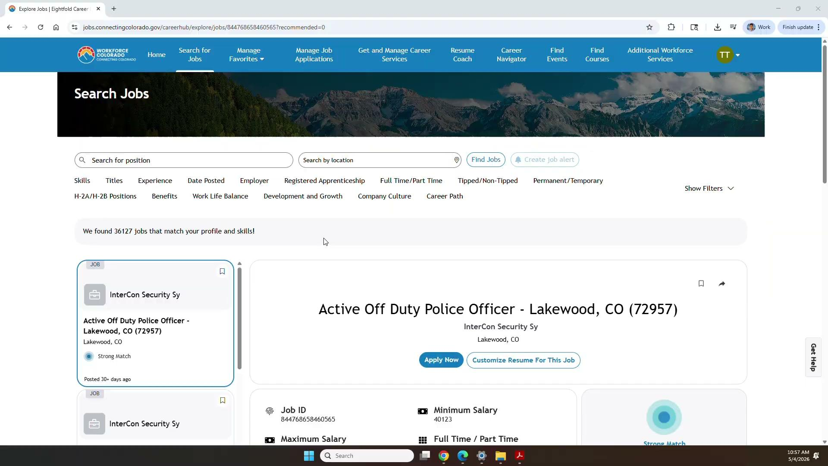
Search, Find and Apply
38
Notes:
Easily search for jobs using a variety of filters. We continue to add new filters and one of our current projects is to be able to add a filter based on Industry and another one that is coming soon by payscale

Slide 39
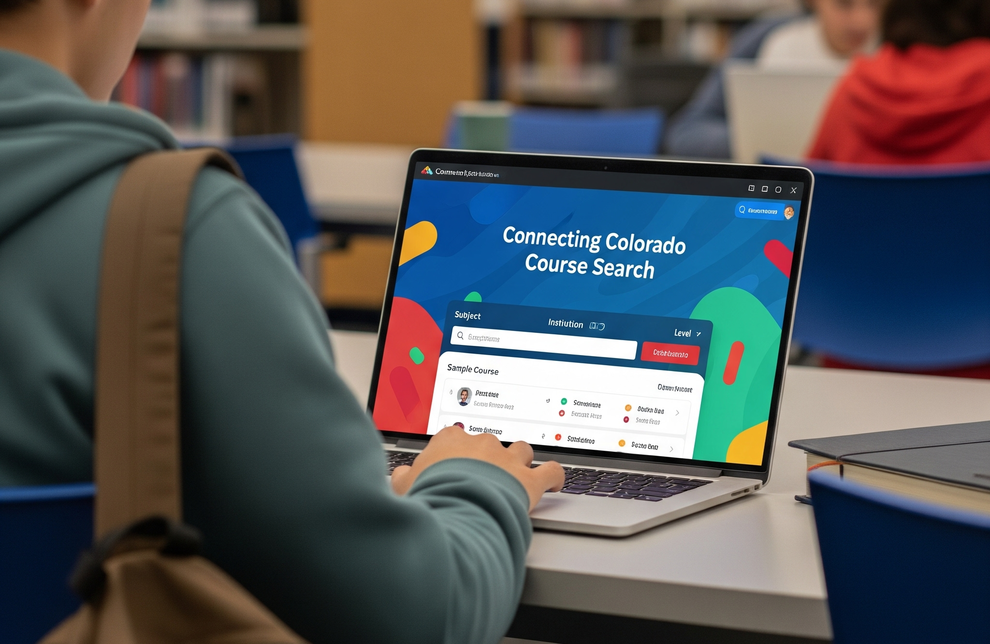
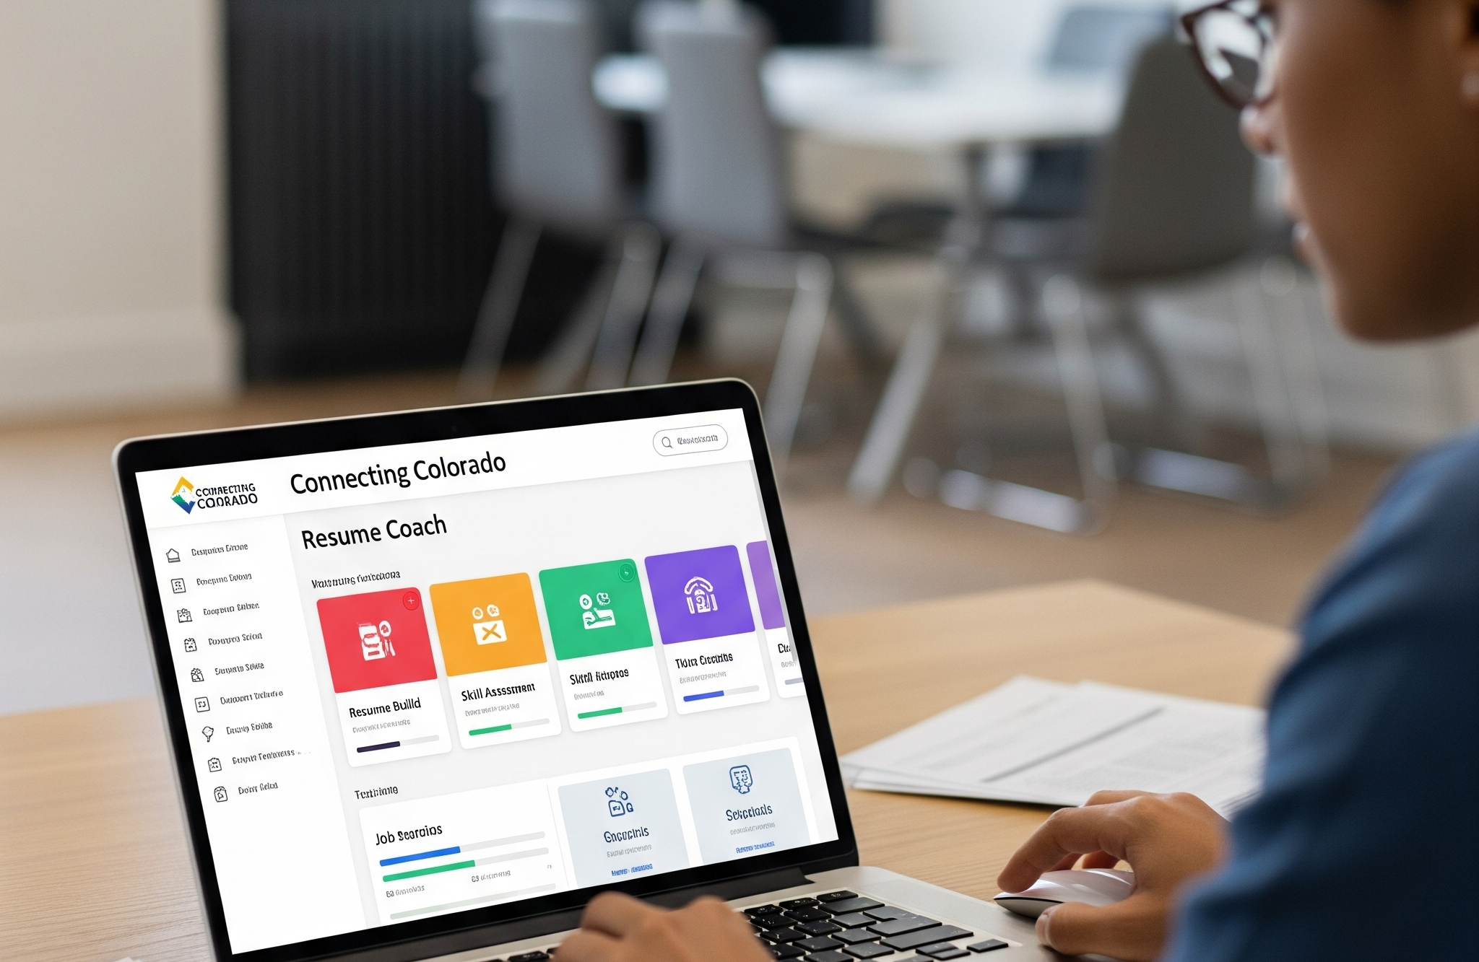

Job Seeker Resources
Explore Courses
Resume Coach
Career Navigator
Job Seekers can find the courses they need to find the job they want.
Empowering Job Seekers to highlight their skills.
Supporting skills-based career pathways.
39

Slide 40

Explore Courses
Recommends Courses
40
Notes:
Find courses to fill skill gaps

Slide 41
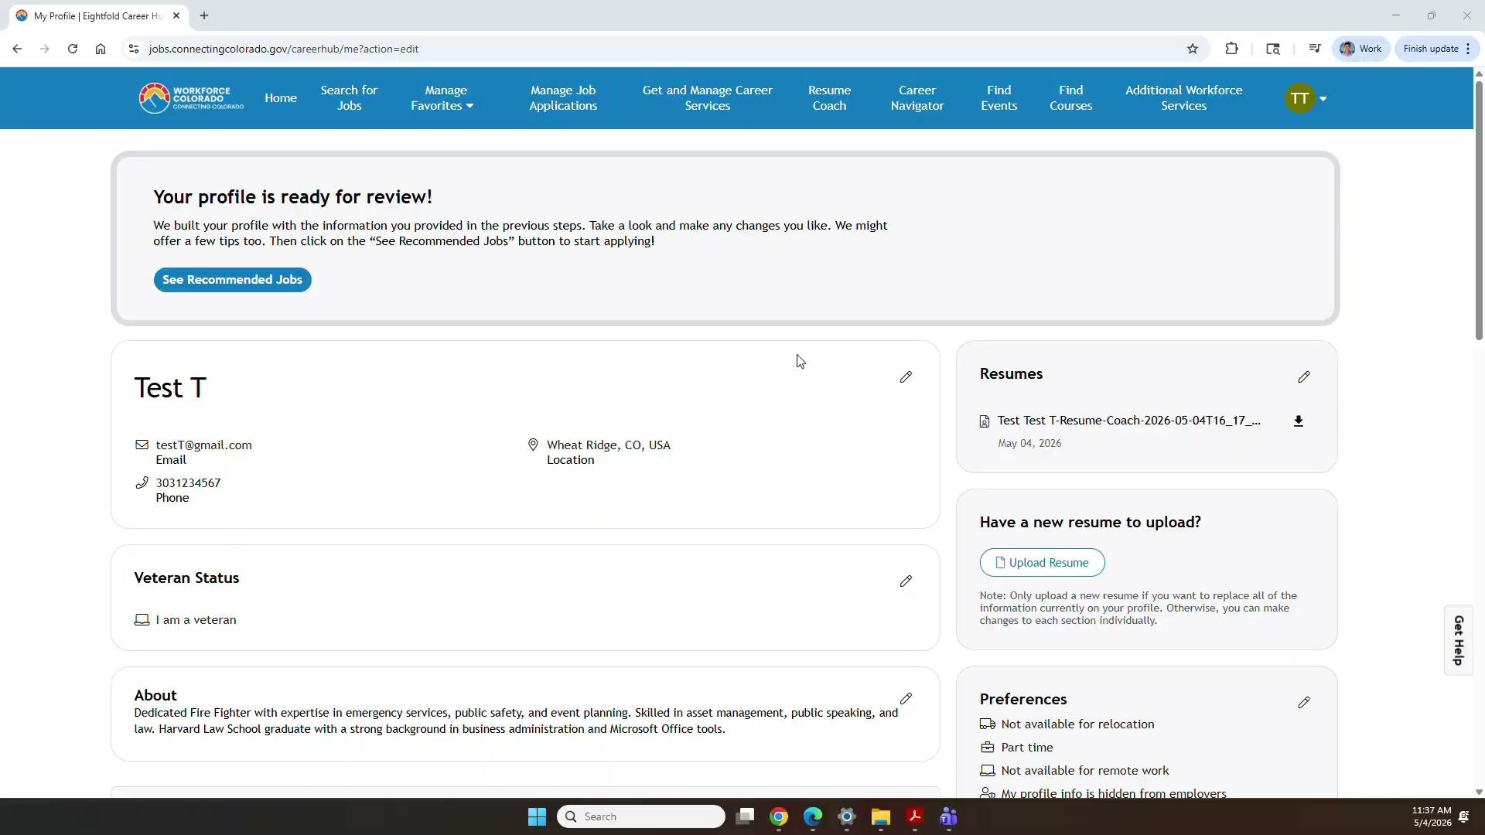
Resume Coach
41
Notes:
Resources for both general and targeted resumes.
Build a resume in seconds..not hours

Slide 42

Career Navigator
42
Notes:
Think into your future career and identify how to get there

Slide 43


“Together, we are building a stronger, more connected workforce system for Colorado.”
43

Slide 44




Thank
You!
44

Slide 45
Compliance through Volunteering
45

Slide 46

Top Questions: Volunteering (Community Service)
“What kinds of volunteer activities count to meet the work requirement? Can I walk my neighbor’s dog or provide unpaid caregiving or do I have to work hours at a food pantry?”
“What kinds of organizations can I volunteer with?”

Slide 47

Top Questions: Volunteering (Community Service)
“How will I have to document the required volunteer hours?”
“What will the obligations of a nonprofit be in engaging someone for the Medicaid requirement?”

Slide 48
Prime Health

Slide 49

Community-Service/ Volunteer Organization
Sarah Lampe, President and CEO
Fostering Innovation to Improve Health in Underserved Communities
49

Slide 50
Medicaid Participatory Action Incubator
Co-design systems with the people who'll actually use them
10 workshops on community engagement requirements - 3 volunteer workshops
What are you currently doing to support volunteer tracking?
What do you want to see in future systems to track volunteer hours?
Survey of Health First Colorado Members
How do you currently track hours?
How do you find out about volunteer (and work) opportunities?

Slide 51
Member and Organization Perspectives
Volunteering already happens and is captured through many different channels
Finding volunteer opportunities (members)
Informal networks and community connections
Not likely to look on job boards or online services
Tracking volunteer hours (organizations and members)
Informal tracking (paper sign-in sheets, spreadsheets, online groups)
Formal platforms (volunteer management software)
Minimal (if any) existing third-party sharing
Many volunteer organizations do not know what this role will look like in verifying volunteer hours to ensure members can maintain their Medicaid
51

Slide 52
Two Capacity Tiers,
Two Very Different Needs
Medium to Large Organizations
Long established, often with statewide or national reach
Well-staffed organizations
Hundreds to thousands of volunteers annually
Typically has systems in place to track hours already (database, etc.)
Small or Grassroots Organizations
Small, often community-based
Small staff (less than 10 people)
Dozens to hundreds of volunteers each year
Typically does not have a technology system to track hours (paper, spreadsheets, or nothing)
Colorado has more than 34,000 charitable organizations
More than 50% are very small (operate on less than $1 million annually)
52

Slide 53
Connect to a Volunteer Organization
Medium to Large Organization Examples
National
  Red Cross
  United Way
  National Parks Service
  American Heart Association
  4-H
Colorado
  Spark the Change
  AmeriCorps through Serve Colorado
Small or Grassroots Organizations Examples
Local food pantries or food banks
Churches
Schools
  After-school programs
Towns, Cities, and Counties
Senior centers
Local community-based organizations
  Peer support groups
  Community centers
  Meal delivery services
  Cultural heritage associations
  Registered neighborhood organizations
53

Slide 54
A Call to Action
We need YOUR help
Many volunteer organizations still don't know they have a role to play in Medicaid work requirements, let alone what that role is, or that they may soon be relied on to support
This is where YOU can help
Reach out to volunteer organizations in your networks
Let them know this is coming
Point them to the HCPF Communications Toolkit to learn more and get engaged early
54

Slide 55
Compliance through Education
55

Slide 56
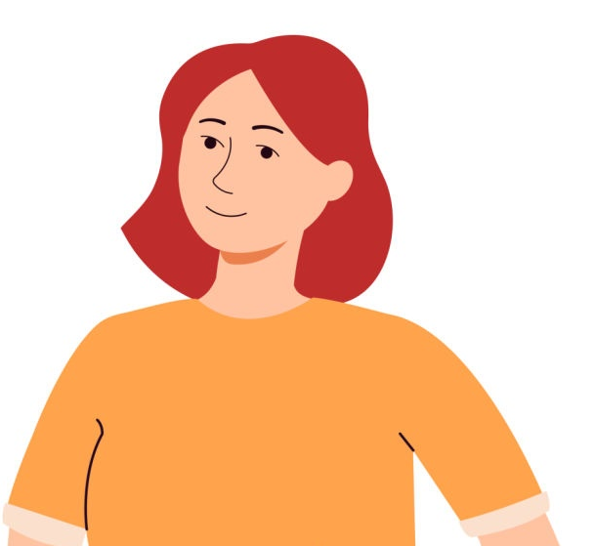
Top Questions: Education
“What other kinds of education programs count? For example, GED prep classes computer classes, etc.?”
“Does student status count toward work requirements?”
“What does half-time enrollment mean?”

Slide 57
Colorado Department of Higher Education

Slide 58
Top Questions: What Counts When Combining?
How do I meet work requirements through a combination of work, volunteering, or education? What if I earn $400 in a month, for example, how many hours would I need to volunteer to meet the requirement?

Slide 59

Higher Education in Colorado
Medicaid H.R. 1 Update Webinar
59
Notes:
Actual presentation time is 10.30am to 10.55am on July 21st.
Please arrive online at 10.20am.
There are 2000 people registered to attend, no live questions, will be recorded.
Focus on presentation.

Slide 60
Agenda
Colorado Department of Higher Education (CDHE)
  Who is CDHE and what do we do?
Searching for a College in Colorado
  What is offered and where in the state?
College Admissions Information
  Institutions in Colorado, Free Application Days
Paying for college in Colorado
  Free Application for Federal Student Aid (FAFSA), Colorado Application for State Financial Aid (CAFSA),College Opportunity Fund ( COF), Colorado Promise
Additional Resources
  Links, tools, and more
60

Slide 61
Colorado Department of Higher Education (CDHE)
About CDHE, our programs, and organization
61

Slide 62
CDHE Mission and Vision Statements
Mission Statement
We advocate, develop policies and support students to maximize higher education opportunities for all.
Vision Statement
All Coloradans will have an education beyond high school to pursue their dreams and improve our communities.
Learn more on the CDHE website.
62

Slide 63
Searching for a College in Colorado
Options for certificates, 2-year programs, 4-year programs,
and more
Notes:
List other types of training, certificates, etc. There are many types of options!

Slide 64
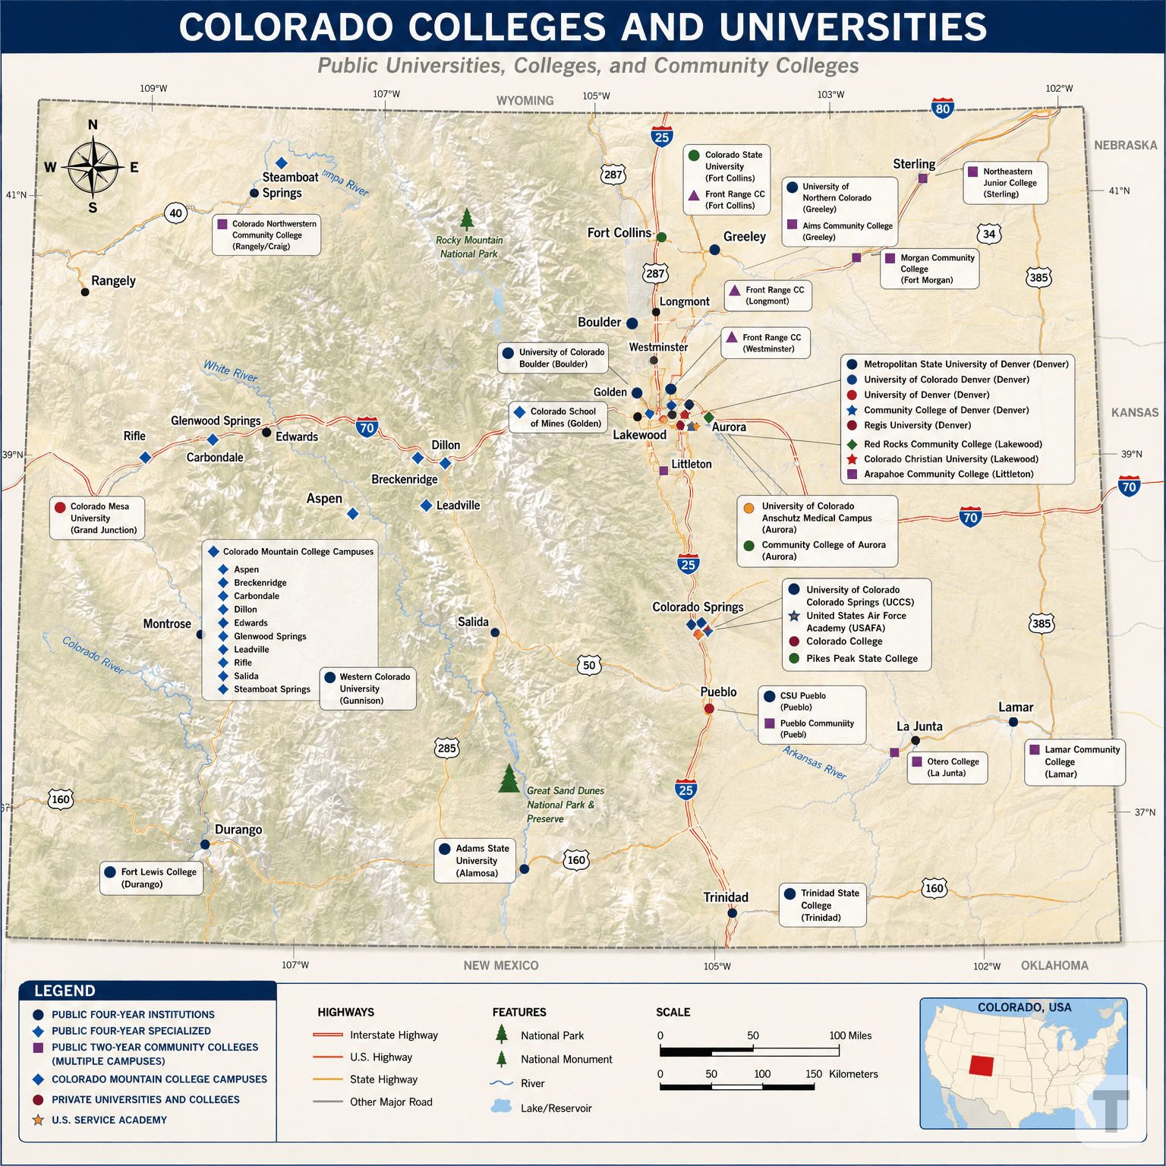
Colorado Colleges and Universities
Public four-year colleges and universities
Community colleges and two-year colleges
Area technical colleges and certificate programs
Private nonprofit colleges
Private occupational schools
Attend school in-person, online, or hybrid for many programs.
Apprenticeships and work-based learning
For more information and an interactive map, visit the selecting an institution webpage
64
Notes:
-Program include residential, online, and hybrid

Slide 65
College Admissions Information
How and when to apply
65

Slide 66
Admissions Information
First time freshmen admission standards:
  Applying to college right after high school graduation; and or
  Have earned fewer than 24 college level credit hours since high school graduation
  Considers GPA and academic courses mix and rigor
  It is optional to submit SAT or ACT test scores in Colorado
Transfer student admission standards
  Graduated from a high school; and
  Completed 24 or more college level credit hours after high school graduation
  Combined GPA from all colleges attended after high school graduation
  Academic course mix and rigor
Visit the admissions eligibility webpage for more information
66

Slide 67
Free Application Days
October 20 through 22, 2026
Colorado residents can apply for free at all state colleges and universities and many private colleges during the three-day program
Fee waiver instructions and direct links to college admissions sites can be found on the Free Application Days webpage
67

Slide 68
Paying for College in Colorado
Options for financing educational and training programs
68

Slide 69
Financial Aid: Free Application for Federal Student Aid (FAFSA)
The FAFSA form is used to determine how much financial aid learners are eligible to receive, which could include grants, scholarships, work-study funds, and loans
The 2026 through 2027 FAFSA is open!
  The FAFSA has undergone major transformations to improve and streamline the application processes for millions of learners and their families.
  Learners are encouraged to complete the 2026 through 2027 FAFSA as soon as possible. Applying sooner will encourage financial aid offices to process and award aid with improved timeliness.
For more information, visit the CDHE FAFSA Resources webpage
69

Slide 70
Financial Aid: Colorado Application for State Financial Aid (CAFSA)
The CASFA is the state financial aid application for students who are not eligible for Federal Student Aid, undocumented students, or students from mixed immigration status families who don’t feel it is safe to share their parents’ personal information with the federal government.
  Students who complete a CASFA are applying for state and institutional aid only (NOT Federal Student Aid). The CASFA bridges equity gaps and creates access to postsecondary education for qualifying students. Students who do not have lawful immigration status and who do not meet Colorado Advancing Students for a Stronger Tomorrow (ASSET) qualifications are still encouraged to apply for institutional aid using the CASFA.
The 2026 through 2027 CASFA is open!
  Learners are encouraged to complete the 2026 through 2027 CAFSA as soon as possible. Applying sooner will encourage financial aid offices to process and award aid with improved timeliness.
70

Slide 71
Financial Aid: College Opportunity Fund (COF)
The College Opportunity Fund (COF), created by the Colorado Legislature, provides a stipend to eligible undergraduate students. The stipend pays a portion of the total in-state tuition when attending a participating college.
  Eligible undergraduate students must apply, be admitted and enroll in classes at a participating college to receive this benefit. Both new and continuing students are eligible for the stipend.
Learners can apply on the College Opportunity Fund website
71

Slide 72
Financial Aid: Colorado Promise
Colorado Promise provides reimbursement through a tax credit for tuition and fees for the student’s prior academic year
  Degree and certificate seeking students can first receive a refund in early 2026 (2024 through 2025 academic year, claimed on 2025 taxes filed in April 2026)
  Covers up to 65 credit hours
  Learners must complete FAFSA/CASFA, Colorado colleges/universities will notify students if eligible
Eligible learners:
  Enrolled at Colorado public colleges/universities
  Family income of $90,000 or less
  Students in their first two years of college
  Amount computed after scholarships and grants
  2.5 semester GPA in at least 6 credit hours
72

Slide 73
Financial Aid: Colorado Institutions with Promise Program
Colorado Institutions with Promise covers at least the cost of tuition for eligible learners at Colorado community colleges, colleges, and universities
Eligibility requirements are income-based and vary by institution
Requirements are listed by institution on the Colorado Institutions with Promise webpage
73

Slide 74
Additional Resources
More links, websites, and information to explore
74

Slide 75
Additional Tools and Resources
CDHE College Search Tool
College Board Search Tool
Applying for College Guide
75

Slide 76
Additional Tools and Resources
Free Application for Federal Student Aid (FAFSA)
Colorado Application for State Financial Aid (CASFA)
College Opportunity Fund (COF)
76

Slide 77
Additional Tools and Resources
My Colorado Journey Pathfinder Tool
Credit Transfer Resources
Higher Education Glossary of Terminology
77

Slide 78
Thank You!

Slide 79
Upcoming Events and Resources
Events:
July 29 Webinar on Medical Frailty
Comprehensive H.R. 1 Webinar in Fall 2026
Resources:
H.R.1 Resources for partners
Health First Colorado H.R. 1 page for members
H.R. 1 Communications Toolkit for partners
Sign up for At a Glance and follow HCPF on Facebook and LinkedIn
Notes:
LInks to share:
H.R.1 Resources for partners: https://hcpf.colorado.gov/hr1-resources
Health First Colorado H.R. 1 page for members: https://www.healthfirstcolorado.gov/changes-are-coming-to-health-first-colorado-colorados-medicaid-program/
H.R. 1 Communications Toolkit for partners: https://hr1toolkit.healthfirstcolorado.gov/
Sign up for At a Glance newsletter: https://lp.constantcontactpages.com/sl/P5xXjrw
HCPF Facebook: https://www.facebook.com/COHCPF
HCPF LinkedIn: https://www.linkedin.com/company/colorado-department-of-health-care-policy-and-financing/posts/?feedView=all

Slide 80
Thank you!

